Slide 1
COLLABORATIVE EFFORTS CAN INCREASE LANGUAGE ACCESS IN FAMILY LAW AND ABUSE PREVENTION ORDER CASES
Language Access Coalition Conference
April 4, 2014

Slide 2
WHO’S ON THE PANEL? WHICH COLLABORATIONS?
Ellen Wilbur – Legal Director at Community Legal Services & Counseling Center (CLSACC)
- Legal services, domestic violence advocates, Trial Court collaborations

Slide 3
WHO’S ON THE PANEL? WHICH COLLABORATIONS?
Ester Serra Luque – Community Liaison at Transition House
Legal services, domestic violence advocates, Trial Court collaborations

Slide 4
WHO’S ON THE PANEL? WHICH COLLABORATIONS?
Caroline Robinson – Websites Project Coordinator for Masslegalhelp.org
Court Forms Task Force
Self-Help Materials Task Force
Access to Justice Working Group on Web & Technology

Slide 5
WHO’S ON THE PANEL? WHICH COLLABORATIONS?
Katia Santiago-Taylor – Manager of Systems Advocacy, Boston Area Rape Crisis Center (BARCC), previously at the Massachusetts Office of Victim Assistance (MOVA) in several capacities.
- Legal services, domestic violence advocates, Trial Court collaborations

Slide 6
WHO’S ON THE PANEL? WHICH COLLABORATIONS?
Wendy Lau – Project Coordinator of the Interpretation Technical Assistance and Resource Center (ITARC) at the Asian Pacific Islander Institute on Domestic Violence

Slide 7
WHO’S ON THE PANEL? WHICH COLLABORATIONS?
Jeff Wolf (moderator) – consulting attorney at Community Legal Services & Counseling Center(CLSACC); senior editor of family law and domestic violence webpages at Masslegalhelp.org
Legal services, domestic violence advocates, Trial Court collaborations
Court Forms Task Force

Slide 8
WORKSHOP FOCUS
Presenters will highlight national and local collaborative efforts to increase language access to the courts in family law and abuse prevention order cases for
people with low literacy,
people with low incomes,
unrepresented litigants,
survivors of domestic violence, and
members of diverse linguistic and cultural communities

Slide 9
WORKSHOP GOALS
To share experiences of some collaborative successes, challenges, and works in progress
To identify resources for increasing language access in the courts
To inspire the development and implementation of collaborative language access initiatives in your own regions and communities

Slide 10
OVERVIEW CRITERIA FOR COLLABORATIVE EFFORTS
The effort can be achieved relatively quickly
The effort can be achieved relatively inexpensively
The effort will help a lot of people in the affected communities and populations

Slide 11
OVERVIEW FORMS OF COLLABORATION
Funded by grants
participants are accountable
strong potential for changing court structures; institutional change
for example: online Do-It-Yourself Child Support Court Forms – English and Spanish funded by a Legal Services Corporation Technology Innovation Grant
Unfunded
Informal, ad hoc
Strong potential for changing court culture; attitudinal change
for example: domestic violence training for interpreters

Slide 12
Collaborations
Legal services and domestic violence advocates.
Legal services, domestic violence advocates, and staff from the Administrative Office of the Trial Court (AOTC)
Access to Justice Initiatives Court Forms Task Force
Access to Justice Initiatives Self-Help Materials Task Force
Legal services, domestic violence advocates, Trial Court, Boston Municipal Court
Legal Services, Suffolk Register of Probate

Slide 13
The legal services and domestic violence advocates collaboration
February, 2010. The legal services and domestic violence advocates collaboration made recommendations to the Trial Court:
Produce multilingual 209A forms
Train interpreters about domestic violence
Produce courthouse navigation materials for filing a 209A case
Develop court/domestic violence advocate collaborations to facilitate the timely presence of an interpreter for 209A hearings.

Slide 14
The legal services, domestic violence advocates, and Administrative Office of the Trial Court (AOTC) collaboration
April 1, 2010. The legal services, domestic violence advocates, and key AOTC staff (Office of Court Interpreter Services, staff attorneys, and the VAWA STOP Grant Coordinator) met to begin collaborations to implement the recommendations.

Slide 15
WHERE ARE THE LANGUAGE ACCESS BARRIERS? An interactive conversation
Where are the barriers between
litigants and courts?
litigants and their advocates and lawyers?
litigants and their service providers?

Slide 16
HOW DO TRANSLATED COURT FORMS HELP?
Having translated court forms and plain language multilingual instructions and support materials helps affected communities and populations more than having to get an interpreter for each litigant to interpret the forms.

Slide 17
THE MULTILINGUAL FINANCIAL STATEMENT
Financial Statement – in Spanish and Portuguese
challenge: the form is not mostly plain language. One solution: use the interactive online Do-It-Yourself Child Support Court Forms package to create your Financial Statement by answering the avatar Angela’s plain language questions (in English or Spanish) about your finances.

Slide 18
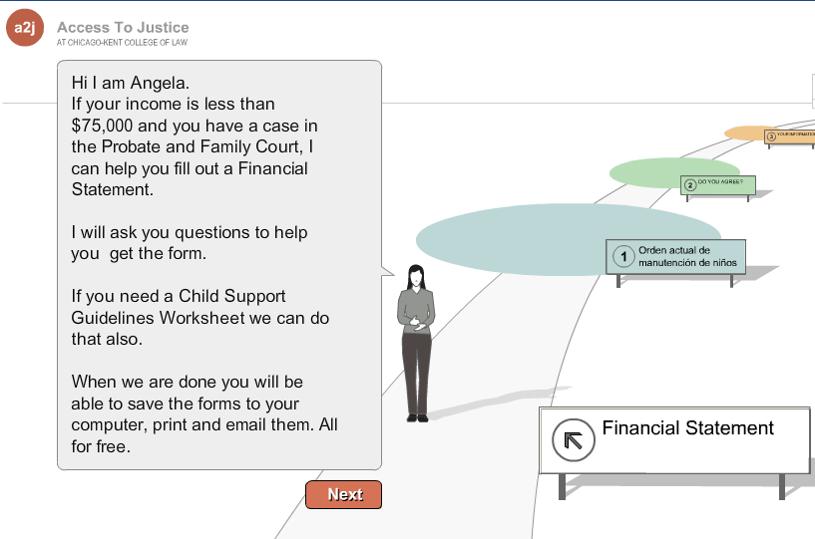
DIY online Financial Statement

Slide 19
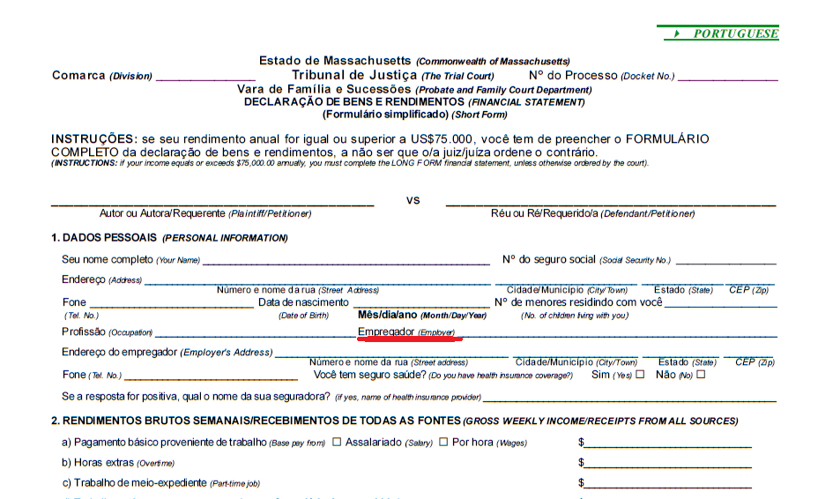
Page 1 Portuguese Financial Statement
Notes:
Notice Portuguese and English on the same page words right next to each other.
Interesting decision – we have no empirical evidence for designing multilingual forms this way – there are different ways to do it, but this is not a data driven, research based, tested decision. It makes sense but….
Content -
Only space for one employer – significant omission.

Slide 20
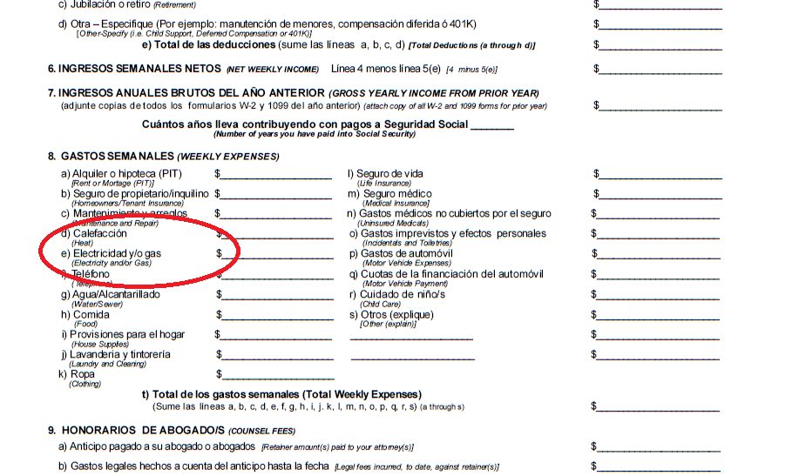
Page 2 Spanish Financial Statement
Notes:
Even a sophisticated number cruncher would find separating out electricity, gas and heat confusing.
Who separates out house supplies – separate from maintenance and then laundry and cleaning – how can that be interpreted one legal services attorney assumes that’s dry cleaning or maybe laundromat expenses, I assumed it was how much I spent on detergent.
Things that are not mentioned are child support, education expenses for children.

Slide 21
THE MULTILINGUAL 209A FORMS
Good for translation: 209A complaint and order forms are mostly text with check boxes
Supporting materials: 13 articles on Masslegalhelp.org about 209A, e.g. How Can a 209A Protective Order Help Me?, translated into 5 languages.
Challenges: the forms and instructions are not in plain language
Notes:
Some of the new 209A forms are more easily made bilingual because they have more space

Slide 22
THE MULTILINGUAL 209A FORMS – WHAT EFFORTS HAVE BEEN MADE?
What is the status of the Trial Court’s efforts to produce multilingual 209A forms?
Old 209A forms
California protective order forms
New 209A forms
Translating new 209A forms summer 2014
Notes:
As well as a difficult job – not easy to make forms readable. Jamie was done – I saw them and thought they could be better pointed her to California forms and she went back to the drawing board.
Edgar Moros began in October lost a month because his mother died has translated and proofed Spanish, Portuguese wating for proofing other forms sent to translators should be ready by summer…Translation is not easy – especially when we want language to be consistent, accurate and understandable.

Slide 23
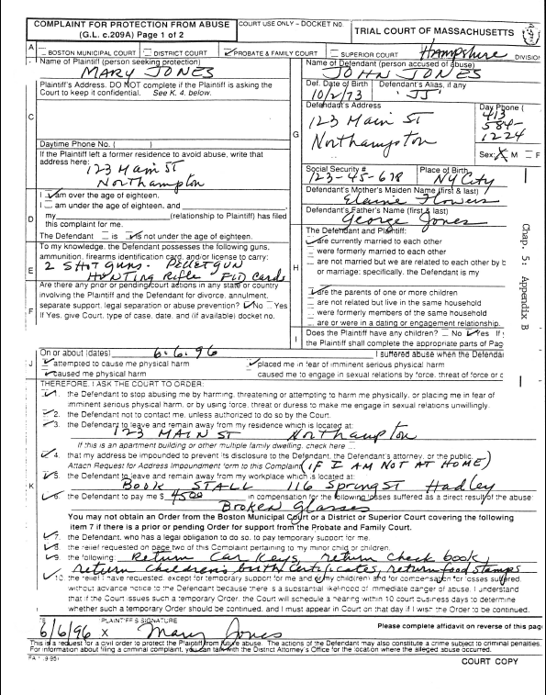
Notes:
Old 209A 1995?

Slide 24
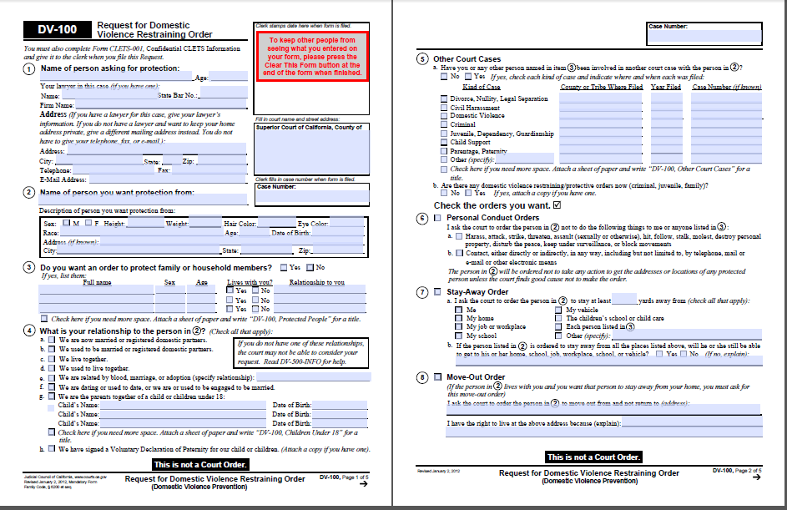
California uses 5 pages for our 3
Notes:
California is a state in which

Slide 25
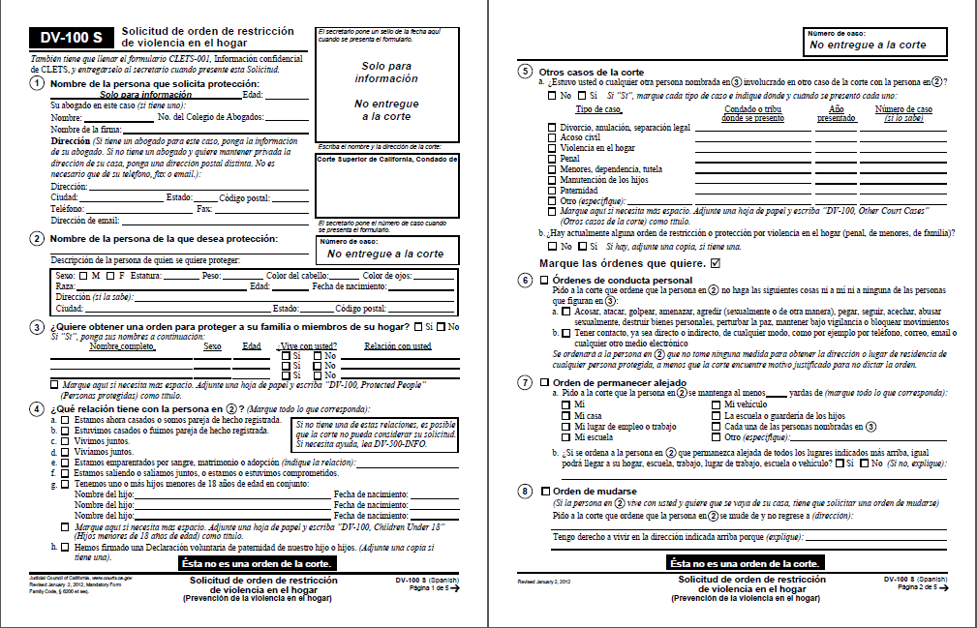
California chose to use only destination language on translated forms – no English at all

Slide 26
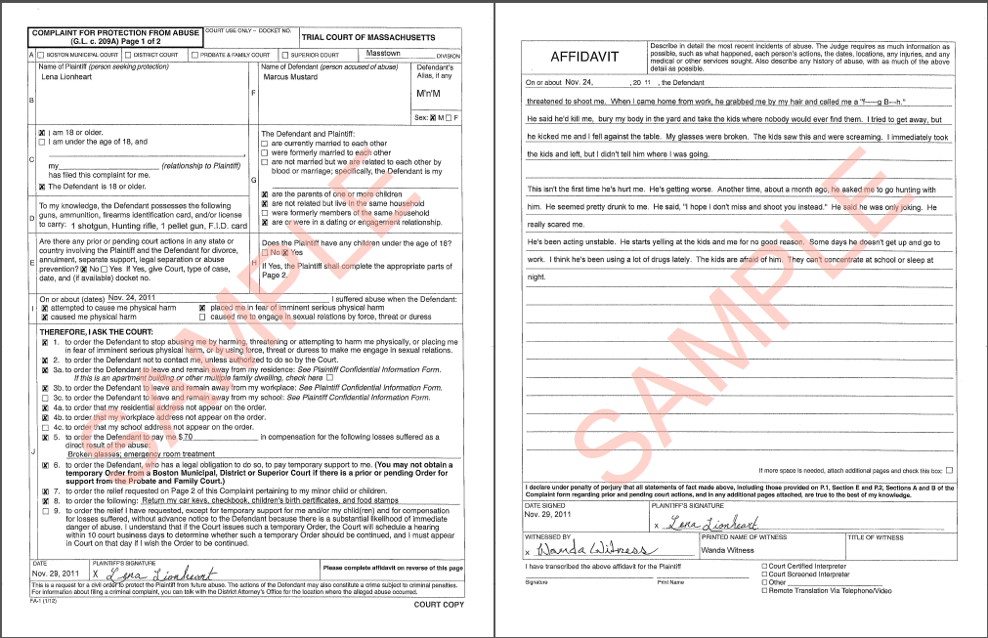
MA 209A Protective Order (2012) Page 1 with Affidavit

Slide 27
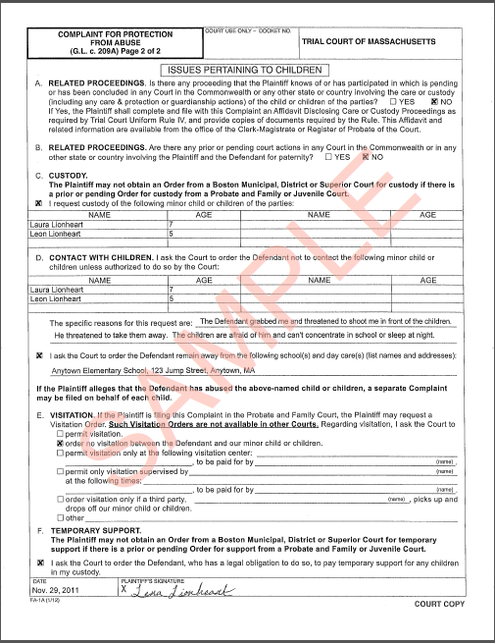
MA 209A Protective Order (2012) Page 2

Slide 28
Collaboration with Courts, legal aid and DV advocates
Roles and importance of collaborators
Online Do-It-Yourself Child Support Court Forms – online now – English and Spanish
Stand-alone Financial Statement module – in testing
209A forms – in progress
Notes:
Background – in producing online interactive “Do-It-Yourself” court forms, who, among the collaborators, does what?
collaboration with Probate & Family Court legal staff essential.
This project is a collaboration among legal aid lawyers and advocates, Trial Court personnel, and domestic violence advocates - challenges …..?
Collaboration with the Probate and Family Court led to the exemption to the requirement that the Financial Statement be filed on pjnk paper

Slide 29
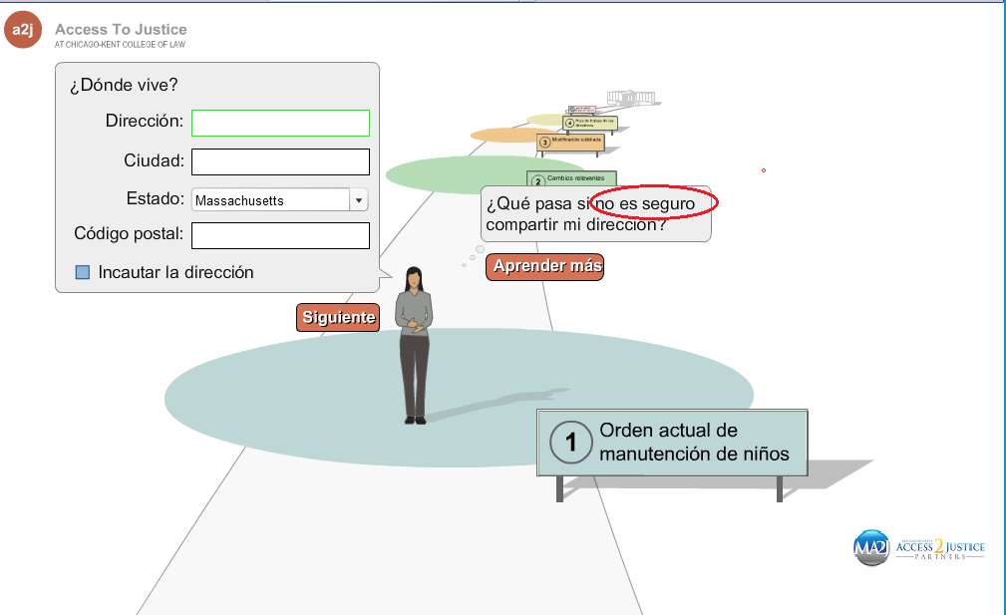
Challenges translation poses

Slide 30
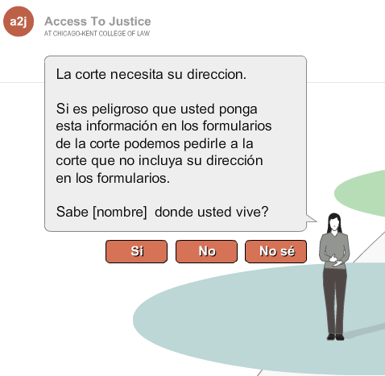
Answer results in better original

Slide 31
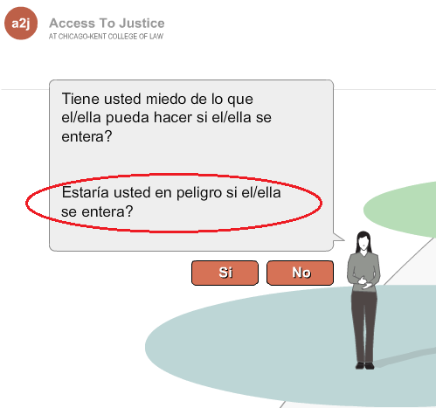
Only an experienced Spanish speaking DV advocate could give us the best way to say this

Slide 32
What court forms would
you
like to see online as DIY interactive forms?
Notes:
Background – in producing online interactive “Do-It-Yourself” court forms, who, among the collaborators, does what?
collaboration with Probate & Family Court legal staff essential.
This project is a collaboration among legal aid lawyers and advocates, Trial Court personnel, and domestic violence advocates - challenges …..?
Collaboration with the Probate and Family Court led to the exemption to the requirement that the Financial Statement be filed on pjnk paper

Slide 33
In the end, the English interview was improved by virtue of being translated

Slide 34
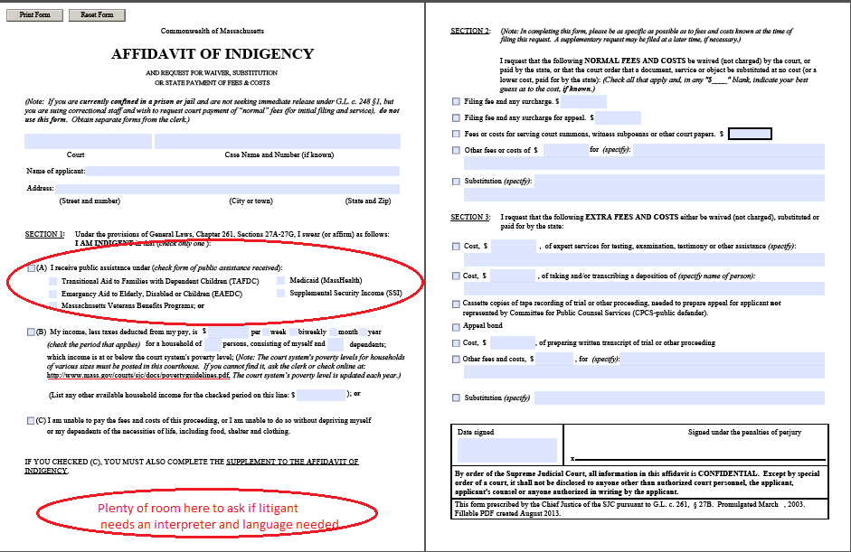
3 missed opportunities from collaboration breakdown
Notes:
Improved layout of Part 1
Broken links with communication breakdown even with court – despite access to justice meetings in which we emphasized the importance of redirects, at least a warning to stakeholders
Access to justice task force on court forms fell through so with redesign of form message to court to put in space for LEP to request an interpreter was lost.

Slide 35
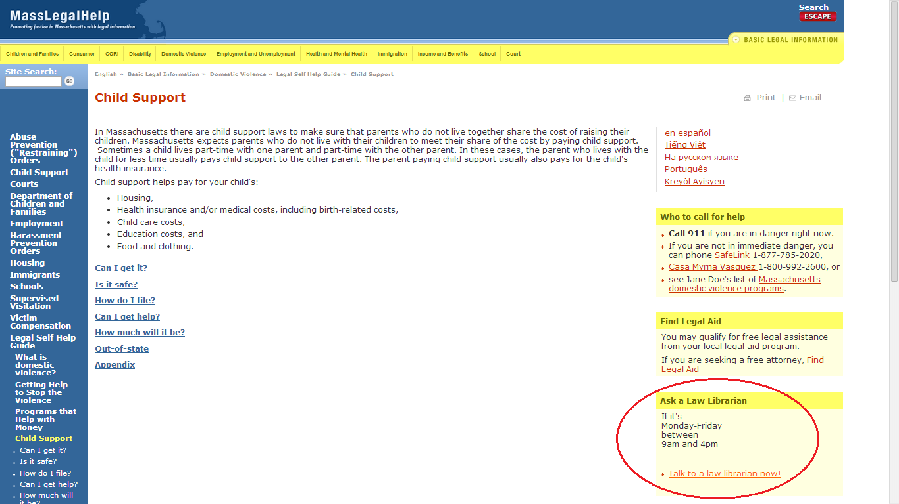
Access to Justice Commission Working Group on Web & Tech => collaboration with law librarians
Law librarians get 600-650 people coming from MLH every month

Slide 36
COURTHOUSE NAVIGATION
How can you ask for an interpreter?
I-Speak - Your Right to an Interpreter flyer
Where and how have these been deployed?

Slide 37
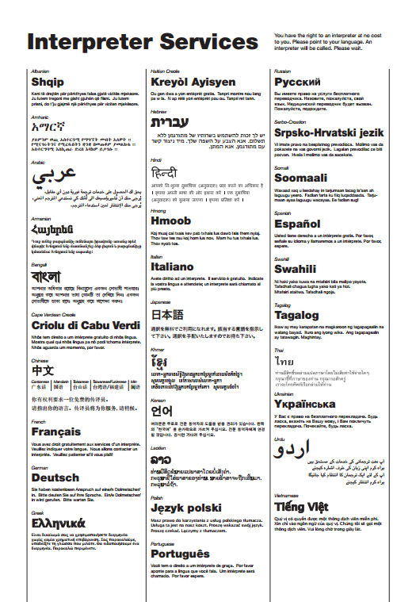
You have the right to an interpreter at no cost to you. Please point to your language. An interpreter will be called. Please wait.

Slide 38
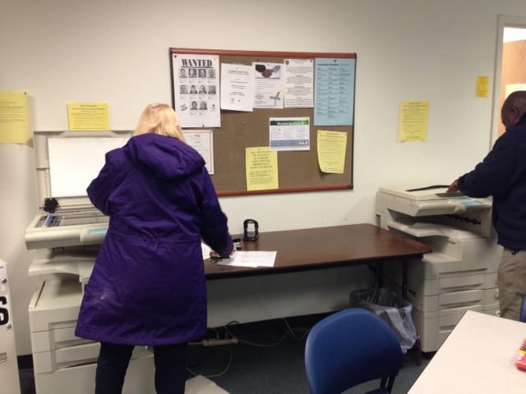
Norfolk Probate and Family Court On or about March 5, 2014

Slide 39
COURTHOUSE NAVIGATION
How can you find where to file a case?
Boston Municipal Court 209A navigation
draft prototype
what is the status of this project?
Suffolk Registry of Probate navigation
draft prototype
what is the status of this project?
Interactive: Where else do attendees think a courthouse navigation project would be successful and effective?

Slide 40
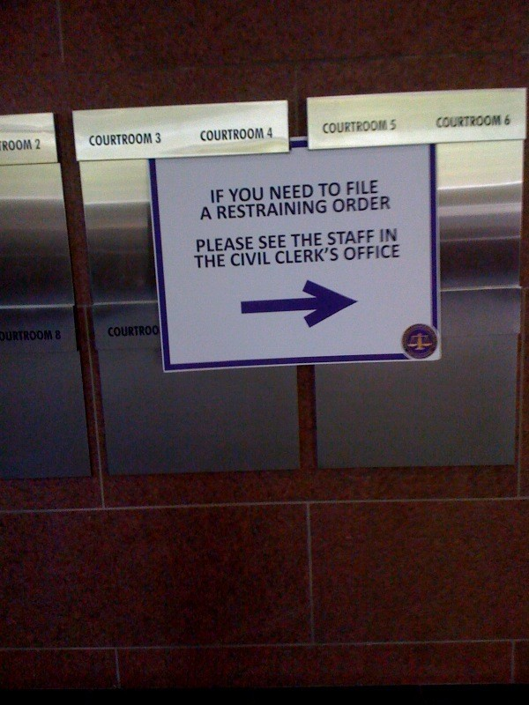

Slide 41
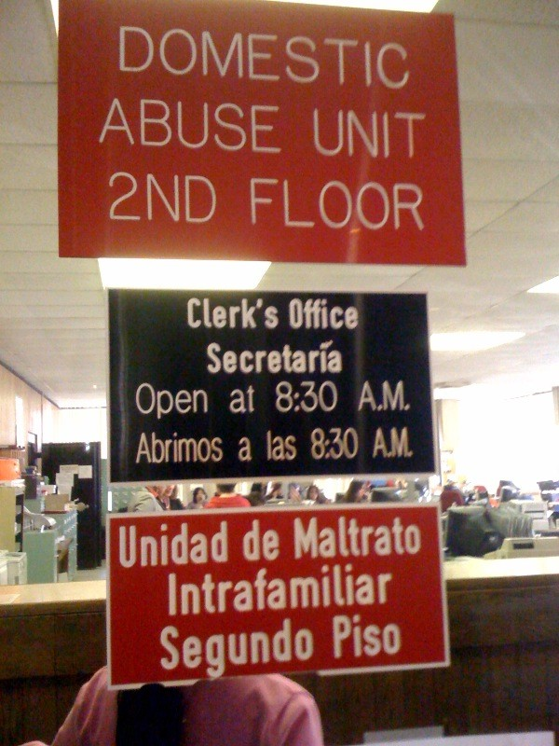

Slide 42
Prototype 209A Navigation
TRIAL COURT OF THE COMMONWEALTH
BOSTON MUNICIPAL COURT
ROXBURY DIVISION
Do you need protection from abuse? Go to the “Domestic Abuse Office” straight ahead and 3d door on the left
Necesita proteccion contra abuso? Vaya a la “Domestic Abuse Office”, todo derecho y la tercera puerta a la izquierda
Avez-vous besoin de protection contre abus? Allez à la «Domestic Abuse Office", tout droit et dans la troisième porte à gauche
Hon. Samuel L. Jones, 1st Justice

Slide 43
SUFFOLK REGISTRY OF PROBATE PROPOSED ENGLISH LANGUAGE VERSION
WELCOME TO THE
SUFFOLK REGISTRY OF PROBATE
If you need an interpreter, please tell one of the court staff at the front desk. You may need to wait for an interpreter to be called.
1. Get court forms
Go to the front desk as you enter the office to get the court forms you need to file your case.
Tell the forms clerk if you need
an interpreter to talk about what forms you need.
an interpreter to tell you what the forms say and to put your information in English.
an “Affidavit of Indigency”, if you are low income and cannot afford to pay any fees.
2. Get the court file
Follow the red line on the floor to the window.
Get and fill out a white file request card at the desk. (You need to write the docket number of your case on the request card. If you do not know the docket number of your case, you can search for it on the computers in front of the window).
Give it to the clerk at the window. The clerk will get the file and give it to you.
3. Fill out your court forms
4. File papers
Wait at the blue line on the floor to speak with one of the clerks who sit behind the desks.
The clerk will review and approve your papers .
Take the file to the scheduling clerk at the front counter if you need a court date.
5. Pay filing fees
Go to the window at the “Cashier” sign to pay any fee.
Get a receipt for paying your filing fee.
Courtrooms are on the fourth floor.
A list of cases and courtrooms is on the wall of clerk’s office by the open door.
Restrooms are on every floor near the elevators.
Patricia Patty Campatelli, Register of Probate

Slide 44
COURTHOUSE NAVIGATION
What can you do?
To make sure that I-Speak materials are developed and properly deployed?
To develop multilingual navigation signage to help people find
Where to file a case
Where the courtroom is
What ever else they need to find in the courthouse

Slide 45
GETTING AN INTERPRETER IN AN EMERGENCY
What are the barriers to getting an interpreter in an emergency such as for an initial ex parte 209A hearing?
1. Getting information to litigants who are not working with an advocate or agency
2. Court interpreters need to be scheduled through a court liaison
3. Lack of interpreters in certain languages
4. Litigants or opposing parties know the interpreters
5. Expense and logistical availability of “Language Line” or other telephone interpreting services
6. Obtaining an emergency 209A at a police station when the court is closed
7. “Shedding” by certain District Courts – they send litigants to Probate & Family Court
8. Client trauma

Slide 46
GETTING AN INTERPRETER IN AN EMERGENCY
What can advocates do about it?
Advocates have contact information for each court’s Court Liaison
Advocates can build relationships with Court Liaisons
Advocates’ building relationships with Court Liaisons can provide significant safety for survivors of domestic violence who need an interpreter in an emergency, e.g., for an initial 209A hearing.

Slide 47
TRAINING INTERPRETERS ABOUT DOMESTIC VIOLENCE
Why is this important?
Interpreters that understand domestic violence
provide meaningful access to non English speakers to the system
enhance safety of survivors in the court
provide critical links between survivors and their advocates who are not bilingual
help survivors better understand what their restraining orders say
better understand the role of the advocate

Slide 48
TRAINING INTERPRETERS ABOUT DOMESTIC VIOLENCE
What is domestic violence training for interpreters?
Basics (legal definition v. power and control)
Domestic Violence 101
Challenges when interpreting in Domestic/Sexual Violence Cases
The importance of words and their different meanings
Interpreters safety, creating boundaries, and self care

Slide 49
TRAINING INTERPRETERS ABOUT DOMESTIC VIOLENCE
Who were the collaborators?
Multicultural Immigrant Coalition Against Violence (MICAV)
Office of Court Interpreters Services(OCIS)
Who provided the training?
From MICAV: Mass. Office of Victim Assistance; Transition House; Mass. Association of Portuguese Speakers
From OCIS: Leonor Figueroa-Feher, Program Manager for Training
Who received the training?
70 OCIS interpreters

Slide 50
TRAINING INTERPRETERS ABOUT DOMESTIC VIOLENCE
What can you do to train interpreters about domestic violence?
Collaborate with OCIS
Set clear boundaries
Understand each other’s roles
Self care

Slide 51
Community Collaborations
AOC California Legal Aid Collaboration
Language Line Usage
DV and SA organizations collaborating (HI)
Group Rate ( National DV hotline)
Law Enforcement
Language Access Planning (NM)
Meaningful Access
Academy Curriculum
Addressing LEP DV issues for first responders

Slide 52
Model DV Courthouse
King County Courthouse
DV Court
Judges Taskforce
Coordinators working across courts
Victim Centered Collaboration
Local Service Providers
Offender Accountability

Slide 53
Resources
State DV Coalitions / National Orgs.
CCI Court Open House – Building collaborative efforts with advocates, judges, and court administrators
Technical Assistance Providers (OVW, HHS)
TA providers at OVW are able to assist OVW grantees and potential OVW grantees.
Staff at APIIDV can refer questions out if they relate to the Domestic Violence Preventive Services Act

