Slide 1
Public Housing Redevelopment & Preservation
Chhaya Kotwani & Mary Lu Mendonca
April 26, 2024
Notes:
AD - introduces Mary Lu and Chhaya

Slide 2
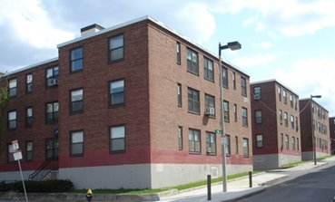
Public Housing in Massachusetts
Massachusetts is 1 of 4 states with a state public housing program
43,270 state public housing units (EOHLC List)
30,134 federal public housing units (HUD dashboard)
About 73,400 total public housing units statewide
Managed by 242 local housing authorities
Notes:
[intro comment – other advocates doing great work in areas like eviction defense, shelter placement, helping people keep mobile vouchers to be used in private housing, etc. Today going to look at how public housing preservation fits into larger picture of the overall housing crisis in MA]
When we talk about PH, we're talking about deeply affordable housing, owned & operated by govt, funded with public dollars.
(different than many other types of affordable housing subsidies)
Many people hear PH & think of really dense multi-story buildings in urban areas
There's public perception that these are all big brick blocks, crowded, substandard apts in crime ridden neighborhoods
BUT -- PH comes in all shapes & sizes - Townhouses, even single family homes
w/ larger portion than you might think in non-urban areas
In MA, LHAs oversee portfolios of PH units that range in size from 10 units to 20,000+ units
Massachusetts is unique bc
We have the most public housing units per capita of any state (looking at combined – state & fed) = over 73K
About 43K of those are part of the state-level program
Massachusetts is 1 of only 4 states with a state public housing program (others: NY, Hawaii, CT)
Of course – we (along w/those states) also have some of the highest housing costs in the US
Statewide we have somewhere around 3 million housing units total in MA
so why is it so important to focus on this relatively small slice of the pie? Let’s look more closely at those 73K PH units

Slide 3
Who Lives in Public Housing?
State public housing units:
House about 70,000 people
2/3 of units are for elders/people with disabilities
Racial/ethnic minorities make up 18% of tenants in elderly/disabled housing and 61% of tenants in family public housing
Federal public housing units in MA:
About 54,200 people
2/3 of units are for elders/people with disabilities
Generally “Black, Latino, Native American, and Asian families make up over two-thirds of people living in [federal] public housing.” (HUD FY 2024 Budget Justification)
Notes:
Our 43K state PH units
house about 70K Massachusetts residents
2/3 of units (about 28K) are reserved for elders/ppl with disabilities
18% of those tenants are racial/ethnic minorities
Remaining 1/3 of state PH units = family housing
especially precious to preserve because there’s not a lot of it.
Over 60% of residents in these units are racial/ethnic minorities
In federal PH (30k units)
Live about 54k MA residents
Again, 2/3 of those units are reserved for elders/ppl w/disabilities
Generally, over 2/3 of residents in federal public housing are Black, Latino, Native American, and Asian families
So – one reason PH is critically important
Is bc these units provide homes for a disproportionate share of populations hat have been historically disenfranchised on the basis of race/ethnicity
& disproportionate share of the most vulnerable individuals in our society:
Elders & persons w/disabilities
We’re also talking about extremely low-income households:
In state public housing 84% of families and 86% of seniors/disabled have incomes between 0-30% of the median.

Slide 4
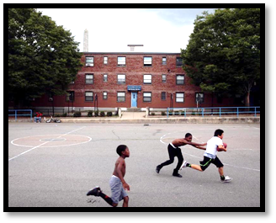
Why We Need Public Housing
Public Housing houses the most vulnerable.
Public Housing has the strongest resident protections compared to other forms of subsidized housing, including:
Affordable rents (generally 25-32% of household income)
Grievance rights
Only fault evictions
Transfer rights
Tenant participation rights
State public housing average monthly rent is $510 in elderly units and $420 in family units
Federal public housing average monthly rent is $464
Notes:
So we really need PH
Aside from housing the most vulnerable,
what makes this resource especially valuable is that
When you are a resident of a unit owned and operated by a PHA
You have about the strongest legal protections a tenant can have
Some examples of these protections:
Affordable rents - unique to PH - In non-PH programs, the rent limit is indexed to the Area Median Income & NOT household's actual income & what's affordable to them. PH unit rents are limited to between 25%-32% of the actual income of the individual tenant/applicant. [see average rent figures here in the box]
Grievance rights - PH tenants are entitled to file grievances (formal complaints) over what they believe is unfair treatment by housing provider
(for the most part) Only fault evictions – unlike in the private market, PH tenants cannot be kicked out of their homes simply because the lease is up & LL wants to raise the rent beyond what tenants can afford
PH tenants have certain rights to transfer to other available units in LHA portfolio, which may not be available in private housing
Tenants have a recognized right to form local tenant organizations and even get funding for tenant participation activities
While there are other kinds of subsidized housing
And the flexibility of a mobile voucher is attractive to many tenants
PH offers the gold standard of tenant protections compared to other types of housing

Slide 5
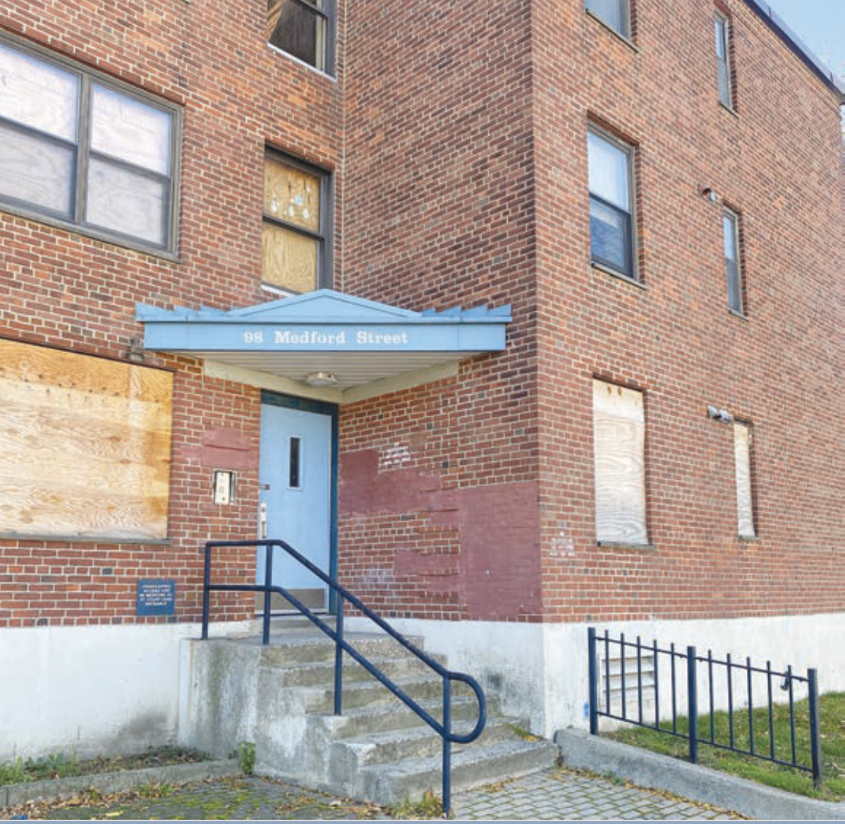
Public Housing Is In Danger
Chronic underfunding of public housing by Congress and the State has resulted in substantial capital needs
In 1998, Congress passed Faircloth Amendment prohibiting LHAs from adding any new public housing units above the number that existed in 1999
Increasing privatization where LHAs partner with private developers to build mixed-income communities to bring in funding through tax credits
Others use programs that allow them to “reposition” the units and convert the subsidy to project-based Section 8 in order to bring in more funds
Notes:
Unfortunately, for decades LHAs operated under huge deficiencies leading to massive capital backlogs
Upkeep of properties is incredibly expensive
Resources are not there
which is one reason why the Governor’s housing bond with $1.6 million for capital repairs is critical to pass.
Many of you are probably familiar w/deplorable conditions in units
Not enough time to dive into long, complex history of how we got here
But the trend over time has been that we’ve been losing PH - both by attrition and by design
One highlight always worth mentioning
Faircloth amendment (read slide)
In general, HUD has increasingly pushed for PH to be removed through demolition or mixed finance development which involves
conversion to other subsidies like LIHTC or Section 8
in order to leverage & to some extent increase the funding that goes towards building & maintaining units
BUT the catch is those units are typically less affordable & with fewer tenant protections than in PH
Understanding how PHAs & developers cobble together these complex redevelopment deals
Which typically have intricately layered subsidies to come up with the financing for this work
= specialized knowledge even for attorneys
So it can be extremely difficult for residents to understand and meaningfully participate

Slide 6
What can legal services do?
Help residents understand and comment on redevelopment applications
Negotiate relocation/rehousing plans to ensure:
- existing rights carry over post-construction
- one-for-one replacement of units
Protect tenant participation rights: collaborate with community organizers to support formation of elected local tenant organizations & help existing groups with governance
Notes:
So – what can advocates do here?
Where LHA is taking on redevelopment of PH property
Whether demolishing and rebuilding, or just renovating
Legal services can support tenants throughout the redevelopment of PH
By helping them participate in processes
and negotiate with LHAs and developers to preserve and assert their rights
Advocates can work with residents (who may be formal LTO, RAB, or other tenant groups)
When HA applies to HUD or state to change the subsidy platform to generate more rental income, we can help existing tenants understand/provide comments on application
We can help them negotiate
relocation/rehousing plan that includes guarantees that residents have the right to return without new rescreening
Other post-construction rights which mirror existing public housing tenant rights – this is the gold standard package we talked about (grievance rights, rent limits, can even advocate for funding for tenant participation activities);
-& thru negotiations, advocate for one-for-one replacement of units so valuable affordable housing is preserved for future
We can also support and protect tenant participation rights:
collaborate with community orgs to support formation of Local Tenant Organizations (LTOs), help existing groups with governance (bylaws, Memoranda of Understanding – w/LHAs and developers)
NEXT will hand it over to Chhaya to tell you about a case study of one of Boston properties we’ve been working on

Slide 7
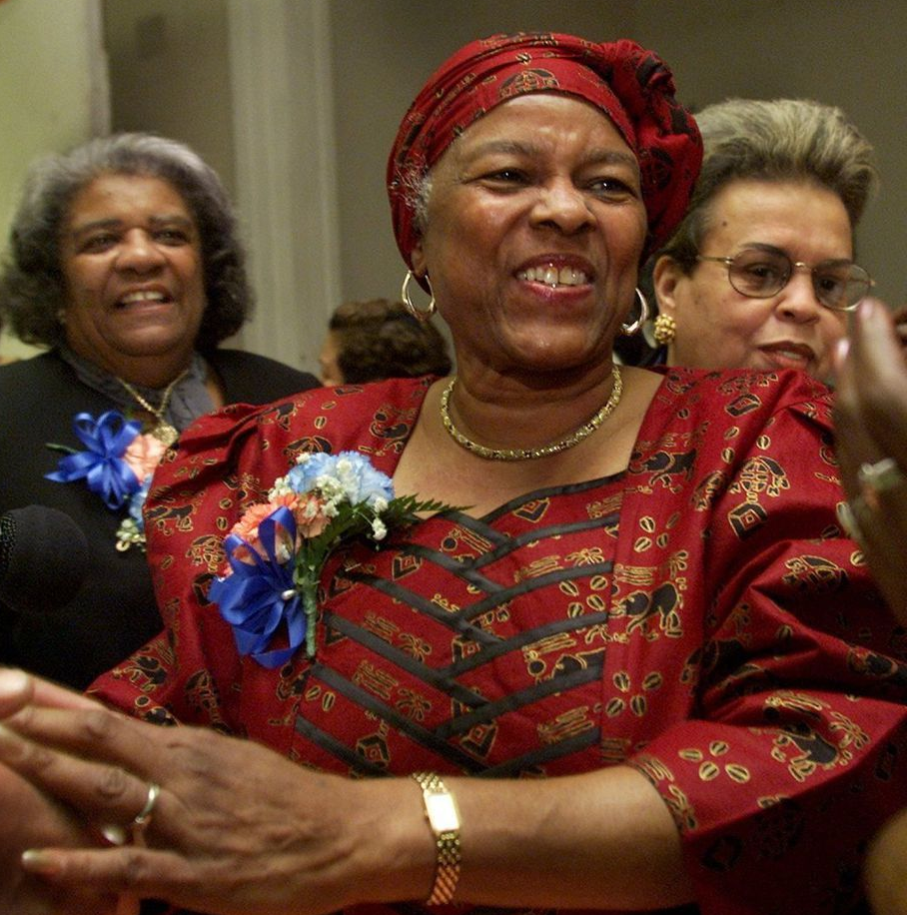
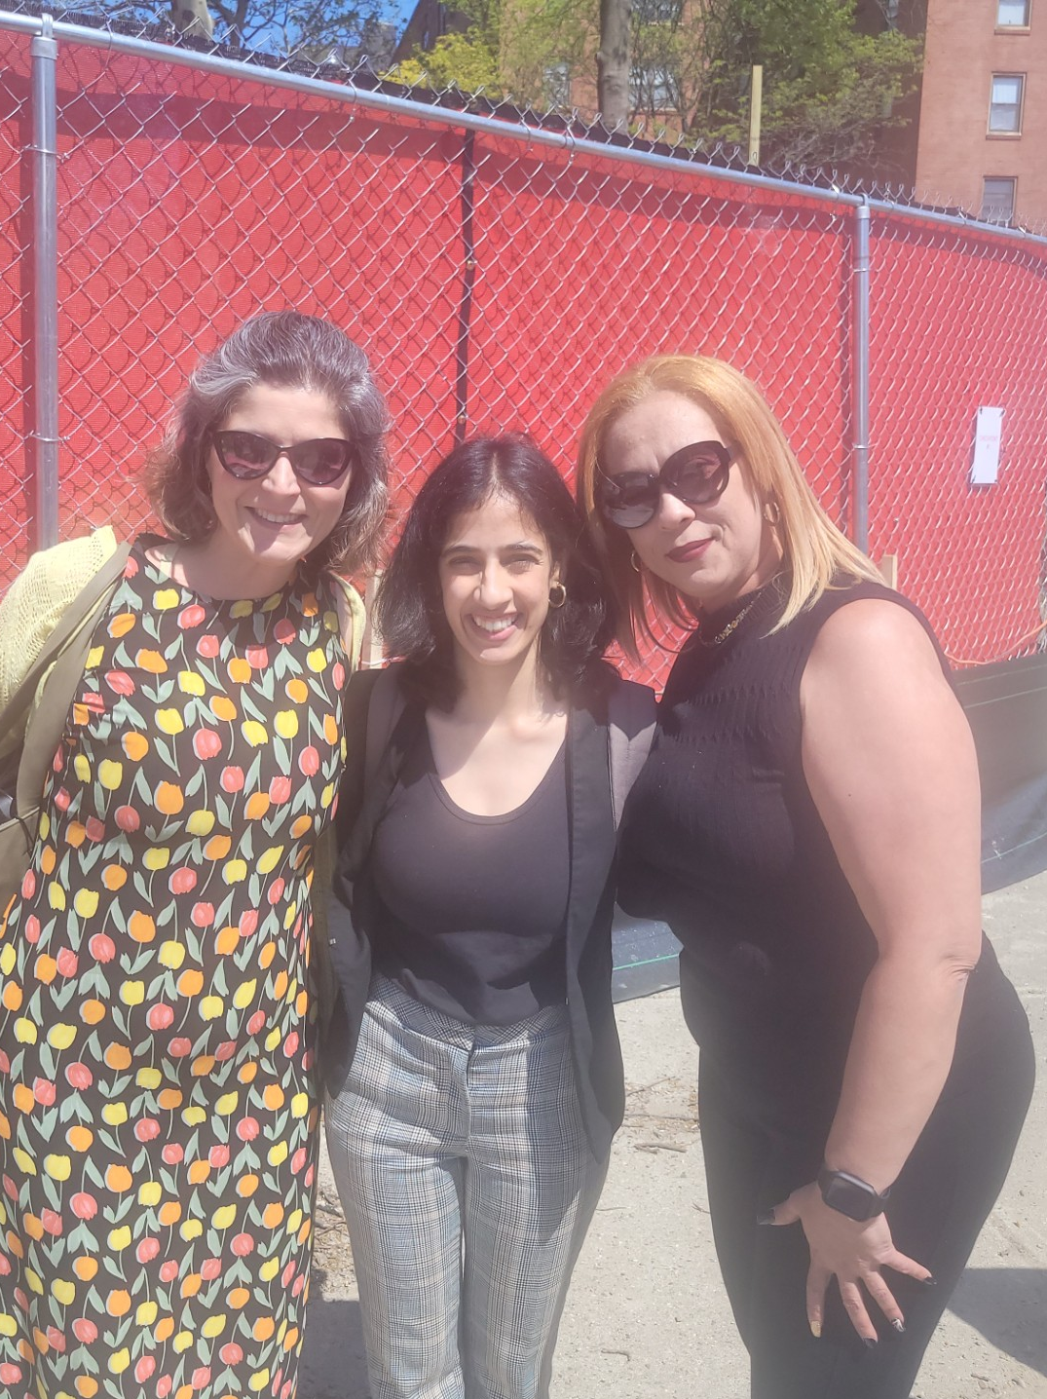
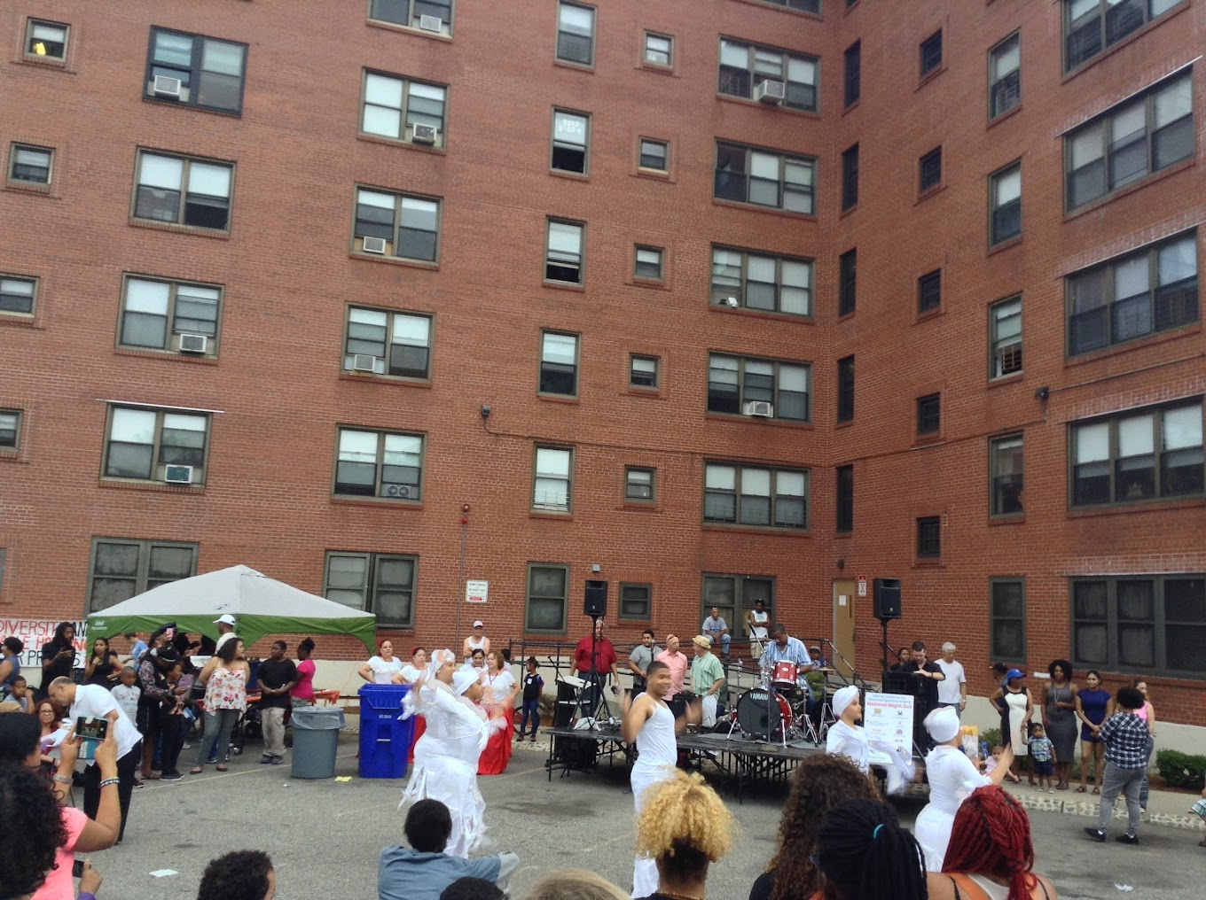
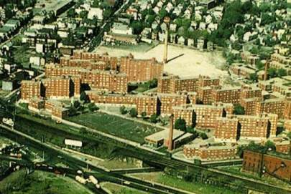
Mildred C. Hailey Apartments
Notes:
Hand it over to Chhaya to tell the Hailey story – what is our role here, what does the work we do look like
Mildred Hailey is a family development in JP, 804 units of federally subsidized public housing in 29 buildings
Represents one of most diverse parts of Boston/Mildred Hailey has large population of youth.
in 2017 BHA issued a RPF inviting developers to submit proposals to preserve it
How and when did tenants come to you?
What did you help them do? Did Mac help with by-laws for MH? If so mention.
What has happened so far?
In May 2023 broke ground

Slide 8
Where Can You Find Information
Most recent list of state and federal public housing from EOHLC (2022) mass.gov/doc/local-housing-authority-unit-counts-by-program-listing/download
Federal Public Housing - HUD’s Dashboard hud.gov/program_offices/public_indian_housing/programs/ph/PH_Dashboard
For a list of all Massachusetts LHAs with links to their individual websites: https://massphas.org/
Public Housing Redevelopment Bill of Rights (principles of good development) masslegalservices.org/content/public-housing-development-bill-rights
Notes:
Bill of rights includes links to negotiated project documents such as the Letter of Assurance, Relocation Plan, Tenant Selection Plan, Management Plan, Mixed Finance Grievance Procedure, Tenant Participation Memorandum of Agreement,
***

Slide 9
Thank you!
Join us at our next meeting:
Public Housing Redevelopment Working Group
Tuesday, May 21, 2024 - 11:00 a.m. - noon
Zoom (meeting info TBD)
Questions? Contact Ckotwani@gbls.org and MLMendonca@gbls.org
Notes:
Annette’s notes and sources/cites for data in earlier slides:
Public Housing units data
State Data from MassNAHRO: https://cdn.ymaws.com/massnahro.org/resource/resmgr/legislative_day/2021/ma_public_housing_facts.pdf
Federal Data from HUD’s dashboard: https://www.hud.gov/program_offices/public_indian_housing/programs/ph/PH_Dashboard
State public housing race/ethnicity data – from 2019 Analysis of Impediments https://www.mass.gov/doc/analysis-of-impediments-to-fair-housing-choice-2019/download
Average rents:
State Data from MassNAHRO: https://cdn.ymaws.com/massnahro.org/resource/resmgr/legislative_day/2021/ma_public_housing_facts.pdf
Federal Data comes HUD’s dashboard: https://www.hud.gov/program_offices/public_indian_housing/programs/ph/PH_Dashboard
State public housing stats on household incomes from 2019 Analysis of Impediments https://www.mass.gov/doc/analysis-of-impediments-to-fair-housing-choice-2019/download

