Slide 1
An Overview of Education Law and Language Access Requirements
MCLE Title VI Language Access Conference
December 15, 2016
Caitlin Parton
Staff Attorney
Disability Law Center

Slide 2
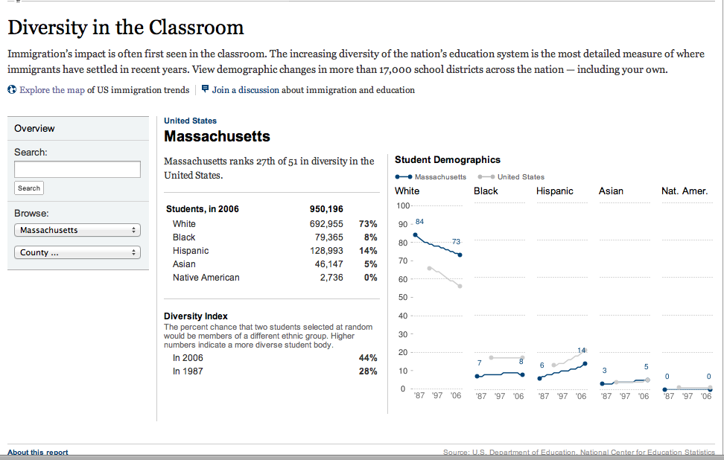
Diversity in the Classroom
http://projects.nytimes.com/immigration/enrollment

Slide 3
Why is this important?
5.5 million ELL students in U.S. public schools speak more than 400 different languages.
80% of ELL students in U.S. speak Spanish as first language.
14% of students (6.7 million) receive special education; 1% for hearing impairments.

Slide 4
Title VI of the Civil Rights Act of 1964
Prohibits discrimination based on race, color, or national origin.
Requires programs that educate children with limited English proficiency to be:
1. Based on a sound educational theory;
2. Adequately supported, with adequate and effective staff and resources, so that the program has a realistic chance of success; and
3. Periodically evaluated and, if necessary, revised.
Notes:
Federal law does not dictate the curriculum schools must use to teach English learners.

Slide 5
Legal Background
Since 1970, USDOE OCR concluded Title VI national origin discrimination included language rights.
Executive Order 13166 (2000) mandated language access in all federally funded programs and school districts. Must take “reasonable steps” to ensure access.
As result, all federal agencies have language access plans. (www.lep.gov)

Slide 6
Equal Educational Opportunities Act of 1974 (EEOA)
Federal law requires states and school districts to provide an equal educational opportunity to students learning English.
Must teach academic content in the language students understand, while also teaching English.

Slide 7
Equal Educational Opportunities Act of 1974 (EEOA)
Requires school districts to take “affirmative steps” to address language barriers so that students can participate meaningfully in the schools’ educational programs.
Horne v. Flores- Supreme Court held that under EEOA, courts can’t dictate form of bilingual education and costs in programming. 557 U.S. 433 (2009).
Notes:
UNDER HORNE– providing inadequate ELL instruction in the Nogales Unified School District (Nogales), in violation of the Equal Educational Opportunities Act of 1974 (EEOA), which requires States to take “appropriate action to overcome language barriers”
The District Court subsequently extended relief statewide and, in the years following, entered a series of additional orders and injunctions. The defendants did not appeal any of the District Court’s orders.
On June 25, 2009, the United States Supreme Court overturned the decision of the state court, deciding in favor of Horne, and allowing the state to determine its own requirements with regards to ELL instruction. Justice Alito wrote the opinion for the 5-4 majority. The opinion held that in evaluating the actions of the state attention should focus on student outcomes rather than on spending and inputs to schools.

Slide 8
Individuals with Disabilities Education Act (IDEA)
Requires states and schools to make a free and appropriate public education available to children with disabilities residing in the state in the least restrictive environment.
The multidisciplinary team must consider the language needs (not content-based) of ELLs when developing, reviewing or revising IEPs.

Slide 9
Individuals with Disabilities Education Act (IDEA)
Mandates parental involvement through a “Team meeting” process.
District “must take whatever action is necessary to ensure that the parent understands the proceedings of the IEP Team meeting, including arranging for an interpreter for parents with deafness or whose native language is other than English.” 34 CFR § 300.322(e).

Slide 10
Individuals with Disabilities Education Act (IDEA)
Mandates procedures designed to ensure that the notices, records, or any other written materials are in the native language of the parents, unless it clearly is not feasible to do so. 20 USC § 1400(b).
Evaluation and placement procedures must be conducted in the child’s native language, parents need to provide “informed consent.”

Slide 11
American with Disabilities Act (ADA)
Prohibits disability discrimination by public and private entities.
Title II deals with state and local government entities, including schools.
Must provide accommodations, unless doing so would fundamentally alter the nature of the service, or result in undue financial or administrative burden.

Slide 12
Section 504 of the Rehab. Act
First Federal civil rights law that prohibits discrimination on basis of disability. Broader definition than IDEA.
Part D- specific provisions applicable to educational programs.
Requires districts provide equal opportunity and accommodations to participate and receive benefit from programs available to all students.
Notes:
Provision of regular or special education and related aids and services designed to meet the student’s needs “as adequately as the needs of non-disabled students are met.”

Slide 13
Every Child Succeeds Act
Signed Dec. 10, 2015.
Gives more control to states to determine education decisions.
Adequate Yearly Progress (AYP) gone- each state will make its own accountability system.
Title I districts must create plans so students are not served by “ineffective” or “inexperienced” teachers at disproportionate rates.
Requires language proficiency standards for ELL students and alternative exams for those with significant disabilities.

Slide 14
DOE Guidance on Deaf Students
Factors to consider when developing IEPs for children who are deaf:
Communication needs and the child’s and family’s preferred mode of communication;
Linguistic needs;
Severity of hearing loss and potential for using residual hearing;
Academic level;

Slide 15
DOE Guidance (con’t.)
Factors to consider when developing IEPs for children who are deaf:
Social, emotional, and cultural needs including issues with peer interactions and communication;
Nature and severity of child’s needs in consideration of curriculum content and method of delivery; and
Including evaluators who are knowledgeable about these specific factors as part of the Team.

Slide 16
DOE and DOJ Guidance on Effective Communication (2014)
Schools must apply both IDEA and Title II effective communication rules in determining how to meet the communication needs of a child with a hearing disability.
Title II and Section 504 also apply to people with disabilities who are not students, like family members or a person who seeks access to any programs or activities conducted at a public school.

Slide 17
Deaf/HH Language Access
Fluidity of communication needs and identity: individualized assessment, in consultation with the child’s family.
Deaf Child Bill of Rights: states’ recognition of particular educational needs of children with hearing loss.
EHDI: legislative action addressing importance of early identification of hearing loss, leading to access to services.

Slide 18
DOE/DOJ Guidance on LEP Students
Schools must provide effective language assistance to LEP parents, like translated materials or a language interpreter.
Districts must ensure interpreters and translators:
Have knowledge in both languages
Know specialized terms or concepts to be used
Are trained on the role of an interpreter
Know ethics of interpreting and maintain confidentiality.
It is not sufficient for the staff merely to be bilingual.

Slide 19
Forward Focus: Language Advocacy in Schools
Assert the language rights of your clients:
Right to a qualified and impartial interpreter during any meetings at the school.
Right to receive all district communications in native language.
Right to receive all evaluations and reports prior to IEP in writing 2 days ahead of meeting, but must request in writing.

Slide 20
Forward Focus: Language Advocacy in Schools
Assert the language rights of your clients:
Right to receive translated IEP within mandated time frame in native language.
Right to an equal educational opportunity to students learning English. Don’t let them “choose ELL or SPED.”
“Affirmative steps” to teach academic content in the language students understand, while also teaching them English and making required accommodations.

Slide 21
Questions and Resources
U.S. Department of Education’s Office for Civil Rights (OCR) at www.ed.gov/ocr or contact OCR at (800) 421-3481 (TDD: 800-877-8339) or at ocr@ed.gov.
For more information about filing a complaint, visit www.ed.gov/ocr/complaintintro.html.
U.S. Department of Justice’s Civil Rights Division at www.justice.gov/crt/about/edu/ or contact DOJ at (877) 292-3804 or at education@usdoj.gov.
For more information about filing a complaint, visit www.justice.gov/crt/complaint/#three.
For more information about school districts’ obligations to English learner students and limited English proficient parents, additional OCR guidance is available at http://www2.ed.gov/about/offices/list/ocr/ellresources.html.

Slide 22
List of Federal Statutes
Title VI of the Civil Rights Act of 1964 (“Title VI”) U.S.C. § 2000d, 34 C.F.R. pt. 100, and 28 C.F.R. § 42.104(b)(2);
Equal Educational Opportunities Act of 1974 (“EEOA”), 20 U.S.C. § 1703;
Individuals with Disabilities Education Act (“IDEA”) 20 U.S.C. § 1400 and 34 C.F.R. pt. 300.
Apply to entities that receive federal financial assistance.

Slide 23
List of Federal Statutes (cont.)
Title III “No Child Left Behind Act” 20 U.S.C. § 6842 et seq.;
Elementary and Secondary Education Act “Every Child Succeeds Act.”
ADA 126 USC § 12106 and Section 504 29 U.S.C. § 701 (for those who are Deaf and hard of hearing).
Apply to entities that receive federal financial assistance.

Slide 24
Contact Information
Caitlin Parton
Staff Attorney
Disability Law Center
11 Beacon St. Suite 925
Boston, MA 02108
Tel. (617) 723-8455 x 124
cparton@dlc-ma.org

