Slide 1

Assisting Limited English Proficient (LEP) patients in the healthcare setting
Lisa M. Morris, MSTD lisa.morris@umassmed.edu

Slide 2
MassAHEC Network
Executive Office of Health & Human Services (MassHealth)
Deliver trainings in 5 Regional Offices:
    Berkshires including Springfield
    Boston
    Central Massachusetts
    Southeastern Massachusetts including Cape & Islands
    Merrimack Valley

Slide 3
Language Services & Training Offered:
60 hour Fundmentals of Medical Interpreter Training
Continuing Education for interpreters
30 hour Mental Health Interpreter Training
48 hour Community Interpreter Training
Translation Bureau

Slide 4
Massachusetts Emergency Room Interpreter Bill
Signed into law as Chapter 66 of the Acts of 2000
Purpose of the law:
All hospitals which provide acute care in emergency rooms or in acute psychiatric services, must use competent interpreter services when treating non-English speaking patients.

Slide 5
The Department of Public Health monitors to ensure that the mandate is followed.
Sample Policies:
Hospital personnel will take appropriate action to ensure that a patient’s inability to communicate in English does not interfere with that person’s medical care.
Family members or friends of non-English speaker or a person with limited English proficiency (LEP) will not serve as interpreters unless the non-English speaker or LEP person expressly requests such an arrangement. In this case, the non-English speaker or LEP patient must document in writing (complete with his or her signature) that this is his or her wish. Interpreters must remain present during the interpretation of legal documents or informed consents.

Slide 6
Office of Civil Rights
Title VI of the Civil Rights Act of 1964 prohibits discrimination based on race, color, or national origin in programs or activities receiving federal financial assistance. All federal agencies that provided grants of assistance are required to enforce the Title VI regulation.

Slide 7

National Code Of Ethics & Standards of Practice

Slide 8
Barriers to Communication
Linguistic barriers
Barriers of register and experience with health care concepts and procedures
Cultural barriers
Systemic barriers

Slide 9
Role of the Medical Interpreter
Conduit
Clarifier
Cultural Broker
Advocate

Slide 10
Advocate
Cultural Broker
Clarifier
Conduit

Slide 11
Tips for working with interpreter in medical setting:
First person interpretation
    Third person exceptions
Consecutive interpretation
    Simultaneous interpretation
Culture broker
    Addressing sensitive topics

Slide 12
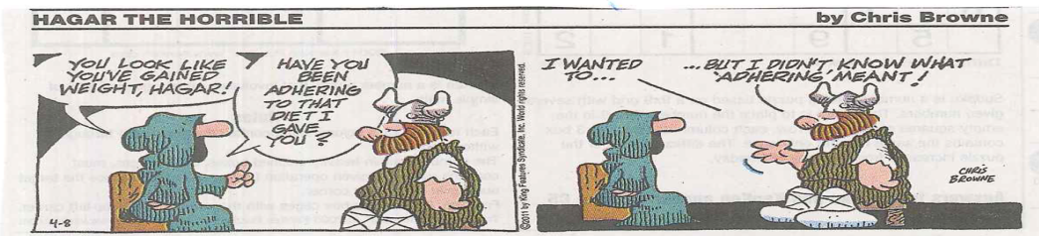
Avoiding the use of complex medical terms and jargon

Slide 13
Professional Interpreter Services
Facilitates equality in accessing meaningful health care
Brings equality and respect for all involved in the triadic encounter
Respects and enhances cultural and linguistic diversity
Enhances communication
Eliminated anxiety and fear
Creates rapport and trust

