Slide 1
Serving Limited English Proficient Clients and Working with Interpreters 101

Slide 2
Definitions & Data
1

Slide 3
Definitions & Terminology
LEP = Limited English Proficient
Interpreters – interpret spoken word
Translators – translate written text
Modes of Interpretation
Simultaneous
Consecutive
Sight Translation
Notes:
Simultaneous – court hearing, emotionally charged situation (911 call, interview of traumatic event), when client is unable to pause for interpretation (mental health, age, emotional state)
Consecutive – phone, client meeting, question and answer, direct exam of a witness (*primary mode in legal services)
Sight Translation – direct oral translation of a written text (**NOT interpreter’s job to explain a document or to assist client in filling out a form.)

Slide 4
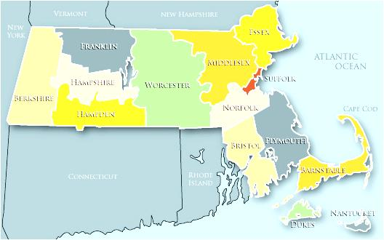
MA LEP Population
MA ranked 8th largest LEP population in US at 8.9%
14.5% of MA residents are foreign born
MA has second highest native-born LEP population (Puerto Rico is first)
72% of MA LEP population is in Greater Boston
Most common languages:
Spanish (38% of the total MA LEP population)
Portuguese
Chinese
French Creole
Vietnamese

Slide 5
Working with LEP Clients and Interpreters
2

Slide 6
What is Interpreting?
Interpreting is very difficult to do well!
Interpreter as a Conduit
Must render the meaning of said from the source language, into the target language:
Accurately, without any distortion of meaning
Without omissions
Without substitutions
Without additions
Notes:
Can be frustrating to work with an interpreter, REMEMBER - Interpreting is very difficult to do well! NOT JUST BILINGUAL
After you have given the interpreter these basic instructions, it’s very beneficial for you to clarify what you believe the interpreter’s role to be.
Almost always, the role of an interpreter is to be CONDUIT. That is the Role of the interpreter is to only transmit the message.
It’s important to know, that even amongst trained interpreters, there often needs to be some clarification about the role of the interpreter.
--This is also the role of interpreters in the courts.
Now this can be distinguished from some other roles, such as being an:
Advocate: To assist the LEP person in communication
Cultural Broker: To explain cultural cues and behaviors to the non LEP person

Slide 7
Video
http://www.youtube.com/watch?v=pVm27HLLiiQ

Slide 8
Instruct the Interpreter
Keep all of this information confidential
Interpret everything that is said
Use the first and second person
Use same grammatical construction as the speaker
Do not omit, edit, or polish what was said
Interpret the meaning as accurately as possible
No side conversations with the LEP person
Notes:
So, you all have identified many of the ways you can improve the outcome of an interpretation. I’d like to quickly give over these so that we can locate the suggestions within the context of an interpretation.
Before you begin in the conversation, it’s always a good idea to brief the interpreter on the nature of the communication and what you hope to achieve during the conversation. When you are doing this, here are some instructions you may give the interpreter:
Keep all of this information confidential (NOT LISTED ON THE TIP SHEET, BUT VERY IMPORTANT!!!)
Interpret everything that is said
Use the first and second person
Use same grammatical construction as the speaker
Do not omit, edit, or polish what was said
Interpret the meaning as accurately as possible
You may have to interpret sensitive material that may be embarrassing or difficult to communicate
No side conversations with the LEP person
(CONTINUED)

Slide 9
Instruct the Interpreter
Never answer for the LEP person
Ask speakers to do any of the following:
Pause
Repeat
Slow down
Ask for clarification or a time out
Notes:
Never answer for the LEP person
Keep all of this information confidential
Ask speakers to do any of the following:
Pause
Repeat
Slow down
Ask for clarification or a time out

Slide 10
Instruct the Client
Explain the role of the interpreter: to be a conduit ONLY
Speak slowly and speak only one or two sentences at a time
Be patient- the interpreter may ask you to slow down or repeat what you just said
Notes:
Then, through the interpreter, you should give the client some instructions.
Such as:
Explain the role of the interpreter: to be a conduit ONLY
Speak slowly and speak only one or two sentences at a time
Be patient- the interpreter may ask you to slow down or repeat what you just said
CONTINUED →

Slide 11
Instruct the Client
Allow the interpreter to finish interpreting before speaking, even if you understand what was said
Do not ask the interpreters any questions or have any side conversations with the interpreter— please address all questions and concerns with me
Notes:
And:
Allow the interpreter to finish interpreting before speaking
Do not ask the interpreters any questions or have any side conversations with the interpreter— please address all questions and concerns with me
In addition to these instructions– you should be aware that meetings using an interpreter always take longer– sometimes 2-3 times as long, as meetings where there is not language discordance.
It may be helpful to keep this in mind when you are scheduling meetings and when you are communicating the length of a meeting to the client and the interpreter

Slide 12
Sample Introduction with Client
“The interpreter is here to help us communicate, please speak directly to me and the interpreter will interpret. The interpreter has ethical guidelines that he/she must follow. Everything said in this meeting will be confidential. The interpreter cannot answer your questions or give you advice about your case. If you have questions, please ask me. Everything that is said will be interpreted. Please speak clearly and in short sentences so the interpreter has time to interpret. If there is something that you do not understand, please tell me.”

Slide 13
During the Interpretation
Look and speak directly to the LEP person
When speaking:
Use first person
Use plain English
Speak slowly and clearly and pause
Ask one question at a time
Try not to interrupt the interpreter
Be aware of cultural differences
Clarify what you said upon request
Notes:
As we know, the key to effective lawyering is good communication. As we saw, the introduction of an interpreter can potentially threaten the rapport between an attorney and client.
Here are some ways an attorney can maintain rapport even while using a interpreter:

Slide 14
Cues that An Interpretation May Not be Going Well
Interpreted answers and responses don’t appear to make sense
Interpreter frequently reformulates or changes words mid-sentence
Interpreter or client appears flustered, frustrated, or confused
Interpreter repeatedly asks for clarification
Client corrects interpreter or appears to disagree with the translation
Client opts to start speaking in broken English
Notes:
If you can’t understand what is being interpreted, here are some cues you can watch out for that may be red flags that the interpretation is not going well.

Slide 15
What to Do When An Interpretation May Not be Going Well
STOP
If you suspect that the interpreter is editing, adding, or subtracting, remind him/her to interpret everything that is said
If necessary, remind the interpreter that his/her only role is to be a conduit
Ask the interpreter if he/she needs a break
Get a different interpreter if necessary
Notes:
SUSAN/ANITA

Slide 16
Ensuring Follow-Up
If the LEP person is supposed to follow-up on anything, ask the LEP person to “teach back” what he/she is supposed to do next
Notes:
At the end of your session,
If you expect the your clients to remember to do something— it’s always beneficial to have them report back in his/her own words what he/she must do next (i.e. if the client has stipulated to make a rent payment).
This will ensure that your client understood what was said and what he/she is expected to do next.

Slide 17
OPI & MassRelay
Optimal Phone Interpreters (OPI):
Statewide Contract with MA Legal Service Orgs
Call: 1-877-746-4674
MassRelay:
Free
For use with Clients who have a TTY number.
Voice and Hearing Users: 800-720-3479
http://www.mass.gov/eopss/agencies/massrelay/
Say "Go Ahead" when you finish a thought. This tells the other party it is their turn.

Slide 18
Working With Telephonic Interpreters
1. Get the interpreter’s name or ID number.
2. Give context and introductions.
3. Test the client’s understanding indirectly.
4. Remember the interpreter is not local.
5. Ask the LEP client if the interpretation was successful.
6. Report problems to your supervisor immediately.
Notes:
It’s likely that you will be using telephonic interpreters through Optimal Phone Interpreters.
Refer to Using Telephone Interpreter Tips worksheet
Ask for the interpreter’s name and number
Describe the situation to the interpreter and state the goal of the communication, Introduce the client to the interpreter
Test the client’s understanding indirectly.
Remember the interpreter is not local (avoid local terms Haymarket, Government Center, red line or green line or explain terms – FoodStamps, DTA)
Ask the LEP client if the interpretation was successful.
Report problems to your supervisor immediately. (Won’t need to pay for the call, etc.)

Slide 19
Debrief With the Interpreter
How did this meeting go?
Were there any moments where you felt you had to go beyond your role?
Were there instances when had to add or subtract what was said?
What suggestions do you have for how I can be more sensitive or more responsive to the client’s culture?
Notes:
It’s always a good idea to debrief with the interpreter, esp. if this is you first time working with him/her.
Some questions you can ask, include:
→ From your perspective as the interpreter, how did this meeting go?
Do you have any questions?
Was the subject matter difficult to interpret?
Did you find that something was lost in the interpretation?
Do you have suggestions for how I can improve future meetings using an interpreter?
→ Were there any moments where you felt you had to go beyond your role in order to faithfully interpret what was said?
→ Were there instances during the interpretation in which you added or subtracted from the interpretation, and if so can you share the reasons for this?
→ What suggestions do you have for how I can be more sensitive or more responsive to the client’s culture, when for example, I ask questions, give information or make suggestions?

Slide 20
When YOU are Interpreting...
Know that your language skills are valuable!
Know what your role is - (interpreter ethics)
Know the vocabulary - (MLS legal glossaries)
Know that you need to practice
Know your limits! Know when to say no!
Interagency Language Roundtable (ILR) Language Proficiency Self-Assessment

Slide 21
Cultural Barriers
Excerpts from The Five Habits: Building Cross-Cultural Competence in Lawyers, Susan Bryant, 8 CLINICAL L. REV. 33 (2001)
“Culture is like the air we breathe -- it is largely invisible and yet we are dependent on it for our very being. Culture is the logic by which we give order to the world.”
“Through our invisible cultural lens, we judge people to be truthful, rude, intelligent or superstitious based on the attributions we make about the meaning of their behavior.”
Notes:
Excerpt from: Susan, Bryant, The Five Habits: Building Cross-Cultural Competence in Lawyers, 8
CLINICAL L. REV. 33 (2001).
Culture = ways people collectively make meaning
ways of looking at, naming and valuing different aspects of the human experience
* many kinds of cultures
working premise here - culture based on ethnicity, race or country of origin
* cultural differences can become “barriers” insofar as they affect how clients negotiate the legal systems in US.
different sets of lenses; different sense of what’s important
we often make decisions as to what is most important, based on our cultural background and upbringing

Slide 22
Cultural Barriers
Ask: What assumptions am I making?
What bias am I bringing?
Listen to the Client.
What cultural understanding of issues does the Client bring?
What understanding of systems and bureaucratic processes does the Client have?
Notes:
Issues that seem clear to us are not always clear or seen the same way by clients
Receipt of public benefits shameful
Mental health is very personal even though as advocate it is important part of the case
DV- just meeting you first time may not want to share it with you, or differ concept – i.e. only physical
Sexual Orientation/Gender and relational stereotypes – who has power of decision and who gets to speak first
Family configuration – decision maker, extended family compositions, who gets to answer for who
Clients May Have Differing Concepts of
Process- how your problem is going to be resolved, brides or court system, filing a complaint may be really foreign to some
Roles- Women vs. Men. defer to male, elders, religious leader, differing consensus decision making. “Individualistic” vs. “Collective” culture
Role of ATTY: Example of “If you do not understand, ask me to explain.” CL does not want to challenge the advocate.
Ownership – sense of entitlement, i.e. retirement at certain age; social security is your children, trust in government agency as helping or watching over you. “Immigration”
Legal world - right to appeal, file complaint w/o retaliation
Different experience of legal systems or non-existent
Example: Is client telling me the truth? Memory, no dates, no clear linear chronology. The issue with linear chronology, what issues to explore? Trauma? PTSD? Mental health issues?

Slide 23
Legal and Ethical Requirements
3

Slide 24
Federal Mandates
Title VI of Civil Rights Act of 1964
Prohibits discrimination by federal fund recipients based on race, color, or national origin
“National origin” covers limited English proficiency (Lau v. Nichols, 414 U.S. 563)
Executive Order 13166: “Improving Access to Services for Persons with Limited English Proficiency”
Notes:
Obligations under Federal Law
Title VI
Governed by Title VI of the Civil Rights Act of 1964 and related regulations prohibiting discrimination on the basis of national origin. Federal Fund Offices that are recipients of federal financial assistance must comply with the language access obligations of Title VI of the Civil Rights Act of 1964. Many public interest offices receive grants from federal agencies or are sub-recipients of federal financial assistance from state or local governments.
Lau v. Nichols, 414 U.S. 563 (1974) – prohibits conduct that has a disproportionate effect on LEP persons as it constitutes national-origin discrimination. (National origin includes limited English proficiency).
Executive Order 13166
Signed by Pres. Bill Clinton, issued on August 11, 2000 – “Improving Access to Services for Persons with Limited English Proficiency”
The Order states that every federal agency that provides funds to non-federal entities must publish guidance on how their recipients can provide meaningful access to LEPs and thus comply with Title VI
Federal financial assistance is defined in 28 CFR § 42.102(c), and includes:
(1) Grants and loans of Federal funds,
(2) The grant or donation of Federal property and interests in property,
(3) The detail of Federal personnel,
(4) The sale and lease of, and the permission to use (on other than a casual or transient basis), Federal property or any interest in such property without consideration or at a nominal consideration, or at a consideration which is reduced for the purpose of assisting the recipient, or in recognition of the public interest to be served by such sale or lease to the recipient, and
(5) Any Federal agreement, arrangement, or other contract which has as one of its purposes the provision of assistance.

Slide 25
Federal & State Guidance
Department of Justice (Guidance and Directives)
Federal Agency Guidance (i.e. HUD, HHS, DOL, etc.)
Legal Service Corporation Guidance for LSC funded legal service programs
MA Executive Order 478
Office of Access and Opportunity – Administration & Finance Bulletin #16 – Executive Branch Agencies

Slide 26
Ethical Responsibilities
ABA Model Rules of Professional Conduct (adopted in MA '97)
Model Rule 1.1: competent representation and preparation
Model Rule 1.4 and 1.4b: communicate with client and explain matter in a way that allows client to make informed decisions
Model Rule 1.14: communicating with client with a disability, reasonable accommodations
**Impossible to comply to these without spoken language interpreter.**
ABA Standards for the Provision of Civil Legal Aid
Standard 4.3: The provider should assure that interpreters maintain client confidences.
Standard 4.6: Requires a sustained and comprehensive effort for a provider to be accessible to LEP persons.
Notes:
ABA Model Rules of Professional Conduct
Brief overview
MA adopted these rules in 1997
ABA Standing Committee on Legal Aid and Indigent Defendants (SCLAID) issued Standard for the Provision of Civil Legal Aid in August 2006, which includes a section on providing services in the primary language of the client. It can be found at http://www.abanet.org/legalservices/sclaid/downloads/civillegalaidstds2006.pdf.
ABA Model Code of Professional Responsibility

Slide 27
4
LEP and Case Handling

Slide 28
www.MassLegalHelp.org

Slide 29
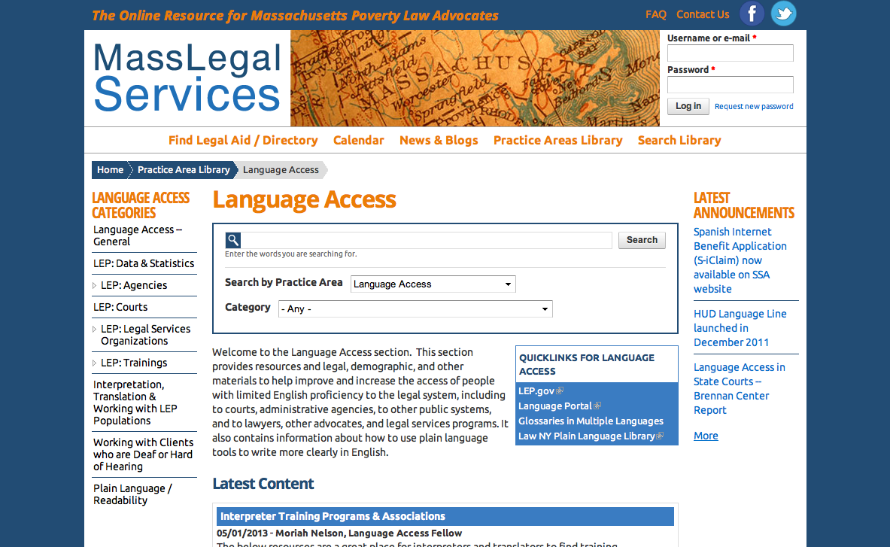
www.MassLegalServices.org

Slide 30
LANGUAGE ACCESS COALITION
The Language Access Coalition (LAC) is a group of legal advocates across Massachusetts interested in language access issues in the courts, state agencies and legal services. LAC works to advance the rights of limited English proficient (LEP) clients in these forums.
Next Meeting - September 23rd, 10am-1pm
Join Listserv on MLS
Email Moriah – mnelson@vlpnet.org

Slide 31
RESOURCES
www.masslegalservices.org/languageaccess
www.lep.gov
For case specific or general questions, contact:
Moriah Nelson, Language Access Fellow
mnelson@vlpnet.org
617-423-0648x138

