Slide 1
MLRI/MCLE Basic Benefits Advocacy Training
Utilities – Advocacy for Low-Income Households in Massachusetts
Jenifer Bosco and Jeremiah Battle,
Senior Attorneys
National Consumer Law Center
jbattle@nclc.org
jbosco@nclc.org
January 16, 2025

Slide 2
Overview of today’s training
Establishing utility service, basic rules
Step 1: Utility Service Protections
Step 2: Reducing Bills
Step 3: Paying Bills
Other utility issues
Q & A

Slide 3
Materials
These slides
Utilities Advocacy for Low-Income Households in Massachusetts and handouts, available at https://www.nclc.org/special-projects/stay-connected-training.html

Slide 4
Intro and types of utilities covered today
Electricity & gas (and some telecom, water)
Investor-owned utilities (IOUs), municipal utilities (munis), competitive energy supply companies
Department of Public Utilities (DPU) Consumer Division
  (877) 866-5066
  DPUConsumer.Complaints@mass.gov

Slide 5
BASIC RULES: OBTAINING UTILITY SERVICE
Obtaining service
  No deposit (except munis)
  ID issues – SSN not required
Bills from prior address and Cromwell waiver
    Utility has right to refuse service at new address if there are unpaid bills from prior address
    Payment must be offered on prior arrears
    Cromwell waiver: sign to have prior utility debt added to new account (D.P.U. 18123 (1974))
Customer of record
  Bills in a child’s, partner’s or roommate’s name?
  Deserted or deceased spouse?

Slide 6
Rules for termination of electric and gas utility service
Termination rules:
  Only Monday-Thursday, 8am-4pm
  No termination on weekends, state or federal holidays, or day before holidays
  No termination if dispute pending
  Notices before termination:
    Initial bill
    second notice (day 27+)
    final notice (day 45+)
  Final notice must give 72 hours notice; good for 14 days
220 CMR 25.02

Slide 7
BASIC RULES/GETTING SERVICE
Reading bills:
See example on next slides
Look for rate letter/number, e.g., “Rate R-2”
When in doubt, call utility company

Slide 8
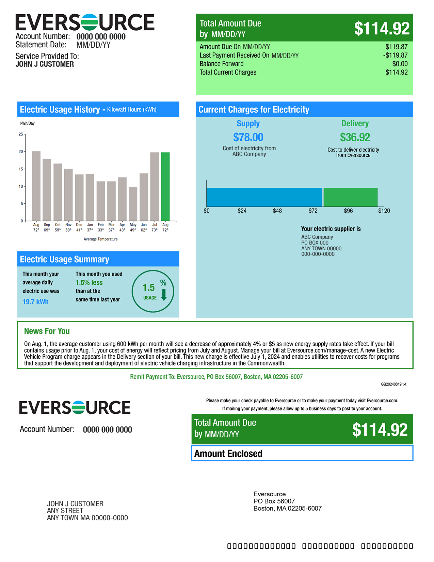

Slide 9
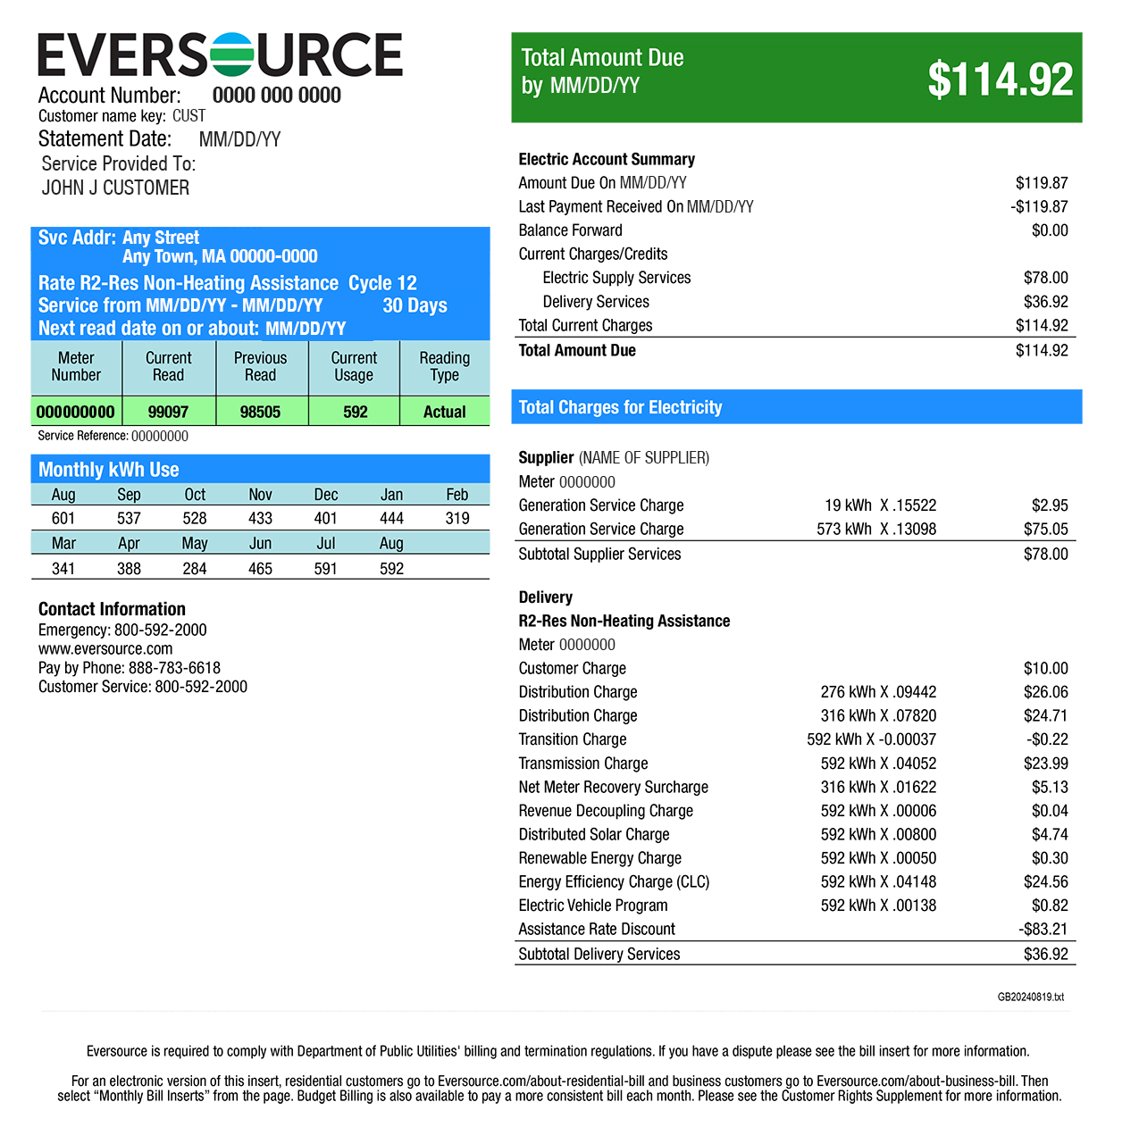

Slide 10
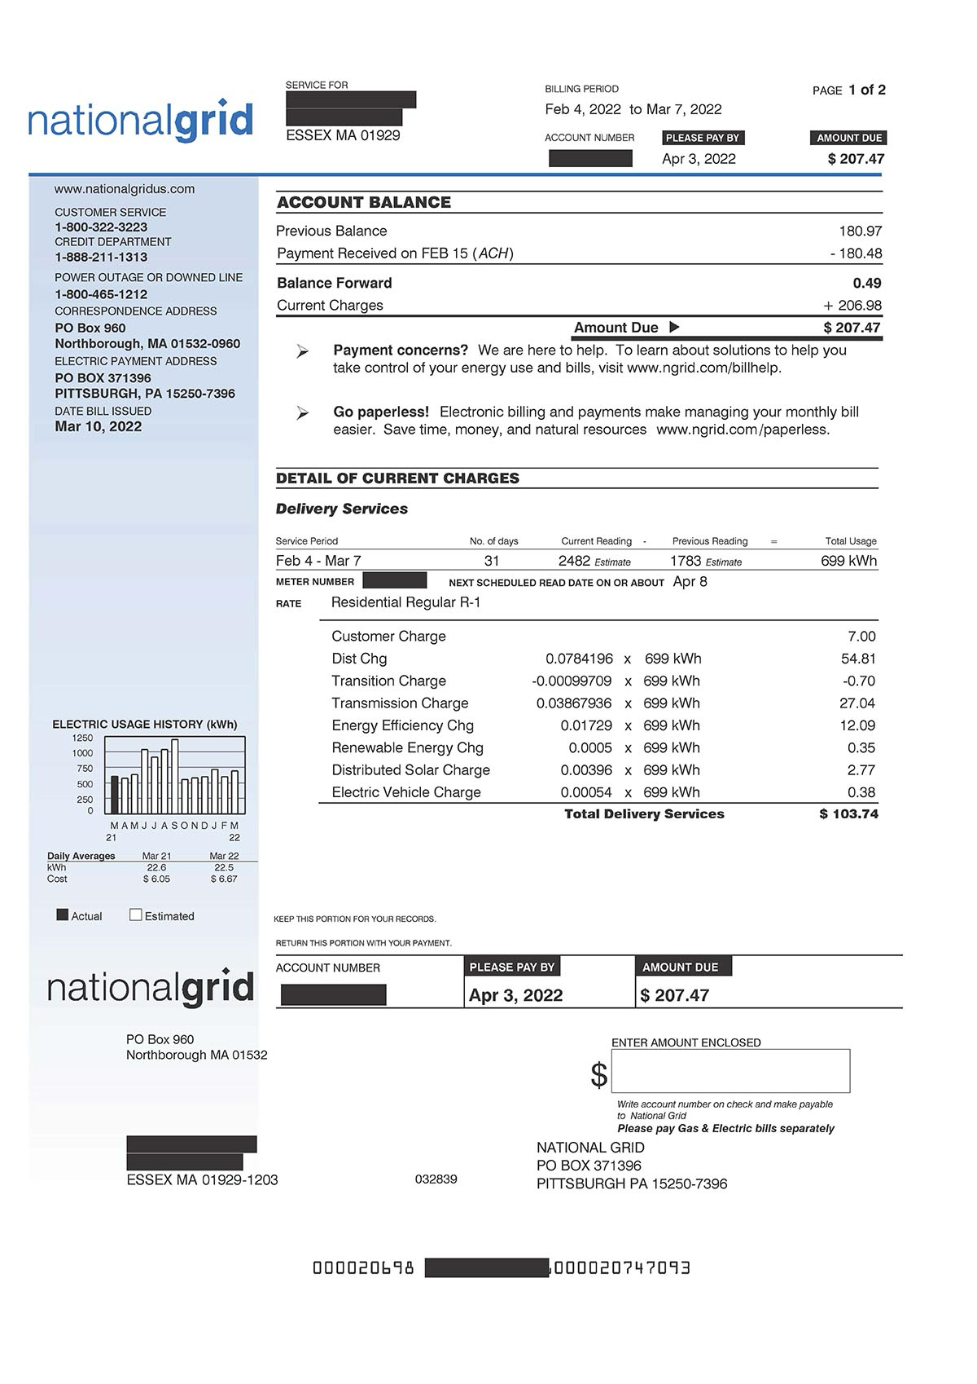

Slide 11
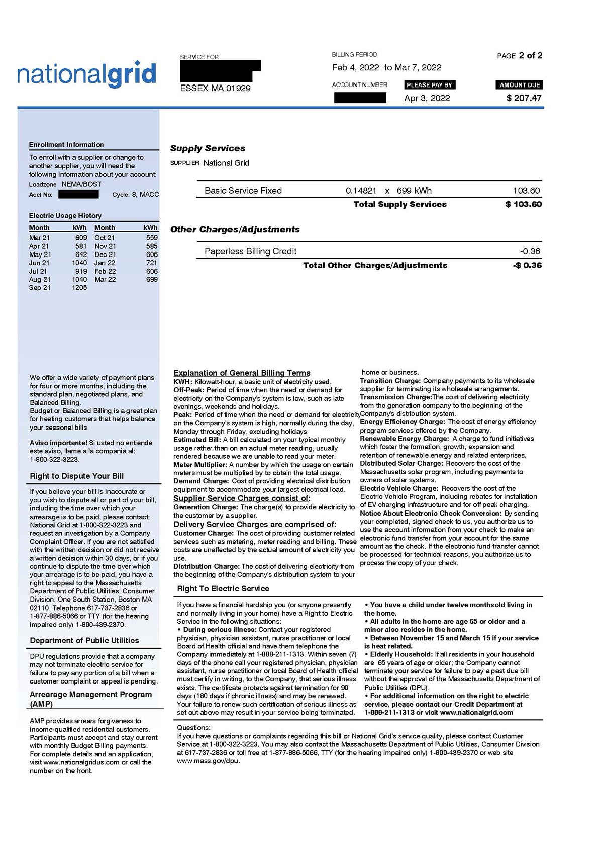

Slide 12
Case scenario 1
Sheila Robinson comes into your office on December 10 and tells you that her family’s gas service was terminated around a month ago because she owes over $2,000 in back bills. She says that she has been unable to keep up with her bills and seems very depressed.
She has a gas furnace and gas stove, so her family does not have heat, hot water, or the ability to cook. She owes about $800 on her electric bill and fears she will get a shut-off notice for that soon too, which would leave her family without light and refrigeration.
Ms. Robinson’s family includes herself, her nine-year old daughter, her seven-year old son, her sister, and her sister’s newborn infant. The family’s income consists of TAFDC and her sister’s SSI check.

Slide 13
STEP #1
STEP #1
PROTECTIONS
STEP #2
STEP #2
REDUCING BILLS
STEP #3
STEP #3
PAYING BILLS

Slide 14
STEP #1 PROTECTIONS
Financial hardship forms:
  Proof of financial hardship is required for most protections from utility shut-off
  Example on next slide
  Utility companies have them available
  Technically, expire within 3 months
E.g., Eversource form, https://www.eversource.com/content/docs/default-source/bill-inserts/ma/ema-financial-hardship-form-oct-24.pdf?sfvrsn=c8ef2298_1

Slide 15
STEP #1 PROTECTIONS
Winter Moratorium
  Applies from Nov. 15 and March 15
  Winter moratorium on terminating heat-related service, Nov. 15 to March 15, usually extended to April 1
  Must demonstrate financial hardship
  Service restored if terminated during moratorium
  220 CMR 25.03

Slide 16
STEP #1: PROTECTIONS
Serious illness
  Is someone seriously ill? Ask for ANY physical or mental illness
  Any letter from doctor/P.A./N.P./Board of Health is enough to protect service or get service restored
  Company may challenge letter it questions, with DPU
  Letters good 90 days (can be renewed) or 180 days (chronic)
  Financial hardship required
  Service can be restored, should seek the protection ASAP and within 90 days of utility disconnection
  220 CMR 25.03

Slide 17
STEP #1 PROTECTIONS
Infant under 12 months
  Is there a child under 12 months in the home?
  Protection time-limited
  Must demonstrate financial hardship
  Prevents termination and restores service
  220 CMR 25.03

Slide 18
STEP #1 PROTECTIONS
Elder protections
  Are all adults in the home 65 or over? (Minor = under the age of 18)
  Notify the company
  If no proof of financial hardship: no terminations allowed, unless utility gets approval from DPU
  If there is proof of financial hardship: no termination at all if low-income
  220 CMR 25.03 & 220 CMR 25.05

Slide 19
STEP #1 PROTECTIONS
Elder Protections, continued
  Utility companies must provide 3rd party notice, on request
  Caution re Liens: Utility companies may take liens on homeowners (seek additional support to learn if homestead exemption or other protections apply)

Slide 20
Summary of disconnection protections
PROTECTION | REQUIREMENT
Elders | All adult household members must be 65 or older. Household must notify company. No proof of financial hardship required; company must get DPU permission to terminate. IF there is a financial hardship, termination is absolutely prohibited.
Serious Illness | Must show that someone (customer or family member) is seriously ill by submitting a letter from doctor/nurse practitioner or physician’s assistant. Must demonstrate financial hardship. Letter must be renewed every 90 days or every 180 days for a “chronic” illness.
Winter Moratorium | Applies to gas (if used to heat) or electricity (if used to operate furnace, boiler, thermostats, or heating controls). Runs from November 15 – March 15 (often extended). Must demonstrate financial hardship.
Infant | An infant under the age of 12 months must be living in the household. Must submit birth certificate, baptismal certificate, or other reasonable proof of age. Must demonstrate financial hardship.

Slide 21
STEP #2: REDUCING BILLS
Discount rates (regulated electric & gas):
  Can save 25% to 36% on bills
  National Grid electric discount will switch to a tiered discount, sliding scale from 32% to 71%, by June 2025
  Eligibility:
    Receipt of benefits, e.g., HEAP, subsidized housing, SNAP, TAFDC, SSI, veterans’ benefits (note: customer of record)
  Eligibility determination:
    Apply directly (e.g., https://www.nationalgridus.com/Discount-Rate-App-MA), or
    HEAP application, or
    Auto enrollment if TAFDC or SNAP
  G.L. c. 164, § 1F(4); 220 CMR 14.03(2A)
  Retroactive discounts: contact NCLC, legal aid, HEAP program or other advocates for help

Slide 22
National Grid electric tiered discount, DPU 23-150
National Grid electric discount rates
Table: Roberto Scalese/WBURSource: Massachusetts Department of Public UtilitiesCreated with Datawrapper
Annual income for a family of 4 | Discount rate
Up to $31,200 | 71%
Between $32,200 - $39,000 | 64%
Between $39,000 - $46,800 | 57%
Between $46,800 - $62,400 | 43%
Between $62,400 - $94,600 | 32%

Slide 23
STEP #2: REDUCING BILLS
Payment plans
  All companies must offer payment plans (prior to termination), 220 CMR 25.02(6)
    At least 4 months, Ch. 140 of Acts of 2005, Section 17(b)
    Utilities may be flexible (also, see AMP)
  Post-termination payment plans: less defined
    If LIHEAP recipient, utility must re-start utility service with 25% payment
  Cromwell waivers
  Make sure payment plan is reasonable and affordable

Slide 24
STEP #2: REDUCING BILLS
Arrearage management programs (AMPs)
  Ch. 140 of Acts of 2005, Section 17(a)
  All utility companies must offer to all low-income customers in arrears
  Customer makes equal payments/like a budget plan
  Arrearage credits applied monthly
Terms of AMPs?
  Each utility is slightly different (e.g., Eversource cap of $12,000, Berkshire Gas cap of $3,000)
  Different options to re-enroll after dropping out of AMP, may have to make up some missed payments

Slide 25
STEP #2: REDUCING BILLS
Budget plans
  All companies must offer budget plans
  Can be helpful in avoiding huge bills
  May still lead to “catch up” bills
  220 CMR 25.02(6)

Slide 26

Break

Slide 27
STEP #3: PAYING BILLS
HEAP (Home Energy Assistance Program)
  Online application at https://toapply.org/MassHEAP
  Cold Relief brochure at https://www.mass.gov/doc/fy-2025-cold-relief-brochure/download
  Additional information at https://www.mass.gov/info-details/learn-about-home-energy-assistance-heap
RAFT (Residential Assistance for Families in Transition)
  Rental Assistance central application, https://www.mass.gov/info-details/how-to-apply-for-raft
  Can be used for utility arrears in some instances (current disconnection notice may be required)
Energy Efficiency
  Contact local HEAP program or MassSave
Weatherization Assistance Program (WAP)
HEARTWAP program
Utility programs and local non-profit resources

Slide 28
Case scenario 1 - Discussion
Sheila Robinson comes into your office on December 10 and tells you that her family’s gas service was terminated around a month ago because she owes over $2,000 in back bills. She says that she has been unable to keep up with her bills and seems depressed.
She has a gas furnace and gas stove, so her family does not have heat, hot water, or the ability to cook. She owes about $800 on her electric bill and fears she will get a shut-off notice for that soon too, which would leave her family without light and refrigeration.
Ms. Robinson’s family includes herself, her nine-year old daughter, her seven-year old son, her sister, and her sister’s newborn infant. The family’s income consists of TAFDC and her sister’s SSI check.
1. What questions should you ask Ms. Robinson?
2. Are there protections or assistance available for this family?

Slide 29
Case scenario 2 - Discussion
During November, Lee calls the legal aid intake line with an urgent request for help – his electricity is about to be disconnected. Lee returned home from an errand and found a utility notice on the door of the apartment, saying that the electricity would be shut off for non-payment within 72 hours. Lee lives with and cares for his elderly father, who had been responsible for the bills for years. He thought that he and his father were behind on their electric bills but heard that the power could not be turned off during the cold weather.
1. What questions should you ask Lee?
2. Are there protections or assistance available to Lee and his father?

Slide 30
Putting Theory Into Practice
Resolving disputes:
  Call the utility company first
  Gather bills and information
  Contact DPU Consumer Division if not satisfied
  Informal process, customers and non-attorney advocates may file complaints

Slide 31


Non-Utility (“competitive”) energy supply issues

Slide 32
Different ways to buy electric and gas supply
Either one of these -
Or this, in some areas -
Utility company (distribution utility, IOU)
Community Choice Aggregation (CCA, municipal aggregation)
Non-utility energy supply company (competitive supply company)
Municipal Utilities in some cities and towns (e.g., Braintree, Chicopee, Holyoke, Middleborough, North Attleborough, Peabody, Reading, Wakefield, etc.)

Slide 33
Competitive Energy Supply —Buyer Beware
Mass. deregulated its electricity supply market in 1997 and market for gas soon after that
Purpose of deregulation was to spur innovation and competition but not what has resulted
The individual market for competitive energy supply is almost always a bad deal. Large & numerous losers. Small & rare winners.
  Municipal aggregation is different—where municipalities buy in bulk from a supplier; is often in fact cheaper for consumers
  City of Boston municipal aggregation info: https://www.boston.gov/departments/environment/community-choice-electricity
Mass. AGO report found that individual residential customers who received their electricity from competitive suppliers paid over $577 million more on their bills since 2015, https://www.mass.gov/competitive-electric-supply

Slide 34
Competitive Energy Supply- Buyer Beware
Check bill for a supplier that is not the utility company (if electric, check to see if the supplier is the municipal aggregation or Community Choice Aggregation supplier for your town)
May sell electricity or gas
Door to door marketing and telemarketing, often misrepresenting the identity of the company, prices, contract terms
Almost always more expensive
Not the same as Community Choice Aggregation (check with city or town)
Contact utility company and supply company to switch
Complaints accepted by Attorney General and DPU

Slide 35
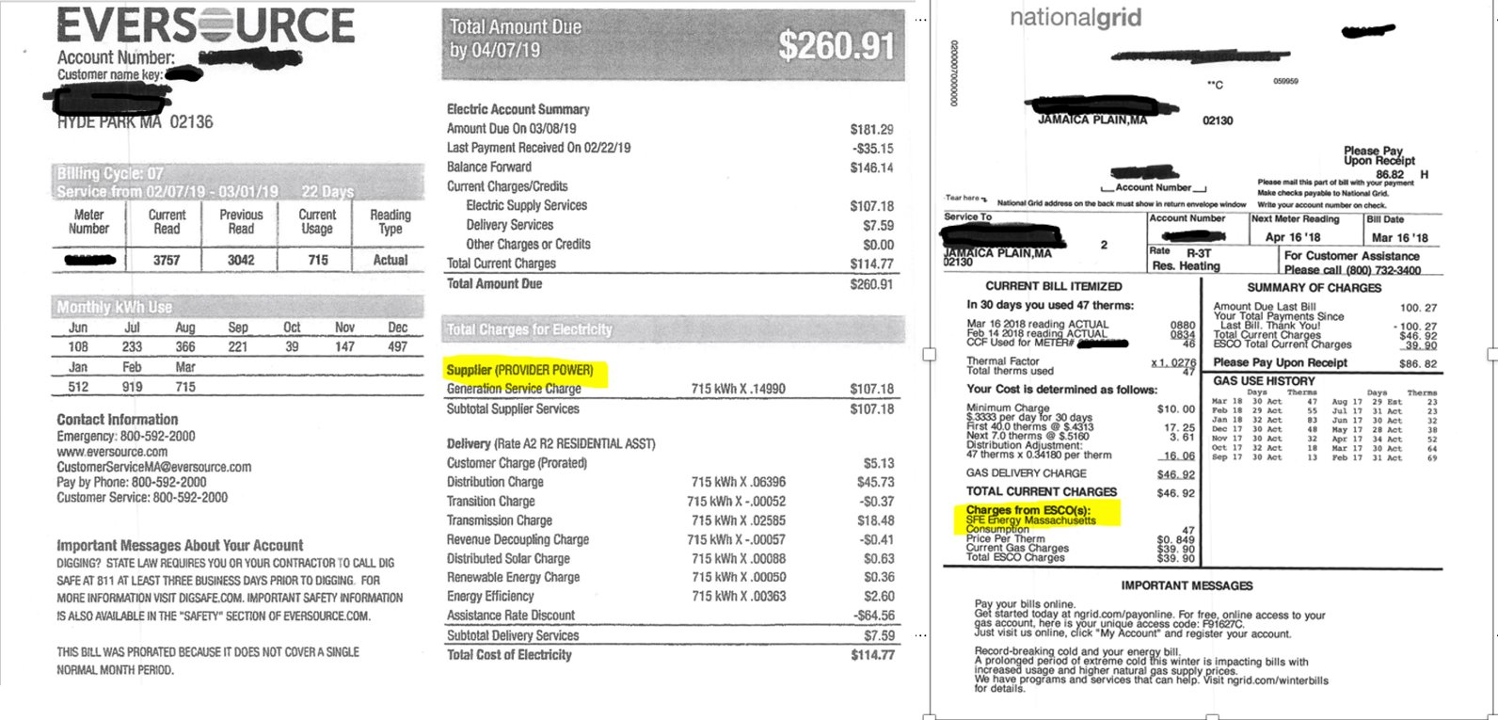
Look at a bill to figure out if someone has a competitive supplier

Slide 40
Predatory energy supply sales
Targeting of vulnerable populations—elders, LEP individuals, low-income communities
Reverse redlining, targeting communities of color
Use of deceptive tactics in door-to-door marketing and telemarketing
  Misrepresentations that marketer is from or associated with the utility
  Misrepresentations that customer will save money
Slamming – Switching costumers without knowledge or consent
Community and Rooftop Solar – legitimate subsidized programs exist, but so do predatory and deceptive sales practices.

Slide 41
Action steps
File complaints with DPU and AGO
Removal from eligible consumer list
Advocate for legislation or regulation to protect consumers
Litigation or arbitration against suppliers
  G.L. c. 93A, Massachusetts UDAP law
  Telephone Consumer Protection Act (TCPA) for telemarketing abuses, 47 U.S.C. § 227
Bankruptcy

Slide 42
Where to file complaints about competitive suppliers:
Department of Public Utilities (DPU) Consumer Division
  (877) 866-5066
  DPUConsumer.Complaints@mass.gov
Attorney General Consumer Complaint Line
  617-727-8400 (M-F, 8am-4pm)
  https://www.mass.gov/how-to/file-a-consumer-complain (for link to complaint form)

Slide 43
Protecting a utility account
Eversource
  To block your account from being switched without authorization, contact Eversource at 866-746-1110 or 800-592-2000
  Register with the Federal Trade Commission's Do Not Call list

Slide 44
Removing yourself from the eligible customer list
National Grid
  To opt out, fill out an on-line form at https://www.nationalgridus.com/MA-Home/Energy-Choice/Opt-Out-of-Supplier-List Or call National Grid Customer Service
  Register with the Federal Trade Commission's Do Not Call list

Slide 45
Other Utility Issues: Water and Telecommunications

Slide 46
Water service for tenants
Tenant only pays water bill if all are met:
  Landlord has installed submeters that measure actual water used in the apartment;
  Landlord has installed low-flow fixtures;
  Tenancy started on or after March 16, 2005
  Previous tenant was not forced out;
  There is a written rental agreement that spells out water bill arrangements; and
  Landlord has filed proper certification.
M.G.L. c. 186, section 22

Slide 47
Lifeline Program
Free or low-cost phone or internet service to low-income households through a monthly service discount of up to $9.25
Eligible households receive one discount for:
  Home or wireless phone service; or
  Home internet or a wireless phone data plan
Eligibility:
  Household income at or below 135% FPL
  Program-based eligibility (MassHealth, SNAP, SSI, Federal Public Housing Assistance, Certain Tribal Assistance Programs, and Veteran's Pension or Survivor's Pension benefit)
  Eligibility up to 200% FPL if survivor of DV or trafficking (Safe Connections Act of 2022, 47 U.S.C.A. § 345)
  More eligibility and application information at https://www.lifelinesupport.org/do-i-qualify/

Slide 48
Regulated land line phone protections
Mass. Department of Telecommunications and Cable administers phone shut off protections
  Applies to regulated land lines only
  Serious illness rules; personal emergency; elder protection rules
  Payment plans available
Rules at DPU docket 18448 (1977)

Slide 49
Questions?

Slide 50

Since 1969, the nonprofit National Consumer Law Center® (NCLC®) has worked for consumer justice and economic security for low-income and other disadvantaged people, including older adults, in the U.S. through its expertise in policy analysis and advocacy, publications, litigation, expert witness services, and training. www.nclc.org

