Slide 1
How to Apply for Public Health Insurance Benefits in Massachusetts
Sonia Amado
Director of Health Access & Wellness Services
Boston Public Health Commission
samado@bphc.org
617-534-2393

Slide 2
Agenda
1. What is the Mayor’s Health Line?
2. Health Coverage Options in Massachusetts
3. How to Apply
How to stay covered

Slide 3
The Mayor’s Health Line
MHL is a program of the Boston Public Health Commission. MHL has been operating for over 35 years as a free, multilingual, confidential, information and referral service line.
We help all residents regardless of immigration status.
Boston’s health & social service referral line
Services are free and confidential
Accept walk-ins, appointments, and phone calls
6 certified Navigators & 3 SHINE Counselors
Multilingual staff:
English, Cape Verdean Creole, Haitian Creole, Portuguese, Spanish
& access to language line with 250+ languages available

Slide 4
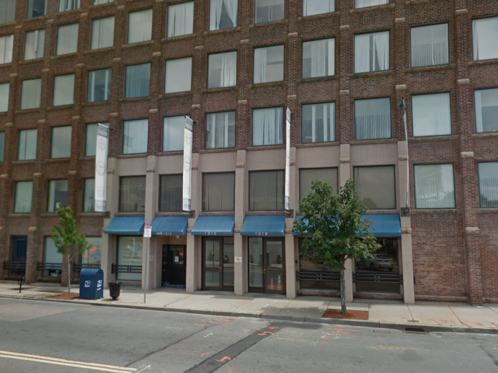
MHL Services
Health Insurance Assistance
MassHealth
Health Connector
Medicare
Dental Coverage Assistance
Help finding a Primary Care Doctor
Health and Social Services
Contact us:
1010 Massachusetts Ave.
2nd Floor
Boston, MA 02118
617-534-5050
MayorsHealthLine@bphc.org
Hours:
Monday - Friday
9am - 5pm
211HELPSteps
https://helpsteps.com/
SNAP application

Slide 5
How to Apply: MA health insurance application process
Massachusetts has one application that residents can complete and submit for health insurance eligibility
There is a separate application process based on age:
under 65
65 and over
Once submitted the individual/family will be screened for their eligibility based on information provided about the household
Members will be able to shop and enroll once they know their eligibility

Slide 6
Public Health Care Coverage Options in Massachusetts
MassHealth
MA Health Connector
Health Safety Net (HSN)
Children’s Medical Security Plan (CMSP)

Slide 7
How to Apply 65 or Over
A person age 65 or over, or households with at least one person age 65 or over (unless caretaker of child under 19), or a person seeking long-term care services must fill out:
Online (PDF version) available in English and Spanish
SACA-2 Paper application (fax or mail)
In-person: with a Navigator or MassHealth Enrollment Centers (MECs)
Over-the-phone: 800-841-2900 (MassHealth Customer Service)
https://www.mass.gov/how-to/apply-for-masshealth-coverage-for-seniors-and-people-of-any-age-who-need-long-term-care-services
Notes:
Valid email needed to submit electronically – The form must be completed in one sitting. It does not save the changes for later.
You are able to make an appointment online with a MassHealth Enrollment Center. They offer phone, video and in-person options. They will ask for member information, including language preferences.

Slide 8
How to Apply Under 65
A person can fill out one application for MassHealth, the Health Connector, HSN and CMSP in one of these ways:
Online: www.MAhealthconnector.org
Over-the-phone: 877-MA-ENROLL (877-623-6765) (Connector) or 800-841-2900 (MassHealth Customer Service)
In-person: with a Navigator, Certified Application Counselor (CAC), MECs
ACA-3 Paper application [NOT RECOMMENDED]
Notes:
The online application is available in English, Spanish, and Portuguese
Paper application is available in those languages + Traditional Chinese and Vietnamese

Slide 9
Application Tips
Apply online, over the phone or in person
Real-time eligibility
Know immediately what proofing documents the state requires
Enroll in a health plan
Navigators and CACs can help – services are FREE, confidential and multi-lingual
1:1 assistance with understanding eligibility and enrollment
Help with accessing services, payment information (if needed) and submitting documents
Staff that are multilingual and speak languages most common in their neighborhoods
Proofing documents
If possible, send proofing documents when you apply (both paper application and online)
Better to upload proofing documents into your portal or FAX the documents.
Save confirmation of submission
Call customer service to check that proofing documents were received
Assisters can also support
Notes:
Here are some helpful tips that would make the applying and enrolling process more seamless.

Slide 10
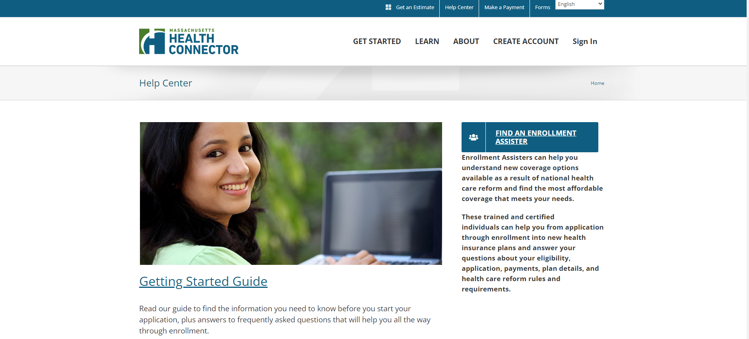
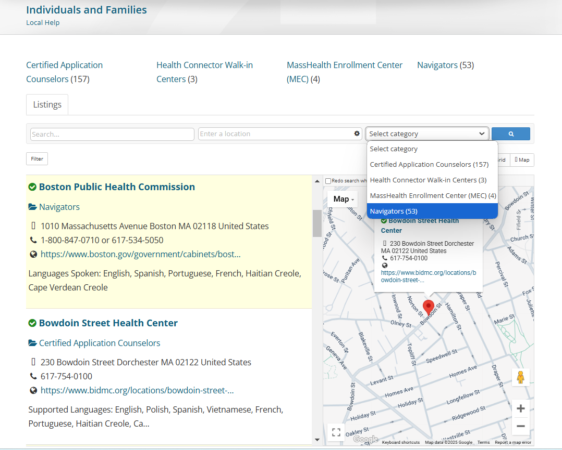
How to Find an Enrollment Assister
www.mahealthconnector.org/help-center

Slide 11
Online Application Process: Creating an online account
Step 1: Go to mahealthconnector.org and click “create account” (select individual & families) and select “apply now”
Step 2: Create MA Login
Step 3: Verify email/phone with activation code and link for MA login to be ready for use
Step 4: Provide HOH profile information
Step 5: Complete identity proofing (IDP)
Step 6: Fill out and submit application
Step 7: Shop for a health plan (if applicable)
Step 8: Enroll in a health plan (if applicable)
Step 9: Pay premium by 23rd of the month (if applicable)
Notes:
Step 2: You will have to provide the member’s complete name, DOB, valid email address, create a username and strong password, and phone number (optional)
There is also a similar verification process for phone numbers provided
Once account is verified you will be able to enter member information and begin

Slide 12
Application Tips and Best Practices

Slide 13
Helpful Information & Documents When Applying for Coverage
Social Security Numbers (SSN) and dates of birth (DOB)
Government issued ID (e.g., state ID, driver’s license, passport)
Immigration documents (e.g., green card, visa, letters verifying pending status, certificate of naturalization)
Income information (e.g., most recent tax form, current pay stubs)
Health insurance information and card(s) (if applicable)

Slide 14
Application Tips & Best Practices: Identity Proofing (IDP)
Step 1
Enter applicant’s name & SSN EXACTLY how it appears on their Social Security card, US Passport or other government issued document.
Step 2
If applicant fails IDP, try another household member(s) who may be able to pass.
Step 3
Assisters can use Health Connector customer service, or the assister line, to resolve IDP issues by providing verification of identity. Members have a different process to verify IDP.
Step 4
Complete the online application once the account is unlocked and applicant’s identity is verified.
Step 5
Submit the verification within 48 hours of calling the assister line. Individuals completing application must submit their verification prior to application being unlocked.
Notes:
Navigators are able to provide the IDP information to the assister line and have the application unlocked to proceed on the same day with the client.
If a member sends the IDP (upload to portal, fax, in-person at a walk-in center, or mail) it can take up to 48 hours for the Health Connector to process the documentation after it is received. Member may log into the application periodically to see if they can continue with their application.

Slide 15
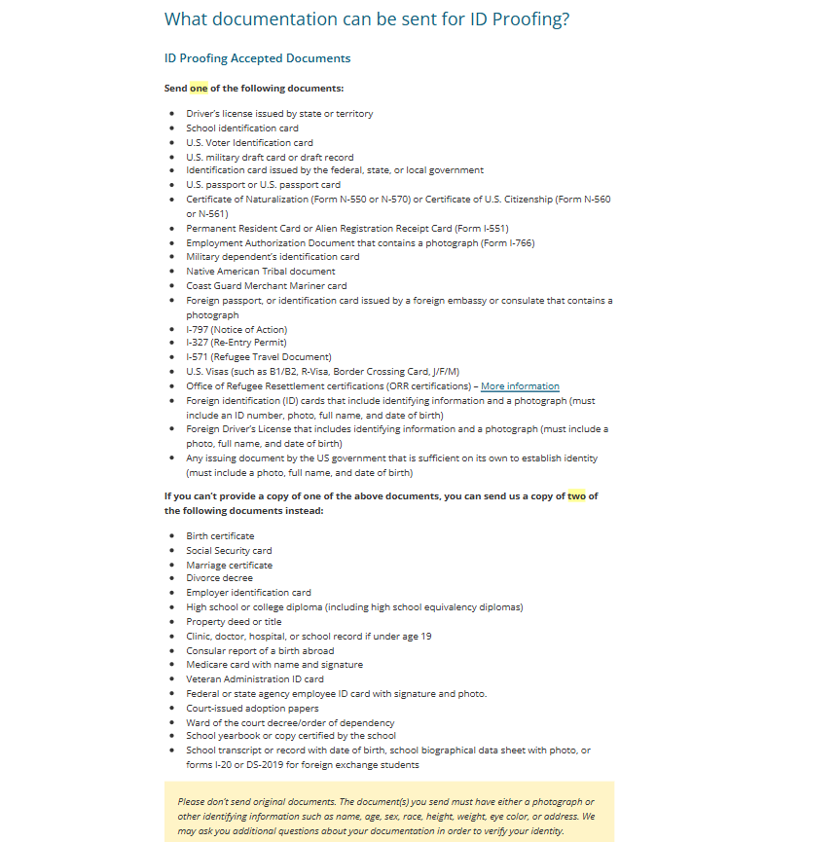
Application Tips & Best Practices: Identity Proofing
WILL THE APPLICANT(S) BE ABLE TO PROVE THEIR IDENTITY IF THEY FAIL IDP?

Slide 16
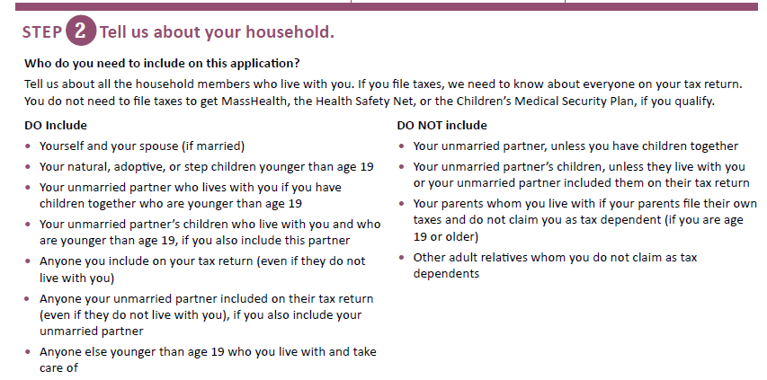
Application Tips & Best Practices: Who to Include ?
Include all household members on the form, even if they already have MassHealth or Health Connector coverage

Slide 17
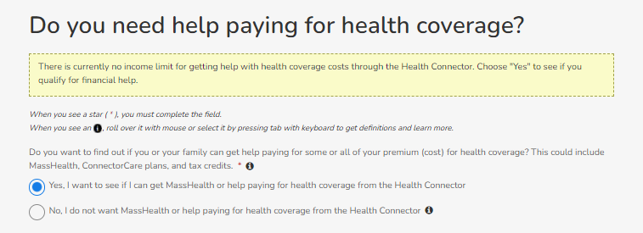
Application Tips & Best Practices
Members must mark “yes” if they want to be screened for MassHealth or subsidized Health Connector coverage, or they want to get coverage for the first time outside of Open Enrollment

Slide 18
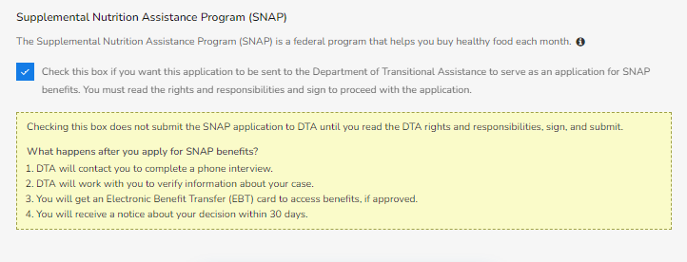
Application Tips & Best Practices
If members want to get screened for SNAP benefits, they must check off the box for screening through Department of Transition Assistance.
Notes:
DTA will receive the information on their end and contact the member for next steps

Slide 19
Application Best Practices: Homeless
If applicable, make sure to check off “No home address” to signify that a member(s) is homeless:
This will prevent the case from being closed for not receiving mail and give additional flexibility for applicable members.
There must be a mailing address on the application
Notes:
Home address is not required on the application for unhoused individuals. However, they do require a mailing address on the application. Often times we provide our address for the member and they will come to the office to pick up the mail. Some clients will provide the shelter’s address as their mailing address. It can also be the address of a loved ones that they trust.

Slide 20
Application Tips & Best Practices: Massachusetts Residency
An applicant must check off the box next to each household member’s name or they will be denied health care coverage in Massachusetts

Slide 21
Application Tips & Best Practices: Massachusetts Residency
Paper Application guidance
An applicant and all family members must answer ‘yes’ to question number 16 or they will be denied health care coverage in Massachusetts
Notes:
Within 60 days

Slide 22
How to Prove Massachusetts Residency
Submit a copy of the following documents:
Copy of deed and record of most recent mortgage payment (if mortgage is paid in full, provide a copy of property tax bill from the most recent year)
Copy of lease AND record of most recent rent payment (i.e. copy of check)
Mortgage deed showing primary residence
Nursery school or daycare records (if school is private, additional documentation may be requested)
Current utility bill or work order dated within the past 60 days
Statement from a homeless shelter
School records (if school is private, additional documentation may be requested)
Section 8 agreement
Homeowner’s insurance agreement
Proof of enrollment of custodial dependent in public school
An affidavit supporting residency (does NOT have to be notarized)
https://www.mahealthconnector.org/verification-documents

Slide 23
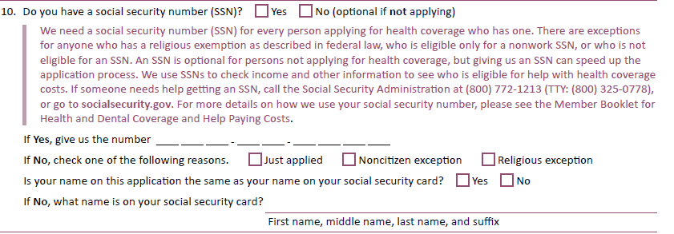
Application Tips & Best Practices: No SSN
If the answer to question 10 is “No”, then you must check one of the boxes underneath the question.
If you do not check one of the boxes, the application is considered “Missing Critical Data” and will not be processed until the member provides an answer to the question
Notes:
Also, please be sure that your name is exactly as it appears on the SS card

Slide 24
Application Best Practices: Disabled
If applicable, make sure to check off “yes” that a member(s) is disabled on question #17:
Member may have to complete a Disability Supplemental form if disability is not automatically verified. MassHealth will send follow-up communication.
Adult Supplement: https://www.mass.gov/doc/masshealth-adult-disability-supplement-0/download
Child Supplement: https://www.mass.gov/doc/masshealth-child-disability-supplement/download

Slide 25
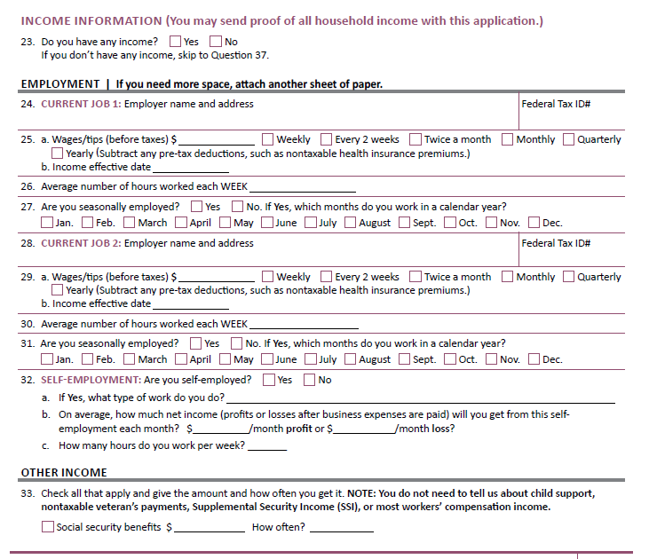
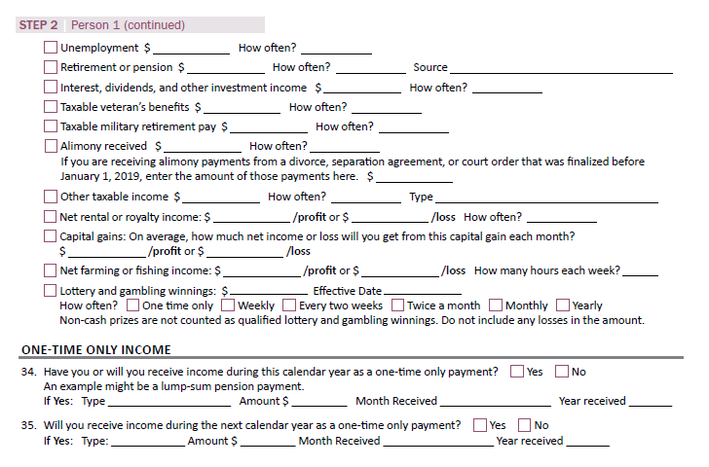
Application Best Practices: Income
Remember: Provide the most updated and accurate income information to receive the correct subsidy and appropriate eligibility

Slide 26
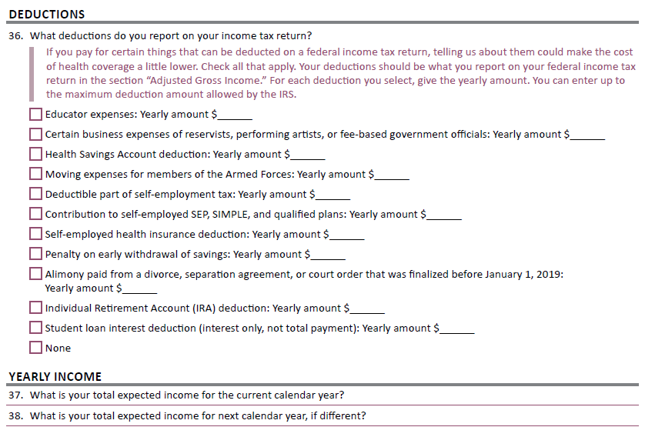
Application Best Practices: Income
Remember: “Your total expected income for the current calendar year” should be after subtracting countable deductions and business expenses. This is prospective, what you anticipate your income will be.

Slide 27
Application Best Practices: Income
Do not list income on the application that is “non-countable” including:
Income to include that is not counted:
SSI (Supplemental Security Income)
Child support
Worker’s compensation
Veteran’s disability payments
Student loans or gift income
SSDI for children that do not have to file a tax return
Income for dependents that do not have to file a tax return
https://www.mahealthconnector.org/how-do-i-answer-questions-about-income

Slide 28
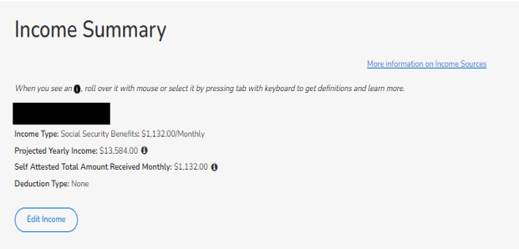
Application Best Practices: Income
When updating a consumer’s income, make sure to adjust the ‘projected yearly income’ accordingly

Slide 29
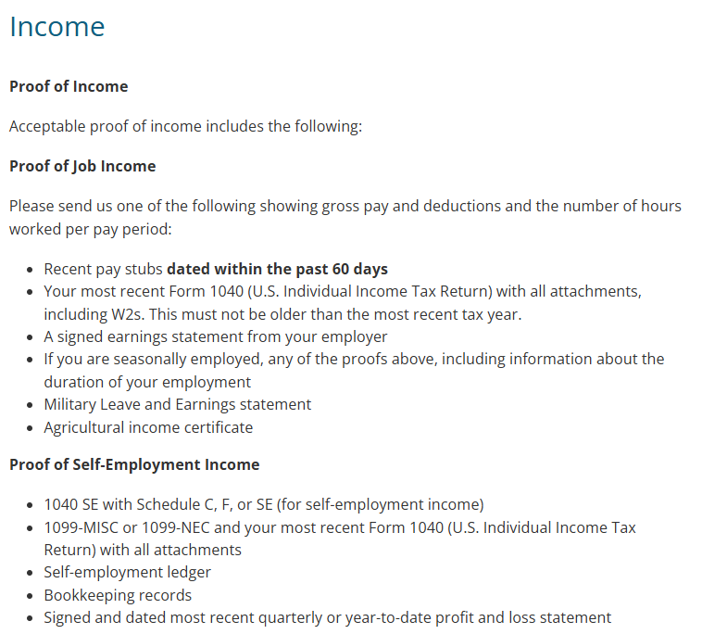
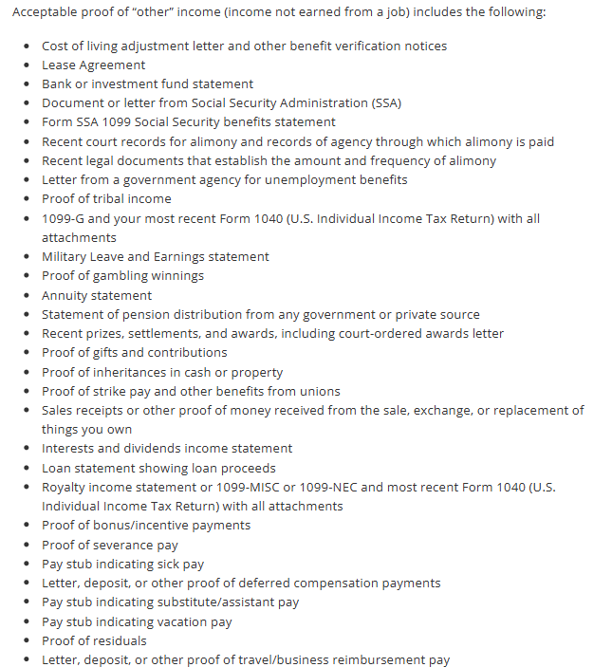
Application Best Practices: Proof of income

Slide 30
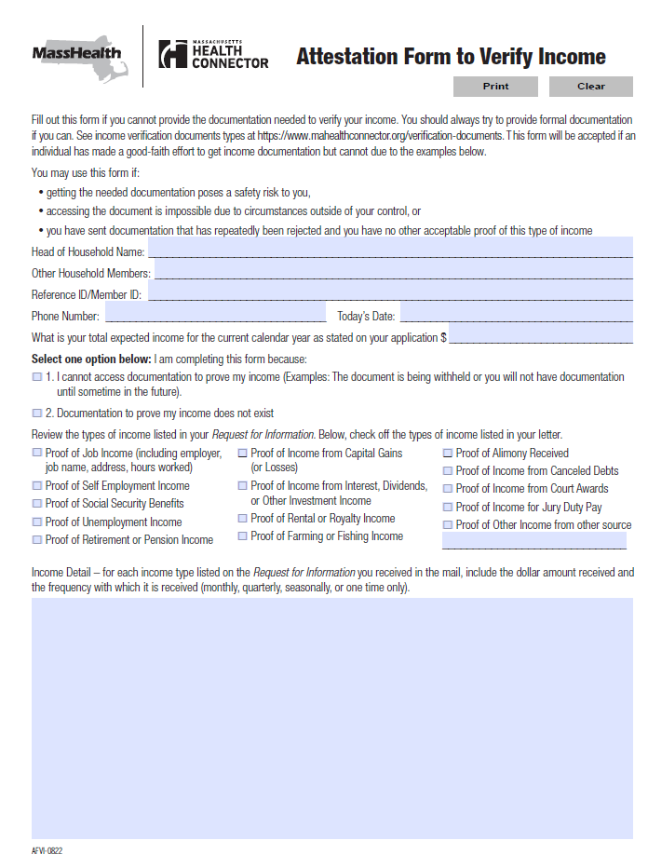
Application Best Practices: Proof of income
https://www.mahealthconnector.org/verification-documents

Slide 31
Application Best Practices: Should I submit a new application?
Do not submit more than one application per household.
A household should only have one account in the online system
If you have a member with duplicate MH IDs, escalate the case via customer service or the assister line
If unsure, call MassHealth/Health Connector to confirm if there is an application on file
They’ll be able to provide the correct REFID for the active application
If a member is looking to apply but found on another application
Call the assister line to have them removed from the other application and create a new application as Head of Household (HOH)

Slide 32
Additional Application and Enrollment Tips
Be sure to answer all questions on the application accurately
Upload information whenever possible, the best next alternative would be to fax and be sure to:
Write applicant’s name, SSN,DOB, and Medicaid ID/ Reference number on all documents
Use MassHealth/Health Connector coversheets
Include the cover page of the notice that was mailed with the request for information
Use the homeless, pregnancy and disability check-off boxes when applicable for accurate eligibility
Fill in preferred language (notices can be sent in their preferred language if available)
Complete authorization forms (PSI, ARD) for members that would like to assign someone to speak on their behalf
Provide pay stubs/income verification that is recent and reflects current income situation
Be sure to include frequency of income (weekly, biweekly, monthly, etc.)
Remind applicants of the need to update the Health Connector or MassHealth with any changes in their household, especially income
Remind households that receive tax credits to file taxes to avoid losing subsidies

Slide 33
Provisional Coverage
90-day “provisional coverage” - applicants can get benefits from the Health Connector and certain member can get MassHealth before additional documentation is submitted and processed
If a new applicant would qualify based on their income for MassHealth or Health Safety Net coverage, but the system is unable to match the income, they will not get a determination until proof of income has been processed
These are the following exceptions:
Applicants who have attested to be HIV positive, pregnant, or have breast or cervical cancer will still get provisional MassHealth
Applicants under the age of 21

Slide 34
Provisional Coverage
If an applicant submits the requested income within the 90-day window their coverage will go back ten days before the application was processed
If income is submitted after the 90-day window the applicant will start coverage back ten days from the date the income (and other verifications) are received
Over 65 – You may have to resubmit your application if request for information (RFI) are not received within the allotted timeframe

Slide 35
What to Expect After Submitting an Application
Online or over-the-phone application:
Applicant(s) receive real-time eligibility determination:
MassHealth eligible (no income request): applicant can use coverage right away. If the member is ACO eligible, they can enroll in a plan or they will be auto-assigned into a plan 14 days after being determined. They will have a 90-day plan selection period.
MassHealth / Health Safety Net (income requested): must submit income to get coverage.
Connector eligible: applicant must select a health plan & pay their premium (if applicable) by the 23rd of the month to have active coverage for the following month.
Paper application/over 65 application:
Applicant(s) receive eligibility decision in the mail within 45 days.
An applicant does not have coverage until an eligibility decision is made. Eligibility will be retroactive for 10 days prior to the date the application was received (under 65) or 1st day of month (65 or over) if proofs were on time. Pregnant people, children and elderly may get retro coverage up to 3 month prior on request.

Slide 36
How to Stay Covered
Follow up with the MassHealth/Health Connector to confirm proofing documents have been processed
Update the application with any changes to your household: new address, birth of a child, new job, lost job, change in income, new phone number, newly eligible for employer sponsored health insurance
Members have to update within 10 days of changes
Read and respond to MassHealth & Health Connector notices
Provisional eligibility only lasts 90 days
If a person does not respond to a notice from the Health Connector or MassHealth, they may lose coverage or not get a determination
Notes:
Notices can be very confusing. Please contact assisters to help you navigate requests.

Slide 37
How to Stay Covered
Renewals/MassHealth Redeterminations
Review application during Health Connector Open Enrollment to ensure you have the correct eligibility for the following year
November 1st – January 23rd (Massachusetts)
MassHealth renewal packets are sent in large blue envelopes to the mailing address MassHealth has on file
Be sure to complete the renewal and submit documents in the allotted timeframe to avoid gaps in coverage
Update application with any new changes that has not been reported for correct eligibility
Be sure to submit all payments on time to avoid gaps/loss of coverage

Slide 38
2025 MassHealth Renewal Changes
Effective January 2025 there have been changes to MassHealth’s member renewal process, the changes for:
MAGI populations (under 65) will begin in January 2025
Non-MAGI (65 or older) will begin March 2025
Annual renewals will be done by individual and not the household level as it has been done in the past
It is important to know that eligibility rules are not changing.
Changes that members will see:
Some members of some family may be auto-renewed, others may get blue envelope
Renewal dates might be different for different household members
Potential changes in circumstance as a result of a one member’s renewal may still affect other household members who were not up for renewal
More members are anticipated to be auto-renewed with renewals on an individual basis
Renewal dates may reset

Slide 39
2025 MassHealth Renewal Changes (cont.)
Members that are not auto-renewed will be sent an individual renewal form to complete
Member should still expect blue envelopes if they are not auto-renewed
All renewal forms will continue to be addressed to the HOH
Notices will provide information for the specific member that needs to take action
MassHealth may combine notices to reduce the number of notices being mailed to members
The notice will provide an updated status for all members in household
Please contact assisters/MassHealth with any questions regarding the update!

Slide 40
Questions

