Slide 1




Introduction to Title VI:
Providing Services to LEP Persons
Tere Ramos
Massachusetts Law reform institute

Slide 2

MassLegalHelp is Available
https://www.youtube.com/watch?v=Te1NLUWNMws

Slide 3
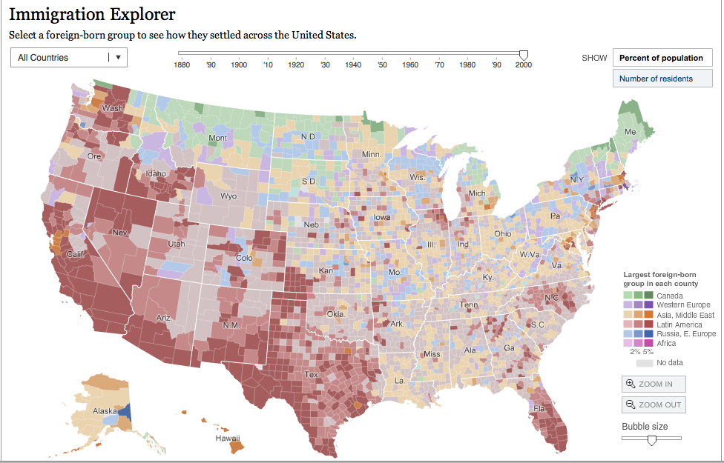
A Country of Immigrants
http://www.nytimes.com/interactive/2009/03/10/us/20090310-immigration-explorer.html?hp

Slide 4
Why Do Language Rights Matter?
U.S. becoming a “majority minority” country.
In MA, 22% of the population speaks a language other than English at home.
Provides access to decision making.
Without them a person may unknowingly waive rights to services.
It is discrimination, same law as if person is not provided services due to color of skin or race.

Slide 5
Who is an LEP person?
“Individual with a limited ability to read, write, speak, and understand English.”
Can be the family member of an English speaker who is involved in the care of that person.
Person “does not have to be limited in all “speaking, reading, writing and comprehending.”
“Flexibility” in addressing needs “should not diminish, and should not be used to minimize the obligation that those needs be addressed.” Must take “reasonable steps” to ensure access.
                Executive Order 13166

Slide 6

The Legal “Argle Bargle”
Title VI of the Civil Rights Act of 1964 prohibits discrimination based on race, color, or national origin in programs or activities that receive federal financial assistance:
  “No person in the United States shall, on the ground of race, color, or national origin be… subjected to discrimination under any program or activity receiving federal financial assistance.” 42 USC § 2000d
Notes:
A "safe harbor" means that if a recipient provides written translations under these circumstances, such action will be considered strong evidence of compliance with the recipient's written-translation obligations.

Slide 7
Language Access Translation
Where a significant number or proportion of the population eligible to be served or likely to be directly affected by a federally assisted program ... needs service or information in a language other than English in order effectively to be informed of or to participate in the program, the recipient shall take reasonable steps, considering the scope of the program and the size and concentration of such population, to provide information in appropriate languages to such persons. This requirement applies with regard to written material of the type which is ordinarily distributed to the public.
28 C.F.R. § 42.405(d)(1)

Slide 8
MA Also Prohibits Discrimination
Chapter 151B prohibits discrimination due to race, color, religious creed, national origin, ancestry or sex.
MA Executive Order 526 prohibits discrimination in all state agencies and programs funded by the state, including language access.
MA Language Access Guidelines (ANF Administrative Bulletin #16) created to:
(a) Improve access for LEP persons;
(b) Reduce disparities and delays, in the provision of state services/programs to LEP persons;
(c) Increase agency effectiveness and public satisfaction.

Slide 9

National Origin
In Lau v. Nichols (1974), the Supreme Court holds that language is a proxy for national origin and that national origin discrimination includes failing to provide LEP individuals “meaningful access” to recipient programs.
Notes:
A "safe harbor" means that if a recipient provides written translations under these circumstances, such action will be considered strong evidence of compliance with the recipient's written-translation obligations.

Slide 10
Alexander v. Sandoval
532 U.S. 275 (2001)
No private right of action to enforce disparate impact regulations under Title VI.
Supreme Court established that private right of actions need to be established by Congress.
Some states have restored this right by passing laws that provide a private right of action for violations of state anti-discrimination laws.
Notes:
DISPARATE IMPACT is when a policy can be considered discriminatory and illegal if it has a disproportionate "adverse impact" on persons in a protected class.

Slide 11
Executive Order 13166
In 2000 Bill Clinton signs Executive Order 13166, providing further guidance on language access in all federally funded programs.
Every federal agency creates their own guidance and plans for providing language access in all of their funded “programs or activities.”
http://www.hhs.gov/civil-rights/for-individuals/special-topics/limited-english-proficiency/guidance-federal-financial-assistance-recipients-title-VI/
Notes:
A "safe harbor" means that if a recipient provides written translations under these circumstances, such action will be considered strong evidence of compliance with the recipient's written-translation obligations.

Slide 12
What is a Recipient?
Entity that receives federal financial assistance and/or operates a program or activity.
Title VI coverage extends to all recipient and sub-recipient operations.
Includes grants, sub-grants, loans, equipment, federal property (whether it is leased or provided), personnel.

Slide 13
What Does This All Mean?
LEP Persons have the same right as anyone else to use public programs in their language.
In all:
schools,
courts,
public housing,
public programs like EI
and Head Start
In most:
hospitals,
doctors’ offices
Staff of public programs must:
  Talk in the person’s language
  Help them as quickly as they can
  Respect the client’s culture
This is a right, not a gift!

Slide 14
What are the Language Rights?
An Individual with a limited ability to read, write, speak, and understand English has the right to:
Use public programs and communicate in the preferred language.
Set a language preference to receive vital written materials.
Right to an interpreter that is free, qualified, trained in subject, impartial, and ensures person understands what everyone says.
Even if the person has some command or knowledge of the language, if they understand their own language better, they can ask for services!

Slide 15


What Are The Program Obligations?
Inform individuals with LEP that language assistance is available at no cost.
Provide language interpreter services that are free and adequate (even if the client speaks some English).
Provide vital documents in the most common languages of LEP clients likely to be served.
Notes:
REMEMBER: speaking English is not a guarantee the person can read English

Slide 16

What are Vital Documents?
Depending on the frequency of the language, important written information that must be translated!
These include:
  Applications to participate
  Complaint and intake forms
  Notices of rights or program administration
  Written notices of rights
  Appeal letters
  Assessments used to determine eligibility or services
  School documents
  Standard forms that are considered “vital” to a program
  Content on website
  It if is a “vital” notice, it usually must be provided in a native language. If the person self-identifies as LEP, offer it!

Slide 17
Language Access Plan
Create a simple language access plan to share with staff and ensure it is implemented.
Include:
      Process to identify LEP individuals who need language services
      How LEP community interacts with Agency
      Process to access interpreters and language assistance services
      Determine which documents to translate and how to find them
      Train staff on policies and procedures
      Create and provide a notice that services are available
      Designate an office or official to monitor and update the plan
4-factor analysis
Number or proportion of LEP persons | Frequency of Contact
Nature and Importance | Resources Available
Notes:
4 factor analysis

Slide 18



Who is an appropriate interpreter?
Appropriate:
Professional
Trained in subject
Qualified
Impartial
NOT Appropriate:
Minor children
Doesn’t know subject or terms
Unqualified to translate
Partial

Slide 19


What an Interpreter Can and Cannot Do
An interpreter should:
An interpreter cannot:
  Treat you with respect
  Make sure they understand what you say
  Make sure you understand what they say
  Interpret everything you say and the program says
  Change your words
  Leave out information
  Talk about you
  Take sides
  Tell you what you should do

Slide 20
In Conclusion
Title VI requires recipients to provide meaningful access to LEP individuals.
Recipients should have written LEP plans, policies, and procedures.
Federal agencies can investigate complaints and enforce Title VI protections.
In MA, person can also make complaint at state level with funding agency or at MCAD.

Slide 21
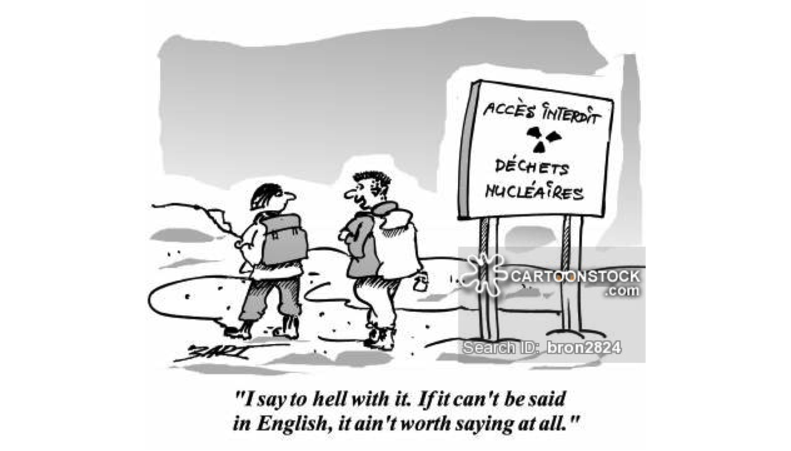
Questions

Slide 22
Resources
Federal Interagency Working Group on Limited English Proficiency: www.lep.gov
Language Access Assessment and Planning Tool http://go.usa.gov/jpJ
U.S. Department of Justice’s Civil Rights Division at www.justice.gov/crt/about/edu/
National Center for Cultural Competence, Working with Linguistically Diverse Populations, http://nccc.georgetown.edu/features/language.html
DOJ Title VI Legal Manual, https://www.justice.gov/crt/department-justice-manuals-concerning-title-vi-civil-rights-act-1964

Slide 23
Resources
Language Assistance Self-Assessment and Planning Tool for Recipients of Federal Financial Assistance, http://www.region4ta.us/documents/PATH_Language_Access_Self_Assessment.pdf
Sample of amazing language access plan, AZ Department of Economic Security, https://des.az.gov/sites/default/files/legacy/dl/DES-1-01-34-Limited-English-Proficiency-for-Client.pdf
Boston Housing Authority Language Access Plan, https://www.bostonhousing.org/BHA/media/Documents/CCECR/BHA-LEP-Policy.pdf

