Slide 1
Limited English Proficient Data with Income and Poverty Overlay Massachusetts

Slide 2
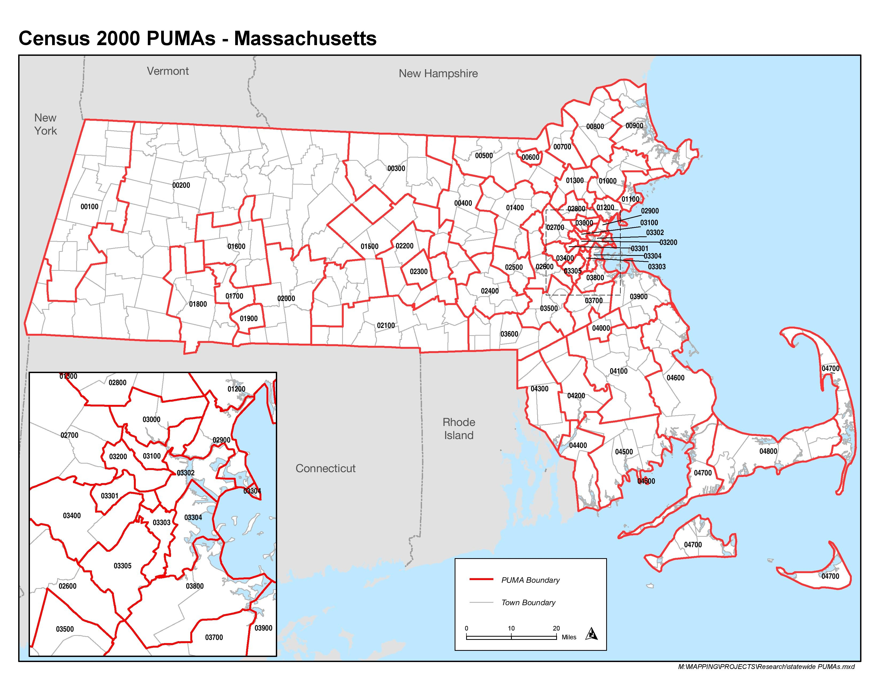

Slide 3
LEP Population in MA

Slide 4
Income in MA
Notes:
% of LEP individuals in the various income brackets
LEP individuals more likely to live in poverty.
10.2% in MA under 100% of poverty.
21.9% of LEP people in MA live under 100% of poverty.
LEP 2x as likely to live in poverty and be eligible for legal aid in MA.

Slide 5
Most Common LEP Languages in MA
Spanish (38.7%)
Portuguese (16%)
Chinese (Cantonese & Mandarin) (8.4%)
French Creole (4.6%)
Vietnamese (4.5%)
Russian (3.3%)
Notes:
Not with poverty overlay

Slide 6
Service Area Examples

Slide 7
MetroWest Legal Services Framingham, MA
Area Served: Acton, Ashland, Bedford, Bellingham, Carlisle, Concord, Dedham, Dover, Foxborough, Framingham, Franklin, Holliston, Hopkinton, Hudson, Lexington, Lincoln, Marlborough, Maynard, Medfield, Medway, Millis, Natick, Needham, Norfolk, Norwood, Plainville, Sharon, Sherborn, South Walpole, Stow, Sudbury, Walpole, Wayland, Wellesley, Weston, Westwood, Wrentham
Elder Only Area Served: Canton, Northborough, Southborough, Westborough

Slide 8
Notes:
The above chart shows number and percentage of LEP individuals in various income brackets based on the federal poverty guidelines. Compared to 5.4% of people in MWLS' service area below the federal poverty line, 15.1% of LEP individuals in MWLS' service area live below the federal poverty line. This shows that LEP individuals are almost 3 times as much as likely to live in poverty and be eligible for legal aid.

Slide 9
Language Spoken of LEP Population – MWLS Area |  |  |  | Language Spoken of LEP Population Under 200% Of Poverty – MWLS Area
Language Spoken | Population | Percent |  | Language Spoken | Population | Percent
Portuguese | 11,710 | 26.1% |  | Portuguese | 5,525 | 29.1%
Spanish | 10,625 | 23.7% |  | Spanish | 4,239 | 22.3%
Chinese* (Cantonese and Mandarin) | 8,949 | 20.0% |  | Chinese* (Cantonese and Mandarin) | 3,030 | 15.9%
Russian | 2,262 | 5.1% |  | Arabic | 842 | 4.4%
Italian | 2,253 | 5.0% |  | Italian | 713 | 3.7%
French Creole | 1,966 | 4.4% |  | Vietnamese | 630 | 3.3%
Arabic | 1,930 | 4.3% |  | Korean | 616 | 3.2%
Vietnamese | 1,645 | 3.7% |  | French Creole | 544 | 2.9%
French | 1,056 | 2.4% |  | Russian | 518 | 2.7%

Slide 10
Greater Boston Legal Services Boston, MA
Area Served: Boston, Braintree, Brookline, Canton, Chelsea, Cohasset, Everett, Hingham, Holbrook, Hull, Malden, Medford, Melrose, Milton, Newton, Norwell, Quincy, Randolph, Revere, Scituate, Stoneham, Wakefield, Waltham, Watertown, Weymouth, Winthrop, Wollaston
Elder Only Area Served: Acton, Arlington, Bedford, Boxborough, Burlington, Cambridge, Carlisle, Concord, Harvard, Lexington, Lincoln, Littleton, Maynard, North Reading, Reading, Somerville, Stow, Wilmington, Winchester, Woburn

Slide 12
Community Legal Aid All Offices (Greenfield, North Adam, Northampton, Pittsfield, Springfield, Worcester)
Areas Served: Worcester, Hampden, Berkshire, Franklin and Hampshire Counties

Slide 14
Language Spoken of LEP Population in all CLA Area
Language Spoken | Population | Percent
Spanish | 56,133 | 52.3%
Portuguese | 6,648 | 6.2%
Vietnamese | 5,808 | 5.4%
Polish | 4,456 | 4.1%
Chinese* (Cantonese and Mandarin) | 3,917 | 3.6%
Russian | 3,788 | 3.5%
French | 3,596 | 3.3%
Kru, Ibo, Yoruba | 1,768 | 1.6%
Albanian | 1,642 | 1.5%
Arabic | 1,297 | 1.2%
Language Spoken of LEP Population in Worcester – PUMA 2300
Language Spoken | Population | Percent
Spanish | 15,730 | 49.3%
Vietnamese | 3,081 | 9.7%
Portuguese | 2,583 | 8.1%
Albanian | 1,642 | 5.1%
Kru, Ibo, Yoruba | 1,480 | 4.6%
Polish | 895 | 2.8%
Chinese | 755 | 2.4%
Russian | 553 | 1.7%
French | 509 | 1.6%
Arabic | 489 | 1.5%
Other | 4,192 | 13.1%
Total | 31,909

Slide 15
For all service area data, visit:
http://www.masslegalservices.org/content/lep-poverty-data-ma
Source: 2007-2011 American Community Survey, Public Use Microdata Sample (PUMS), BRA Research Division Analysis

