Slide 1
Executive Office of Elder Affairs
RESPECT INDEPENDENCE INCLUSION
The EOEA Home Care Program
MCLE Training
April 30, 2024

Slide 2
Executive Office of Elder Affairs Mission
Mission
The Executive Office of Elder Affairs promotes the independence, empowerment, and well-being of older adults, individuals with disabilities, and their caregivers.
Vision
Older adults and individuals with disabilities will have access to the resources they need to live well and thrive in every community in the Commonwealth.
Values
We value growing older
We value choice, including the choice to live in the community
We value the contributions that older adults and individuals with disabilities make to society
We value a person-centered approach that promotes dignity and takes into account cultural identities
We value collaboration with our partners, advocates, and other stakeholders
*For presentation only. Not for distribution.

Slide 3
Agenda
What is an Aging Services Access Point (ASAP)?
Home Care Eligibility & Services
The Role of the ASAP RN
Frail Elder Waiver (FEW) Overview
Self-Directed Service Delivery and Additional Program Options
How Do I Make a Referral to an ASAP for services?
Questions
*For presentation only. Not for distribution.

Slide 4
What is an Aging Services Access Point (ASAP)?
*For presentation only. Not for distribution.

Slide 5
ASAP Functions
An ASAP is a regional agency that contracts with the Executive Office of Elder Affairs (EOEA) and provides programs and services to older adults and individuals with disabilities
There are 24 ASAPs in Massachusetts that are designated by EOEA ensuring coverage across the commonwealth. ASAPs are defined in Massachusetts Law M.G.L. 19A
Provides assistance regardless of income or eligibility
Provide resource/community service information at no cost.
Provides programs & services to older adults and individuals with disabilities
*For presentation only. Not for distribution.

Slide 6
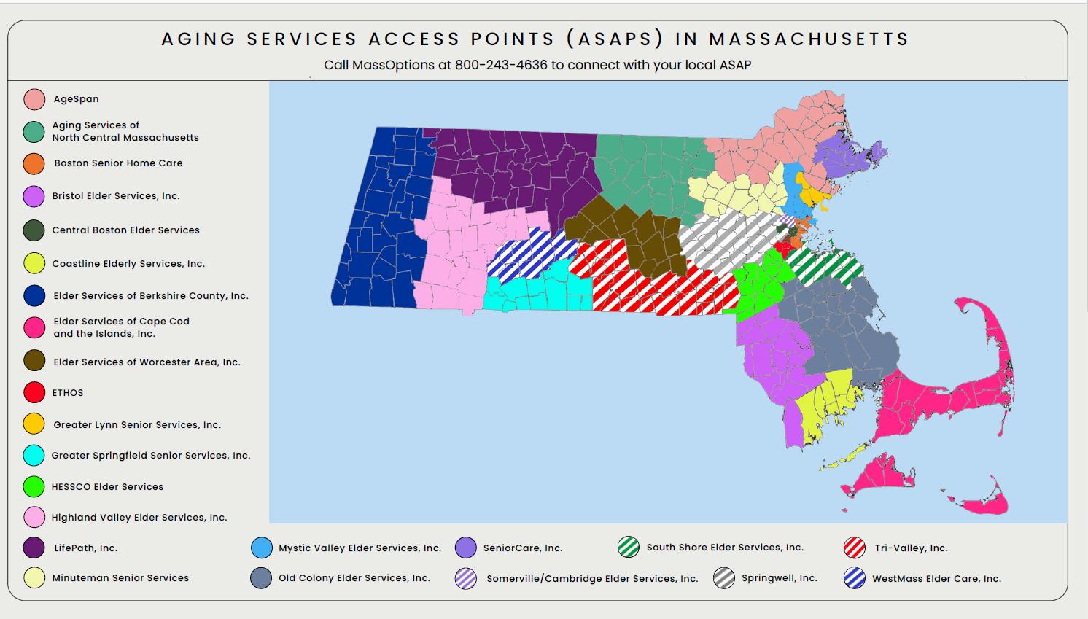
ASAP Map
https://www.mass.gov/location-details/aging-services-access-points-asaps-in-massachusetts
*For presentation only. Not for distribution.

Slide 7
Aging Services Access Points (ASAPs)
Home Care Program Functions
Care Management
Eligibility & Assessment
Enrollment
Advocacy & Education
Care & Support Coordination
Authorization & purchase of Home Care services
Coordination of comprehensive community care
Management of procured provider network
Provider vetting and monitoring
Negotiation of rates and services
Other ASAP Functions
Clinical Assessment & Eligibility for Medicaid-funded institutional & community-based care
Nutrition (home-delivered meals)
Information & Referral
Community Transitions Liaison Program (CTLP)
Options Counseling
Adult Protective Services (APS) Family Caregiver Support Program (FCSP)
*For presentation only. Not for distribution.

Slide 8
Home Care Eligibility & Services
*For presentation only. Not for distribution.

Slide 9
EOEA Home Care Program
The Home Care Program provides care management and in-home support services to help older adults, people with disabilities, and people with Alzheimer’s Disease or related dementia successfully age in place within Massachusetts. Services are available based on assessed needs.
*For presentation only. Not for distribution.

Slide 10
Age & Residence Eligibility
Age
60 years of age and above
Under age 60 with a diagnosis of Alzheimer’s or related Dementia disorder
Residence
Resident of Massachusetts
Not living in an institutional setting or Assisted Living Residence
*A referral can be made, and an intake can be conducted for the Home Care Program for applicants transitioning to the community prior to leaving a facility
*For presentation only. Not for distribution.

Slide 11
Function & Need Eligibility
Functional Impairment Level (FIL):
Require assistance with at least One Activity of Daily Living (ADL)
OR
6 or more Instrumental Activity of Daily Living (IADL) impairments
AND
Intervention that Home Care will provide to meet this need at the time of enrollment - a critical unmet need (any ADL, meal preparation, food shopping, home health services, medication management, Respite, transportation for medical treatments)*
Exceptions to the Home Care Eligibility (only need 4 IADLs):
At Risk: | Older Adults who are at risk due to a variety of factors, including, but not limited to substance abuse, mental health problems or cultural and linguistic barriers.
Protective Services: | Older Adults who are receiving or are eligible to receive Protective Services.
Congregate Housing: | Older Adults residing in a Congregate Housing Facility.
Waiver Consumers: | Older Adults who are eligible for the Home and Community Based Waiver Program.
*This is for initial eligibility only
*For presentation only. Not for distribution.

Slide 12
Cost Share
Any Income
A co-pay can only be assessed after a financial assessment has been completed
Cost share contribution based on Income & MassHealth:
Annually adjusted based on cost of living adjustment (COLA)
Exceptions to income: some VA benefits, pooled trust, etc.
2024 Cost Share Schedule
Voluntary Donation | Fixed Monthly Max Copay (ranges from $10-$199, not to exceed actual cost of qualifying services) | % Based Monthly Copay (based on qualifying services received)
Individuals whose annual income is below $15,460 | Based on a sliding scale, Individuals whose annual income is $15,461 - $34,733 | Based on a sliding scale, Individuals whose annual income is $34,734 and above
A couple whose annual income is below $20,820 | Based on sliding scale, A couple whose annual income is $20,821 - $49,145 | Based on a sliding scale, A couple whose annual income is $49,146.00 and above
MassHealth members whose income is at or below 300% SSI FBR ($2,829/month in 2024) will not have a copayment for Home Care Services, including Medicare Savings Plan
*For presentation only. Not for distribution.

Slide 13
The Home Care Program
Home Care Basic/Non-Waiver
Home Care Basic/Waiver*
Home Care / Percent Based
Enhanced Community Options
Community Choices*
* Frail Elder Waiver Program, MassHealth Standard (Expanded Income Eligibility – 300% SSI FBR)
*For presentation only. Not for distribution.

Slide 14
Home Care Services
In-Home Services
Homemaking
Personal Care
Community Based Services
Delivery of pre-packaged medication
Home Modifications
Chore
Home Health Services
Home Health Aide
Companion
Home Safety/Independence Evaluation (Occupational Therapy)
Supportive Home Care Aide
Home Health Aide
Electronic Supports
Behavioral Health Services
Peer Support
Electronic Comfort Pets (non-waiver)
Virtual Communication and Monitoring
Homebased Wandering Response Systems
Assistive Technology Device
Adult Day Health
Supportive Day Program
Respite Care
Home Delivered Meals
Nutrition Assessment and Counseling
Goal Engagement
Environmental Accessibility Adaptations
Alzheimer’s Dementia Coaching
Medication Dispensing Machines
Laundry
PERS/Enhanced PERS
Transportation
Complex Care Training and Oversight (Skilled RN)
Home Safety and Independence Evaluation (Occupational Therapy)
Grocery Shopping
Vision Rehabilitation
Orientation and Mobility
Physical Therapy
Speech Therapy
Home Care Services | Mass.gov
*For presentation only. Not for distribution.

Slide 15
Home Care Programs
Individual Care Plans are developed and implemented based on a consumer’s unique and specific needs
Home Care Basic-Non-Waiver
&
Home Care / Percent Based
Enhanced Community Options (ECOP)
HCBS Frail Elder Waiver (FEW)
MassHealth Only
Basic level of care needs
Example Care Plan #1:
Home Delivered Meals 5 meals/week
Homemaking/Personal Care 2-3 hours/week
Example Care Plan #2:
Home Delivered Meals 3 meals/week
PERS Monthly
Homemaking 1.5 hours/week
Nursing Facility Level Of Care Needs
Example Care Plan #1:
Home Delivered Meals 5 meals/week
PERS Monthly
Homemaking/Personal Care 2-3 hours/week
Example Care Plan #2:
Adult Day Health 1 day/week
Homemaking 1.5 hours/week
PERS Monthly
Nursing Facility Level Of Care Needs: 2 Types of Programs based on Formal Support Needs
Home Care Basic-Waiver
Example Care Plan:
Home Delivered Meals 5 meals/week
Homemaking/Personal Care 3 hours/week
Informal Supports
Lower Formal Support Need
CHOICES
Informal Support
Higher Formal Support Need
Services to meet needs
Up to 24/7 care
Sample Care Plans Based on Program above
*For presentation only. Not for distribution.

Slide 16
Benefits of Home Care
Care Management
Management of care plan
Provider Network
Meets qualifications set by EOEA
Service Rates
Negotiated based on all ASAP Business
Advocacy
Connection to other community resources/partners
Engagement with provider
ASAP contracted, monitored & audited
Meets programmatic standards
Less expensive than Private Pay
Consumers with a High % Co-Pay
Benefits of HC Enrollment vs. Private Pay
Use ASAP Network of services & providers vs. having to navigate on your own
No minimum service plan required
Centralized care coordination by Care Managers
State set for certain MassHealth services
Benefit of having an advocate to address concerns
*For presentation only. Not for distribution.

Slide 17
Care Planning & Care Management
Initial Assessment
Initial on-site assessment (OSA) to determine consumer eligibility
Functional Needs Assessment and identification of supports in place
Initial Service Plan developed with consumer to address identified unmet needs
Ongoing Assessment
Visit schedule of an OSA at least every six months
Reassessment of Functional Needs
Ongoing review of care plan/service plan and consumer satisfaction
Annual Assessment
Annual re-determination of home care program eligibility
Review of care plan/service plan and consumer satisfaction
Annual re-determination of personal care needs, as well as clinical eligibility for waiver and ECOP by ASAP RN
*For presentation only. Not for distribution.
17

Slide 18
The Role of the ASAP RN

Slide 19
Clinical Assessment & Eligibility (CAE)
MassHealth Screenings:
Adult Day Health
Group Adult Foster Care
Eligibility screens completed by Coastline Elderly Services only
Frail Elder Waiver Clinical Eligibility
Nursing Facility Clinical Eligibility
Pre-Admission Screenings
Post-Admission Screenings
State Home Care Screenings:
ECOP Clinical Eligibility
Personal Care Determinations (PC, SHCA, HHA)
*For presentation only. Not for distribution.

Slide 20
Frail Elder Waiver (FEW)
*For presentation only. Not for distribution.

Slide 21
HCBS/Frail Elder Waiver Eligibility
Participants must be financially eligible for MassHealth
Financial Eligibility for HCBS Waivers based on Federal Regulations
Applicants Income (Spouse’s Income not Reviewed)
Below 300% SSI Federal Benefit Rate
2024 300% SSI FBR is $2,829
Assets 2024
Requirement for applicant is $2,000
Countable limit on applicant’s spouse is $154,140
Requires nursing facility level of care (LOC)
Clinical Eligibility Criteria based on Federal Requirements
MassHealth is the only entity that can determine financial eligibility
*For presentation only. Not for distribution.

Slide 22
FEW Options
Higher income threshold for MassHealth eligibility allowing consumers who need a nursing facility level to care to access MassHealth
Access to MassHealth State Plan Benefits
Option to enroll in a Senior Care Options (SCO) Plan
Applicant's single/individual income and assets is reviewed for eligibility
Spouse's assets are considered
Home Care Basic-Waiver
For older adults with involved supports (Informal & Formal)
Receiving some formal supports through home care
Consumer accessing state plan services (such as ADH, PCA)
Support through Home Care may be supplementing state plan services
Choices
Minimum care plan cost 1.75x Basic POS Rate
For older adults needing significant formal supports through home care
Up to 24/7 Care
Informal supports
Consumer accessing state plan services (such as ADH, PCA)
*For presentation only. Not for distribution.

Slide 23
Application Process: Financial Eligibility
MassHealth is the only entity that can determine Financial Eligibility
Financial Eligibility for waiver includes an asset test
Consumers under age 65 with MH Standard will need SACA
Consumers under age 65 must be formally disabled
Consumers over age 65 must complete SACA
*For presentation only. Not for distribution.
23

Slide 24
Application Process: Clinical Eligibility
ASAPs conduct all Initial FEW Clinical Screenings and any annual redeterminations for ASAP Home Care enrolled consumers
Individuals who are eligible for FEW and enroll in a Senior Care Options (SCO) Plan
SCO RNs will complete the annual redetermination for SCO enrolled FEW members
ASAPs have a process for review of clinical denials of FEW clinical eligibility
Recommend internal Nursing Quality Review for all Denials
Denials are appealable
Must be linked to MassHealth NF regulations 130 CMR 456.409
*For presentation only. Not for distribution.
24

Slide 25
Maintaining Waiver Eligibility
Consumers are visited & assessed a minimum of 2x/year for an in-home assessment
Consumers must have one waiver service scheduled monthly in order to maintain waiver status
Waiver clinical eligibility is re-determined every year to ensure consumer remains Nursing Facility eligible
MassHealth will collect updated income & asset information annually
*For presentation only. Not for distribution.

Slide 26
Self-Directed Service Delivery Options
*For presentation only. Not for distribution.

Slide 27
Self-Directed Service Delivery Options
Consumer Directed Care (CDC)
A self-directed service delivery option for non-waiver enrolled consumers in accordance with EOEA PI-18-02
Consumer can choose to recruit, train and hire their own worker for personal assistance services
ASAP assesses need & authorizes an average number of hours per week, is responsible for the overall management of program service costs within the limits for HCB-NW and ECOP program
Services Offered
Homemaking
Personal Care
Home Health Aide
Transportation
Chore
Companion
*For presentation only. Not for distribution.

Slide 28
Self-Directed Service Delivery Options
Veteran’s Independence Plus Program (VIP)
VIP Program serves
Veterans of any age
at risk of nursing home admission
Supports family Caregivers
VIP Program qualifications
Receive primary care at VAMC (Veteran’s Administration Medical Center)
Have a VA primary care team
Meet the eligibility criteria for home and community-based services as determined by VA
Receive a referral to VIP Program from the VAMC
ASAP case manage VIP enrollees (Care Advisor)
*For presentation only. Not for distribution.

Slide 29
Additional Program Options
*For presentation only. Not for distribution.

Slide 30
Community Transition Liaison Program (CTLP)
Program Description:
The Community Transition Liaison Program (CTLP) supports nursing facility residents in transitioning to the community. CTLP supports any resident (age 22+) of a nursing facility (regardless of insurance) who is interested in receiving support & assistance to transition to the community.
The CTLP Team Weekly:
Engages with residents who are in the nursing facility to understand if they are interested in returning to the community
Provides informed choice on community transition options
Provides assistance & coordination with discharge planning
Connects residents to state programs & local community supports
Assists the resident in mitigating issues that may impact their ability to successfully transfer to the community
*For presentation only. Not for distribution.

Slide 31
Hospital to Home Program
Program Description:
The focus of the Hospital to Home Partnership Program (HHPP) grant is to build partnerships between Acute Care Hospitals (Hospitals) and ASAPs and to strengthen communication and coordination with community providers to promote skilled nursing facility diversions, and to improve hospital discharge rates from Hospitals directly to home and community-based settings.
Grant included funding for HCBS Hospital Liaison and/or Innovation programs
The embedding of ASAP staff within the hospital to serve as HCBS Hospital Liaisons to help connect individuals ready for discharge to HCBS alternatives
Innovations to help individuals transition from a hospital to their home, which may include improvements (including technology) to share information more effectively or mitigate discharge barriers
All current HHPPs are HCBS Hospital Liaison programs
ASAP staff have hospital privileges
*For presentation only. Not for distribution.

Slide 32
Title III Meals
The Senior Nutrition Program provides nutritious meals to older adults who are unable to leave their homes due to illness, disability or frailty through the Home Delivered Meals Program.
Supper & weekend meals are also available in some areas
Nutrition assessments & nutrition counseling provided to older adults at nutritional risk
Who Qualifies?
People aged 60 or older if they:
No income eligibility review required
Have physical, emotional, or cognitive impairments, or have inadequate kitchen facilities, resulting in an inability to prepare nutritionally adequate meals
Are unable to attend congregate meal sites
Have no one to help with meal preparation
Meet home delivered meals intake criteria
Act as a caregiver to an immediate family member, and the family member is disabled
*For presentation only. Not for distribution.

Slide 33
Family Caregiver Support Program (FCGS)
Family Caregiver Support Program
National Program implemented by Elder Affairs through ASAPs
Funded primarily with Federal Title III-E funds; with limited state and local agency funds
Program with a multi-faceted approach that supports the Caregiver
*For presentation only. Not for distribution.

Slide 34
Caregiver Specialist
Caregiver Specialist focuses on supporting the Caregiver
Conducts caregiver assessments
Develops a caregiver action plan
Provides personal assistance in connecting caregivers with resources and services which may include:
Respite care options
Supplemental Services
One-on-one counseling & coaching
Identified training in group settings or for individuals
Facilitates family meetings
*For presentation only. Not for distribution.

Slide 35
Who is a Caregiver in the FCGS Program?
A family or informal caregiver who is:
caring for an individual aged 60 or older, or someone with Alzheimer’s
a grandparent aged 55 or older caring for a child age 18 or younger
over the age of 55 caring for a disabled individual between the ages of 18-59; can be the parent
Contact the Massachusetts Family Caregiver Support Program: Local ASAP 1-800-243-4636 or www.mass.gov/caregiver

Slide 36
Other EOEA Programs
Assisted Living Operations – Certification & Ombudsman
Aging & Disability Resource Consortia
Home Care Programs
Nutrition Title III Programs
Protective Services
Family Caregiver Support Program
Information & Referral
Community Care Ombudsman
Long Term Care Ombudsman
Council on Aging
Prescription Advantage
Senior Employment
SHINE
*For presentation only. Not for distribution.

Slide 37
How Do I Make a Referral to an ASAP for services?
*For presentation only. Not for distribution.

Slide 38
How Can Information and Referral Help?
Resources
Entities that could meet needs or desires (hairdressers, podiatrists, meal delivery services)
Referrals
Senior Living Advisors
Housing
Weatherization Assistance
Public Benefits (SNAP, Health Insurance, Fuel Assistance)
Internal (Home Care, Nutrition, Family Caregiver Support, etc.)
External (Personal Care Attendant, Adult Family Care, Senior Care Options, Program for All Inclusive Care for the Elderly, Group Adult Foster Care, etc.)
Legal
Transportation
Senior Centers/Councils on Aging
Veteran’s Benefits
All information and consultations provided by Information and Referral staff are FREE!
*For presentation only. Not for distribution.

Slide 39
Helpful Information to Have When Referring to Home Care
Consumer
Demographics
Medical Conditions
Caregiver Needs
Any information you think would be helpful!
Formal/Informal Supports
In-Home Care Needs
*For presentation only. Not for distribution.
39

Slide 40
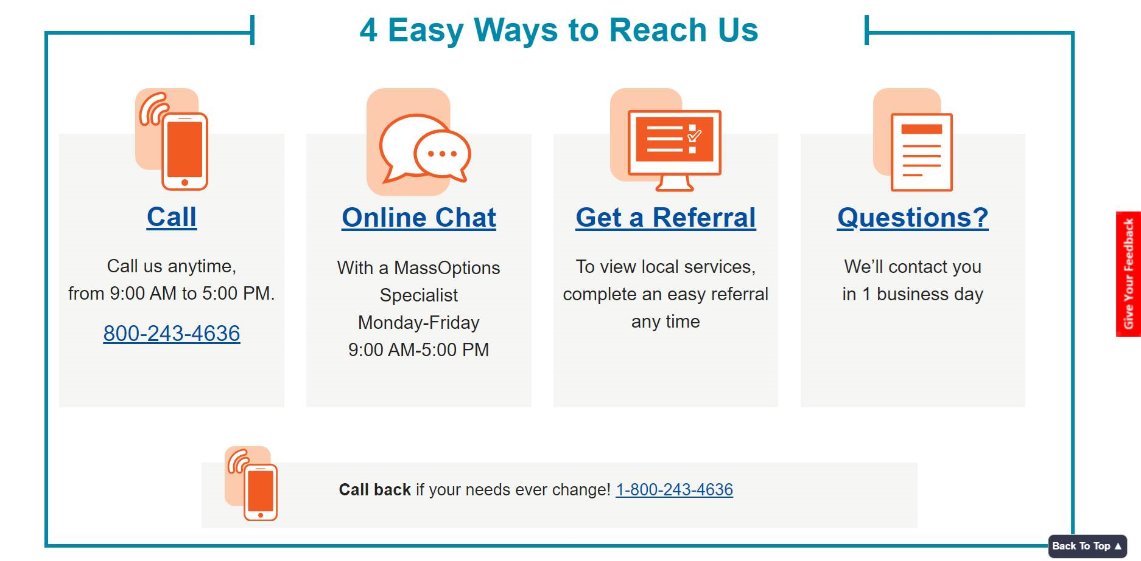
MassOptions (800) 243-4636
www.MassOptions.org
*For presentation only. Not for distribution.

Slide 41
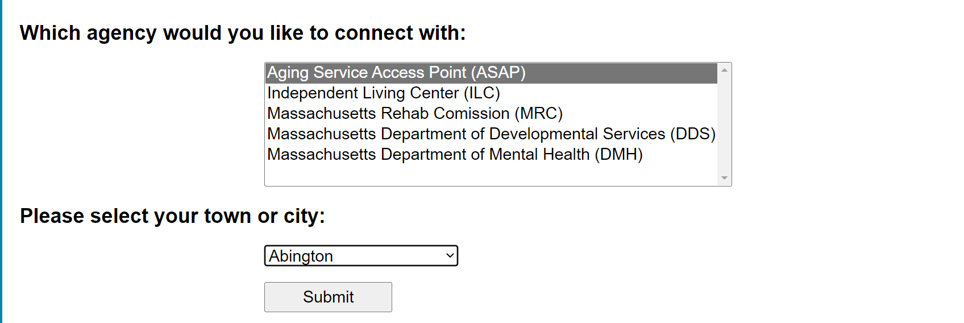
Find the Aging Services Access Point (ASAP) covering your area
Click on “Get a Referral”
Choose “Aging Service Access Point (ASAP)”
Choose your town or city from the drop-down list.
www.MassOptions.org
*For presentation only. Not for distribution.

Slide 42
Questions
*For presentation only. Not for distribution.

