Slide 1
MassHealth Updates: Continuous Eligibility
Isabel Wanner, iwanner@mlri.org
Massachusetts Law Reform Institute

Slide 2
MassHealth 1115 Demonstration Waiver
December 22, 2021: MA EOHHS announced its submission of a Request to Extend the MassHealth Section 1115 Demonstration to CMS
September 28, 2022: CMS approved Massachusetts’ request to extend the MassHealth Section 1115 Demonstration
October 1, 2022 - December 31, 2027: The $67 billion waiver is in effect
Notes:
Executive Office of Health and Human Services (EOHHS)
Centers for Medicare and Medicaid Services (CMS)
https://www.mass.gov/service-details/1115-masshealth-demonstration-waiver
Medicaid 1115 Demonstration Waivers allow states to “waive” certain provisions of the Medicaid law and receive additional flexibility to design and improve their programs. Waivers may provide federal authority for states to expand eligibility to individuals who are not otherwise eligible for Medicaid or CHIP, offer services that are not typically covered by Medicaid, and use innovative service delivery systems that improve care, increase efficiency, and reduce costs. The Commonwealth of Massachusetts’ current 1115 Demonstration (Project Number II-W-00030/I) Extension was approved on September 28, 2022, effective October 1, 2022 through December 31, 2027.

Slide 3
What is Continuous Eligibility?
Continuous Eligibility: Once someone is found eligible for MassHealth, they will remain enrolled in MassHealth for the duration of the continuous coverage period regardless of changes in circumstances
Circumstances that typically lead to loss of coverage (increases in income, missing paperwork/deadlines, etc.)
MassHealth population & income fluctuations
The demonstration approves continuous eligibility for two groups:
12-months continuous eligibility for people re-entering the community from incarceration
24-months continuous eligibility for people who have been confirmed as homeless for 6+ months
They will receive the benefits of the Medicaid eligibility group according to their most recent eligibility determination
Notes:
Coverage churn is common in the MassHealth program. In 2017, 34% of those terminating their Health Connector coverage were individuals transitioning to MassHealth, and 31% of new Health Connector enrollees were transitioning from MassHealth. Churn also creates greater administrative burden, as MassHealth must disenroll and re-enroll members as their income fluctuates from month to month.
“As Medicaid advocates, we have worked with many clients with fluctuating incomes who experience gaps in coverage due to difficulty understanding and keeping track of their fluctuating insurance eligibility, leading to medical debt and poor health outcomes. Not only are these care outcomes bad for individual patients, but preventable medical problems also increase costs across the MassHealth system while making it harder to ensure plan accountability for patients cycling in-and-out of coverage.”

Slide 4
Continuous Eligibility Exceptions
An individual will not be eligible for continuous coverage if:
They are no longer a Massachusetts resident
They request termination of eligibility
They are deceased
The agency determines that eligibility was erroneously granted at the most recent determination, redetermination, or renewal of eligibility because of agency error or fraud, abuse, or perjury attributed to the individual

Slide 5
Continuous Eligibility for Justice-Involved Individuals
Eligible Populations: MassHealth eligible individuals under age 65 released from a correctional institution
Including County Correctional Facilities (CCFs), State Department of Corrections (DOC) Facilities, and Department of Youth Services (DYS) juvenile justice facilities
Duration of Continuous Eligibility: 12 months following release date
Eligibility period begins at the date of release and will extend through the end of the 12th month following release.
If eligibility determination is made after release date (but within 12 months of release), the individual will be eligible for continuous eligibility through the end of the 12th month following release.
This may result in continuous eligibility periods of less than 12 months for some individuals.
How are eligible members identified?
Existing procedures notify MassHealth when a member is in custody or is being released
Information provided on an application
MassHealth system will flag their record to receive continuous eligibility
Implementation Date: April 1, 2023
Notes:
Duration: “For individuals who are released from a correctional institution, each individual’s 12-month continuous eligibility period shall begin at the date of their release and will extend through the end of the 12th month following release. Eligible individuals for whom an eligibility determination is made after their release date but before 12 months after their release date shall be eligible for continuous eligibility through the end of the 12th month following release. This may result in continuous eligibility periods of less than 12 months for some individuals.”
MassHealth will continue to has existing procedures and direct communication with correctional facilities who notify MassHealth when a member is in custody, or a member or new applicant is being released. While MassHealth also utilizes electronic data matching to identify this population, these established relationships allow for more timely notification. Once a member or applicant has been identified as justice-involved, either through communication with correctional partners or by information provided on an application, the system will place a flag on their record ensuring their identification as a recipient of 12 months of continuous eligibility.

Slide 6
Continuous Eligibility for Individuals Experiencing Homelessness
Eligible Population: MassHealth eligible individuals under age 65 with a confirmed status of homelessness for at least 6 months
“Confirmed status of homelessness” is verified through Statewide Homeless Management Information System and/or from the Department of Housing and Community Development, Emergency Assistance shelter system for families
Duration of Continuous Eligibility: 24 months
“24-month continuous eligibility period for individuals experiencing homelessness will begin no later than the third month before the month of application or on the effective date of the most recent renewal of eligibility”
Implementation Date: December 1, 2023
.
Notes:
3 months retroactive coverage - “third month before the month of application”

Slide 7
Continuous Eligibility for Individuals Experiencing Homelessness (Cont.)
12 Month Verification: 12 months into the 24-month continuous eligibility period, MassHealth will make a reasonable effort to confirm that the individual still meets the continuous eligibility criteria before resuming the remainder of the 24-month eligibility period
MassHealth will utilize available data sources and standard member outreach procedures in an attempt to verify information. The termination of continuous eligibility would only result in the event of a response affirming out of state residency, death or voluntary withdrawal.
This is a federal requirement (42 CFR 435 952(d) and 42 CFR 457.380)
NOTE: Mail being returned or undelivered will not result in a termination of benefits or an interruption in the continuous eligibility period unless there is sufficient evidence indicating reason for termination
Notes:
For individuals who qualify for a continuous eligibility period that exceeds 12 months, the state must continue to attempt to verify residency at least once every 12 months. Additionally, the state must attempt to confirm the individual is not deceased at least once every 12 months, consistent with the data sources outlined in the state’s verification plan(s) and/or confirmed by the household per 42 CFR 435.952(d) and 42 CFR 457.380. The state must continue to redetermine eligibility if the state receives information that indicates a change in state residency or that the individual is deceased, verifying the change consistent with 42 CFR 435.916(d) and in accordance with 42 CFR 435.940 through 435.960 and the state’s verification plan developed under 42 CFR 435.945(j) or 42 CFR 457.380
. For all continuous eligibility periods longer than 12 months, the Commonwealth will be required to attempt to update MassHealth Medicaid and CHIP Section 1115 Demonstration Page 15 Approval Period: October 1, 2022 through December 31, 2027 beneficiary information on an annual basis. The Commonwealth must have procedures and processes in place to accept and update beneficiary contact information and attempt to update beneficiary contact information on an annual basis, which could include annually checking data sources and partnering with managed care organizations (MCOs), Behavioral Health Prepaid Inpatient Health Plan (BH PIHP), Primary Care ACOs (PCACOs), and Accountable Care Partnership Plans (ACPPs) to encourage beneficiaries to update their contact information. This must include procedures to annually check data sources and to partner with MCO, BH PIHP, PCACOs, and ACPPs to encourage beneficiaries to update their contact information. The Commonwealth is reminded that updated contact information from third-party sources with an in-state address is not an indication of a change affecting eligibility. Contact information with an out-of-state or no forwarding address indicates a potential change in circumstance with respect to State residency, but without additional follow up by the Commonwealth per 42 CFR 435.952(d), the receipt of this third-party data is not sufficient to make a definitive determination as to whether beneficiaries no longer meet State residency requirements.
The implementation of continuous eligibility will not replace or interfere with standard operational procedures related to the maintenance of member records. The customary process to perform verifications on beneficiary residency will continue to allow reported changes from a third party, a member self-attestation, or related record updates to be applied without interfering with benefit continuity. Changes to a member’s record, including contact information, can be made at any time throughout the continuous eligibility period and are required annually at the time of eligibility renewal. The operating system will attempt to confirm if the reported changes can be verified via available data sources and will generate noticing to the member if manual verification is required. Notices of renewal, requests for verifications, or any other correspondence requiring member action will be sent to the member in advance of any upcoming program determinations. Member materials inform beneficiaries that changes in circumstance require timely reporting and further explain necessary member duties and responsibilities, specified timeframes for submission, and modes by which the member may respond to satisfy requests. In the case where members are homeless or considered otherwise transient, mail may be returned undeliverable indicating the most recent and updated information may no longer be valid; such an event will not result in a termination of benefits or an interruption in the continuous eligibility period unless there is sufficient evidence indicating this is a result of the previously mentioned termination exception. Staff are instructed to process all received changes in accordance with the current operational procedures which will preserve case accuracy, member communication and operational reliability but will not downgrade member benefits.

Slide 8
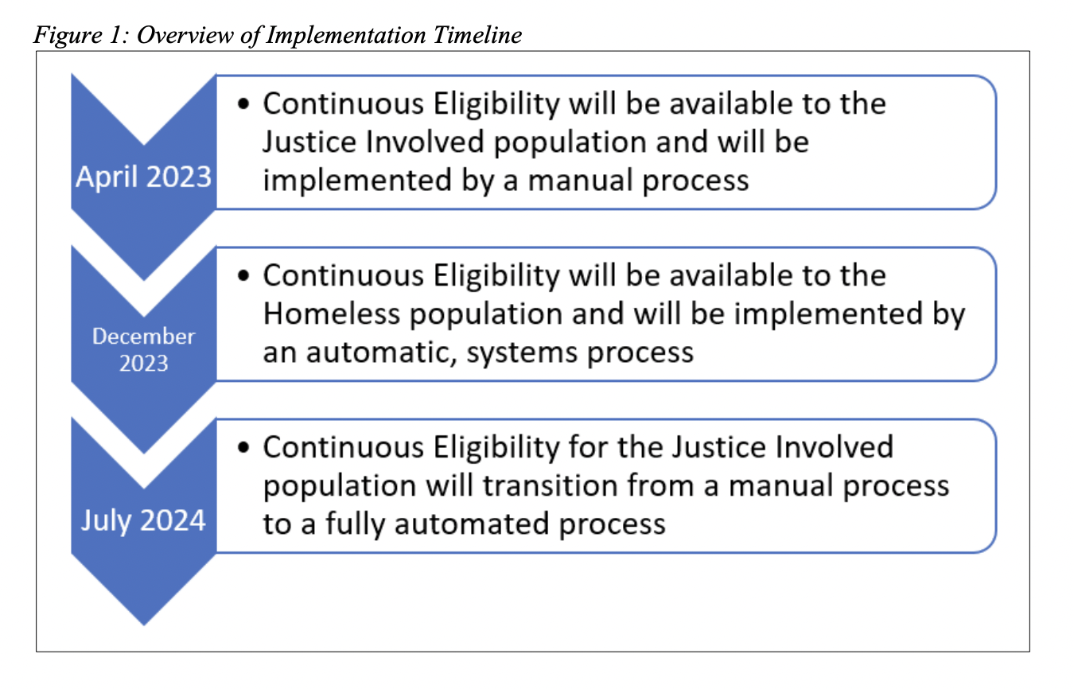
Continuous Eligibility Implementation
Notes:
Operational Implementation: Existing operational processes around MassHealth enrollment of individuals released from correctional facilities requires manual processing by a designated team of MassHealth staff that is initiated by direct communication from correctional facilities. MassHealth expects to finish automating systematic enrollment processing of justice-involved individuals by July 2024. Ahead of this scheduled system update, MassHealth will implement a manual process for the justice-involved population so that continuous eligibility can take effect as of April 2023.
Continuous eligibility for members experiencing homelessness will take effect for individuals as of December 2023. In order to fulfill the requirements of the STCs for continuous eligibility, verification of homelessness through the Statewide Homeless Management Information System is required. In order to automate the existing process as well as the communication between MassHealth systems and the statewide system, comprehensive system upgrades and testing of systems will be required. These processes to systematically apply continuous eligibility will be completed by December 2023. Ahead of this scheduled system update, the federal public health emergency Maintenance of Effort requirement will continue coverage until a renewal is completed during unwind.
Basically between now and Dec 2023 they are setting up the infrastructure for data verification between MassHealth and SHMIS

Slide 9
Ending the Continuous Eligibility Period
At the end of the continuous eligibility period, MassHealth will attempt to automatically renew coverage
If they are unable to autorenew, a request for renewal will be sent to the member
If a member does not submit a completed eligibility renewal following the end of the continuous eligibility period, benefits will be determined based on available data sources during a “systematic program determination”
Notes:
Make clear that this applies to both programs
Autorenewal = ex parte, just say autorenew
Masshealth with autorenew
If unable, theyll send request to member
Beneficiaries are required to complete an eligibility renewal in its entirety and submit it timely to ensure continuity of benefits that will be determined based on established regulatory eligibility criteria.
If Masshealth , theyll check available sources

Slide 10
Sources & Additional Information
CMS, MassHealth Demonstration 1115 Waiver Approval Letter (September 28, 2022): https://www.medicaid.gov/medicaid/section-1115-demonstrations/downloads/ma-masshealth-ca1.pdf.
CMS, Continuous Eligibility Implementation Plan (May 19, 2023): https://www.medicaid.gov/medicaid/section-1115-demonstrations/downloads/ma-masshealth-ca-demstrtn-aprvl-05192023.pdf.
If you have any questions about continuous eligibility or are interested in more information on MassHealth for justice-involved individuals, you can email me (Isabel Wanner) at iwanner@mlri.org.

