Slide 1
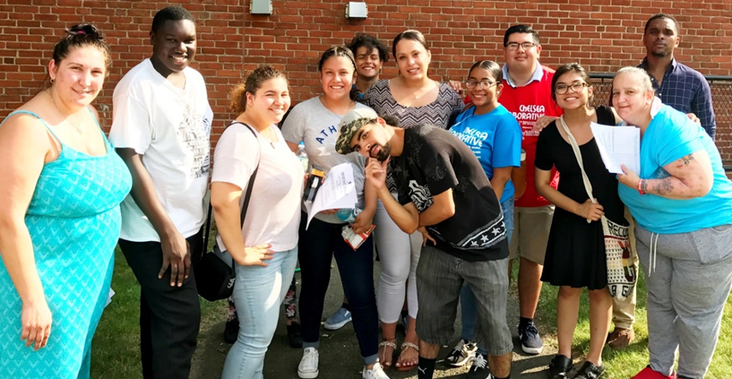
BUILDING TENANT GROUPS
By-LAWS &

Slide 2
WHAT WE ARE GOING TO COVER
Why by-laws are important
Where do you start
What new state regulations say
How to use by-laws to help your group operate

Slide 3
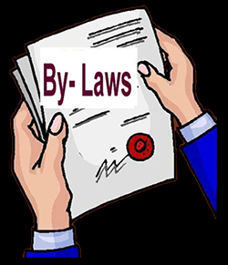
WHY BY-LAWS ARE IMPORTANT

Slide 4
Why By-laws are important
“You can’t run an organization unless you have something to run it with and that would be your by-laws. And you won’t get recognized by housing authority unless you have by-laws.” Bill King President of the Massachusetts Union of Public Housing Tenants

Slide 5
Getting Recognized
Why By-laws are important
Regulations require that to become a recognized Local Tenant Organization, the LTO must adopt and comply with written rules or by-laws

Slide 6
What are by-laws
Why By-laws are important
By-laws spell out the procedures and rules by which your LTO and your LTO Board will operate

Slide 7
By-LAws MUST SPELL OUT
What new regulations say
LTO residents represented
LTO notices to residents about LTO activities
Quorum is needed to pass or change by-laws
LTO Meetings
LTO Budgets
Notes:
.

Slide 8
By-LAws MUST SPELL OUT
What new regulations say
LTO Boards of Directors Responsibilities
LTO Board Elections
LTO Recall Elections
LTO Board Vacancies

Slide 9
New Sample state by-laws
Why By-laws are important
NEW sample by-laws for state public housing tenants available and are up-to-date with the new regulations.
Sample include endnotes with citations to the state regulations.

Slide 10
WHERE DO YOU START?

Slide 11
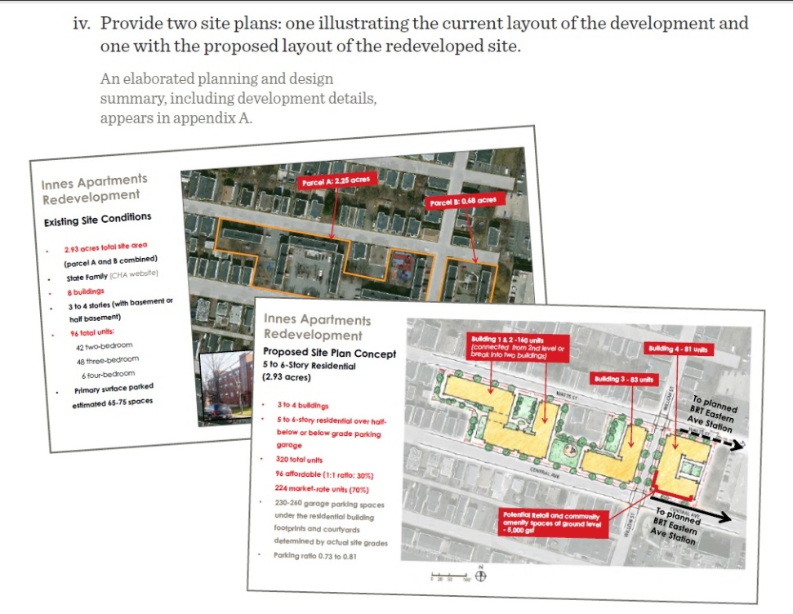
INNES TENANTS in Chelsea
Where do YOU Start?
November 2016 - Chelsea Housing Authority Request for Proposal (RFP) for redevelopment of the Innes apartments
96 units of state public housing
Corcoran was selected as developer
Demolition of existing buildings
Replacement with 320 new units
96 public housing units and 224 market rate units
Relocation and right to return – affect on families

Slide 12
INNES TENANTS in Chelsea
Where do YOU Start?
Chelsea Collaborative
Social service non-profit whose mission is community empowerment of Chelsea residents
Community meetings hosted by CHA and Corcoran
Connecting with active residents present at the meetings
Youth Organizers – Youth Riot Squad
Door knocking and flyering
Help on election day
Bridging gap with parents

Slide 13
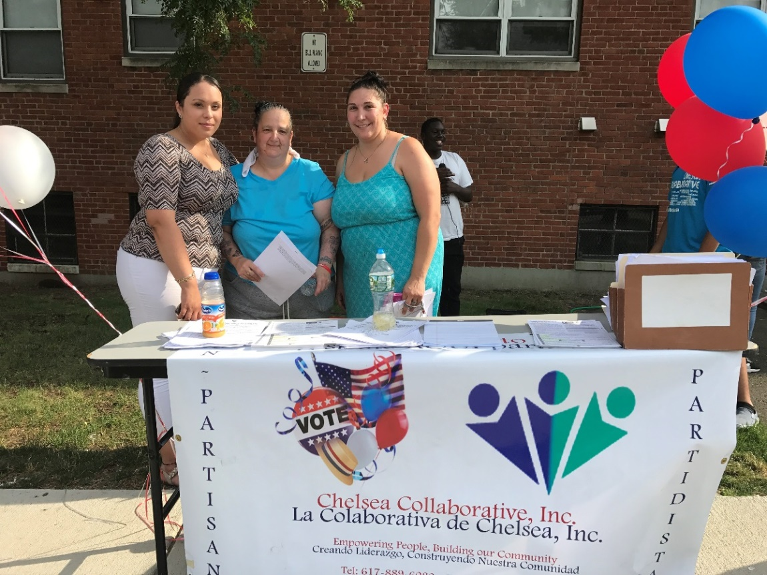
INNES TENANTS in chelsea
Where do YOU Start?
Steering Committee
Meeting space
Notice of meetings
Bi-weekly meetings – timing, agenda
ESL and translation
Role of a LTO in redevelopment at Innes
Representative of the community
Seat at the table – negotiations
Partnerships – CHA, Corcoran, Chelsea Collaborative, GBLS

Slide 14
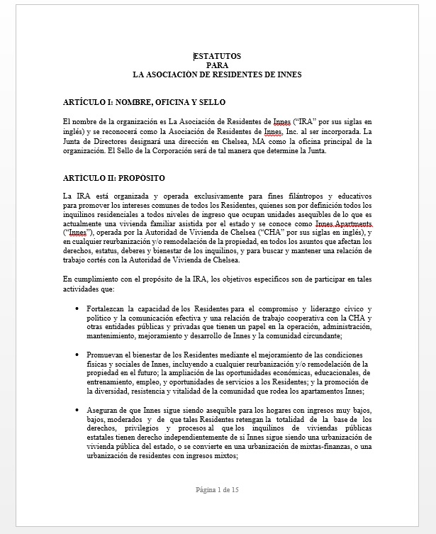
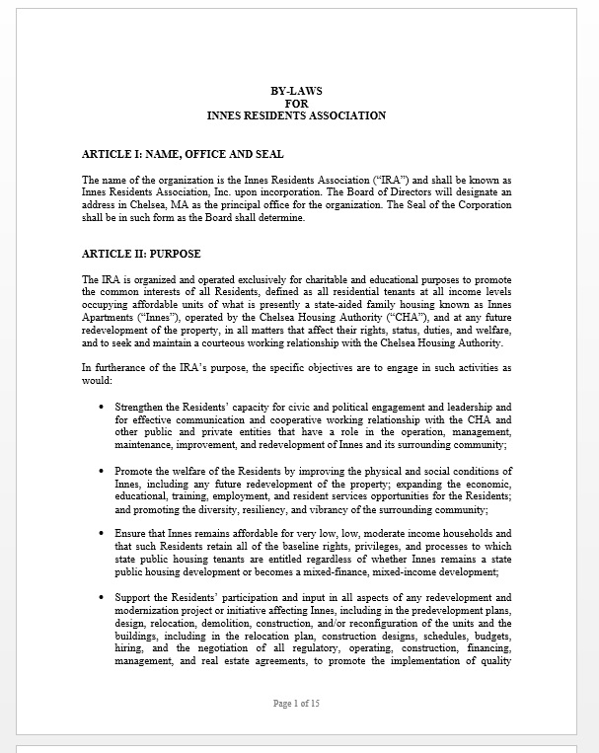
INNES Steering Committee & Greater Boston Legal Services
Where do YOU Start?
Work with other redevelopments
BHA Mixed Finance Meetings
Drafting By-laws
Holding Elections

Slide 15
INNES Resident Association & Greater Boston Legal Services
Where do YOU Start?
Bi-weekly meetings
Guidance on issues in redevelopment
Assistance in negotiations
Trainings and best practices
Drafting relocation agreements, Memorandum of Understanding, budgets, non-profit status

Slide 16
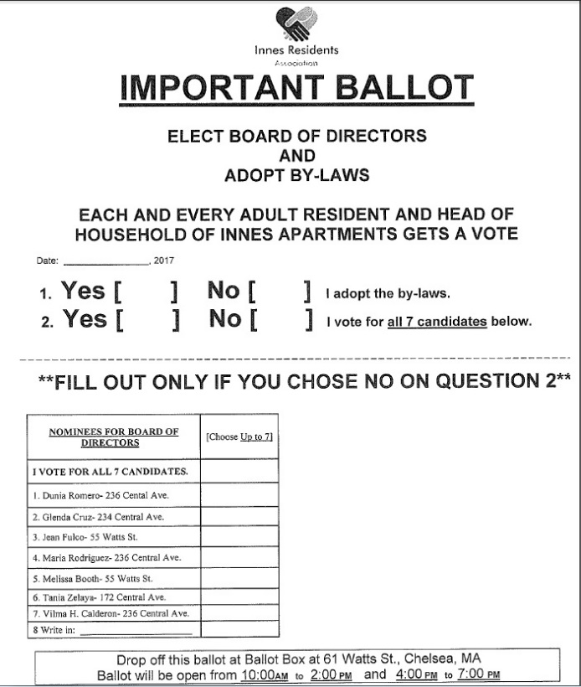
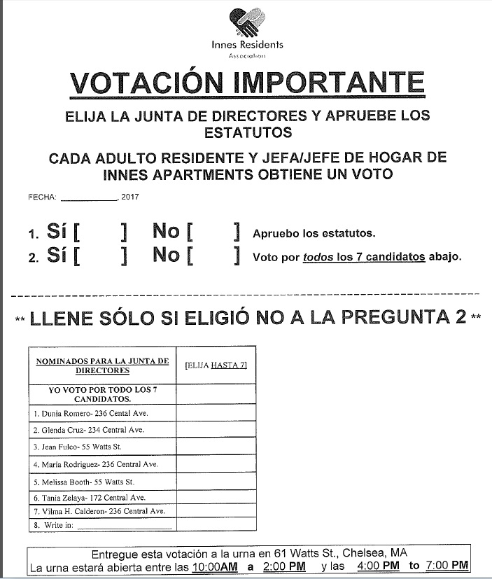
Elections - INNES TENANTS in Chelsea
Where do YOU Start?
Notices and information – multilingual community
At least one election every 3 years
Candidates
each term can last maximum 3 years, what about re-election?
What is a manageable number of Board members?
Only one representative from a family?
Previous removal ineligible to run again?
Employed by housing authority or developer must resign?
By-laws adoption

Slide 17
INNES TENANTS & Day of Elections
Where do YOU Start?
Every represented adult resident able to vote
Checking in voters – no duplicates
Absentee ballots
Third-party monitor
Certificate of elections

Slide 18
What new regulations say

Slide 19
LTO membership
What new regulations say
LTO can represent: “all residents in a particular state-aided development or in public housing operated on behalf of an LHA which is not owned or managed by the LHA

Slide 20
Quorum to pass by-laws
What new regulations say
By-laws or written rules must spell out what a quorum of residents is for purposes of adopting or changing by-laws or written rules.

Slide 21
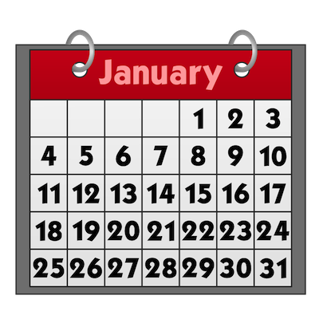
Sufficient Notice of LTO activities
What new regulations say
LTO Board must provide the membership with at least 7 days calendar notice before an LTO event - unless LHA Board has emergency meeting, then 48 hours notice is ok.
LTO must post notices in prominent locations in lobbies or communities room and in the LHA's Offices
Regulations encourage more notice, including flyers, mail or email.

Slide 22
LTO Officers
What new regulations say
By-laws must establish a procedure to elect officers.
A procedure may be that the General Membership chooses the officers.
Or a procedure can be that the Elected Board chooses the officers

Slide 23
LTO Budgets
What new regulations say
LTO must have a meeting with LTO Membership to discuss and adopt the LTOs proposed yearly budget
At that meeting the LTO must provide the LTO Members present with a yearly statement of the previous year’s income and expenditures from all funding sources
LTO must submit a financial statement for all income and expenses from state tenant participation funds (not for funds raised from private or other sources)

Slide 24
LTO Board Vacancies
What new regulations say
LTO by-laws must establish a process for filling vacancies on LTO Board that can happen between regular elections
Process can be a special election or other fair procedure.
For example, by-laws can say that vacant will be filled by the person who received the next highest votes in the previous election.

Slide 25
LTO Recall elections
What new regulations say
Regulations state that a recall election may be held to unseat and replace a LTO Board Member at any time.
There must be a written request from the LTO General Membership that states the reason for the recall election.
Request must be signed by one or more residents in at least 2 households or 10% of the households, which ever is greater.
Recall elections must be fair.

Slide 26
How to use by-laws to Help your group operate

Slide 27
Meetings
How to use by-laws to help your group operate
Regularly schedule meetings
Community organizers – distribution of information via notices or door knocking
Flyers or Newsletters
Social Media – facebook, website
Phone calls, emails, text messages
Social events

Slide 28
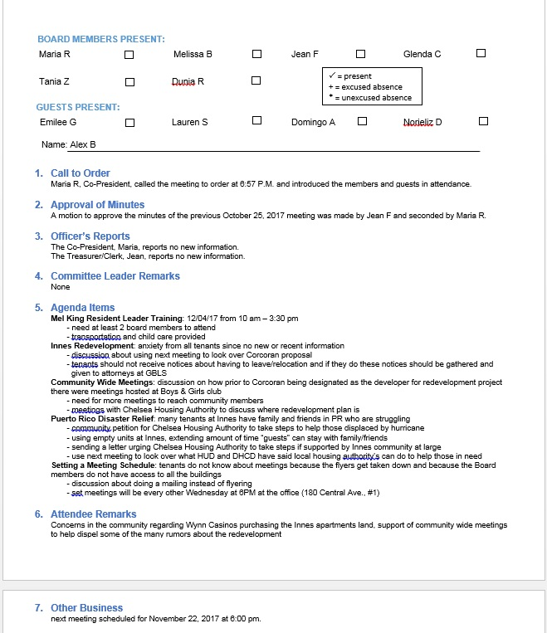
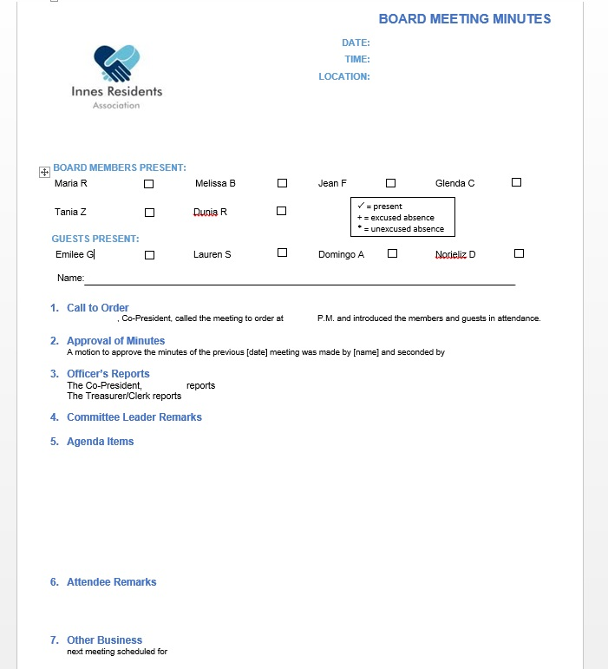
CONDUCTING MEETINGS
How to use by-laws to help your group operate
Secretary/Clerk – taking minutes
Template of minutes
Binder for all minutes
Available to public if requested

Slide 29
CONDUCTING MEETINGS
How to use by-laws to help your group operate
Makeup of a Meeting
Call to order
Approving minutes
Officer’s reports
Agenda items
Public/attendee comments
Adjournment
Executive Sessions

Slide 30
Board Meetings
How to use by-laws to help your group operate
Regularly scheduled
Pursuant to written bylaws
Things to consider
Correct Board size
Odd numbers for tie-breakers
1 vote each
Excused/unexcused absences from meetings
Resignation
Removal
Vacancies

Slide 31
General Membership Meetings
How to use by-laws to help your group operate
Required by state law to be:
open to all residents
2 per year
reasonably convenient location
provide notice
residents voices heard on matters of common interest
Other options to include in bylaws:
Interpreter services if needed and funding
Alternatives to posting in buildings if demolition/relocation
Announcement at prior meeting
Handicap accessible locations if possible
Inviting management or other guests

Slide 32
Annual Meetings
How to use by-laws to help your group operate
Not required by state law
Options to include in bylaws:
1 per year
President’s annual report
Treasurer’s proposed budget and previous year’s expenditures
Other information relevant to the community at large
Updates on redevelopment and provide information from meetings with developer and housing authority

Slide 33
Roles & responsibilities of Officers
How to use by-laws to help your group operate
President or Co-Presidents
- chair meetings
- sign correspondence
- general supervision
Vice President
- duties of President when absent/unable
- oversee agenda of meetings
Secretary-Clerk
Record and maintain minutes
Notice of meetings
Record attendance
Treasurer
Manage financial affairs
Sign checks
Provide financial reports

Slide 34
Using Committees
How to use by-laws to help your group operate
Board members and general members
Election committee
Redevelopment committee
Outreach committee

Slide 35
LTO Board Needs a Quorum
How to use by-laws to help your group operate
What is a reasonable quorum for purposes of by-laws?
Some establish a quorum of 2/3rd of the Board Members
For general membership – smaller number? Set percentage?
To change bylaws require majority vote of quorum of residents (as defined in bylaws)
State regulations on LTOs state a quorum must be established for purposes of taking a vote/conducting business and not for purpose of holding a meeting
What is a reasonable quorum for board meetings and votes?
Not defined in state regulations
Can be different than general membership quorum
Included in bylaws
Should not be less than 3 so majority vote can occur

Slide 36
Tenant Participation Funds What Can They BE Used for
How to use by-laws to help your group operate
Sample by-laws are very general and say that funds shall only be used for “ordinary and necessary business and authorized activities”
Funds should not be used for social events
No funds for the benefit of private individuals
Appropriate uses of funds
Trainings, meeting costs, office supplies, flyers, expert advisors costs

Slide 37
Tenant Participation Funds What Can They BE Used for
How to use by-laws to help your group operate
LTO funded upon request at $6.00/unit occupied or an annual total of $500, whichever is more
Disbursal from housing authority upon approval of budget
LTO must submit accounting for all expenditures at end of the year

Slide 38
Sample state public Housing by-Laws available online
www.masslegalservices.org/content/public-housing-tenant-bylaws

Slide 39
Questions
?

