Slide 1

Presenters:
Cynthia Mark, Asian Outreach Unit, Greater Boston Legal Services
Karen Chen, Chinese Progressive Association
Cheryl Kesher, Empire Justice Center
Martha Maffei, SEPA Mujer
Building Community Collaborations

Slide 2

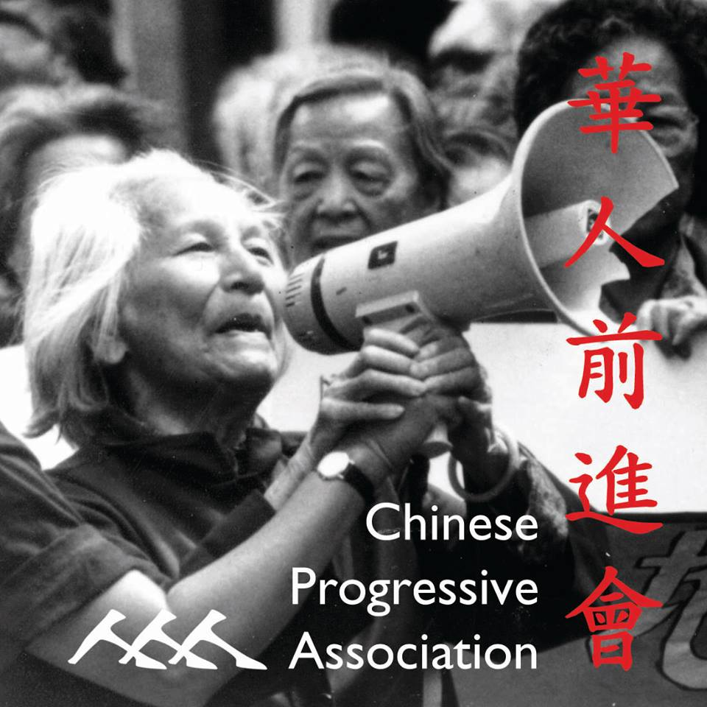

Cynthia Mark
Asian Outreach Unit GBLS
Karen Chen
Chinese Progressive Association

Slide 3

Cheryl Keshner
Empire Justice Center
Martha Maffei
SEPA Mujer

Slide 4
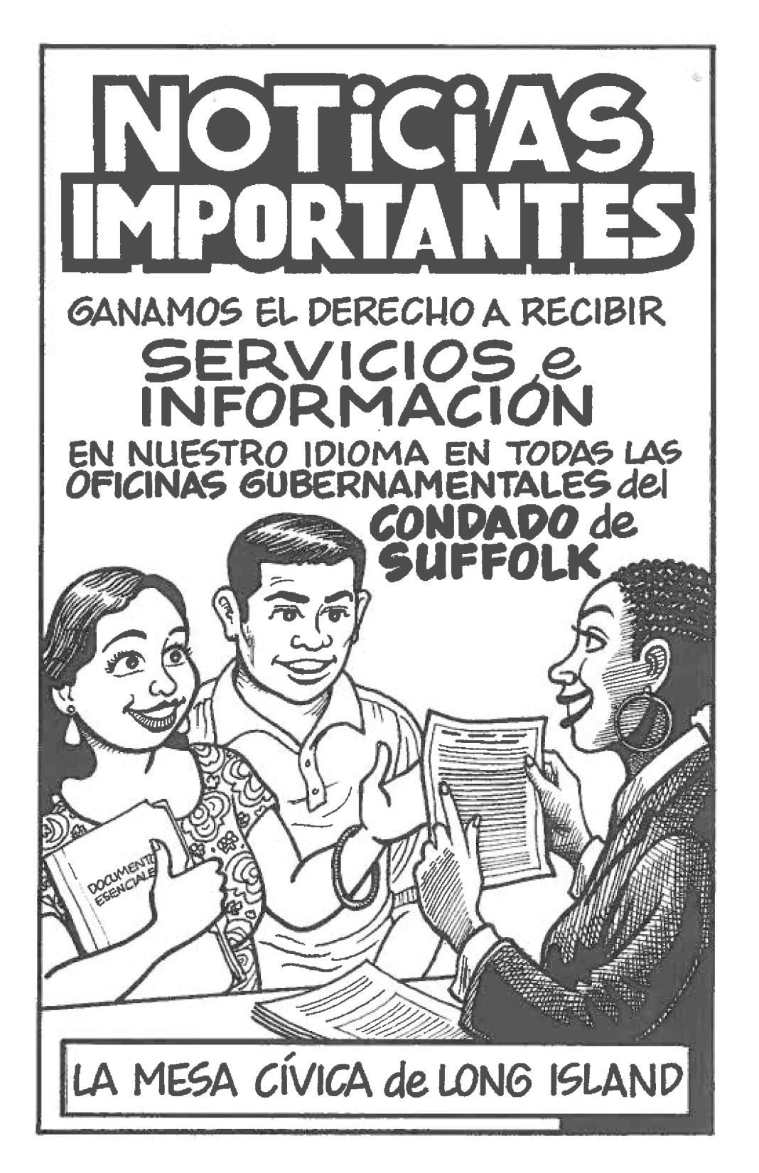

Slide 5
