Slide 1
Language Barriers & Medication
Shena Elrington
Director, Health Justice
New York Lawyers for the Public Interest
March 27, 2014

Slide 2




About NYLPI
The Pro Bono Clearinghouse provides community groups and nonprofit organizations with free legal assistance by drawing on hundreds of volunteer attorneys from New York’s most prestigious law firms and corporate law departments
The Disability Justice Program protects and promotes the civil rights of people with disabilities
The Environmental Justice and Community Development Project provides organizing and legal assistance to low-income neighborhoods and communities of color that bear an unfair burden of environmental threats
The Health Justice Program works to ensure access to quality health care for low-income communities of color and immigrants

Slide 3
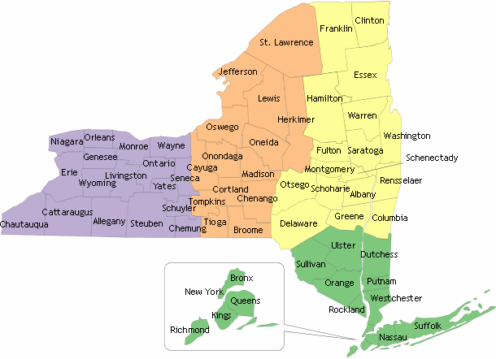
New York State by the Numbers...
About 2.5 million people are limited English proficient
  13% of the total population (40% increase since 1990)
The most common languages are:
  Spanish (over 50% of total LEP), Chinese, Russian and Korean

Slide 4
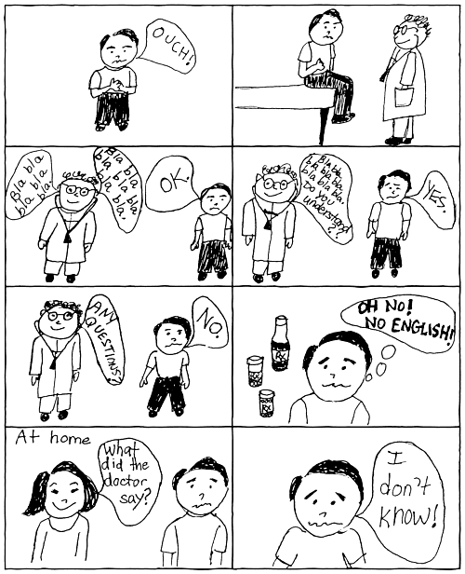
Language Access Matters!
Notes:
LEP is associated with:
Decreased likelihood of having a usual source of care
Poor health outcomes
Receipt of lower quality of care
Increased risk of misdiagnosis and adverse medication reactions

Slide 5
Multi-Pronged & Multi-Layered Approach
Legal Advocacy
Organizing & Outreach
Legislation (Local →State)
Notes:
June 2007: Consumer complaints & NYAM Study
July 2007: Filing of first complaint with state AG
November 2008: CVS & Rite Aid settlements announced
December 2008: Local Rx legislation introduced
April 2008: More Settlement agreements announced
Monitoring – statewide
Early 2012: Safe Rx included in budget

Slide 6
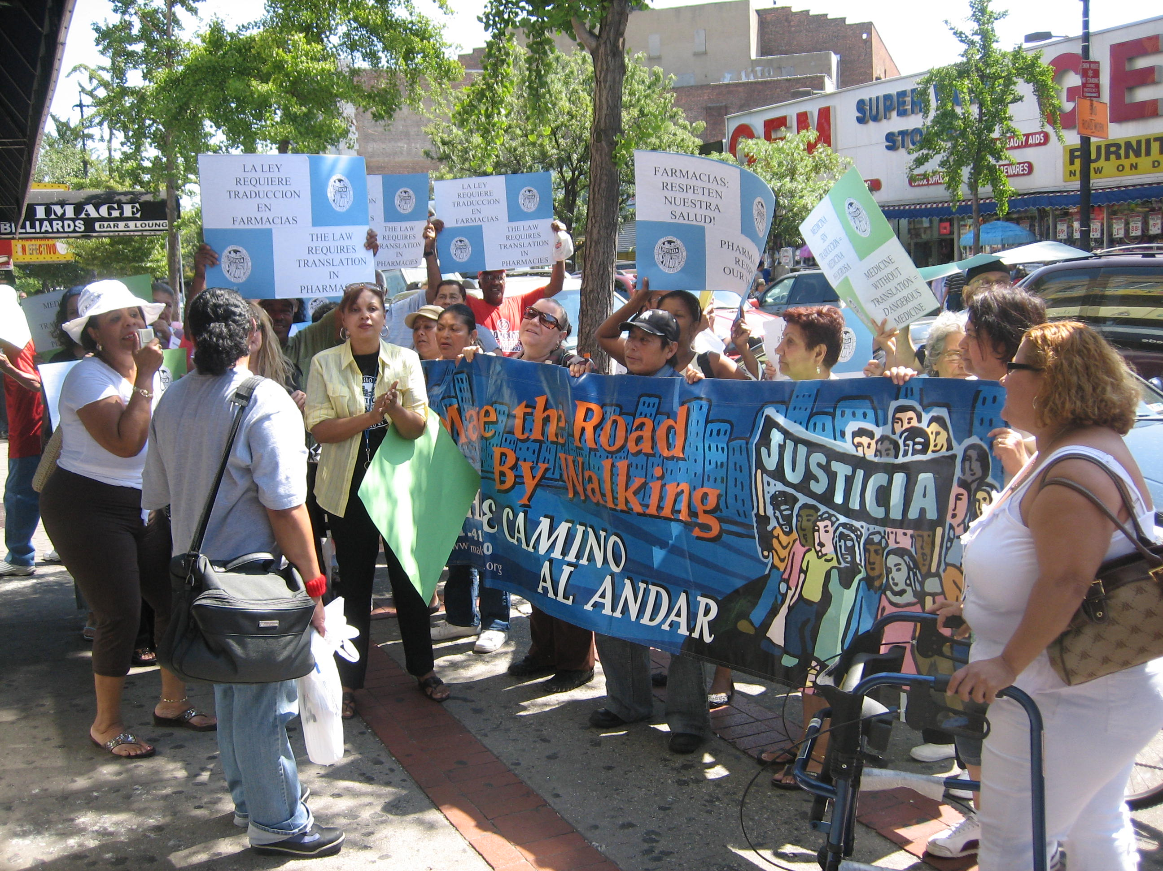
Legal Advocacy: The Complaint
Notes:
Very receptive State Attorney General’s Office
Represented CBO & immigrant rights coalition
CBOs collected vignettes of patient experiences
Filed complaint alleging violations of: Title VI, state statute & regs governing pharmacies, and local human rights law
16 Rxs named in NYC & Long Island

Slide 7
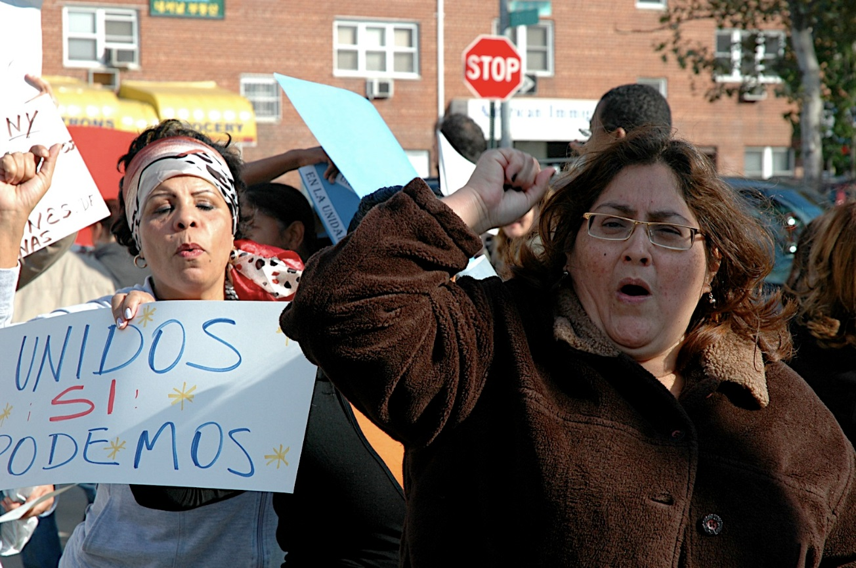
Organizing & Media Outreach
Notes:
CBOs organized three major actions in conjunction with filing of complaint
Extensive media outreach: national, local & ethnic press (print, TV & radio)

Slide 8
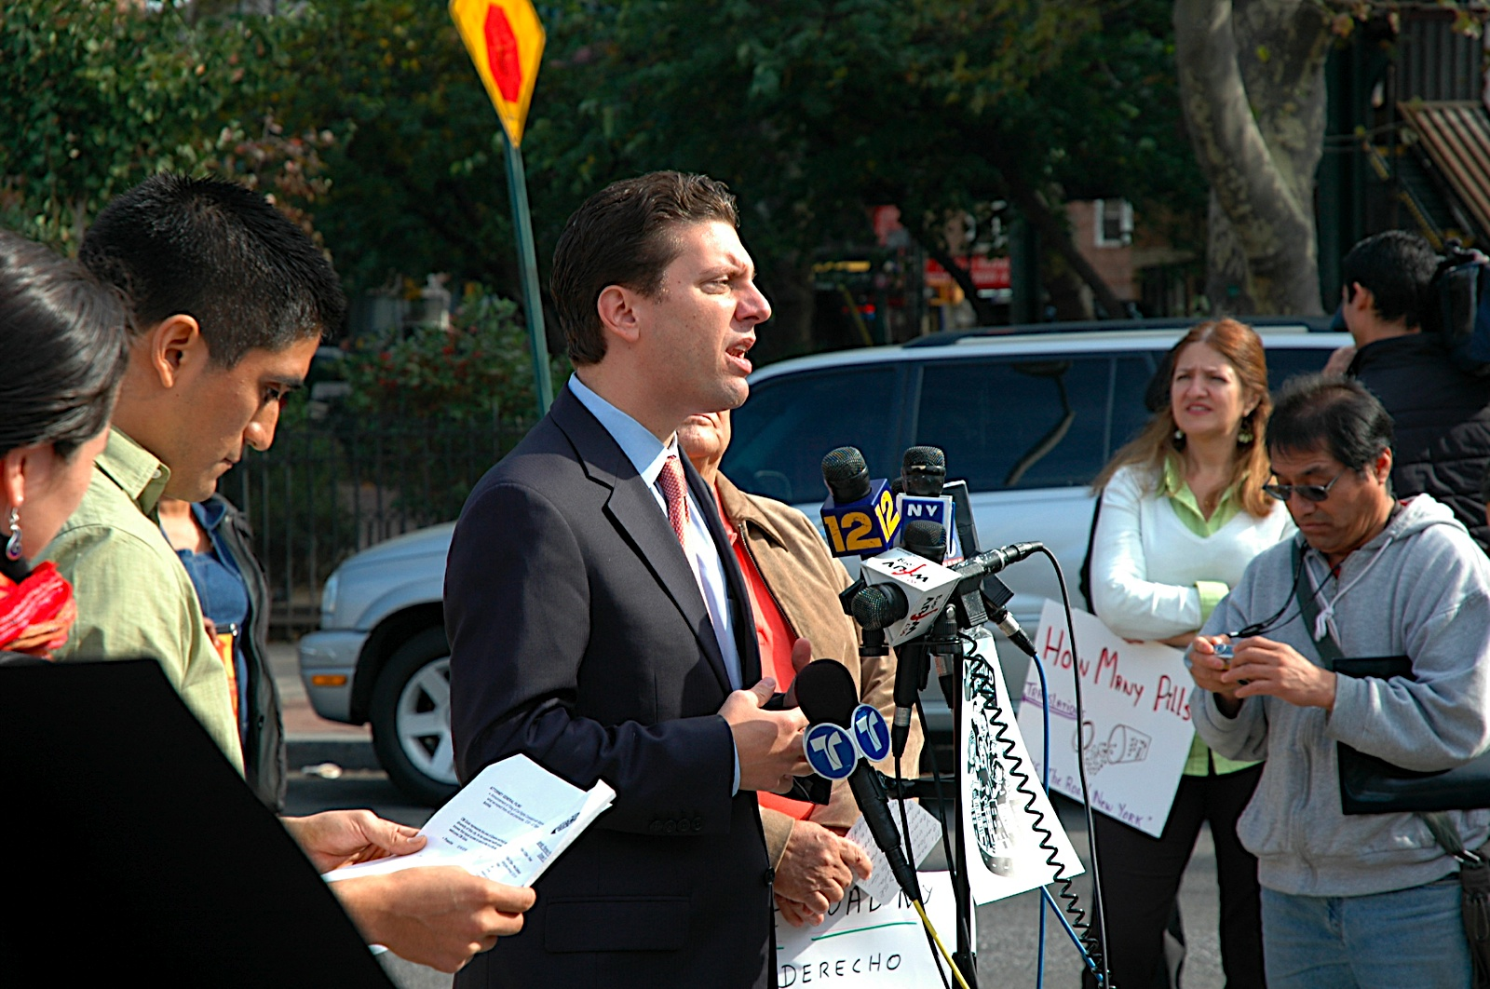
Legislative Advocacy : NYC Pharmacies Language Access Act
Applies chain pharmacies w/ 4+ stores in NYC
Notice of rights to language assistance displayed prominently
Interpreters required for counseling in all languages
Patient information & labels translated into top 7 languages
Notes:
Very responsive City Councilmember & Public Advocate
Components of bill:
Interpretation services
Translated labels
Notice
Record-keeping
Mobilized stakeholders for oversight hearings

Slide 9
Continuing our advocacy………..

Slide 10
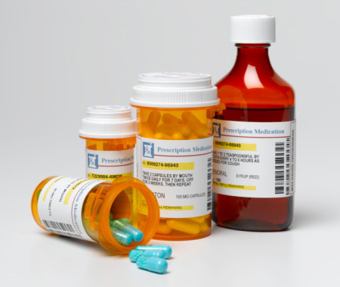
Statewide Language Access: Safe Rx
Requires chain pharmacies to:
  provide interpretation and translation services
  post notices
Standardizes prescription labels
Prescription pads have place for providers to designate patients’ language
Notes:
Importance of Messaging:
To provide pertinent information
To assist with community organizing
To counter negative messaging
Relationship Building:
Members of the community/community based organizations
Elected officials
Special interests groups (e.g., service providers)
Providing Data
Community Demographics
State/City Specific Data
Local Data
Need for services at a particular agency/entity
Technical Information
Confront questions regarding costs
Information regarding legal
implications

Slide 11
Victory…Now What?
Notes:
Discussion of challenges encountered…

Slide 12
Tools to Ensure Effective Implementation
Establishing a mechanism for continued and meaningful advocate involvement
Engaging in the regulatory/rule-making process if applicable
Engaging in systemic monitoring efforts and providing feedback (including positive!)
Using media to continue to shed light on the issue
Notes:
1. Provide as much assistance as necessary (model language, templates, etc.)
Offering to provide routine agency training
2. Providing comments (w/ broad-based sign-ons)
Calling for public hearings

Slide 13
Questions?
THANK YOU!
Shena Elrington selrington@nylpi.org
212-244-4664, ext. 315 http://healthjustice.wordpress.com http://www.nylpi.org

