Slide 1
Refugee Services: An Overview
Presented by: Lisa Ann Brennan, MTS
Program Manager, Services for New Americans
lbrennan@ascentria.org
www.ascentria.org

Slide 2
Ascentria Services for New Americans is part of a national network of voluntary organizations which works in conjunction the U.S. Department of State and the Massachusetts Office for Refugees and Immigrants, to resettle refugees in Massachusetts.

Slide 3
Reception and Placement Services
Resettlement agencies receive approximately $2,000 per person to spend on behalf of refugees in the first 90 days after arrival to help them get established in the United States.

Slide 4
Reception and Placement Services
With these funds case workers provide…
A warm welcome at the airport
Translation in primary language
A familiar meal and groceries
Furnished housing
Local safety and navigation information
Assistance with accessing medical care
Assistance with school enrollment for children
Assistance with applications for required US documents (i.e. social security card)
Assistance with enrollment in public benefits
Support to become self sufficient including referrals or enrollment in English language and employment services

Slide 5
English Language and Employment Services: Critical to Self-sufficiency
Resettlement agencies offer access to onsite or local education services including:
English proficiency assessments
ESOL classes for all levels
Math and computer literacy
Job readiness
Career Pathways
College and Career Readiness

Slide 6
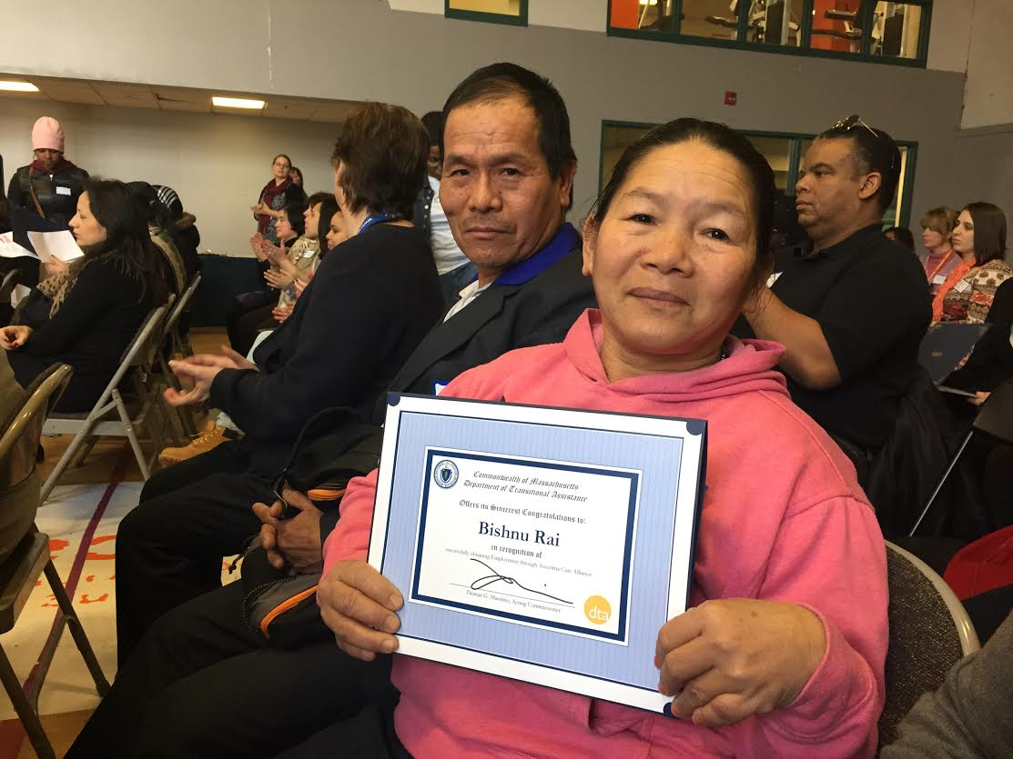
English Language and Employment Services: Critical to Self-sufficiency
Resettlement agencies also offer access to onsite or local employment services for up to 5 years.
Skills/interests assessments
Job readiness coaching
Resume writing and interview skills
Job search and placement services
Assistance with barrier removal
Co-enrollment with local Workforce Centers
Soft skills certification (self-esteem, dressing for success, conflict negotiation)
Preparation for drivers education, permits, licenses

Slide 7
Legal Assistance
Ascentria’s Immigration Legal Assistance Program offers:
Status adjustment
Naturalization and Citizenship
Family Reunification
Full representation for victims of trafficking, torture, domestic violence, and unaccompanied refugee minors

Slide 8
Partnerships are essential
Local leaders
Policy makers
Professional associations
Faith communities
Civic groups
Colleges and universities
Local businesses
Community-based non-profit organizations
Concerned individuals

