Slide 1
Technology Based Public Engagement Strategies Tech Tools for Mapping LEP Community Engagement
Presented by:
John Lozada, Manager of Federal Programs, MassDOT Civil Rights
Gregory Sobczynski, Title VI Specialist, MassDOT Civil Rights
Paul Chenard, Transportation Planner, Old Colony Planning Council
Jimmy Pereira, Community/Transportation Planner, Old Colony Planning Council
Notes:
All:
- Introduce yourself and give a brief description of your job duties.

Slide 2
Notes:
Greg:
General description of MassDOT
While we want to demonstrate the technology we are developing for improving public engagement, including language access, we are also committed to taking opportunities like this Conference to describe the work of the agency, its partners, and encourage that members of the public get involved in shaping transportation activities in the Commonwealth

Slide 3
Notes:
Greg:
Describe the structure of MassDOT
Creation in 2009
Modal divisions and type of work performed in each
Where ODCR is situated

Slide 4
The Federal Title VI Requirement
To ensure that public funds are not spent in a way that encourages, subsidizes, or results in discrimination.
Federal Requirements Extend to All Recipients and Subrecipients of Federal Aid for Transportation
State Transportation Agencies (MassDOT) are direct recipients of Federal transportation dollars; pass-through Federal financial assistance to subrecipients (such as Metropolitan Planning Organizations); monitor subrecipients for compliance and provide technical assistance.
Notes:
Greg:
The impetus for the topics we are discussing and the tool we will be demonstrating is MassDOT’s obligation to comply with Federal nondiscrimination obligations, namely Title VI of the Civil Rights Act of 1964, as well as analogous state requirements.
Due to the connection between Title VI obligations and federal funding, MassDOT maintains subrecipient relationships throughout the transportation sector.
One of MassDOT’s key partner agencies, and subrecipients, is the state’s thirteen Metropolitan Planning Organizations
These subrecipients are bound by the same nondiscrimination obligations , oversight of which MassDOT is responsible
We are joined today by representatives from the Old Colony Planning Council who will not only describe the work of an MPO but will also detail the MPO role in maintaining the outreach tool we will demonstrate shortly and will describe some of the successes OCPC has had in connecting with the public across languages and demographics.

Slide 5
Metropolitan Planning Organization (MPO)
Notes:
Paul/Jimmy:
MPO as a creation of federal regulation for the purpose of structuring the transportation planning process and managing federal transportation dollars
Description of membership, including the efforts to ensure diverse membership reflective of the communities served
The purpose of the 3 certification documents and the mandate for public input on their development
RTP
TIP
UPWP

Slide 6
Notes:
Paul/Jimmy:
There are multiple geographic divisions across the state when dealing with transportation work. This includes RTA service areas, MPO boundaries, MassDOT highway districts - all of these present the public with opportunities to get involved in transportation decision making, but it requires the opportunities for participation to be clear. MPOs provide the public with a great opportunity to share ideas about future transportation investments, and the MPOs can also direct the public to other opportunities to engage (such as project public hearings in highway districts).
These divisions are particularly important in those instances where on municipality crosses MPO boundaries (ex: Stoughton)

Slide 7
Notes:
Greg:
Transportation work is cyclical and the key documents (long range visions and short term project plans ) are updated on recurring cycles
These cycles include opportunities for public participation
But, the strength of the transportation plans produced through this process is at risk of being compromised when barriers prevent full and meaningful public participation
The innovations we are discussing today which are designed to facilitate full and meaningful participation are an effort to rectify the programmatic weakness of the past

Slide 8
Examples of Programmatic Weakness – How did we Get Here?
MassDOT has had mixed experience with inclusive and strategic public participation:
WeMove Massachusetts – insufficient engagement of language/minority groups in building long-range transportation strategy
MPOs and limited reach into minority/language group constituencies – low meeting attendance and risk of challenge to Transportation Improvement Plan by people who are not included
Departmental activities – field translations in Right of Way done ad hoc, by staff or by family members, where taking of property is involved
Spending for interpreters based on lack of timely meeting notice
Notes:
John:
- Provide details on the examples of weak/ineffective public engagement and the risk of not building a strong public engagement process

Slide 9
Notes:
Greg:
- As MassDOT continued to strive for more comprehensive and effective Title VI program development and implementation, the experiences John described coupled with federally identified areas of concern
Through the federal compliance review process, several public engagement concerns were identified and MassDOT set about developing multi-faceted strategies to eliminate these concerns
These strategies, including steps to improve public engagement, were built with not only MassDOT in mind, but also MassDOT’s subrecipients.

Slide 10
MassDOT Title VI Public Participation Plan (PPP)
FHWA and FTA have concurred with MassDOT’s PPP, which is designed to be used across MassDOT and MBTA public engagement.
The PPP adds protocols and resources to public engagement, supporting civil rights requirements, related federal and state regulations, and existing agency Standard Operating Procedures
PPP is built for two audiences:
Members of the public – identifying opportunities to identify, shape, and weigh in on transportation initiatives
MassDOT/MBTA staff – detailing protocols and resources for encouraging diversity and eliminating barriers in public involvement
PPP provides scaled and customized public engagement strategies across three key public participation formats in the transportation sector:
General invitation large group sessions like public meetings and public hearings
Focused small group sessions like public advisory committees
One-on-one interactions like meeting property owners or walk-ins
Notes:
John:
History of the development of MassDOT’s PPP
Purpose of the PPP (MassDOT use, subrecipient use, civil rights obligations reached by the protocols/resources therein)
Greg:
MassDOT looked to internal departments and external partners, like subrecipient MPOs, for examples of strong and replicable public engagement strategies that met the spirit of civil rights requirements
OCPC has stood out from the crowd for a number of years as a subrecipient committed to achieving full and meaningful public participation

Slide 11
OCPC Innovating in Public Engagement
Multi-lingual Radio:
http://www.ocpcrpa.org/media/OCPC_Radio_English.mp3
http://www.ocpcrpa.org/media/OCPC_Radio_Espanol.mp3
http://www.ocpcrpa.org/media/OCPC_Radio_Portugues.mp3
YouTube Outreach:
https://www.youtube.com/watch?v=8GNd-T1dFRY
Notes:
Jimmy/Paul:
- Brief description of examples of OCPC innovations in public outreach and how these activities support the organization’s Title VI/ADA requirements

Slide 12
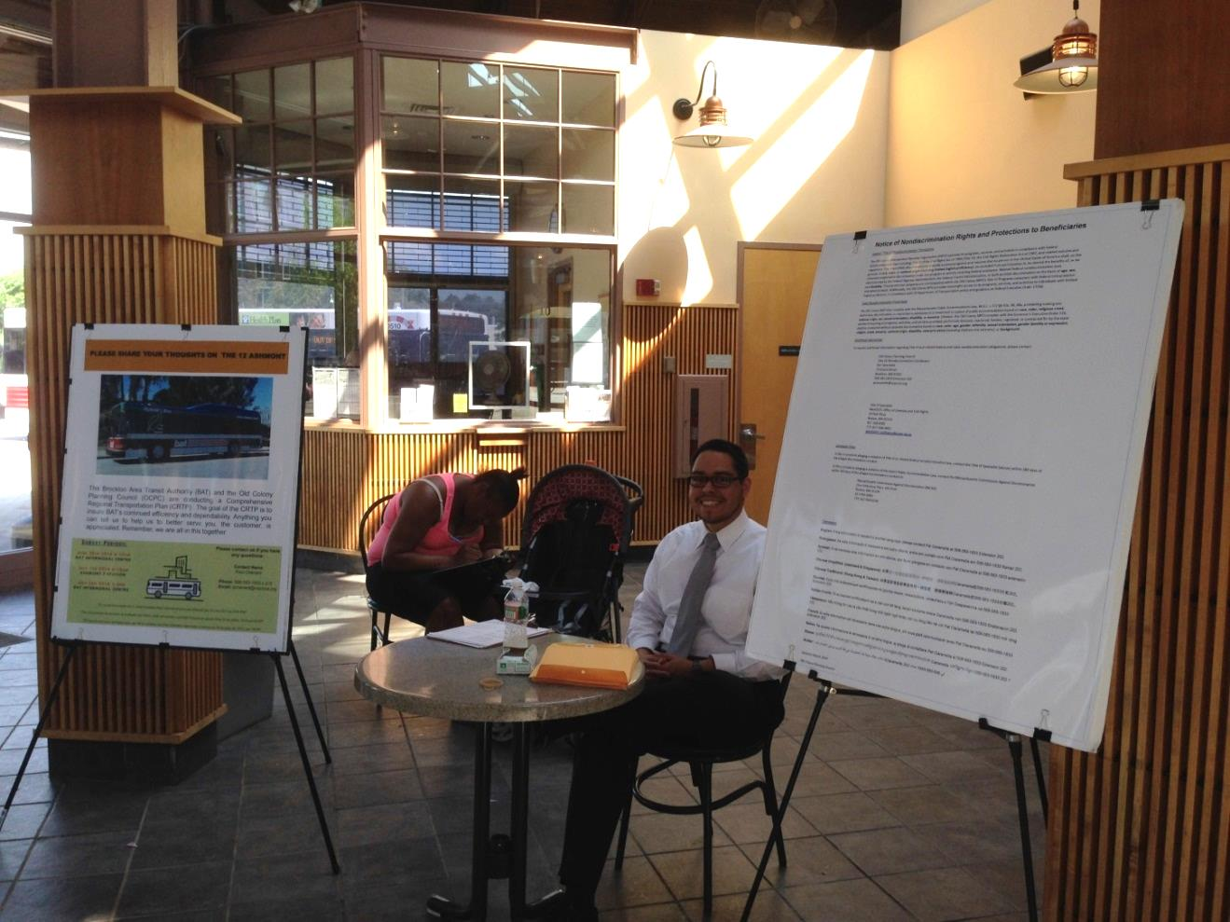
Connecting with people in places where people already congregate, such as malls, farmers markets, supermarkets and groceries
Notes:
Jimmy/Paul:
Continued description of novel OCPC outreach work
How have these strategies improved the work of the MPO, solidified relationships with community groups, and increased participation.

Slide 13
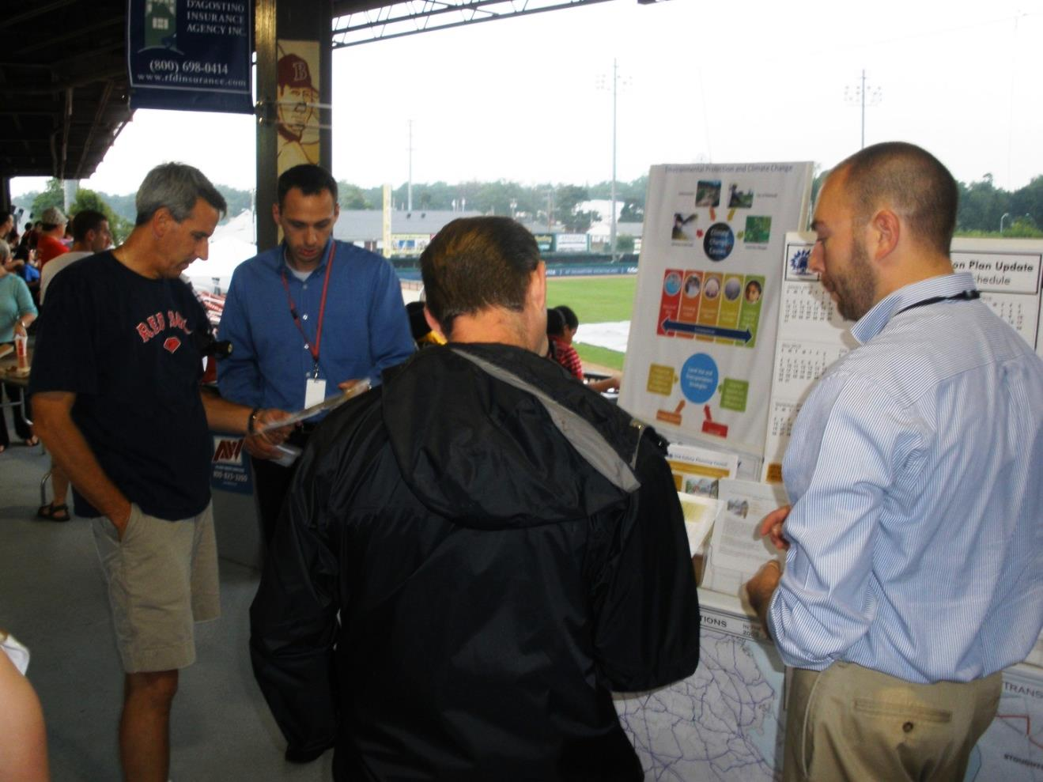
Attending community events, like minor league baseball games, open streets events, fairs and festivals.
Notes:
Jimmy/Paul:
- Continued description of novel OCPC outreach work

Slide 14
Key Innovation- Title VI Project Mapping Tool
Evolving beta version serves to identify languages spoken, accessible meeting locations, and local organizations for outreach
Intended users include MassDOT/MBTA, MPOs, municipalities, consultants, and the general public
Map is currently under development to improve data quality and usability. Next steps envision a deeper platform with additional features.
http://services.massdot.state.ma.us/maptemplate/languagetracts
http://54.175.228.150/TitleVITest
Notes:
Greg:
Description of the Map Tool as a key innovation for meeting the objectives of the Public Participation Plan
Vision: one-stop shop for demographic/community/resource data to inform public engagement strategies
Current capabilities: three key functions
[PERFORM THE DEMONSTRATION]
Greg/John:
Future use:
Ability to incorporate and cross reference all manner of geo-coded data through GIS layers (transit stop locations, MPO/RTA boundaries, project level-data connect)
Ability to automate quality control by running reports on magnitude of data and accuracy of data
Challenges encountered thus far:
MPO challenges with culling outreach lists
Limitations of the template platform (inability to combine multiple layers into a selection)
IT security issues,

Slide 15
Sharing the Public Engagement Responsibility
This responsibility reaches any person or entity using state or federal monies on behalf of MassDOT/MBTA projects and initiatives:
MassDOT and MBTA (primary responsibility, but can delegate authority through contracts and designations), including all public facing agency departments
Project Proponents - Cities and Towns
Consultants (planners, designers)
MPOs – all are subrecipients to MassDOT and many are direct FTA recipients, having major Title VI program responsibilities,
RTAs – most are direct recipients of Federal dollars through FTA, but there is also responsibility to MassDOT through pass-through of state and federal dollars.
Notes:
John:
The Title VI/ADA compliant public engagement responsibility reaches numerous partners and stakeholders in the transportation sector – the tool should therefore grow to be available/useful to all these groups
The consultant community (ACEC) is being kept in the loop on the development of this tool
Subrecipient meetings (MARPA, TMG) are regularly used to showcase latest developments and request testing/feedback

Slide 16
Further Discussion
Can you see a use for such a tool in your industry?
Could the work you do be streamlined or strengthened with comprehensive advance knowledge of community demographics?
Could this type of program be adapted and supported by your agency, or does your agency already have a similar tool or strategy?
Where MassDOT is relying on the MPO structure for the integrity of contact data, how could other state or private agencies ensure data stays current and accurate?
What resources would be required for an adequate quality control process?
How would you suggest determining if an outreach database is representative of a community?
How best to designate the responsibility of assessing the accessibility of potential meeting locations?
Notes:
Greg:
Open discussion of the questions
Jimmy/Paul:
- Questions for the public:
What would make our public events more convenient for you?
Are there any missing links in the process that aren’t currently clear to you?

Slide 17
Additional Resources
OCPC Title VI Content:
http://www.ocpcrpa.org/title_vi.html
OCPC Current Projects:
http://www.ocpcrpa.org/projects.html
MassDOT Title VI Content:
Notice to the Public http://www.massdot.state.ma.us/OfficeofCivilRights/TitleVI/NoticetothePublic.aspx
Public Participation Plan http://www.massdot.state.ma.us/Portals/0/docs/CivilRights/TitleVI/FTA/0018_Appendix05-A.pdf
Language Access Plan http://www.massdot.state.ma.us/Portals/0/docs/CivilRights/TitleVI/FTA/0020_appendix06-A.pdf
MassDOT ADA Content:
Interim Transition Plan http://www.massdot.state.ma.us/OfficeofCivilRights/ADA.aspx
Metropolitan Planning Organizations (MPO):
https://www.massdot.state.ma.us/planning/Main/PlanningProcess/RegionalPlanning.aspx
Massachusetts Association of Regional Transit Authorities (MARTA):
http://matransit.com/
Notes:
John/Greg:
Closure

