Slide 1
Know Your Rights
and Best Practices for Service Providers
Massachusetts Immigrant and Refugee Advocacy Coalition
March 19, 2025
Notes:
Hello- welcome everyone to our Know Your Rights training! Today, I hope to give you some information about your rights when it comes to immigration enforcement. I will also give you some tools and information so you and your family can feel more prepared in the event of immigration enforcement. There are a lot of things that we can’t control, but we can make sure we are all informed!
I also want to tell you what I cannot do in this training. I am not able to answer questions about what changes are happening or may happen in immigration law and policy, and I am not able to answer questions about your individual cases. [NOTE: If you are a lawyer or an Accredited Representative and you plan to answer individual questions after the training, modify this accordingly.]

Slide 2
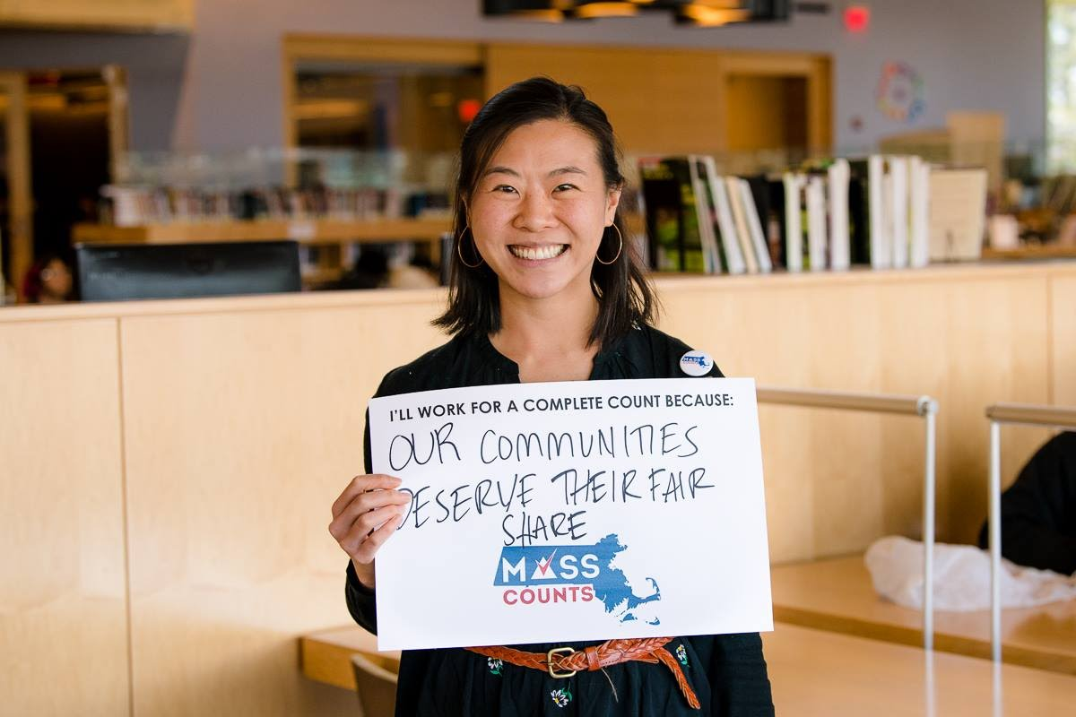
About MIRA:
Programs:
Both federal and state advocacy
Organizing and civic engagement
Our vision is a Commonwealth – and a nation – where all can thrive, no matter where they came from or how they got here, and all can fully participate in their community’s social, economic, and civic life.
Notes:
IF YOU ARE REPRESENTING MIRA: I work with the Massachusetts Immigrant and Refugee Advocacy Coalition - MIRA. MIRA advocates to improve the lives of immigrants and refugees in Massachusetts, and our vision is a state where we can all thrive and participate in our community’s social, economic, and civic life, no matter where we came from or how we got here.
IF YOU ARE REPRESENTING A DIFFERENT ORGANIZATION: replace this slide or add another slide here to introduce your organization!

Slide 3
Best Practices for Service Providers
Notes:
We will begin with an overview of what immigration enforcement looks like.

Slide 4
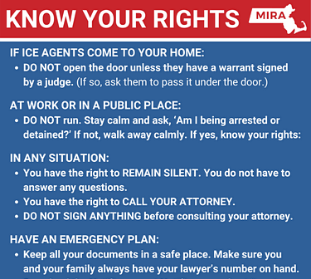
How can I support immigrants within my professional capacity?
Respond to questions
Validate experiences
Explain that you are unable to answer legal questions or provide legal advice since you are not a lawyer.
Instead, share resources and the multilingual recorded videos (English, Spanish, Portuguese, and Haitian Creole) with students found on the MIRA Know Your Rights website.
Send a Family Preparedness Packet home with immigrant families so that they prepare a plan, designate a point of contact, and update documents in case their family members are ever separated.
Download and print materials here:
miracoalition.org/news/know-your-rights/

Slide 5
How can I support immigrants within my professional capacity?
Review the spaces in your offices that are considered public or private.
Before an ICE officer or law enforcement enters a private area of an organization, they must present a judicial warrant with the name of the person in question or a search warrant with the organization’s address. The warrant must be signed by a judge.
What spaces at my organization are public? What spaces are private or restricted? Do we make this distinction clear? Is all of our staff aware?

Slide 6
How can I support immigrants within my professional capacity?
Conduct a deep dive of internal organizational data and technology use policies.
Even with a subpoena, the Family Educational Rights and Privacy Act (often called “FERPA”) protects students’ education records, which schools generally may not produce without taking certain steps to notify the student or parent. Meanwhile, the Health Insurance Portability and Accountability Act (“HIPAA”) protects individually identifiable health information, which generally can only be disclosed after notifying the patient or obtaining the patient’s authorization.
What data are we collecting and why?
Review plan to purge data

Slide 7
How can I support immigrants within my professional capacity?
Speak to your organization's leadership and legal team to create a plan.
National Immigration Law Center: Guidance for employers
AGO Guidance for Service Providers
Advocate preparation checklist
Have discussions about addressing vicarious trauma and self-care for staff.

Slide 8
Know Your Rights:
Quick Overview of Immigration Enforcement
Notes:
We will begin with an overview of what immigration enforcement looks like.

Slide 9
The Immigration System:
The 3 main agencies in the
Department of Homeland Security
U.S. Citizenship & Immigration Services
Customs & Border Protection
Immigration & Customs Enforcement
Notes:
There are three big agencies in the Department of Homeland Security:
The first one I’ll talk about is Immigration and Customs Enforcement, or ICE, who are the immigration police inside the United States. ICE arrests individuals who it is trying to deport, and also represents the government in immigration court.
The second one is Customs and Border Protection, or CBP, who are the immigration police on the border of the United States. They can also carry out enforcement anywhere inside the 100 mile area all along the land and coastal borders. You may see CBP officers at the Canadian and Mexican borders, and they are also at all of our international airports. CBP also does checkpoints anywhere within 100 miles of the border. For example, you may hear of checkpoints along the roads in Maine, Vermont, New Hampshire, or upstate New York.
And then there is US Citizenship and Immigration Services, or USCIS. They review applications and conduct interviews for asylum, green cards, special visas, and citizenship. They can grant status to people who qualify, but can also deny applications.

Slide 10
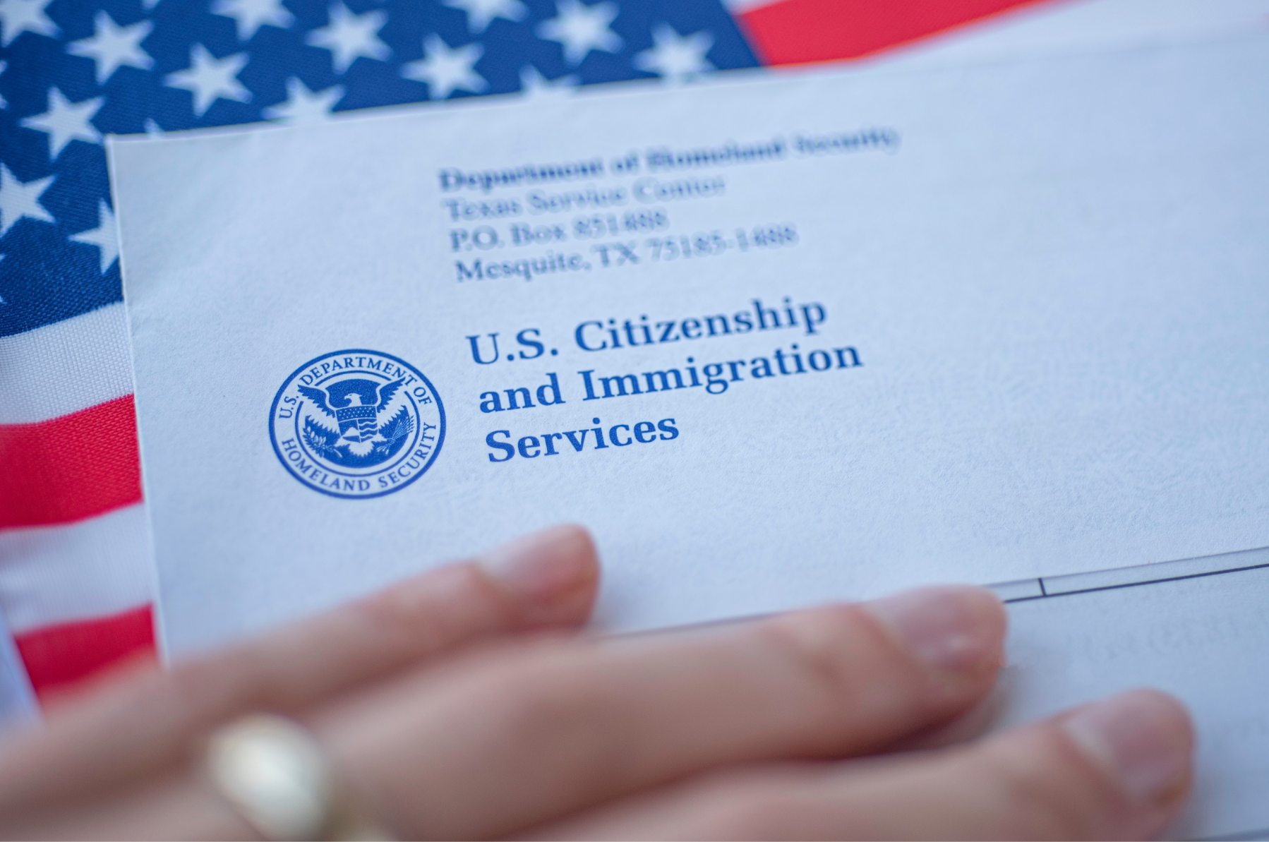
The Immigration System: Department of Homeland Security
U.S. Citizenship & Immigration Services (USCIS)
Review applications and conduct interviews for:
Asylum
Green cards
Special visas
Renewing work permits
Applying for citizenship
They can grant status to people who qualify, but can also deny applications.
Notes:
https://immigrationimpact.com/wp-content/uploads/2020/03/immigration-impact-coronavirus-uscis.jpg

Slide 11
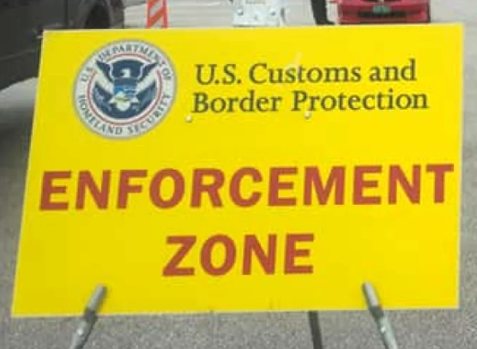
The Immigration System: Department of Homeland Security
Customs & Border Protection (CBP)
Border patrol
within 100 miles of all borders,
at checkpoints,
and at ports of entry.
Notes:
https://www.wamc.org/new-england-news/2019-05-07/remote-border-checkpoint-in-vermont-draws-criticism

Slide 12
The Immigration System: Department of Homeland Security
Immigration & Customs Enforcement
Immigration arrests, detentions, and deportation removals
ICE agents are sometimes dressed in casual clothing and drive unmarked vehicles when attempting to make an immigration arrest.
Notes:
https://www.aclumaine.org/sites/default/files/styles/featured_image_mobile_480x319/public/screenshot_2023-08-24_at_12.00.07_pm.png?itok=EVePvfSG

Slide 13
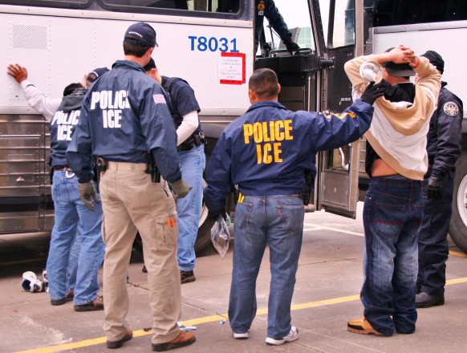
How People May Come into Contact with Immigration Enforcement
Contact with the criminal system
Applying for a benefit at USCIS, while having a removal order or criminal charge
Raids & targeted enforcement
Notes:
There are unfortunately many ways that immigration can use to find individuals for deportation.
Many people are encountered by CBP at the border when they try to enter the United States without valid documents. ICE officers can also detain people who are already in the United States. When people are arrested by the police and charged with a crime, their fingerprints are shared with immigration and then immigration can decide to detain that individual and place them in deportation proceedings. One of the more common ways people can be identified by the police is through traffic stops - we will talk later about your rights if stopped while driving, but you should take steps now to make sure you have a valid license and registration. Enforcement can also happen as part of a raid, or a targeted effort to detain specific individuals.

Slide 14
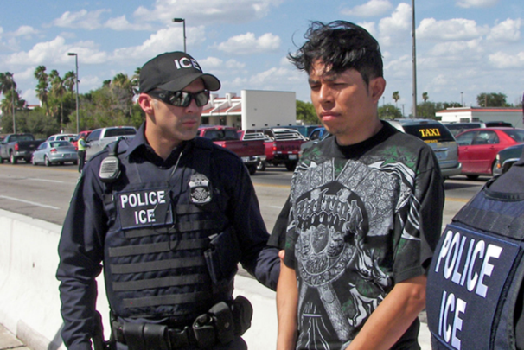
Who is at Risk of Deportation?
Anyone who is not a U.S. citizen can be vulnerable if they fall under a ground of deportation such as:
Lack of lawful status
Criminal convictions
Prior order of deportation
This can include:
Unauthorized / Undocumented immigrants
People with asylum or refugee status or some other form of protection
Lawful permanent residents (green card holders)
Non-immigrants (visitors, students, etc.)
Notes:
Anyone who is not a US citizen can be vulnerable to deportation. People who don’t have immigration status can be deported just for not having status. But even people with immigration status can sometimes be deported, usually if they have been convicted of a crime.
If you have submitted an asylum application you cannot be deported until after an immigration judge reviews your application, and even then you may be able to submit an appeal. Most immigrants already inside the US have a right to due process and cannot be ordered deported without first having a hearing in immigration court.

Slide 15
Know Your Rights
in Interactions with Immigration Enforcement
Notes:
So now that we have talked about what immigration enforcement looks like, let’s talk about what your rights are.

Slide 16
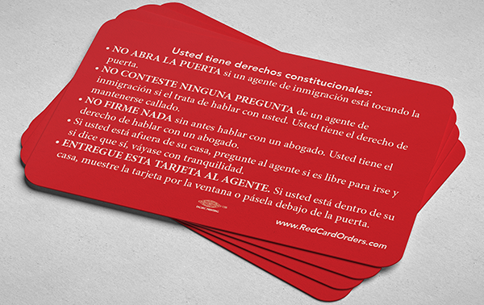
Know Your Rights Card (wallet size)
Helpful reminder to:
Not open the door
Not answer questions
Not sign anything
Show the card to the officer through the window or under the door.
Scan to print cards:
Available in English, Spanish, Portuguese, Haitian Creole, Arabic, Chinese, Farsi, French, Korean, Pashto, Punjabi, Russian, Tigrinya, Tagalog, Vietnamese, Ukrainian and Hmong.

Slide 17
If Immigration Comes to Your Home...
Do not open the door unless the officer provides you with a warrant signed by a judge.
Ask officers to identify themselves (agency, name, ID).
Ask if they have a warrant signed by a judge.
Slide a “Know Your Rights” card under the door.
You have the right to remain silent and to an attorney
You do not have to answer questions about immigration status or when you entered the country.
State to officers “I request my right to silence and to an attorney.”
Call a US citizen friend or family or an attorney

Slide 18
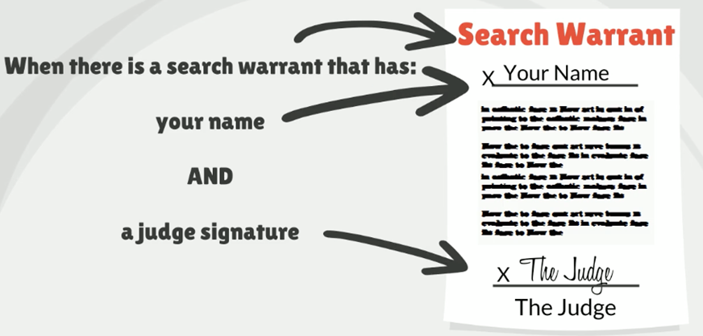
When can Law Enforcement enter my home?
Judicial Warrant
Notes:
How can you tell if the piece of paper the officer is showing you is a judicial warrant?
A judicial warrant can look different depending on what court issued it. But they will all have a signature by a judge on it, so look for the signature and see if it says “judge” underneath it.

Slide 19
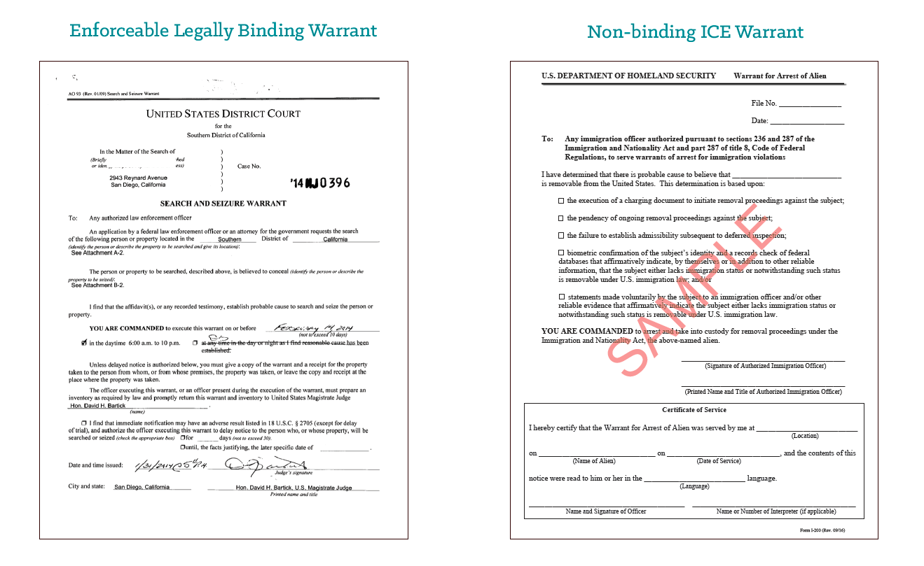
Warrants
Example of immigration warrant: does not give
Example of warrant signed by a judge immigration permission to enter the home

Slide 20
Driver’s Licenses
If you live in Massachusetts you are eligible to get a driver’s license regardless of immigration status!
YOU MUST: drive only on a full driver’s license, not a permit
TO DRIVE on a permit, you must have someone in the car who has:
Been driving for 1 year
2) Over the age of 21
3) Sitting next to the driver
Notes:
Next I’m going to speak briefly about being stopped while driving. The first thing to know is that if you live in Massachusetts you are eligible to get a driver’s license regardless of your citizenship or immigration status. The information that you share with the RMV when you apply for a license cannot be shared with immigration except in very rare circumstances.
Usually, when you are getting a license for the first time, you first get a driver’s permit. After having the permit for 6 months, you take the road test and obtain your full license. While you have your driver’s permit, you must have someone else sitting next to you in the car any time that you are driving. That person must be at least 21 years old and must have been driving for at least 1 year. You cannot drive alone while you have your driver’s permit. Doing so is considered driving without a valid license. So you should consider obtaining your full driver’s license as soon as possible.

Slide 21
If You Are Stopped When Driving…
Stay in the car and place your hands on the steering wheel.
The driver must provide their own name and address.
Passengers do not need to answer any questions
If you can, show your Know Your Rights card.
Police can search your vehicle if they believe you have been involved in a crime.
You can say “I do not consent to the search.”
Never provide false documents.
Notes:
So what to do if you are stopped by the police or immigration enforcement while driving?
The first thing to remember is that you must stop and pull over safely. Remain in the car and place your hands on the steering wheel so the officer can see them. If you need to reach into your pocket, bag, or glove compartment to get your license or registration, ask the officer for permission to do so first so that they do not think you are reaching for a weapon.
As the driver, you must provide your name and address. However, you do not need to answer any other questions, including any questions about where you were born or what your immigration status is. Instead, you can tell the officer you are exercising your right to remain silent and show them your “Know Your Rights” card.
The police can only search your car if you give them consent or if they have probable cause to believe you have been involved in a crime. You can state clearly that you do not consent to a search. However, if they choose to search your car, do not interfere.
Passengers in the car can ask if they are free to leave, and then leave if it is safe to do so.
Lastly, it is important not to provide false documents or even carry them with you! If you are detained, immigration can search your person and having false documents will make your case more complicated.

Slide 22
If Immigration or Police Stops You in Public…
Stay calm, do not run or resist arrest!
Say, am I under arrest or I am free to leave?
Remain silent
Say, I want to speak to a lawyer.
Can I call a lawyer?
How to Prepare
Practice asserting your rights.
Memorize phone numbers of family, friends, or lawyer.
Think of a U.S. citizen or someone with immigration status that you trust who can pay bond if you are granted one by an immigration judge.
Notes:
And what if immigration or the police stops you in public?
Again, it is important to remember to stay calm and do not run. Ask if you are under arrest or free to leave. If you are told you are not under arrest and you are free to leave, walk away calmly. If you are detained or arrested, do not resist.
Tell the officer you want to exercise your right to remain silent and speak to an attorney.
Immigration or the police cannot fingerprint you unless you are being arrested.
Remember - never provide false documents! If you have valid immigration documents and you are 18 or older, the law requires you to carry your immigration documents with you at all times.

Slide 23
If Immigration or Police Stops You in Public…
Police can search you if they have a reasonable suspicion that you are armed and dangerous.
If you have valid immigration documents and are over the age of 18, the law requires you to carry those documents on you.
Never provide false documents!
Think about your safety.
Notes:
And what if immigration or the police stops you in public?
Again, it is important to remember to stay calm and do not run. Ask if you are under arrest or free to leave. If you are told you are not under arrest and you are free to leave, walk away calmly. If you are detained or arrested, do not resist.
Tell the officer you want to exercise your right to remain silent and speak to an attorney.
Immigration or the police cannot fingerprint you unless you are being arrested.
Remember - never provide false documents! If you have valid immigration documents and you are 18 or older, the law requires you to carry your immigration documents with you at all times.

Slide 24
Expansion of Expedited Removal
The Trump administration has announced that it will move to quickly deport individuals who entered without permission and have been in the US for less than 2 years without the giving them the opportunity to go in front of an immigration judge unless they pass an initial asylum screening.
What to know:
If you've been in the US more than 2 years, carry proof of that- such as proof of residence, or school/work/medical records.
If you've been in the US for less than 2 years but are already in deportation proceedings or have valid parole status, carry evidence of that. Immigration could still try to place you in this fast deportation process but would first have to take steps to close out your immigration court proceedings or end your parole.
If you have a pending immigration court case- check on the status every day to check for any changes. Contact your lawyer or seek legal services if you see any changes.
Advocates are already pushing back on this broad application of the expedited removal process- stay tuned for updates!

Slide 25
Know Your Rights: Family Preparedness
Notes:
The next topic we will discuss is knowing your rights when it comes to your children and family.

Slide 26
Family Preparedness
Available in English, Spanish, Portuguese, and Haitian Creole
Notes:
It is helpful to be prepared as a family. Massachusetts advocates have prepared a packet of “Advice for Immigrant Families” that is available in English, Spanish, Portuguese, and Haitian Creole. Some parts of it are also available in Arabic. The Boston Medical Center has also prepared a family preparedness plan that can be especially helpful for families who have significant medical needs.

Slide 27
Family Preparedness
What is a Family Preparedness Plan?
A tool to have conversations and make decisions about how to care for your family if ever separated.
Provides a safety plan and opportunity to make decisions about:
Who will care for your children in your absence
Plans for meeting child’s educational, medical, and emotional needs in your absence
Plans for reunification
Notes:
So what is a family preparedness plan?
A family preparedness plan is a tool that can help you make informed decisions about how to take care of your family in the event of immigration detention or deportation of a parent. It guides you through making decisions like who you would like to take care of your children in your absence, plans for meeting your child’s educational, medical, and emotional needs, and in some cases plans for reunification with your child or children.

Slide 28
Making a Plan
Protect your information: Tell the school you don’t want your families information in the school directory or on school social media.
Update school contacts: Provide the school with contact information of trusted adults to pick your child up from school in case you are cannot.
Register your child’s birth with your foreign consulate: if your child wants to travel or move to your home country.
Apply for passports for your child: most governments require that both parents give permission for their child to get a passport. If you have sole legal custody or a specific court order you do not need the other parent’s permission.
Write a travel letter: if your child needs to travel outside the U.S., they may need a notarized letter that gives them permission to travel with a trusted adult. You may want to contact an airline or your consulate to get exact instructions.
Notes:
Here are a few things that you can do to prepare in advance:
Review information about what trusted adults have permission to pick up your child from school or any activities.
Tell the school you do not wish to have your family’s information included in the school directory, to protect your privacy.
Register your child’s birth with the consulate of your country of origin. If your child wants to travel or move to your country of origin, it could be easier if their birth is already registered with the consulate.
Apply for passports for your child. If your child was born in the US, apply for a US passport. Generally, both parents must give permission for a child to get a passport. If you have sole legal custody you do not need the other parent’s permission to obtain a US passport. In Massachusetts, unwed mothers have sole custody unless a court has decided otherwise.
Write a travel letter to allow your child to travel outside the US with a trusted adult.

Slide 29
Parental Rights
Right to make decisions about your children, no matter your immigration status.
Right to not share information about your children. If you are the main caretaker, you might want to tell immigration.
Right to arrange who will take care of your child.
If detained, you can ask for a phone call and ask how to contact your children.
If your children are in foster care:
You can take part in child welfare meetings while you are in detention and even after deportation, unless you have lost your parental rights.
Notes:
If you are a parent, you have rights as a parent regardless of your immigration status.
In interactions with immigration officers, you generally do not have to provide information about your children. However, if you are the primary caregiver of a child, you may wish to tell the immigration officer that, as it may affect the decision of whether to detain you.
If you are detained by immigration, you have the right to make arrangements for your child’s care. You can ask for an additional phone call to make these arrangements, and ask how you will be able to contact your children.
If your children are in the foster care system or there is a family court case regarding your children, you have the right to participate in those proceedings even if you are detained or after you have been deported. Immigration detention and deportation should not be considered abandonment of your children.

Slide 30
Caregiver Authorization Affidavit
Temporary Agent Authorization
Informal option
Guardianship
talking to the people you want to care for your child or writing down what you want to happen in an emergency
easiest, but does not give caregiver legal rights and your child’s school or doctor might not follow your plan
gives the caregiver the right to make decisions about your child’s health care and education for up to 2 years
Parent keeps all rights and can end it at any time
Needs signature of parent and 2 witnesses, notarized
allows the “agent,” or person you choose, to make any decisions a parent can make (except marriage and adoption) for your child, including about property and finances
Valid for 60 days once it takes effect, but can be renewed
Both parents must sign if available
Must be signed by agent and 2 witnesses
legal guardian has all rights a parent has, but exercises these rights instead of the parent
must be obtained through the courts
Notes:
You may also wish to consider who may take care of your children if you are detained or deported. There are a number of options for you to consider, ranging from informal to formal.
The most informal option is to simply talk to a family member or friend who you want to care for your child. You can also put in writing to this trusted individual what your wishes are for your child or what you want to happen in an emergency. This doesn’t require any formal documents, but it does not give the caregiver any legal rights when it comes to your child’s school or doctor
A more formal option is to complete a Caregiver Authorization Affidavit. This document gives the caregiver of your choice the right to make decisions about your child’s healthcare and education for a period of up to 2 years. It does not take away any of your rights as a parent. The document must be signed by the parent or parents as well as 2 witnesses, and must be notarized. There is a sample of this document in the Massachusetts packet called “Advice for Immigrant Families”
Another option is the Temporary Agent Authorization form. Like the Caregiver Authorization Affidavit, this allows the caregiver to make decisions about healthcare and education, but it also adds power over finances. It is only valid for 60 days but can be renewed. Both parents must sign it if available, and it must also be signed by the caregiver and 2 witnesses.
The most formal option is to seek guardianship in family court. If the family court judge appoints a guardian, the guardian has the authority to exercise the same rights as the parent and does so instead of the parent. A family court judge may not always agree with your choice of who should be the guardian for your child, so this may not always be the right option. You should consult with a family lawyer before asking a family court to take action regarding your children.

Slide 31
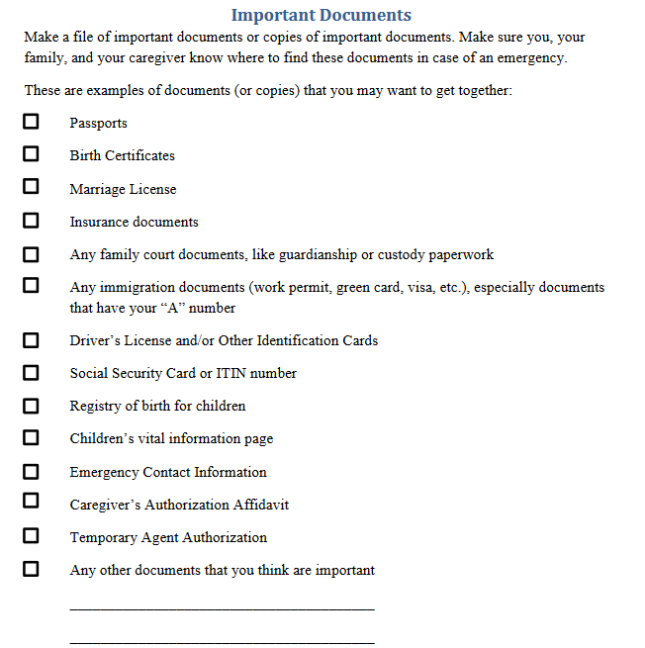
Remember to save all immigration documents
Some documents have dates for hearings or other immigration appointments - these dates are very important!
Keep documents stored safely and share location with family members if needed.

Slide 32
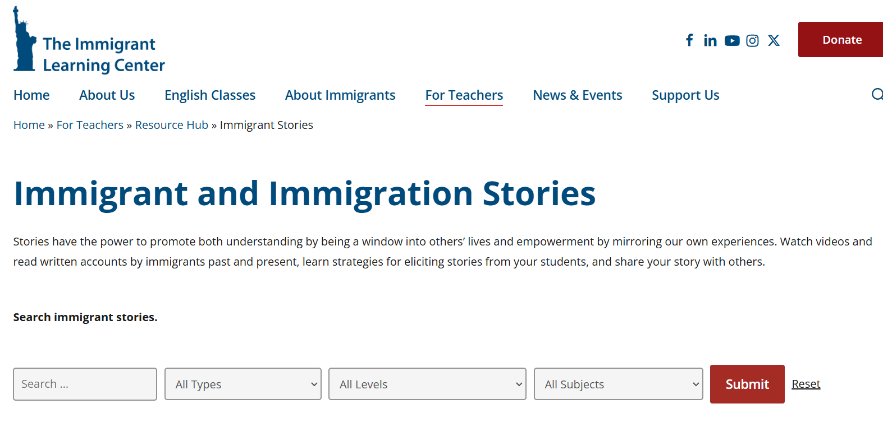
How can I support immigrants within my professional capacity?
Share stories of strength and power.
Share stories of resilient immigrants in literature, media, or in the community.
Examples:
Children:
Book: Mama's Nightingale: A Story of Immigration and Separation
Book: Something Happened to My Dad: A Story about Immigration and Family Separation
Youth and Adults:
7-Minute Animated Video in English and Spanish
Article: Walking Undocumented: The Story of Wildin Acosta
Videos: Immigrants Rising: Life Outside of the US
Image from NEA EdJustice

Slide 33
Next Steps
Print and share multilingual Know Your Rights wallet size cards.
Print and share Know Your Rights Handouts and hang up posters.
Talk to families about Family Preparedness Packets (available in English, Spanish, Haitian Creole, and Portuguese)
Use this training as a resource to refer back to and to answer any questions.

