Slide 1
Immigrants and Public Benefits
BBT Training
March 19, 2025
This Photo by Unknown Author is licensed under CC BY

Slide 2
JEANNE BRENNAN FUNK, ESQ.
SENIOR IMMIGRATION ATTORNEY,
Massachusetts Law Reform Institute

Slide 3
Housekeeping
Mute: As a reminder, all audience lines are muted. If you have a question or any technical issues, please use the chat feature.
Participants’ View: You may select Gallery View or Speaker View
Recording: Today’s webinar is being recorded and will be made available.

Slide 4
AGENDA:
9:30-9:32 Welcome
9:32-10:35 Immigrants, Documents & Public Charge
10:35-10:45 Break
10:45-11:45 Health Benefits & Immigrants
11:45-12:40 Lunch
12:40-1:50 Cash & Nutrition Benefits
1:50-2:00 Break
2:00-2:45 Housing & EA Shelter Benefits
2:45-3:30 Know Your Rights

Slide 5
The ABC’s of Immigration

Slide 6
Defining Immigrant
“Aliens” vs. Non-citizens
Non-citizen – anyone not a U.S. Citizen
Lawful Permanent Resident
Visa holders
All others not U.S. Citizens
The right to stay, work, & qualify for benefits vary by status even when lawfully in the U.S.
Notes:
Immigrant v Nonimmigrant -

Slide 7
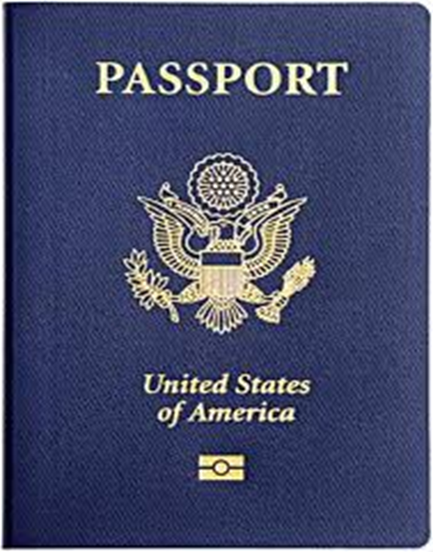
Citizens
Birth in U.S.
Birth Certificate
Passport
Naturalization
Naturalization Certificate
Passport
Acquire or Derive Citizenship From USC parent
Certificate of Citizenship
Passport
Nationals

Slide 8
Lawful Permanent Residents (LPR)
“Green card” holders
Legal right to live and work in U.S. permanently and travel
Subject to deportation grounds
Steppingstone to citizenship
Status is permanent and not
dependent on card expiration
Notes:
Also Conditional Residents – 2 year periods

Slide 9
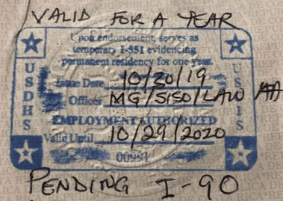
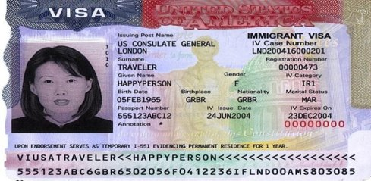
Other Residence Documents
Conditional Resident Card
I-551 Passport Stamp
Immigrant Visa
Reentry permits
Immigration court orders
Notes:
If not committed in US could still implicate criminal inadmissibility bars or nonpolitical crime asylum bar
Will want to request criminal history records – federal and state
If passes this analysis crime may still make an applicant inadmissible – still have to analyze whether it makes a person inadmissible to the US

Slide 10
Humanitarian
Refugees (Processed overseas)
Asylees (In U.S)
VAWA Self-Petitioner
U visa for victims of specific crimes
T visas for trafficking victims
Special Immigrant Juveniles
Have a path to LPR Status
Notes:
Can lead to lawful permanent resident status

Slide 11
Refugee/Asylee Documents
I-94 card/electronic
RE (refugee) or 207
AS (asylum), “Asylum Granted Indefinitely,” or 208
Employment Authorization Documents (EAD) with codes (a3, a5, c8)
USCIS Asylum Office grant letters
Immigration court orders granting asylum

Slide 12
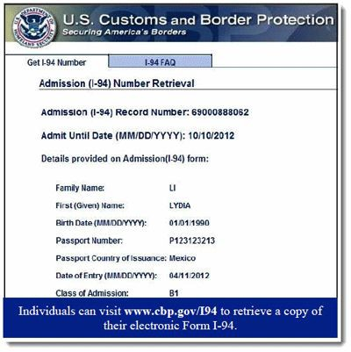
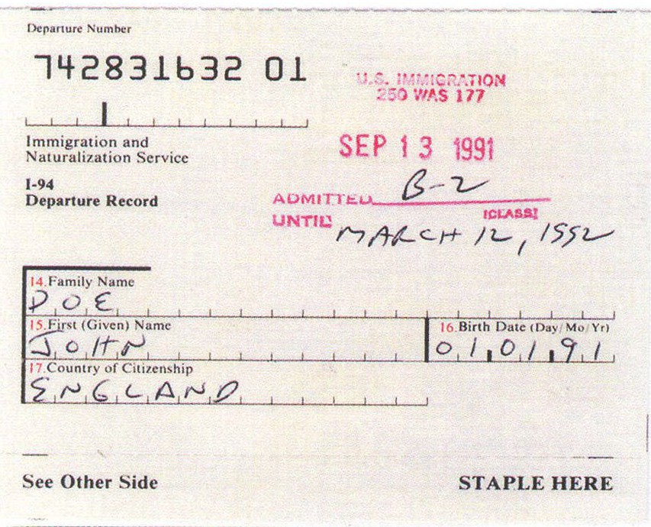
Sample I-94

Slide 13
VAWA Self-Petitioners and Special Immigrant Juveniles
VAWA Self-Petitioners
Special Immigrant Juveniles
Under 21
Unmarried
Under the jurisdiction of a juvenile, family court, guardianship
Due to abuse, neglect or abandonment
Not in best interests to return to home country
Can be granted deferred action if approved
Both eligible to become LPRs
Spouse of U.S. Citizen or LPR
Child of U.S. Citizen or LPR
Parent of over 21 U.S. Citizen
Subjected to abuse or extreme cruelty
Not a “status” by itself
If approved granted deferred action and Employment Authorization Document (c)(31)

Slide 14
U and T Visas
U visa for victims of specific crimes
Help with investigation or prosecution of crime
Bona Fide determination
T visa for trafficking victims
Sex trafficking and Labor Trafficking
Force, Fraud or Coercion
Report trafficking
Eligible for benefits as refugees
Non-immigrant visas
Have a path to permanent residence
Documents include
I-797 Approval Notice
I-94 Card
Visa in passport
T visas granted Continuous Presence document or HHS letter of certification

Slide 15
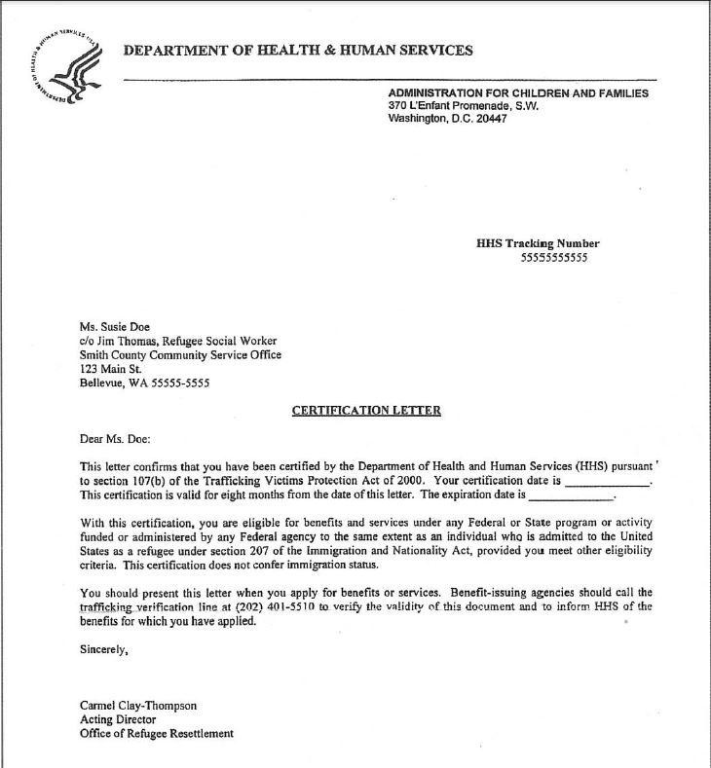
Notes:
Trafficking victims Do not need Immigration doc if have this letter to receive benefits

Slide 16
Temporary Lawful Residence / Non-Immigrant Status
Admitted to the U.S. for a limited period of time and for a specific purpose
“Alphabet soup”
20+ Categories including:
B-2 visitors for pleasure (Tourists)
F-1 students
Some categories offer a transition to LPR status (e.g. U or T visa)

Slide 17
Parolees
Can be short term or 1 year or more
Recent parolees typically granted 2-year paroles
Afghan Humanitarian Parole
Ukrainian Humanitarian Parole (U4U)
CHNV Parolees – Cuban, Haitian, Nicaragua, Venezuela
DT – port parole
INA 212(d)(5) humanitarian parole
INA 236 – parole from ICE custody, not parole for EAD eligibility
Parole in Place (PIP)
Military Parole in Place (MPIP)
Most new arrivals who used CBP One app

Slide 18
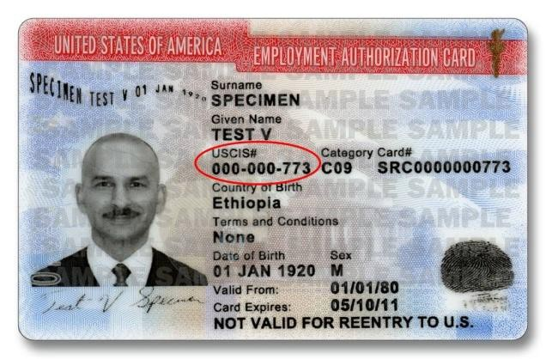
Parolee Documents
I-94 – w/annotation [e.g. 212(d)(5)]
I-512 parole grant document
EAD – check code reference (c)(11)

Slide 19
Temporary Protected Status (TPS)
Specific country’s nationals designated for temporary protection due to conditions in that country
On going armed conflict
Environmental disaster
Extraordinary and temporary conditions
Designated for 6, 12 or 18 month periods
Not removable during period
Eligible for employment authorization
(c)(19) pending applications
(a)(12) approved TPS
Currently 17 countries designated
Afghanistan, Burma (Myanmar), Cameroon, El Salvador, Ethiopia, Haiti, Honduras, Lebanon, Nepal, Nicaragua, Somalia, South Sudan, Sudan, Syria Ukraine, Venezuela, Yemen
This Photo by Unknown Author is licensed under CC BY-SA
Notes:
Currently under attack from administration
Venezuela’s extension issued January – revoked
Termination announced for Venezuela – end date April 7, 2025
Haiti’s extension partially rescinded – shortened from 18 months to 12 – set to expire 8/3/2025 – anticipate administration move to terminate
Litigation pending on both designations

Slide 20
Other Lawful Statuses
Deferred Action for Childhood Arrivals (DACA)
Withholding of removal (or deportation)
Deferred Enforced Departure (DED) grantees
Deferred Action grantees
Under Order of Supervision or Stay of Removal
Certain beneficiaries of “prosecutorial discretion”
and others including applicants for a status, with or w/o work authorization

Slide 21
Multiple Status Documents
Arrival/Departure Record
Form I-94
USCIS Notice of Action
Form I-797, I-797C
Employment Authorization Document (EAD card)
Forms I-688, I-688A, I-688B, I-776
Common codes:
(a)(3) refugee
(a)(5) asylee
(a)(10) withholding of removal
(a)(12) TPS granted
(a)(16) granted T visa
(c)(8) asylum pending
(c)(11) Parolee (Humanitarian Parole)
(c)(19) TPS pending
(c)(25) T visa family member

Slide 22
Important I-94 Codes
SI/SQ parolee (Afghan Special Immigrant Parolee)
OAR, OAW, PAR - Afghan Humanitarian Parole
UHP - Ukrainian Humanitarian Parole
CHP, HHP, NHP, VHP - CHNV Humanitarian Parole
DT - port parole
212(d)(5) or paroled
PIP (parole in place)
refugee/RE or 207
asylee/AS or 208
T 1-5 codes

Slide 23
Undocumented/Unauthorized
A person with no lawful status or current valid documents = “undocumented” or “unauthorized to be in the U.S.”
Can have entered the U.S. without inspection or
Entered with valid status and overstayed period of authorized stay

Slide 24
Immigration Status and Benefits: The Intersection

Slide 25
Qualified Immigrants
Lawful Permanent Residents (LPRs)
Refugees and Asylees
Persons paroled into the US for at least one year
Persons granted withholding of deportation or removal
Persons granted conditional entry (before 4/1/1980)
Battered spouses and children
(with a pending or approved spousal visa (I-130) or a self petition for relief under VAWA (I-360)
Cuban and Haitian entrants
(paroled into the US, applied for asylum or are in exclusion or deportation proceedings without a final order)
Victims of severe form of human trafficking
(including their derivative beneficiaries)*
Notes:
Petty Offense – 1 Conviction of CIMT – Maximum possible sentence one year or less, actual sentence under 6 months
Youthful Exception One CIMT conviction, young person convicted as an adult, crime occurred while under 18, commission and release occurred 5 years before current application
Admission to CIMT –
need formal admission
Reason to believe drug trafficking – not need conviction -

Slide 26
Five-Year Bar
Qualified Immigrant arriving on or after PRWORA enactment (8/22/1996) may be ineligible for federal means-tested benefits for five years
Federal means-tested benefits - Medicaid (except for emergency), CHIP, TANF, SNAP, SSI

Slide 27
PRUCOL
Permanently Residing Under Color of Law
PRUCOL is not an immigration status and will not appear on any immigration document, but is used in determining benefits
Residing in the US with the knowledge and permission of DHS and DHS does not presently contemplate enforcing their departure
Each state can define PRUCOL for their own state benefit programs. In MA PRUCOL is defined by the individual state benefit programs and each program defines it differently.

Slide 28
Cuban Haitian Entrants
NOT an immigration status
Benefits category
From Cuba or Haiti
In the U.S.
After Being paroled into US
With a pending asylum application, OR
In pending immigration court (removal proceedings)
Can have multiple statuses
Cannot have a final order of removal
Remain a Cuban Haitian Entrant after period of parole expires

Slide 29
Public Charge
This Photo by Unknown Author is licensed under CC BY
Someone who is likely at any time to become primarily dependent on the government for subsistence as shown by either the receipt of:
Public Cash Assistance for Income Maintenance OR
SSI, TANF, State and Local Cash Assistance (EAEDC)
Long-term institutionalization at government expense
* Most people who face the public charge test are NOT eligible for the benefits included in the test. *

Slide 30
Public Charge Inadmissibility
Applies
Does Not Apply
Applying for a green card through family/employment in the US
Applying for an immigrant or nonimmigrant visa to enter the United States
Lawful permanent residents returning to U.S. after a trip of over 6 months
U.S. Citizens
Citizenship applicants
Green card renewals
Refugees/Asylees
VAWA
T/U visas
Special Immigrant Juveniles
DACA initial or renewals
TPS initial or renewals
Humanitarian parole
Many immigrants are NOT subject to public charge. It does not apply to all immigrants.
Notes:
What is admissibility?
Public Charge deportability 2 steps
person has become a public charge within 5 years of entry and
the circumstances causing the person to become a public charge arose before their entry into the US

Slide 31
Most Benefits are NOT Considered
Health care programs
Medicaid, CHIP, care at community health care centers
Housing assistance
State and Federal, Section 8, RAFT, Public Housing
Food Programs
SNAP, WIC, school lunches
Cash benefits from work
Unemployment, Social Security, pensions
COVID-related support
Testing, treatment, vaccines, P-EBT, Child Tax Credit
State, local or tribal non-cash benefits
Safe Benefits” List for Massachusetts:
https://miracoalition.org/wp-content/uploads/2022/10/Massachusetts-Safe-to-Use-Benefits-October-2022.pdf

Slide 32
Totality of Circumstances
Age
Health
Education & Skills
Affidavit of Support
Certain Benefits Use
Income/Assets
Family Status
Employment
The public charge test looks all of an immigrant’s circumstances
No one factor is enough
Test is prospective (future use)
Receipt of beneﬁts will not alone be suﬃcient.
A sufficient Affidavit of Support considered favorably

Slide 33
Exemptions
Many noncitizens exempt from Public charge by statute
The Final Rule lists 29 exemptions at 212.23(a)
Include - asylees, refugees, Afghan SIVs, Cuban Adjustment Act applicants, Trafficking victims, U nonimmigrants, VAWA Self-petitioners
If nonimmigrant was in exempt status when they received the beneﬁt, that benefit will not be considered
Refugees/Asylees
Afghan/Ukrainian parolees receiving benefits as refugees

Slide 34
Takeaways
Most immigrants in Massachusetts should keep their benefits!
Receipt by family or household members of immigrant subject to public charge will not be considered
Avoiding benefits does NOT mean you will pass the public charge test
Use of public programs does not automatically make you a public charge.
Benefits used by family members will not count in public charge decisions.
When in doubt, seek consultation from an immigration/beneﬁts professional!
Notes:
This afternoon will be hearing about know your rights – which also impacts immigrants’ considerations of whether to continue with their benefits.
Privacy of information
What information organizations collect regarding immigration status
Eligibility has not changed
Public Charge has not changed as of this time

Slide 35
Protecting Immigrants Families Campaign (PIF)
National Campaign: www.protectingimmigrantfamilies.org
Join the campaign: https://pifcoalition.org/join
More info: www.masslegalservices.org/publiccharge
Massachusetts campaign (PIF-MA): Reach out to the organizations below

Slide 36
Questions

Slide 37
THANK
YOU

