Slide 1
USDA Food and Nutrition Service
Regional Offices
FNS Regional Offices work with States, Tribal governments, and community partners to increase food security and reduce hunger
by providing children and low-income people access to food, a healthful diet, and nutrition education
in a manner that supports American agriculture and inspires public confidence.

Slide 2
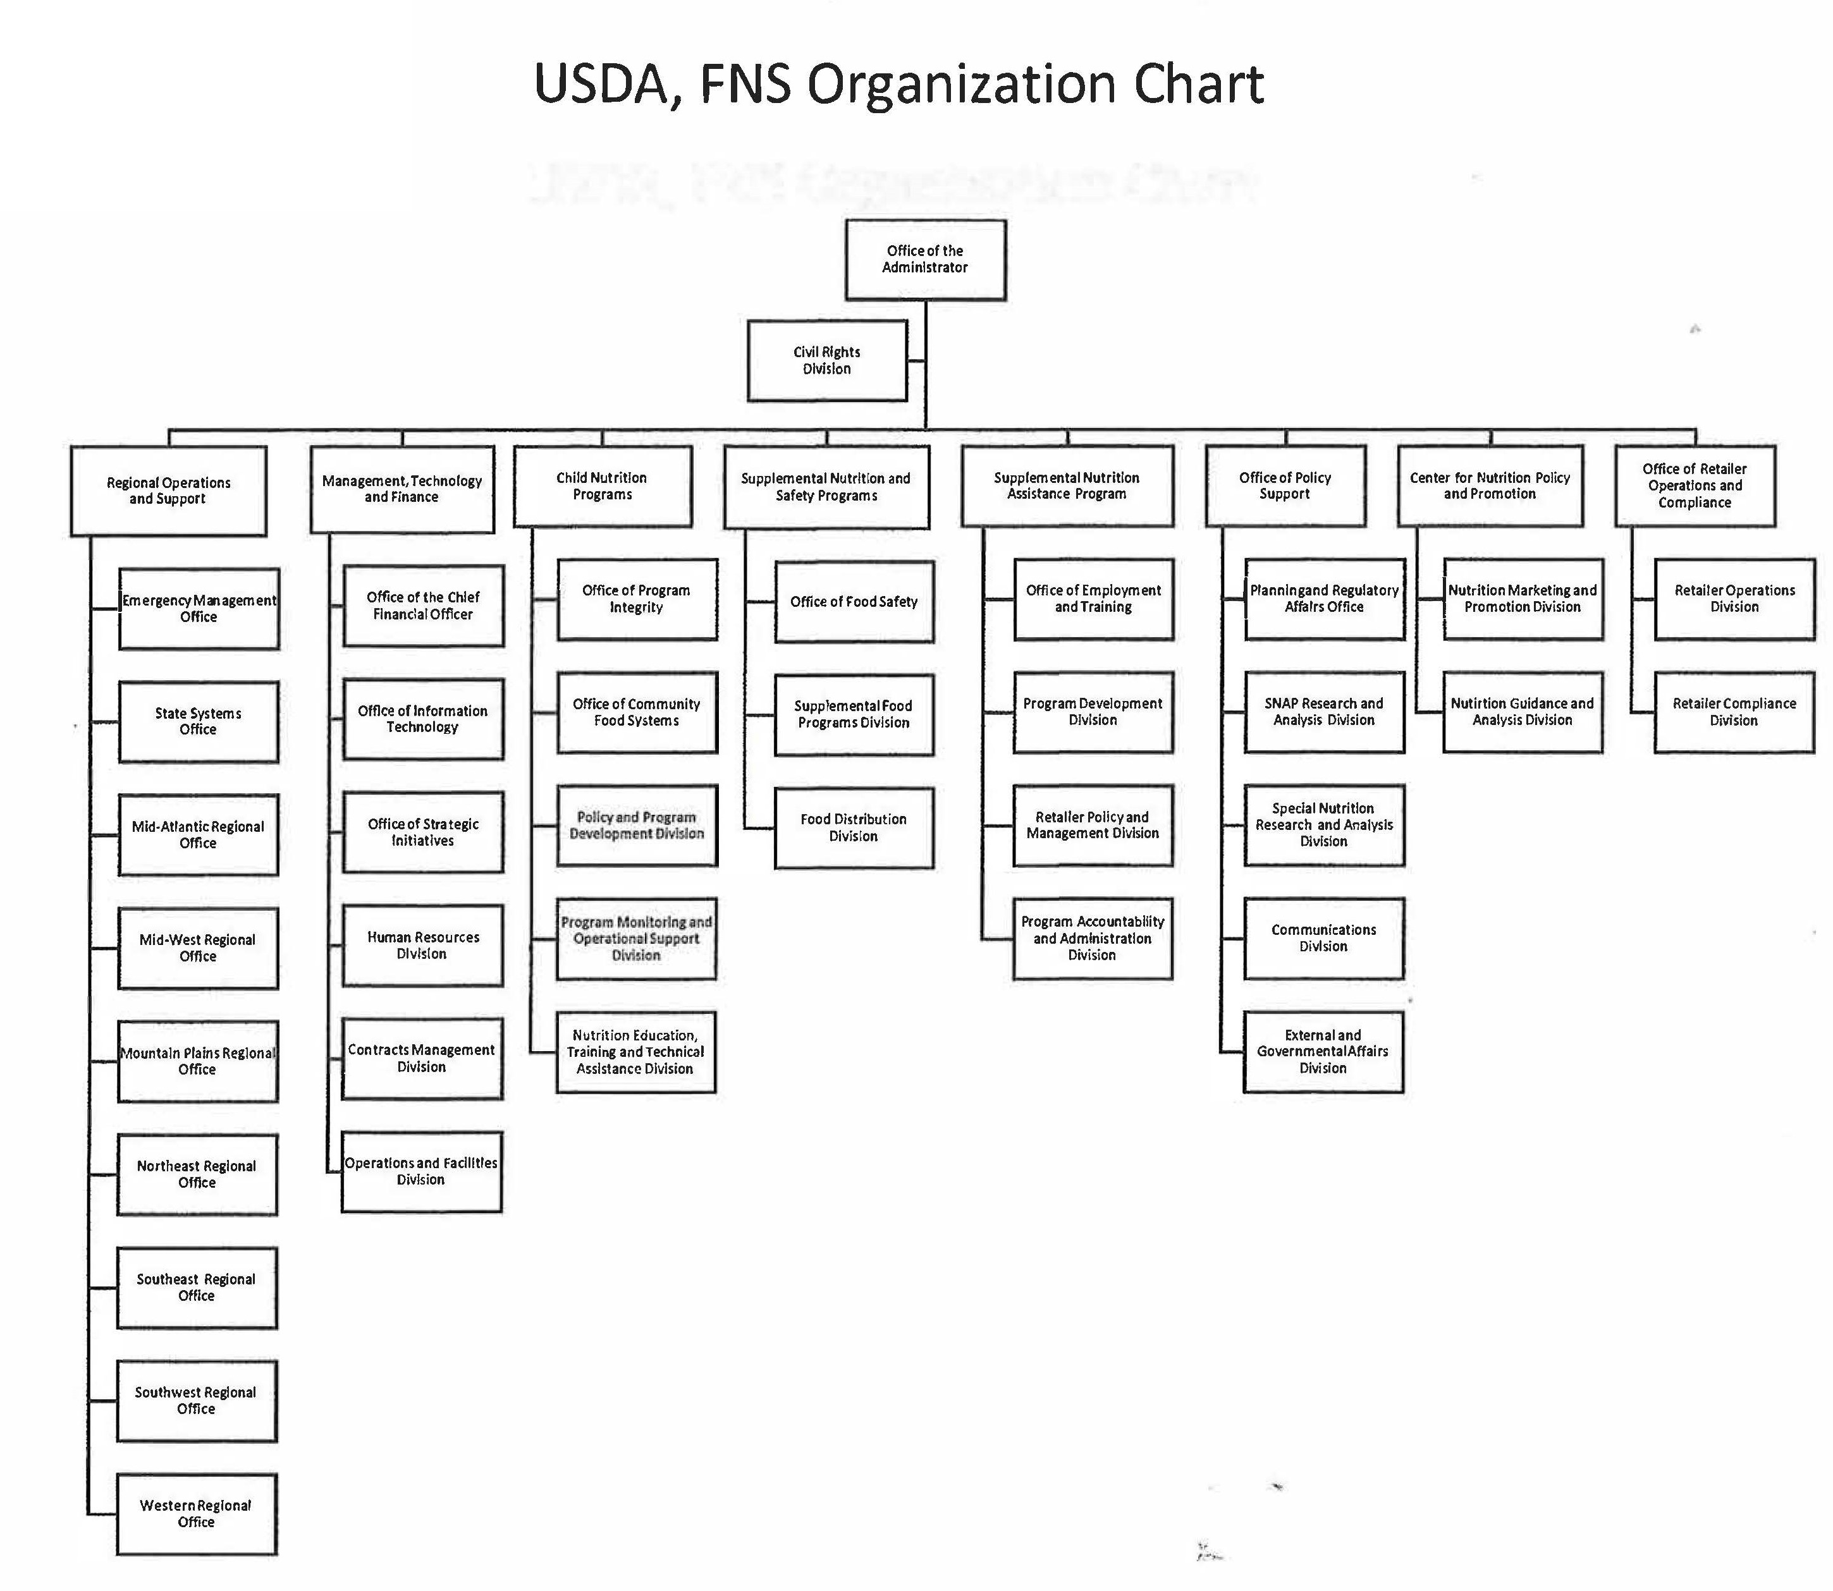

Slide 4
