Slide 1
Project Bread, Flexible Services

Slide 2
Flexible Services Overview
Launched in 2020, 3 year, $149M program from Medicaid (MassHealth) to address members’ food security & housing needs
Accountable Care Organizations (ACOs) should partner with high-capacity Social Service Organizations (SSOs) to provide services. Programs must avoid duplication of state and federal programs
Eligibility criteria includes ACO membership and both health & social factors:
Health Needs-Based Criteria
Complex Physical Health condition
Complex Behavioral Health condition
Challenges with Activities of Daily Living (ADLs)
High Risk Pregnancy
Frequent ED Utilization
Social Risk Factor:
Nutrition Program: Food Insecurity Tenancy Program:
Experiencing Homelessness
–or-
At Risk of Homelessness
Notes:
In addition to explaining the authority provided through the waiver and the criteria for providing services to members, also note the overarching goals of the program.
- Address food insecurity, improve health outcomes, reduce coast of care
Authority is provided through the 1115 Waiver (2018-2022)
Authorized a groundbreaking pilot which allows Medicaid dollars to be used on “non-medical” expenses. It is intended to address social determinants of health such as food insecurity and housing stability.
Patients must be enrolled in one of MassHealth’s ACOs
Meet at least one of the Health Needs Based Criteria
Behavioral health need or complex physical health need
Needing assistance with one or more documented Activities of Daily Living or Instrumental Activities of Daily Living
Having repeated Emergency Department use w/in a certain period of time
Experiencing a high-risk pregnancy
Meet at least one of the Risk Factors
Experiencing homelessness
Being at risk of homelessness
Being at risk for nutritional deficiency

Slide 3
Waiver Extension: Flexible Services Updates
Flexible Services program has been reauthorized for another five years (2023-2027)
Service expansion to household level for:
Eligible children
Pregnant women
Medically tailored meals and prescription programs limited to six months
Provision of $8M through a social service integration fund
Changes to payment structure expected 2025

Slide 4
SSOs Offering Nutrition Supports
About Fresh
Berkshire Fallon Health Collaborative
Community Counseling of Bristol County
Community Servings
Daily Table
Elder Services of Worcester Area
Father Bill’s Mainspring
Fresh Food Generation
Just Roots
Merrimack Valley Community Partner
Old Colony YMCA
Project Bread
Southern Middlesex Opportunity Council
The Guild
Well Spring
Western Mass Food Partnership

Slide 5
Project Bread Partnerships
C
Referrals received from a network of 14 community health centers
Referrals received from 10 affiliated physician’s offices
Referrals received from 16 community health centers, treatment centers, and hospitals
Notes:
The core of the flexible services program requires ACOs to partner with community-based organizations who are known and trusted by communities and have expertise in food security and nutrition to provide services instead of stretching themselves to be experts in another arena outside of healthcare provision.
We worked with our partners to design the programming that we offer to meet the needs of their patients. And we have adapted the services offered based on their target populations.
We maintain close communication with standing meetings (biweekly) to address individual patient cases and to ensure that overarching systems are working as needed.
We also work with them on program evaluation to determine if the programming is meeting its stated goals

Slide 6
Project Bread Services and Reach
6,600 people served to date
SERVICE | No. People Served | Dollars Spent
Cooking Classes | 739 | $40,645
Nutrition Counseling | 551 | $30,450
Refrigerators | 427 | $187,161
Kitchen Supplies | 4805 | $1,068,481
Gift Cards | 33,650 (cards sent) | $4,944,921
Transportation | 504 | $25,458

Slide 7
Program Outcomes
“This program has given me emotional relief & peace. I am less worried about food and I am very grateful for this program. I am attending the cooking classes because I love them, not only because of [receiving] gift cards. This program has given me life. My daughter and I sit together to eat and I can see it in her face that she's growing healthy.”
-- flexible services client
“My health improved because my doctors reduced my insulin doses [...] my A1C was 13 at the start of the program and now its 8, my goal is to reach an A1C of 5. I learned so much that I am helping my mom who is in Puerto Rico and also has diabetes. I even tell my co-workers to add more fruits and vegetables, to replace juices and sodas for water, and if they say that they don't like plain water, I give them tricks like adding fruits to the water.”
-- flexible services client

Slide 8
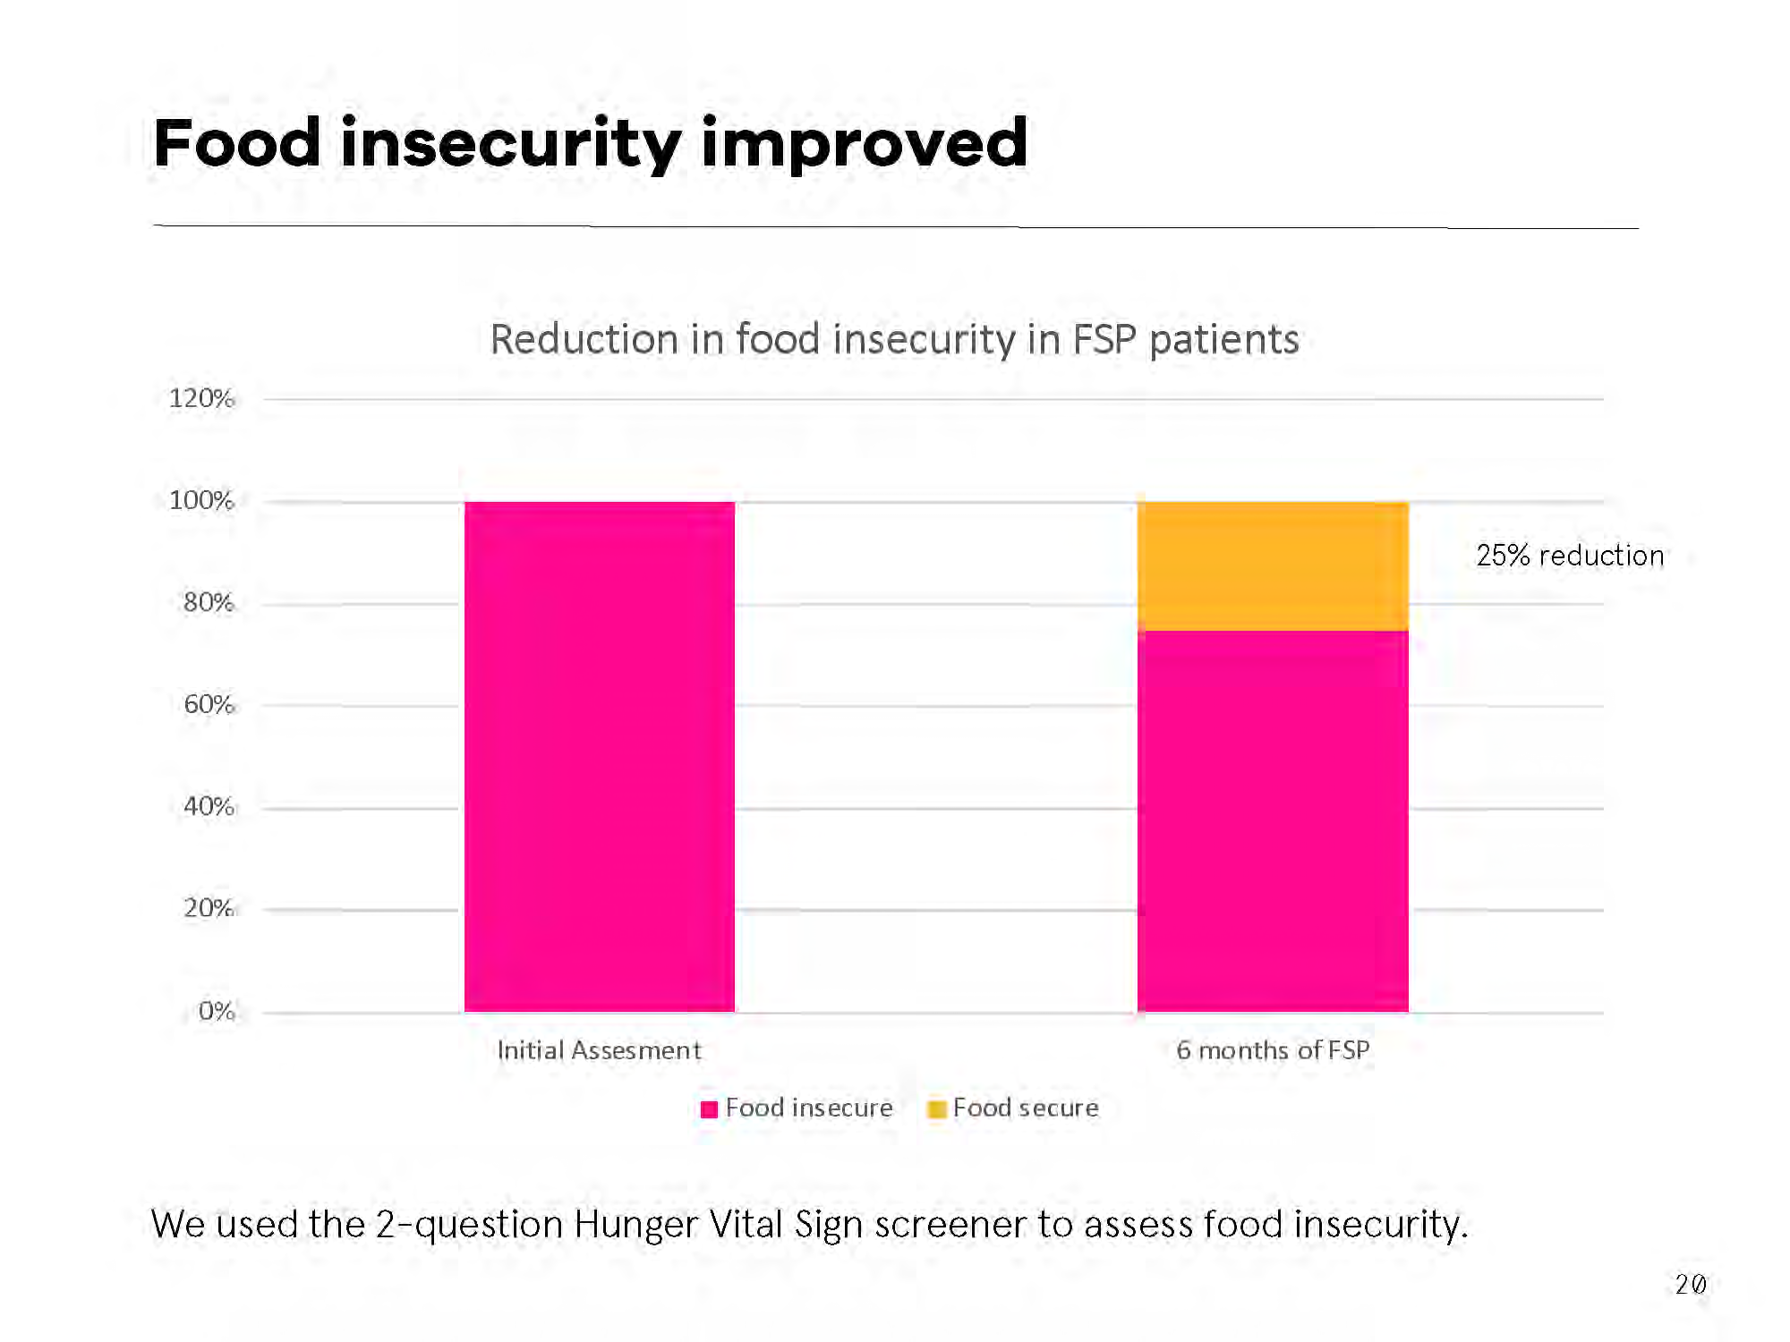

Slide 9
Diet quality improved
Ability to access healthy foods for 3+ weeks increased from 21% to 53% over six months of programming.
Fruit and vegetable consumption increased by 0.5 servings per day

Slide 10
Health care is a critical access point
SNAP Utilization
At initial assessment, 58% of clients were participating in SNAP at the time of the initial assessment
By 6 months, 72% of clients were participating in SNAP
Notes:
members enrolled in these intensive programs are already experiencing reductions in TCOC while our PB program is showing improvements in food & nutrition security, diet quality, health status, and diabetes control, all which bode well for longer term reductions in utilization and cost – and that we’re working on that data but we know that takes time.

Slide 11
Next Steps for Systems Change
Increasing Project Bread staff to increase our capacity
Increasing capacity at other organizations to meet state-wide need
Integrating program into operating practices of ACOs
Working with other states to create CMS billing codes and payment levels

