Slide 1
MassHealth Redetermination Campaign
Kathy Melley, Senior Advisor
Health Care For All
June 22, 2022

Slide 2
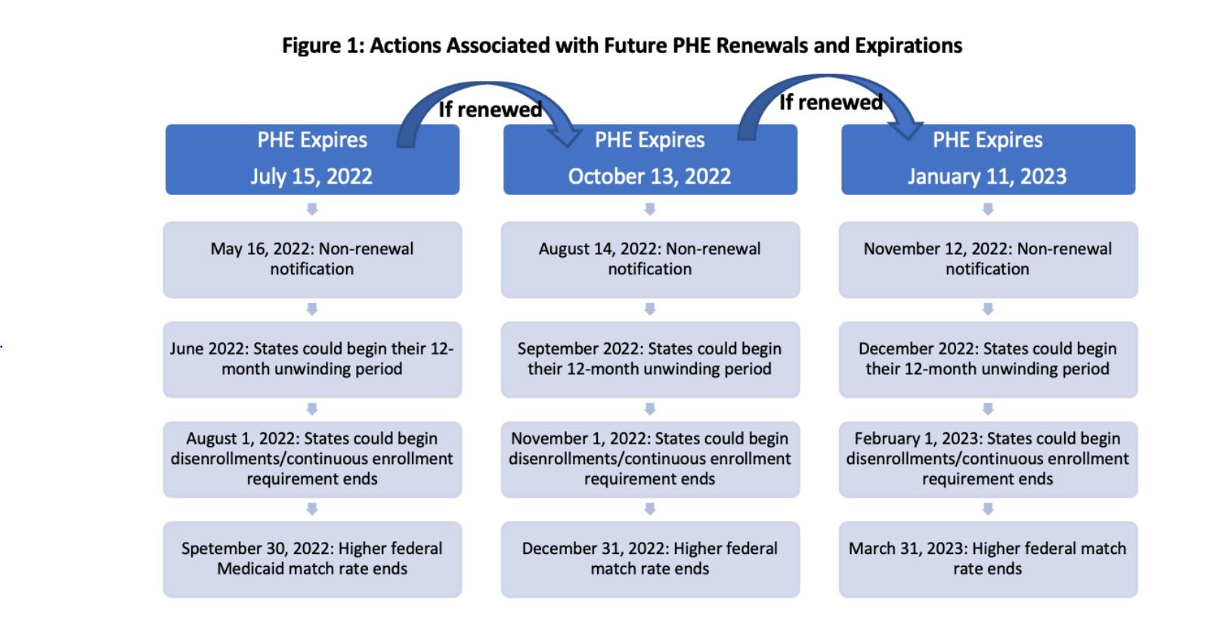
Potential Dates Related to PHE
The PHE is Continuing—What’s Next for Medicaid? - Health Management Associates

Slide 3



Campaign Goals
​
HCFA is partnering with MassHealth and the Health Connector on a large-scale targeted campaign to ensure Massachusetts residents keep their coverage and to reinforce information about COVID vaccinations.

Slide 4
Where: 15 Target Municipalities*
Boston
Brockton
Chelsea
Everett
Fall River
Framingham
Lawrence
Lowell
Lynn
Malden
New Bedford
Quincy
Revere
Springfield
Worcester
*Tentative list - subject to change

Slide 5
Populations and Languages
Culturally and linguistically appropriate campaign
Materials and communications in nine languages to reach target populations and adapted to ensure accessibility
  Arabic
  Cape Verdean Kriolu
  Chinese (Mandarin)
  English
  Haitian Creole
  Khmer
  Portuguese
  Spanish
  Vietnamese

Slide 6



The Strategy
Our multi-pronged approach will include:
2. A communications campaign that includes ads in targeted multilingual community-oriented outlets, digital ads, PSAs, and media outreach
1. Collaboration and engagement with community-based organizations (CBOs) and faith-based organizations (FBOs)
3. One-on-one outreach via door knocking/canvassing

Slide 7



CBO/FBO Partnerships
Community- and faith-based organizations from each of the 15 municipalities + organizations serving key populations, including people living with disabilities, people experiencing homelessness, and older adults
CBO/FBOs will deliver visibility activities and events:
Tabling and posters in areas of high pedestrian traffic
Fliers and tabling at community events
Posters, church bulletins, and events at local religious institutions
Business walks to distribute info and materials to local stores & businesses
Social media campaigns
Ambassador program for participation in media outreach, videos, key events
Joint events with local health centers, vaccination clinics/providers, and other stakeholders that reach targeted populations

Slide 8
MassHealth Redetermination Campaign
Current focus:
Mapping 3 campaign strategies to the 2 possible PHE-end timelines
Working toward an October expiration
  Message development, testing and materials design
  Developing the ad buy plan
  Writing canvassing script
  Developing trainings for canvassers and CBO/FBOs
  Finalizing CBO/FBO applications and selection process

Slide 9
Questions?
Thank you!
Please feel free to reach out:
www.hcfama.org
kmelley@hcfama.org

