Slide 1
MCLE Basic Benefits Training
SNAP 101:
Benefits & Eligibility 2025
Vicky Negus and Pat Baker,
January 29, 2025

Slide 2
Agenda
What is SNAP and what’s at risk in 2025?
Household composition rules
Specific populations: Students, Immigrants, ABAWDs
10 minute break
SNAP math & benefit amounts
Getting on: Applications, Interview, Verifications
Staying on: Reevaluations, Reporting Changes
Client rights: Language Access, Disability Accommodations, DV, Appeals
Advocacy Tips, Resources
Please ask your questions as they arise, we will monitor the online chat for virtual participants

Slide 3
Noteworthy 2024 Changes
SNAP benefit math | February increase to 200% gross income level. October 1st COLA increase in SNAP max. grants + increase to standard, shelter & homeless deductions.
Replacement of stolen SNAP benefits | Congress ended replacement with federal funds for SNAP stolen after Dec. 20, 2024. DTA implements lock/unlock EBT card feature.
State SNAP | Feeding Our Neighbors Campaign successfully gets $6 million in state SNAP benefits for certain lawfully present immigrants. DTA issues in early 2024. Benefits sunset April 2024.
Summer EBT | Summer EBT issued for the first time in summer 2024. ~$70 million federal dollars to ~600k kids.
SNAP Recertification interview | DTA re-starts Recertification interviews for some households after a pandemic pause.
Notice improvements | DTA starts issuing core approval, denial, & recalculation notices in Portuguese, Haitian Creole, Vietnamese, and Simplified Chinese (in addition to English and Spanish)

Slide 4
Challenges to come in 2025 & threats to SNAP
Significant Federal Threats | Congress proposing to cut SNAP through budget vehicles or the Farm Bill, etc. The new Administration may cut SNAP through regulation or policy changes. The new Administration may expand the “public charge” rules that would harm immigrants.
Access Issues | DTA will need resources to improve customer service/timely action on cases. For much of 2024, significant challenges getting through the Assistance Line to reach a worker, getting documents quickly looked at, etc. Caseload declined August - Dec. 2024. More households will need an interview when they recertify.
Stolen SNAP benefits | No replacement unless Congress or Gov. Healey/legislature authorize funds. No systemic protection in the checkout line unless DTA moves to chip/tap EBT cards. Risk of sophisticated phishing schemes.
ABAWD Time Limit (certain childless adults) | Time limit will restart in MA in 2025. 3 month time limit will apply to childless adults age 18 to 55 (Congress expanded from age 50) unless exempt or meeting work rules.
Collection on overpayments | DTA will collect on outstanding SNAP overpayments Includes overpayments that were DTA’s fault, and unintentional client mistakes

Slide 5
What is SNAP?

Slide 6
Supplemental Nutrition Assistance Program
100% federally-funded entitlement program.
Paid through Electronic Benefits Transfer (EBT).
Limited to food, vegetable/fruit plants & seeds (no hot foods).
Over 5,500 EBT retailers in state, including farmers markets, CSAs.
SNAP recipients qualify for HIP (Healthy Incentive Program).
Online purchasing available
Restaurant Meals Program in certain areas of state
for recipients age 60+, get a disability benefit, and/or homeless

Slide 7
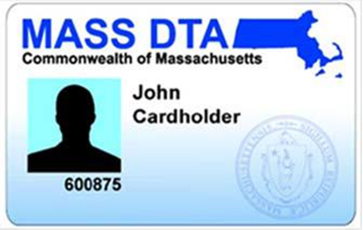
SNAP EBT cards
One EBT card issued to head of household
Most do not have photos on them
Everyone in SNAP household can use the card
Retailers cannot look at card, PIN is security code
To get help with food shopping:
Household can let trusted person to use EBT card/PIN.
Household can appoint an “Authorized Representative” to get 2nd EBT card to help them food shop.

Slide 8
SNAP theft
Summer 2022
December 2022
October 2023
December 20, 2024
SNAP skimming theft begins in MA
Congress provides federal $ to replace stolen SNAP
DTA starts replacement with federal $
Congress ends federal replacement for SNAP stolen after 12/20
Since 2022, sophisticated criminal rings have stolen more than $12 million from 25k MA families
State funds needed to replace stolen SNAP

Slide 9
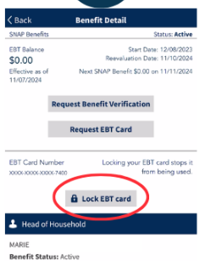
Right now: Protect SNAP & advocate for fixes
EBT card does not have chip/tap = vulnerable to skimming & theft
To try to protect SNAP from theft:
change PIN often
lock/unlock EBT card on DTAConnect
See Mass.gov/ProtectYourEBT - resources in 11 languages
Report theft to DTA for tracking
Advocate for fixes
Urgent need for state $ to replace stolen benefits!
Chip/tap EBT cards
Report cases to MLRI.

Slide 10
Replacement SNAP due to misfortune
If household loses food bought with SNAP because:
lost power for 4 hours +
fire
equipment failure (ie. fridge dies)
shut off of utilities
other “bad luck” reasons
Report to DTA loss of food bought with SNAP. DTA can replace up to one month of SNAP.
Report has to be within 10 days of the loss.
Household then has 10 more days to get key info to DTA via a self declaration or a form.
Learn more: Masslegalservices.org/SNAP-misfortune

Slide 11
Who qualifies for SNAP?
Most low-income households - including:
Families with children and pregnant people
Older adults and persons with disabilities
Unemployed/low-wage individuals
Other low-income individuals/families
U.S. citizens and many immigrants qualify.
Ineligible adults can apply for eligible dependents.
Must meet SNAP income limits/financial rules.
NO asset tests for most households.

Slide 12
Household Composition

Slide 13
What is a SNAP household?
People living together must be in the same SNAP household if they:
Typically “purchase and prepare” most (2/3) of their food together - even if they are not related to each other*
Are legally married spouses, living together
Are children under age 22 living with their parents
Are minors under age 18 living with responsible adults
*Note: Special rules for persons with disabilities & foster kids/Adult Foster Care, see SNAP Advocacy Guide

Slide 14
Household Example #1
Susan is 20
Works part time
Lives with her parents & barely eats at home
Susan must apply for SNAP with her parents. She is not eligible for her own SNAP - even though she rarely eats with them.

Slide 15
Household Example #2
James is 21
Single parent of a 2 year old
Lives with his working Mom and 2 teenage siblings
James and his child must be in the same SNAP* household with his Mom and siblings, until he turns 22 (and is making/buying most of his and child’s food separately).
*NOTE: TAFDC rules are different! James may be able to get TAFDC cash for himself and his 2 year old, without counting his Mom/siblings or her income

Slide 16
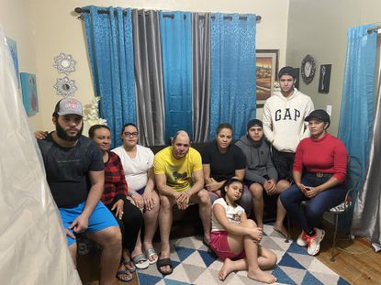
Household Example #3
Shawn lost his job and was evicted. His family moved in with his sister Carla and her family in a small apartment.
Carla works and gets SNAP for herself and her two young kids.
She typically prepares food for her kids and buys food separately from Shawn.
Shawn is going to food pantries and used the rest of his savings on groceries.
Shawn can apply for his family only as long as he is not customarily making and buying food together with Carla and her family.

Slide 17
Common client Qs about SNAP “households”
Do I have to list on the SNAP application everyone who lives under the same roof? NO
Do I have to include the SSN or income of people who are not part of my SNAP household? NO
Do I have to include my adult children who live with me? NO - if age 22+ and make/buy most of their food apart from you.

Slide 18
Homeless, Group Homes
& Senior Congregate Meals
Some households qualify for SNAP - even if getting prepared meals:
Homeless or domestic violence shelters
Licensed group homes
run by the Dept of Mental Health (DMH), Dept of Developmental Services (DDS) or other licensed group homes for persons with disabilities
Senior congregate living programs
Meals on Wheels or Senior Day Care
Notes:
‹#›

Slide 19
Example: Homeless Individual
Gary is a 62 year old homeless veteran. He gets many meals at a local shelter.
Gary is eligible for his own SNAP benefits even though homeless. He does not need cooking facilities and can use the SNAP to supplement his diet.

Slide 20
QUESTIONS?

Slide 21
Low-income college students & SNAP

Slide 22
SNAP College Student Rule:
Special SNAP eligibility rules apply to college students who are:
Ages 18 through 49
Enrolled in college half-time or more
Attending a college (post-secondary program) that requires a GED, HiSET etc.
Many low-income students in MA are SNAP eligible BUT need to tell DTA about an exemption to qualify.

Slide 23
College Students SNAP Eligible in MA:
SNAP eligible students (who meet financial and other rules) include:
Enrolled in community college or voc/tech program
Awarded Work Study and anticipates working
Receiving MASSGrant financial aid
Caring for child under 12 (specific rules apply if child is 6-11), or getting TAFDC cash benefits
Has an incapacity or disability OR
Enrolled in college through SNAP Employment and Training (ET).
* * *
If none of the above, students qualify if working an average of 20 hours/week (includes self-employment).

Slide 24
Community College students
Includes students in:
Community Colleges
Quincy College
Franklin/Cummings Institute of Technology
Regional Voc/Tech Students that offer post-secondary programs
Proofs required?
No DTA form needed. May be self-declared (telephonic or in writing) unless questionable.

Slide 25
Financial Aid Students
Work Study:
If awarded work study and anticipates working during the school period.
NOTE: Students offered a work study job, and decline are NOT SNAP eligible (unless other exemption).
Mass Grant:
If financial aid package includes MassGrant award
Proofs required? May be self-declared (telephonic or in writing) unless questionable.

Slide 26
Students with incapacity/disability
Student has an Impairment or disability that ability to work 20 hours a week and attend school.
Receiving a disability-based benefit like SSI, EAEDC, MassHealth as disabled
Enrolled through Mass Rehab Commission (MRC)
Licensed healthcare professional determines student cannot work 20 hours a week while attending school.
Receiving an accommodation at school based on disability
Proofs required? May be self-declared (telephonic or in writing) unless questionable.
See also USDA FNS Guidance, December 20, 2024

Slide 27
Student Example #1
Jane is 23 and a full time student at North Shore Community College majoring in Health Education.
Jane is eligible for SNAP (if she meets the income rules).
She tells DTA she is enrolled at North Shore during the application interview. DTA should not ask for more proof.

Slide 28
Student Example #2
Raquel is getting her bachelors degree at Worcester State.
She was awarded work study and is actively looking for a work study job.
Raquel is eligible because of her work study award. She can self-declare her work study during her application interview.

Slide 29
Student Example #3
Charles is a full-time student at UMass Boston.
He receives a MassGrant award.
Charles is eligible and can self-declare his MassGrant during his application interview.

Slide 30
Student example #4
Clarissa attends UMass Lowell.
She has dyslexia.
UMass office of accommodations has approved her for tutoring for her classes and time and ½ for taking tests.
Because Clarissa has a learning disability, DTA should exempt her from the student work rules.

Slide 31
Additional SNAP Student Rules
Students living with others may qualify for their own SNAP:
if they “purchase and prepare” 50% or more meals separately or
if they have a meal plans - it covers less than ⅔ meals
Students under age 22 and living with parents must apply with parents, or be added to parent’s existing SNAP household.
Student financial aid does not count toward SNAP (or cash) benefits:
Federal education $ and Work Study does not count
State, local, private financial aid does not count

Slide 32
Talking points for reaching students
Most low-income students are eligible for SNAP.
SNAP is “financial aid you can eat” - up to $292/month for 1 person household, more if living with spouse or children.
SNAP can help reduce other financial pressures, like paying for books and travel costs.
It’s easy to apply: Online through DTAConnect.com from a phone or computer, or call DTA or an outreach provider!
SNAP/student FAQs here: Hungerfreecampusma.org/resources/

Slide 33
Take action to address food insecurity on college campuses
Join the Hunger Free Campus Campaign: Hungerfreecampusma.org

Slide 34
Questions?

Slide 35
Eligibility for non-citizen immigrants
Basic Benefits training on Immigrants & Public Benefits at MCLE on March 19, 2025. Register here.

Slide 36
Immigrant eligibility - 4 key points
Immigrant parents can always apply for US citizen dependents - even if parent is not eligible!
No need to provide SSN or immigration status if applying for dependents, but immigrant must still verify their income.
Many lawfully present immigrants are eligible for federal SNAP.
DTA does not report any immigrants to USCIS or Homeland Security (unless shown a final order of deportation).

Slide 37
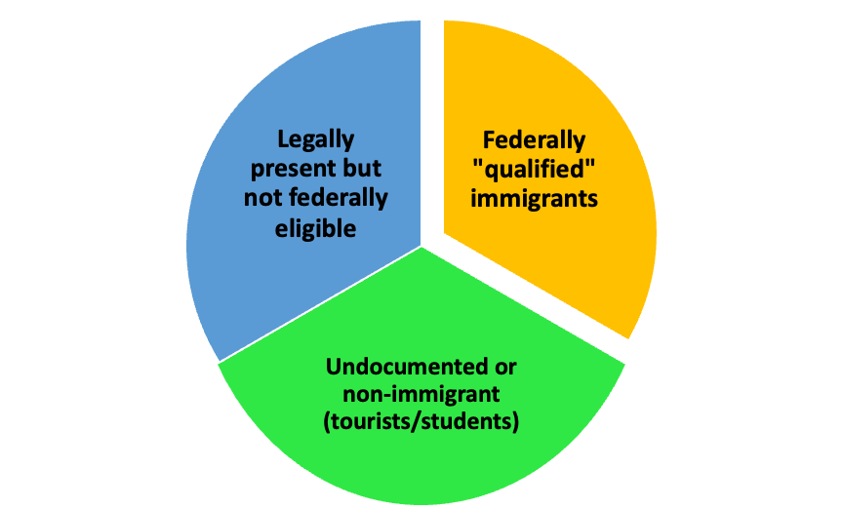
Three immigrant benefits groups
See MLRI and GBLS chart: Masslegalservices.org/content/incomefood-benefits-and-immigrant-eligibility-chart-eligible-statuses
See MLRI and GBLS chart:

Slide 38
Eligible for SNAP: NO waiting period
Entered US as a Refugee
Granted Political Asylum
Granted Withholding of Deportation
Victims of Trafficking (in persons)
Certain nationals of Cuba or Haiti (next slide)
Ukrainians who entered pre 10/1/24 with Humanitarian Parole
Iraqi and Afghan with Special Immigrant Visa status (SIV) and Humanitarian parolees
Afghan evacuees and Ukrainians with Humanitarian Parole

Slide 39
Cuban/Haitian Entrants:
“Cuban/Haitian entrant” is a public benefits status, not an immigration status.
Cubans or Haitians nationals with:
Pending political asylum
Granted humanitarian parole at any time and for any length (even if now expired)
In “removal proceedings” - but no final enforceable order of deportation issued
Granted LPR (green card) status granted under certain special federal laws that affect Cubans and Haitians
Benefits: Cuban/Haitian entrants qualify for federal benefits including SNAP, TAFDC cash or Refugee Cash assistance

Slide 40
Eligible for SNAP: But possible waiting period
MAY need to wait 5 years - unless exempt:
Legal Permanent Residents (“green card” holders)
LPR via relative, lottery, employer petitions
Humanitarian Parole with 365+ days of parole status
Certain battered immigrants (VAWA petitioners)

Slide 41
Eligible for SNAP: But possible waiting period
Exemptions from 5-year wait:
Children under 18
Adults who receive disability-based benefit
e.g. EAEDC cash, MassHealth/disabled
LPRs who have 10 years of countable work history in US or certain other countries
Work of self, spouse, and/or parents before LPR turned 18
If time needed to verify, DTA should approve for 6 months
The 5-year waiting period has ended

Slide 42
Immigrants NOT eligible for SNAP
Temporary Protected Status (TPS)
Pending political asylum (unless Cubans or Haitians)
Pending adjustment of status
U-Visas (victims of violence)
Dreamers/DACA (deferred action)
Certain Humanitarian Parolees with less than 365 days
Other immigrants “under color of law”
Also not eligible for SNAP:
Non-immigrant status - including foreign students, tourists, diplomats
Undocumented immigrants
Any immigrant who is not eligible can apply for eligible dependents/other eligible household members!

Slide 43
SNAP Benefits for “Mixed Status” Households
“Mixed status” are households with eligible & ineligible immigrants. Examples:
TPS or pending asylum parent with US citizen children
Families with LPR status - children eligible, adults must wait 5 years
Undocumented parent with citizen kids
DTA calculates SNAP in two ways:
Favorable calculation if the ineligible family member is legally present, verifies status with DTA & has income.
Unfavorable calculation if the ineligible family member is undocumented or opts out of verifying status with DTA & has income.
See Q 54 of SNAP Advocacy Guide.

Slide 44
Review:
Key Qs to ask clients:
Current immigration status?
Does it expire and when?
Prior status before now?
What country are they from?
How long in the US?

Slide 45
Immigrant Example #1
Harvec and Arja entered the US as refugees in November.
They have an arrival/departure record (I-94) and their Employment Authorization Documents, but don’t have their “green cards” yet.
They are both eligible now because of their Refugee status. They can show DTA either the I-94 or their EAD work authorization. They do not need a “Green Card” and do not have to wait 5 years to qualify for federal benefits.

Slide 46
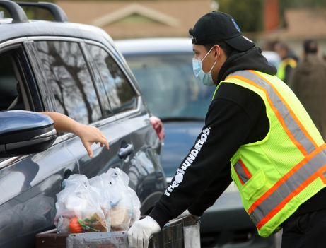
Immigrant Example #2
Juana has 3 young kids.
The family fled Venezuela in September 2023 and were granted Humanitarian Parole for 2 years.
Juana works at the local school’s cafeteria.
Her children are eligible for SNAP. Amount depends on her income - if she shows DTA she has lawful status, there is a more favorable SNAP benefit calculation.

Slide 47
Immigrant Example #3
Sarah recently fled her abusive husband with their child.
Sarah has filed a VAWA petition.
She has a work permit.
Sarah should be eligible for SNAP for her child. Sarah may also be eligible for TAFDC cash assistance for herself and child.

Slide 48
Immigrant Example #4
Ping is undocumented with a US citizen baby.
She entered the US with a student visa in 2018 but had to drop out of college.
She is planning to file for political asylum but has not done so yet.
Her US citizen child is eligible for SNAP and TAFDC. Ping is not eligible for SNAP or TAFDC for herself if she is undocumented.

Slide 49
The SNAP 3-month time limit - ABAWDs

Slide 50
What is the 3-month time limit/SNAP work rules?
So-called “ABAWD” work rules (Able Bodied Adults Without Dependents) - can only get 3 months of SNAP in 3 year period unless exempt from or meeting strict work rules:
Work paid or unpaid or in DTA school/training program 20 hours/week or do certain # of community service hours/month.
Many people are exempt!
Time limit will go back into effect in MA in 2025 in some areas of MA.
Some areas with elevated rates of unemployment may be waived.
DTA has to screen people for exemptions before starting the 3-month clock.
If cut off, can get back on SNAP if become exempt or meet the work rules
MLRI ABAWD training to come in 2025

Slide 51
Who is exempt from the time limit?
Under 18 or 55 or older or in SNAP household with child under 18 | Applied for or getting unemployment benefits
In school | Earning $217.50/week (14.5 hours/week in MA)
Homeless or at imminent risk of homelessness | Disabled or not able to work because of a health reason - short or long term, mental or physical
In substance abuse treatment program | Caring for a disabled person or child under 6, even if not living together
Veteran (any branch, regardless of discharge) | Was in foster care when turned 18, and is under 25
Pregnant | In refugee training program

Slide 52
QUESTIONS?

Slide 53
STRETCH BREAK – 10 mins

Slide 54
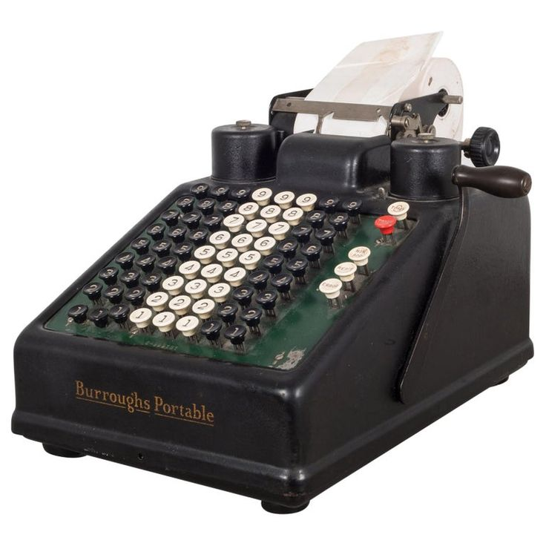
How SNAP Benefits Are Calculated

Slide 55
SNAP Financial Rules - Overview
NO asset test for vast majority of SNAP households
Most households must have pre-tax (gross) income under 200% FPL.
Monthly SNAP amount is based on “net” income, after certain allowable deductions - shelter, dependent care, medical costs (for 60+/getting disability benefit).
Many income sources do not count!

Slide 56
The SNAP math – 3 steps!
Determine SNAP household size and gross income:
Does household pass gross income test?
Determine household net income:
Which deductions are allowed?
Estimate SNAP benefit amount for household

Slide 57
Examples of non-countable income
All federal, state, local and private financial aid including - Pell, educational loans, work study, MassGrant, internships etc
Non-educational loans
AmeriCorps, VISTA, certain other stipends
Tax credits - Child Tax Credit, EITC
Earnings of high school students under 18
Certain third party vendor payments
Cash contributions from someone not legally required to give money – when money for specific purpose
Income spent on legally-obligated child support (if verified)

Slide 58
Figuring out Monthly Income
Determine the average weekly gross income
Multiply weekly income by 4.333 (not 4!)
For self-employment income including gig workers:
Only count pre-tax net income – after all business-related expenses
In general, SNAP looks at “anticipated” income over certification period, not income that has ended/terminated
Notes:
‹#›

Slide 59
SNAP Gross income Limit - 200% FPL
Household Size | Maximum gross monthly income (as of Feb 2025)
1 | $2,608
2 | $3,525
3 | $4,442
4 | $5,358
5 | $6,275
6 | $7,192
7 | $8,108
8 | $9,025
Each additional member | Add $917
Note:
Households with a senior 60+ or person getting a disability benefit do not have a SNAP gross income test.
BUT if gross income is over 200% FPL they have asset test & need very high expenses to qualify for SNAP. This is not common.

Slide 60
Example: Working student
Raquel is a student at Worcester State.
She works 15 hours/week with a cleaning company and makes about $200/week gross.
Raquel also gets financial aid and her uncle gives her $200/month to help her with her car payments.
Raquel’s earnings from her job counts for SNAP. None of her financial aid counts and the help from her uncle does not count because it is for a specific need - her car.

Slide 61
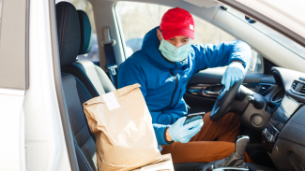
Example: Gig worker earnings
Charlie drives for a restaurant take out chain.
He’s an independent contractor, paid per delivery plus tips.
Charlie is leasing a car and pays a $350/mo leasing fee, plus car insurance, gas and tolls.
His vehicle costs eat up roughly half of what he earns from the driving.
If Charlie applies for SNAP, he should report his gross income and his business expenses - and DTA should only count his pre-tax net income after all his business expenses but before his income taxes, FICA and FUTA.

Slide 62
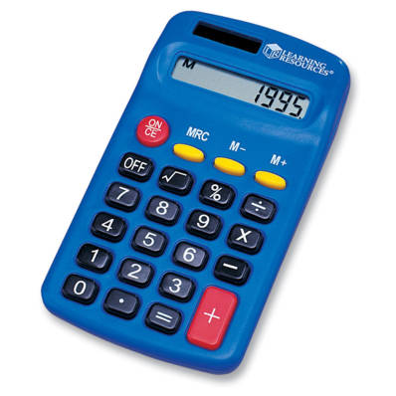
SNAP math - getting to net income
In general, SNAP is based on “net” income after 5 possible deductions :
A standard deduction based on household size
The 20% earned income deduction (off gross income),
Or pre-tax self employment - after business expenses
includes verified child support paid out of earnings
Health care costs of 60+ or getting disability benefit members only
Dependent care costs (child or disabled adults)
Shelter costs
rent/homeownership + utilities (standard utility allowance)
OR homeless deduction

Slide 63
How monthly SNAP amount is calculated
Three key steps:
Identify maximum SNAP benefit for the household size
Subtract 30% of net countable income after deductions
The difference is the monthly SNAP
The minimum SNAP for 1 and 2 persons < 200% FPL = $23
EXAMPLE:
Jane has two kids. She has net countable income of $900/month after child care and shelter deductions:
Max SNAP for 3: $768
30% of net income: - $300
Monthly SNAP: = $468

Slide 64
SNAP Monthly Benefits
Household Size | Maximum SNAP (as of 10/1/24)
1 | $292
2 | $536
3 | $768
4 | $975
5 | $1,158
6 | $1,390
7 | $1,536
8 | $1,756
Regular SNAP issued the 1st to 14th of the month - based on last digit of the household’s SSN.
SNAP benefits are usually adjusted (COLA) October 1st of each year.

Slide 65
Maximize SNAP with deductions
Four key deductions to maximize SNAP:
Child support paid to child outside of home
Child care and adult dependent care costs
Health care costs for persons age 60+ or disabled
AND
Shelter costs - rent or homeownership costs.

Slide 66
Child support paid out can boost SNAP
Legally-obligated child support paid out* by a household member:
Does not count as income, AND
When paid from earnings, child support amount is included in the 20% earnings deduction (higher deduction)
* Child support paid out must be verified - both the amount and the legal obligation (unless paid out of Social Security or Unemployment benefits).

Slide 67
Child support - example
Jules earns $700/wk - making $3,033/mo gross. Jules pays $1,000/mo court-ordered child support and $1,200/mo rent plus utilities.
If DTA counts $700/week earnings with no child support excluded, Jules over income for SNAP.
BUT if DTA correctly excludes the child support paid, Jules is eligible for $139/mo in SNAP.

Slide 68
Dependent Care Costs Can Boost SNAP
The cost of child care or disabled-adult care are also a deduction including:
If needed for adult to work, attend school or look for work
Includes costs of YMCAs, summer day camps, after-school programs
Includes cost of transportation to/from (if driving, at federal mileage rate)
Dependent care costs can be self-declared!

Slide 69
Dependent Care Example
Jaime has 2 kids and earns $700/week. He pays:
$1,500/mo in rent & has heat costs.
$500/month for babysitting.
Has mileage totals $200/month driving his kids child care.
No child care and travel costs claimed | $315/mo SNAP
Claims childcare and travel | $525/mo SNAP

Slide 70
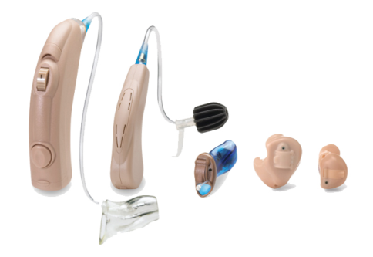
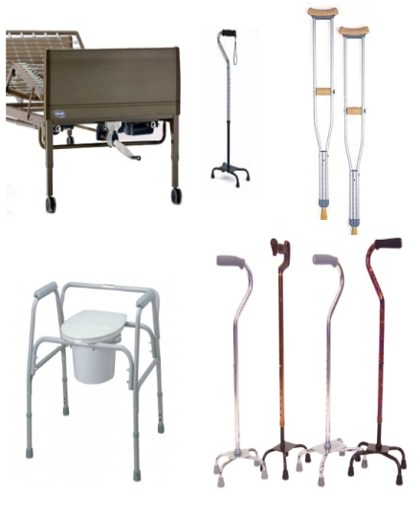
Health Care Expense Deduction

Slide 71
Healthcare costs can boost SNAP
For SNAP household members who are 60+ or getting a disability benefit
Incur unreimbursed medical costs of $35/month or more
Can be self-declared if monthly costs are between $35 & $190
Notes:
‹#›

Slide 72
Common types of Health Care Costs
Medicare Part D, private insurance premiums and co-pays
Over-the-counter health care
pharmacy and “medicine chest” items
Hearing aids, batteries, eye glasses
Outstanding one-time bills
Dental and vision care
Adult dependent care
Durable medical equipment
Travel to MD, therapists, pharmacies
T-pass, bus, taxi/Uber, etc - or car mileage (fed mileage rate)

Slide 73
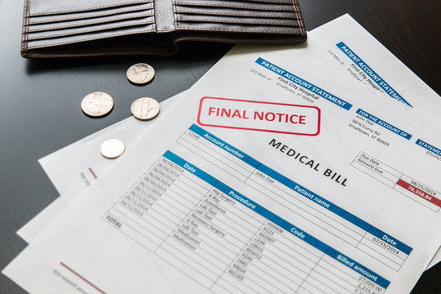
Sample proofs for healthcare costs if claiming $190+
Written or verbal statement for mileage costs
Unpaid bills or paid receipts
Insurance bills with premiums amounts due
Pharmacy print out of co-pays (can remove drug names/dosages to protect private information)
Receipts that show cost of OTC drugs, vitamins (statement or Rx from MD not required!)
Public/subsidized housing “rent calculation worksheets.” See MLRI handbook: Masslegalservices.org/HousingSNAPguide

Slide 74
Shelter expense deduction
If household is homeless: standard homeless deduction of $190/month
If household has shelter costs:
Capped shelter deduction of $712/month or
Uncapped shelter costs if any SNAP household members are age 60+ or getting disability benefit
Notes:
‹#›

Slide 75
What counts as shelter costs?
Monthly rent due OR
Homeownership costs – mortgage, property insurance, real estate taxes, condo fees
And a “Standard Utility Allowance” (SUA) amount added to rent/home ownership
*Note special rules adjusting these households to the full heating/cooling SUA. See Advocacy Guide for more information.
$890 | Heating/cooling or fuel assistance
$542 | Electricity/cooking gas (if no AC)*
$62 | Phone/cell phone only*

Slide 76
Shelter Deduction- Example
Massachusetts family of 3:
Income from work is $2,500/month
Rent is $1,000 + additional heat costs
No one is 60+ or disabled, no child care costs
Shelter costs = annual difference of $2,568 for food!
NO shelter costs claimed:
Monthly SNAP = $229
Shelter costs claimed:
Monthly SNAP = $443

Slide 77
Checking approved SNAP amount/balance
Notices: DTA “Benefit Decision Notice” approval and update notices list SNAP amount & what DTA used to calculate SNAP.
does not include calculation - if you need it, email the DTA Ombuds.
Online: DTAConnect has client information on the monthly EBT benefit, when issued and balance
By Phone - two options:
DTA Assistance Line for information on current balance & monthly benefit
EBT Customer Assistance line for current EBT balance

Slide 78
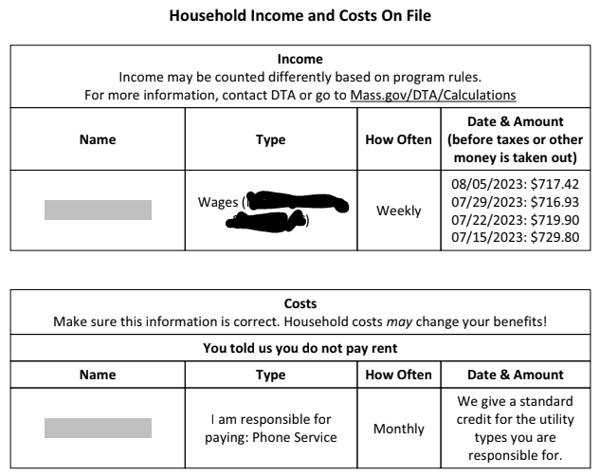

Slide 79
Calculators for SNAP math
MLRI’s Online SNAP Calculator: Masslegalservices.org/content/online-snap-calculator
MLRI Excel calculator and paper worksheet: Masslegalservices.org/SNAPCalculator
Notes:
‹#›

Slide 80
QUESTIONS?

Slide 81
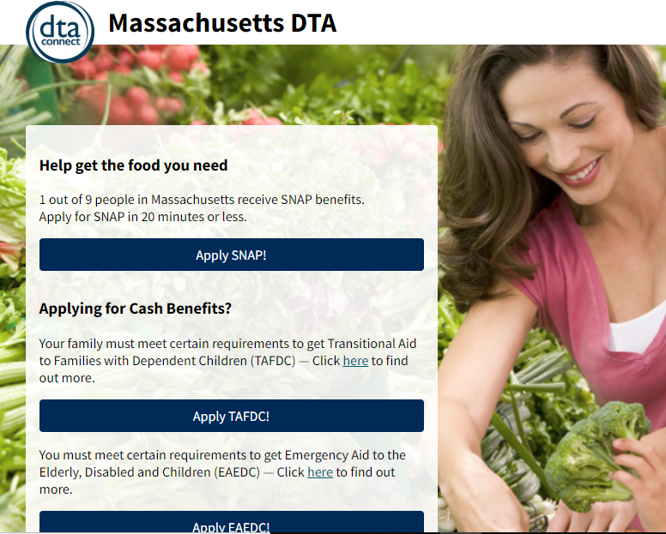
How to apply for SNAP + check case info

Slide 82
Applying for DTA Benefits
SNAP only
TAFDC or EAEDC cash benefits
DTAConnect.com
By mail/fax (paper apps in 13 languages, Mass.gov/SNAP)
By phone: 877 382-2363 (press #7) or if 60+: 833 712-8027
In person at DTA office
By phone through DTA Outreach Partner. List: Mass.gov/SNAP
Via checkbox on MassHealth/Medicare Savings Plan applications
DTAConnect.com (online or smartphone)
Call local DTA office and leave a message
In person at a DTA office
DTA Connect applications in English, Spanish, Portuguese, Vietnamese, Haitian Creole & Chinese
No need to make an account

Slide 83
Example: Applying for SNAP
Carol lost hours at work and is struggling to feed herself and two kids. She calls your food pantry for help but you realize she might also be eligible for SNAP.
If Carol has a smartphone and is comfortable filling out an online application, she can go to DTAConnect.com and apply for SNAP immediately.
If she has enough minutes on her phone, or access to a free phone, she can call the DTA Assistance Line OR call a SNAP Outreach Partner and apply.
If she has no or very low income, tell her about TAFDC cash benefits.

Slide 84
Do not delay filing application!
Do not wait to apply if you do not have all the information yet.
Waiting to apply denies SNAP to low-income household
If approved, benefits are retroactive to the date of the application
Except for when missing proof documents provided between 30 & 60 days from date of application - then, SNAP prorated if the delay was applicant’s “fault”

Slide 85
The SNAP application interview
All applicants must have an interview with DTA.
by phone or if household chooses, in person.
DTA should cold call applicant within 1-2 days of getting application. If household does not answer, DTA sends a notice with date/time for interview.
Applicant can call DTA Assistance Line anytime before interview date/time!
Applicant has right to in-person interview if preferred.
DTA must call on date/time of scheduled interview.
Interview is to talk through application, ask additional Qs, review/assess household composition, share SNAP rules, answer questions, etc.
DTA should schedule interview within 7 days of application date. Interview must be done within 30 days from date of application.
During interview DTA worker must screen for expedited SNAP.

Slide 86
Expedited SNAP
Eligible for expedited if household:
shelter costs > gross income and assets
gross income < $150, assets < $100 or
migrant household, assets < $100
Expedited DTA has to provide SNAP & EBT card within 7 days of application
Proof of identity is only verification required (DTA verifies SSN = verification of identity)
SNAP benefits issued for between 1-2 months
Notes:
‹#›

Slide 87
Verifications
Documents households provide, such as:
Pay stubs or pension information
Receipts or bills from health care providers
Proof of legal immigration status
Information DTA gets through state or federal databases, such as:
Social Security (RSDI or SSI)
MA Unemployment Benefits
Child support through MA Department of Revenue

Slide 88
Verifications (continued)
Collateral contact - Information DTA confirms directly with a third party-usually when household is having a hard time getting proof (such as proof of income).
Self-declarations – Statements from the household DTA should accept (unless “questionable”), such as:
U.S. citizenship
Shelter (rent or homeownership costs)
College student status
Type of utilities (heating/cooling, etc)
Child care/adult day care costs
Health care costs between $35-$190/mo for people 60+/getting disability benefit

Slide 89
“Questionable” information:
DTA may ask for more proof when information appears to be “questionable.”
Questionable means information must be INCONSISTENT with previous statements made by the client OR with other information DTA has.
Worker MUST write a case note explaining why something is questionable.

Slide 90
“Questionable” example
Fia applies for SNAP, to show MA residency sends in lease.
Lease states rent is $1,000/mo.
During interview Fia says her rent is $2,000/mo.
Worker asks Fia to explain the difference. Fia says her rent amount is twice the amount on the lease, but the lease was signed the month she applied. This could be considered questionable.
Worker asks for proof of rent, and explains why proof was requested in the case narrative.
Fia applies for SNAP, to show MA residency sends in lease.
Lease states rent is $2,000/mo.
During interview Fia says her rent is $1,000/mo.
Worker asks Fia to explain the difference. Fia explains she has a roommate (she doesn’t make/buy food with) and they split the rent. This is NOT questionable.
Fia’s self declaration that her rent is $1,000 is accepted.
VS.

Slide 91
Verifications at SNAP application
Identity of household head
DTA confirms when verifying SSN with the Social Security Administration
Other proofs acceptable if necessary
MA residence
DTA can confirm with RMV if client has MA ID or MA driver license
Other proofs acceptable if no MA RMV record
Self declaration if homeless or meeting other criteria
Income
“The Work Number” (if employer participates)
Social Security, SSI, DOR Child Support and Unemployment databases
Pay stubs, letter from employer, self employment proofs
Lawful immigrant status - if applying / showing status for favorable SNAP calculation

Slide 92
Example of Verifications
Jane is 67. Her only income is $1,050/mo Social Security. She pays for rent & heat. Social Security deducts $240/mo for the Medicare deductible.
Jane reports she buys monthly vitamins and goes to the Y for exercise.
DTA directly can verify:
Jane’s identity when verifying her SSN
MA residency with the RMV because Jane has a MA ID
Social Security & Medicare deduction from SSA
Jane self-declares on her application:
she isn’t working
her rent and utility costs
her over the counter vitamins and gym costs
DTA does phone interview & approves SNAP.

Slide 93
Core Verification RIGHTS
Self-declare certain expenses (verbally or in writing)
DTA must consider any reasonable proof submitted
Get help from DTA – “worker assistance”
Have DTA accept the “best evidence available” for income
Get a decision within 30 days (if not expedited) – and if denied for proofs, can get re-opened within 30 days
Appeal a denial or termination

Slide 94
DTA worker assistance
DTA workers are required to help clients get verifications.
Help doesn’t mean just one thing!
Explain different types of proof documents
Discuss a “reasonable accommodation” due to disability
Do a “collateral contact”
Get information that can be verbally self declared
Check to see if proof is already on file
Look at data from other agencies
Accept the “best evidence available” for income

Slide 95
Best evidence available: Case Example
Janet is 78 and lives with her husband
Her income is RSDI and a monthly pension of $150
Her pension is deposited directly into her bank account, she doesn’t get monthly statements
She has been retired for 15 years and does not know how to reach the employer

Slide 96
Best evidence available: Case Example
What does Janet do?
Send DTA a letter with her pension amount & copy of bank account deposits.
Explain she does not have other proof because her employer does not send paper statements and she doesn’t know how to get in touch with them.
Give DTA permission to call the employer.
What should DTA do?
Accept the proof she can provide.
If DTA can find contact information, DTA can try to call the pension employer.
If not successful, DTA must accept the “best evidence available” and approve the application with a pension amount of $150/month.

Slide 97
Getting an EBT card
Answer application question if have a EBT card OR need a card
To get an EBT card:
DTAConnect.com, DTA Connect mobile app, DTA Assistance Line (follow prompts)
Go to local DTA office.
Call DTA Ombuds if regular mail or in person not helpful (eg. emergency for someone who can’t go in person).
Possible to have card overnighted (takes 2-3 days) or in extreme circumstances sort out in person delivery option.
EBT card sent by mail usually takes ~3-7 days to arrive

Slide 98
DTA communications to households
DTA will text/email at certain times, including:
When the SNAP application is received
If an interview is scheduled or missed
If proofs are missing
When the application is approved or denied
Quick tip: Easy to update phone #/email on DTA Connect.

Slide 99
DTA Connect
DTA Connect mobile app & DTAConnect.com:
Notices for last 12 months
Update key information like contact info, rent, child care, medical costs (DTA often act on updates automatically!)
Case status
Lock/unlock EBT card
Deposit history
Upload documents
Do Recertification or Interim Report
Request EBT card

Slide 100
Assistance Line
(877) 382 2363
If on SNAP, recently on, or applied, if authenticate can get specific case info via phone system without talking to a worker
Reach a worker for SNAP or cash
Update contact info
Request EBT card
Connect directly with DV help or Client Assistance Coordinator
Report loss of food due to misfortune for replacement SNAP
*If can’t authenticate, press 7 at beginning to reach a worker

Slide 101
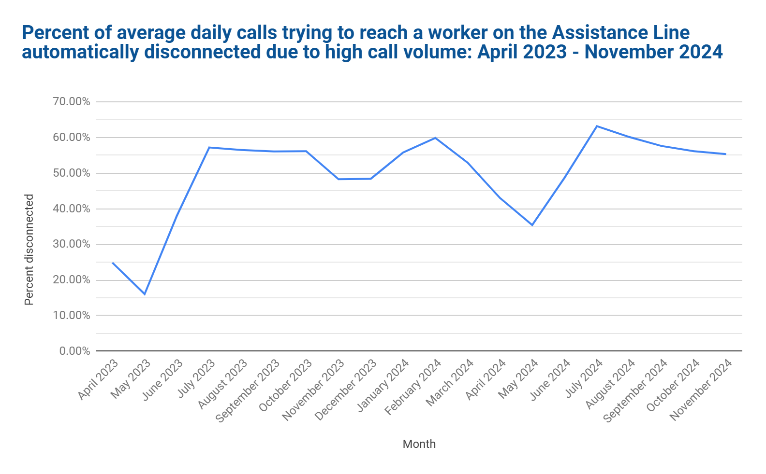

Slide 102
Advocacy Tips: How to Reach DTA
MLRI’s Advocacy Tips
Check/use DTAConnect
If age 60+, call Senior Assistance Office
Go to a local DTA office
Call the Ombuds Office
Call your State Rep or Senator
And:
Document calls/attempts
Possibly file an appeal

Slide 103
Submitting documents to DTA
Upload via DTA Connect app or DTAConnect.com online account (fastest option)
Fax to 617-887-8765
Go to local DTA office
Mail to:
DTA Processing Center
PO Box 4406
Taunton, MA 02780
Put DTA Agency ID or last 4 of SSN on the top of each page if faxing or mailing documents.
See DTA’s contact info on Mass.gov here

Slide 104
Senior Assistance Office (SAO)
SAO number: (833) 712-8027
Live DTA workers answer phone, no IVR
Handles applications filed by older adults 60+
Any older adult 60+ can call SAO for SNAP help!
SAO staff also help clients identify medical costs and maximize medical expense deduction

Slide 105
QUESTIONS?

Slide 106
Reporting changes
& reviewing eligibility

Slide 107
Keeping SNAP: Reevaluation paperwork
Paperwork is required:
Every 12 months for most SNAP cases
Some have to do an Interim Report after 6 months.
Every 36 months for cases with only seniors/persons with disabilities & no earnings (“EDSAP”)
To complete:
Do by phone
Online on DTAConnect
Mail/fax/bring to local office
Household must respond to an Interim Report or Recertification!
SNAP ends if paperwork is not done.

Slide 108
What has to be reported between paperwork periods?
EDSAP (60+ or disabled, no earnings) must report if
someone starts working, OR
someone leaves or joins the SNAP household
For other SNAP-only households, ONLY have to report when household income exceeds 200% FPL for the household size.
But, if someone in case is 60+ or getting disability benefit, don’t have to report any changes
Report these changes by the 10th of the month following the month of the change.
Different rules apply for households getting TAFDC or whose TAFDC recently ended & for some households getting just SSI. See MLRI reporting rules chart.

Slide 109
Reporting Example:
Jayna is a mom of 2 who starts SNAP on April 1st after losing her job. She starts a new job in May.
The pay she gets in May puts her income over the SNAP gross income test of $4,442 (for 3 people)
Jayna needs to report new earnings to DTA by June 10. Her SNAP will end starting July.

Slide 110
QUESTIONS?

Slide 111
Protections for specific populations

Slide 112
Disability Access & Accommodations
DTA Client Assistance Coordinators (CACs)
CAC contact info is here
Common accommodations –
Help with forms, verifications, understanding notices
Reminder calls
Sign language interpreter
Large print notices
See DTA’s Disability Access Info & CAC brochure
If issues with access due to disability - contact CAC and/or legal services.

Slide 113
Domestic Violence Protections
Block DTA Connect & automated info from Assistance Line – can request verbally
Heightened Level of Security (HLS)
broader level of protection than DTA block
Contact DTA Ombuds Office about this option
DV Specialist in each DTA office
If issues with DTA rules because of DV - contact DV specialist and/or legal services.

Slide 114
Language Access
Right to free interpreter!
Core DTA notices in 6 languages
DTAConnect.com & Assistance Line in 6 languages
Some DTA brochures available in additional languages
DTA case specific texts/emails in English and Spanish
If issues with language access - contact DTA Ombuds Unit at 617-348-5354 and/or legal services.

Slide 115
Problem solving – advocacy tips
MLRI’s Advocacy Tips
Contact Assistant Director or Director of local DTA office. DTA Local Office Contacts
Contact DTA Ombuds Unit: 617-348-5354 or email sara.craven@mass.gov
DTA needs permission from client to talk to you. Specific form not required – can be photo of simple handwritten note. See sample.
Appeal: Help client file appeal within 90 days of date of notice.
Call DTA Division of Hearings at 617-348-5321 & leave message, or
Fax appeal form or written request for hearing to 617-348-5311
Contact Legal Services

Slide 116
QUESTIONS?

Slide 117
Additional benefits and resources

Slide 118
The Added Benefits of SNAP
SNAP Households can also receive:
Healthy Incentives Program (HIP) – EBT for purchases at Farmers Market, Farm Stands, CSAs
Currently $20/month for all households (reduced as of December 1, 2024)
Join Mass Food Systems Collaborative campaign to restore funding for HIP: MAfoodsystem.org
~$120/K-12 child for Summer EBT!
EBT “Card to Culture” – free or discounted museum and theatre passes with EBT card
Regulated utility discounts
Easier/faster applications for Fuel Assistance
MBTA Youth Pass discounts
DTA Employment & Training programs - including childcare voucher!

Slide 119
Cash benefits and other resources
Families cannot live on SNAP alone!.... Help them apply for:
DTA Cash Assistance: TAFDC for families with kids/pregnant people, EAEDC for older adults/persons with disabilities with no or very low income. DTAConnect.com
Chapter 115 Veterans Benefits: Monthly cash benefit for needy MA Veterans, dependents & parents of veterans. Mass.gov/service-details/chapter-115-benefitssafety-net-program
Child care subsidy: If not on TAFDC or in SNAP E&T, call 2-1-1 to get on waitlist. See child care flyers.
MA Child & Family Tax Credit - includes families with low or no income: FindYourFunds.org
RAFT - Rent, mortgage, and utilities help: Call 2-1-1 or go to Mass.gov/how-to/apply-for-raft-emergency-help-for-housing-costs

Slide 120
SNAP Advocacy Resources
2024 SNAP Advocacy Guide available HERE (2025 coming soon!)
All MLRI’s Advocacy Guides available for free on MassLegalServices.org
MassLegalHelp.org
MLRI’s How to talk about SNAP: Messaging/information for households reluctant to apply
Join the MA SNAP Coalition (monthly zoom meetings)!
Contact Vicky Negus vnegus@mlri.org or Pat Baker pbaker@mlri.org to join.
DTA Regulations and the DTA Online Guide

Slide 121
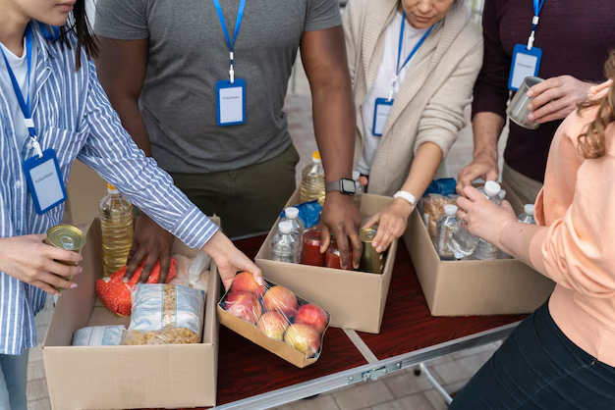
Emergency food resources
o Call Project Bread’s FoodSource Hotline: 1-800-645-8333
o Call Mass 2-1-1
o Direct info from the Food Bank in your area:
Greater Boston Food Bank: GBFB.org/need-food
Food Bank of Western MA: Foodbankwma.org/get-help/locate-a-local-feeding-program/
Worcester County Food Bank: Foodbank.org/find-food/
Merrimack Valley Food Bank: mvfb.org/member-agencies/

Slide 122
Legal Services
Free civil legal services for low-income people, including help with:
Benefits
Housing
Immigration
Disability, MassHealth
Employment
Family law
CORI/re-entry
Find Legal Aid programs across Massachusetts

Slide 123
Stay connected with legal aid and advocacy community
Help us identify problems and trends
Seek support on administrative appeals
Get advice on challenging cases
Engage with coalitions
Support clients in speaking out

Slide 124
QUESTIONS? And THANK YOU!

