Slide 1
Transgender Health Access Project
Accessing Gender-Affirming Care
December 8, 2021
Kara Hurvitz
Staff Attorney

Slide 2
HLA’s Transgender Health Access Initiative
Legal representation for income-eligible transgender clients
Trainings about access to coverage and appeals for transgender consumers
Policy advocacy through the Transgender Health Access Coalition

Slide 3
Trans Health Access Coalition
Participating organizations
AIDS Action Committee
Boston Health Care for the Homeless Program
CHLPI
Community Catalyst
Fenway Health
GLAD
Health Care For All
Health Law Advocates
Mass. Transgender Political Coalition
Mass Equality
PFLAG
Planned Parenthood League of Mass.
Notes:
Andrew
Can ask if there are any AmeriCorps members serving at any of these organizations? BHCHP has an AmeriCorps program

Slide 4
Transgender clients
Common Case Issues:
Denial of medically necessary services
Insurance reimbursement of services
Navigating prior authorization processes
Accessing out-of-network/state providers
Non-transgender-specific matters

Slide 5
Gender-affirming care
Hormone Replacement Therapy (HRT)
Surgery
“Top surgery”
“Bottom surgery”
Facial feminization surgery, other body-sculpting surgery, etc.
Hair removal

Slide 6
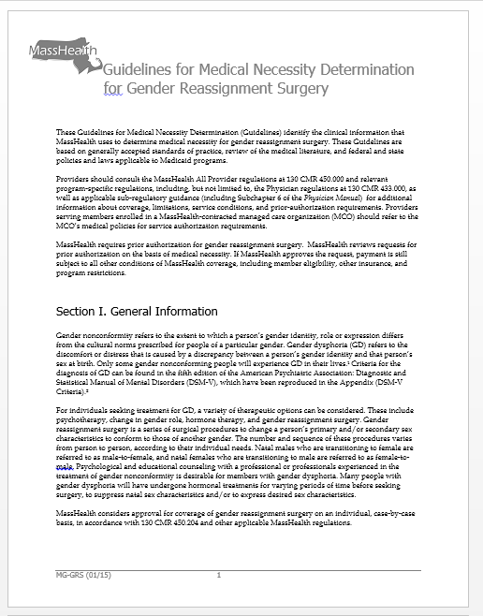
Barriers to care
“Cosmetic” vs. medically necessary care
Provider billing issues
Cultural competency
Burdensome prior auth.
Age of majority restrictions and parental consent
Inadequate provider networks
Uncovered services

Slide 7
MassHealth Medical Necessity Guidelines: Hair Removal
Major change:
Added coverage for facial neck/hair removal
Relevant regs:
130 CMR 405.000: Community Health Center Services
130 CMR 410.000: Outpatient Hospital Services
130 CMR 433.000: Physician Services
130 CMR 450.000: Administrative and Billing Regulations

Slide 8
MassHealth Medical Necessity Guidelines: Surgery
Major changes:
Removed requirement for two mental health clinician letters (though two clinical letters are still required)
Removed exclusion of vocal therapy
Removed age barrier for masculinizing chest surgery
Relevant regs:
130 CMR 415.000: Acute Inpatient Hospital Services
130 CMR 410.000: Outpatient Hospital Services
130 CMR 433.000: Physician Services
130 CMR 450.000: Administrative and Billing Regulations

Slide 9
Recent THA Policy Work
Response to MassHealth medical necessity guidance
Submitted response to new guidance and advocacy for next steps in early December
Response to DOI Bulletin 2021-11
Major changes to private insurance guidance to prevent discrimination in access to gender-affirming care
THA provided written commentary on 10/15
Attended listening sessions on 10/8 and 10/22

Slide 10
Looking Ahead
WPATH Standards of Care 8
The World Professional Association for Transgender Health is the leading authority for gender-affirming care best practices in the medical community
They are currently in the process of updating their Standards of Care
Public comments on each section are due by December 16 at 12pm

Slide 11
Questions?
Kara Hurvitz
Staff Attorney
P: 617-275-2846
E: khurvitz@hla-inc.org

