Slide 1

DTA Data Updates for SNAP Coalition
Massachusetts Department of Transitional Assistance | November 10, 2020

Slide 2
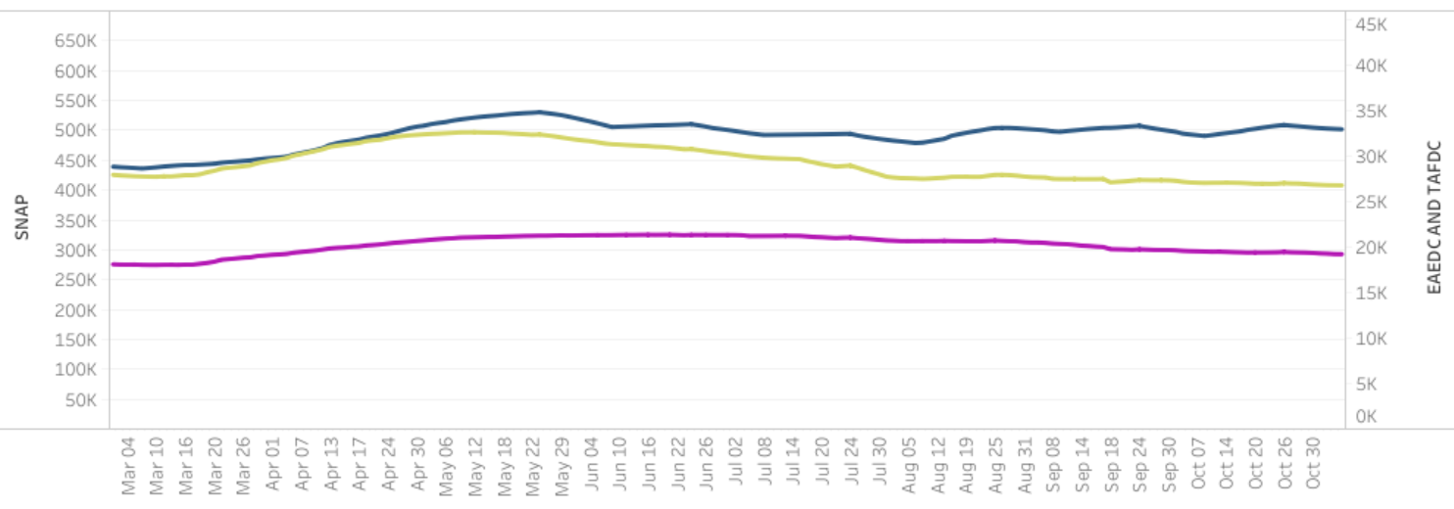

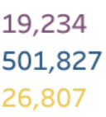

DTA Daily Active Cases: Mar 2020 - Present

Slide 3
SNAP Monthly Cases: Dec 2019 - Present

Slide 4
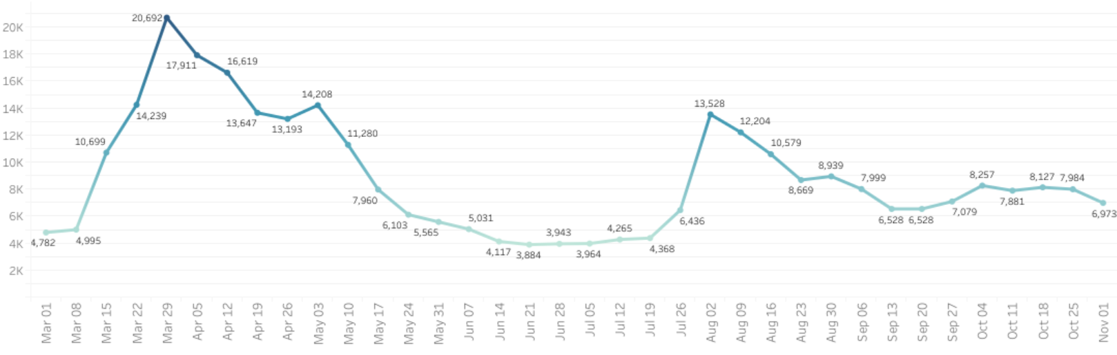
SNAP Applications Weekly: Mar 2020 - Present

Slide 5
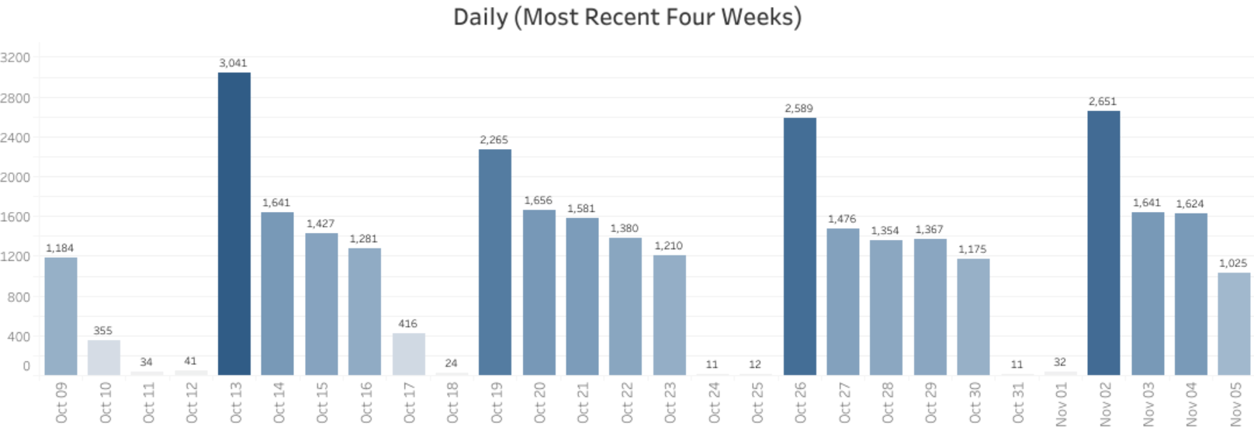
SNAP Applications Daily: Past 28 Days

Slide 6
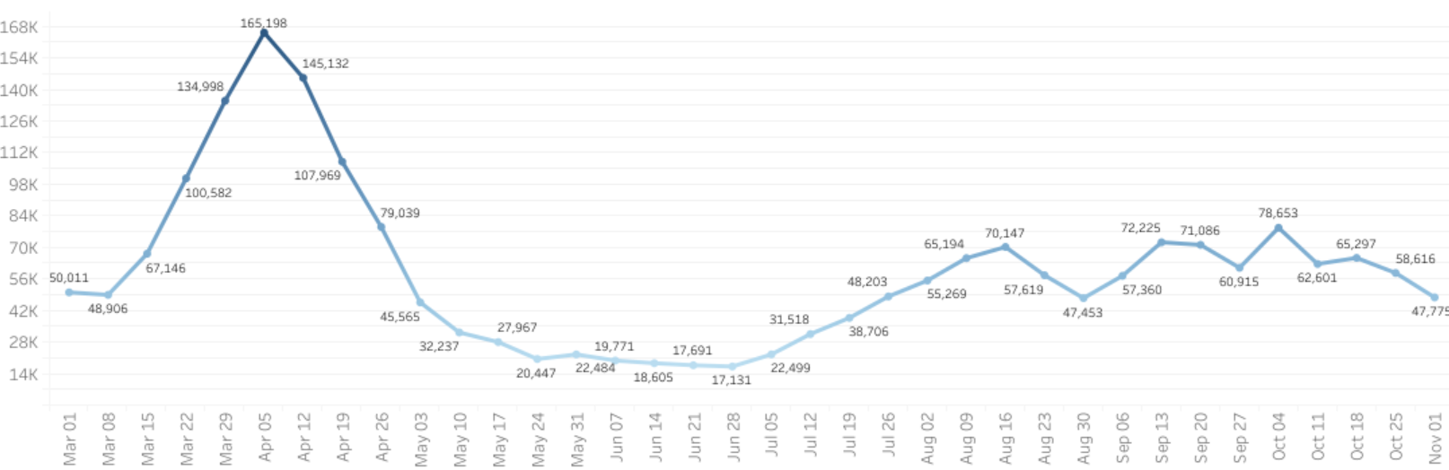
SNAP Weekly Pending Cases: Mar 2020 - Present
Pending on 11/5/20: 11,280

Slide 7
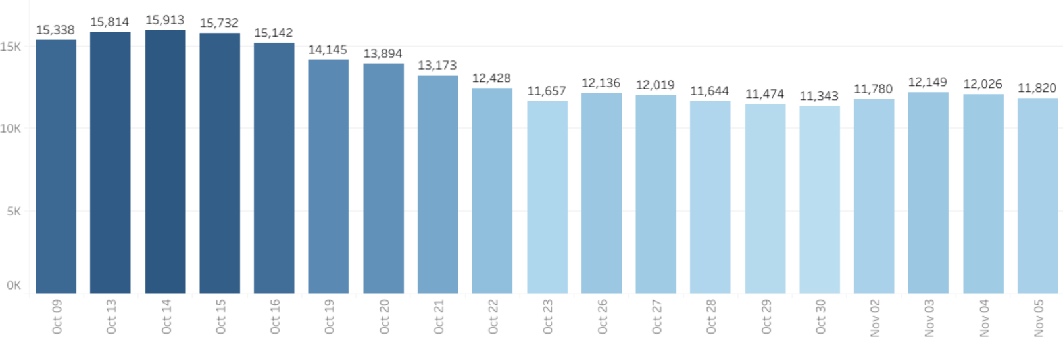
SNAP Daily Pending Cases: Past 28 Days

Slide 8
DTA Monthly Call Volume: Jan 2020 - Present

Slide 9
DTA Monthly Call Wait Times: Jan 2020 - Present

Slide 10
Days to Approve a New SNAP Application: 2019-20

Slide 11
DTA Data Updates for SNAP Coalition
Massachusetts Department of Transitional Assistance | November 10, 2020

