Slide 1
Winter 2024
MassHealth and the Health Connector Updates

Slide 2
MA Health Care Learning Series
The MA Health Care Learning Series provides regular updates and presentations from Health Connector and MassHealth staff, to educate those who help Massachusetts residents in applying, getting and keeping their health coverage through MassHealth, the Health Connector and Health Safety Net via MAhealthconnector.org.

Slide 3
Agenda
2023-2024 MassHealth Redetermination Update
Reminder: Citizenship and Immigration
Health Connector Reminders

Slide 4
2023-2024 MassHealth Redetermination Update

Slide 5
End, Extension of Certain Flexibilities
As of April 1st, 2024, MassHealth completed selection of members for renewal as federally required for the COVID Public Health Emergency redetermination period
Moving forward, MassHealth will continue renewing members coverage annually
Ending, extension, or making permanent of certain flexibilities:
Flexibilities ending as of 4/1:
Temporary federal authorities that allowed additional income and resource disregards for non-MAGI members
Allowing Hospital-Determined Presumptive Eligibility (HPE) for non-MAGI members: MassHealth will no longer allow HPE for non-MAGI members
The process and policy will return to pre-PHE (2020)

Slide 6
End, Extension of Certain Flexibilities
Extension of Flexibilities
MAGI only:
Autorenewals for zero income: In effect until 6/1/24, MassHealth will continue to auto-renew members who report zero income, but whose income could not be confirmed through data sources
Autorenewals for null income: In effect until 6/1/24, MassHealth will continue to auto-renew members who report income under 100% FPL, but whose income could not be confirmed through data sources
Temporary ARD for Certified Application Counselors (CACs)
Extended to December 31, 2024
Notes:
TP: Note: When the above flexibilities are discontinued on 6/1/24, it is expected that fewer members will auto-renew as a result of the discontinuations. Members in these circumstances will be expected to submit a renewal to receive a final and accurate determination.

Slide 7
End, Extension of Certain Flexibilities
90-day reconsideration period –extending to 1/1/25:
MassHealth’s reconsideration period is a 90-day period where members can submit their renewal after their coverage was terminated for not submitting the renewal form or did not respond to an VC/RFI related to a renewal by the original due date
A renewal submitted during the reconsideration period ensured members did not experience a gap in coverage if they remain eligible. If the member submits the renewal within 90 days, they would be reinstated back to the date of termination if they continue to be eligible once the renewal and any VCs/RFIs related to that renewal were complete
Reinstating benefits back to the date of closing so there is no gap in coverage should be done regardless of how long it takes MassHealth to process the renewal and related VCs/RFIs as long as the renewal was received by MassHealth within 90-days of the benefit termination date
This flexibility will remain in effect until at least 1/25/25
Notes:
TP: Reinstating benefits back to the date of closing ensures there is no gap in coverage regardless of how long it takes MassHealth to process the renewal and related VCs/RFIs as long as the renewal was received by MassHealth within 90-days of the benefit termination date

Slide 8
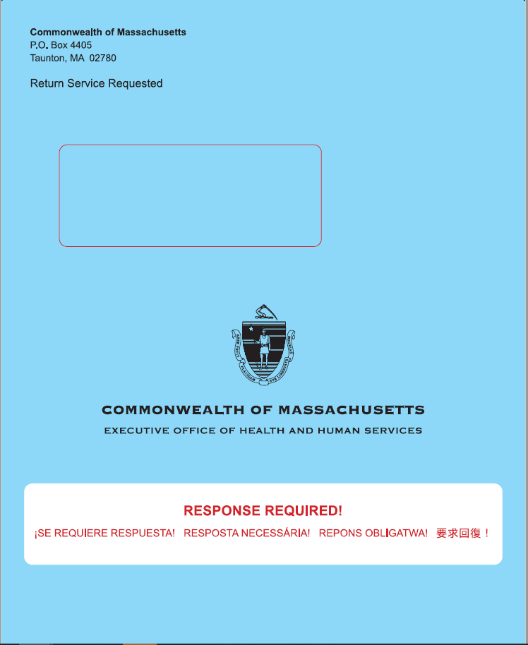
Permanent Flexibilities
Pharmacy copays: Effective 4/1, MassHealth permanently eliminated pharmacy copays for ALL members including HSN, and CMSP members
Blue renewal envelops
Non-MAGI: Timeline to Respond to Renewals and VCs
Request for information or VCs: MassHealth will permanently extend response timelines to 90-days for VC for most non-MAGI members
Renewals: MassHealth will permanently extend response timelines for non-MAGI members for renewals to 45 days

Slide 9
Reminder: Citizenship and Immigration

Slide 10
Eligibility Requirements
MassHealth and the Health Connector require verification of the following eligibility factors to make an eligibility determination:
Residency
Social Security Number
Income
Citizenship
Immigration Status
Incarceration
Non-custodial Parent Info (MassHealth only)
American Indian/Alaska Native (Health Connector only)

Slide 11
Who May Qualify for MassHealth?
U.S. Citizen or U.S. National
Lawfully Present Immigrants - three categories
Qualified Noncitizen (including Protected Noncitizens) - QLP
Certain Qualified Noncitizen Barred - QAB
Certain Nonqualified Individuals Lawfully Present - ILP
Certain Nonqualified Persons Residing Under Color of Law (PRUCOL)
Certain Other Noncitizens
As a condition of eligibility, an applicant or member must be a resident of the Commonwealth of Massachusetts and meet other universal eligibility requirements
Any applicant confined even if not convicted is not eligible for MassHealth

Slide 12
Who May Qualify for Health Connector coverage?
U.S. Citizen or U.S. National
Lawfully Present Immigrants - three categories
Qualified Noncitizen (including Protected Noncitizens) - QLP
Certain Qualified Noncitizen Barred - QAB
Certain Nonqualified Individuals Lawfully Present - ILP
Must be a resident of Massachusetts
Not in jail

Slide 13
Reminder: Citizenship and Immigration
The online application system at MAhealthconnector.org or HIX, provides a selection option for both the Citizenship and Immigration documents to allow individuals to indicate when they do not have a required document available from the predefined list.
U.S. Citizen Document Selection
If an individual indicates they are a naturalized, acquired, or derived U.S. Citizen and their status cannot be verified by SSA, the HIX system will present a new document selection option to select if they do not have a Naturalization or Citizenship Certificate available
The selection option will state: “I am a naturalized, derived, or acquired U.S. citizen, but I do not have a Naturalization Certificate or Citizenship Certificate, and I need more time to provide acceptable document information.”
Notes:
Part of R24

Slide 14
Citizenship and Immigration: Screenshots

Slide 15
Citizenship and Immigration: Screenshots

Slide 16
Immigration Document Selection
Immigration Document Selection
If an individual indicates they have an eligible immigration status but does not have an immigration document available from the predefined list, the HIX system will present the document selection option to allow the individual to select
The selection option will state: “I have an eligible immigration status, but my immigration document is not available at this time and I need more time to provide this information, or my immigration document is not listed above, or my immigration document does not have the required information.”
When either of these options are selected, either a citizenship or immigration RFI will be sent to the member or applicant
Notes:
The applicant or member will be given a reasonable opportunity period (90 days) to provide proof of their immigration document.

Slide 17
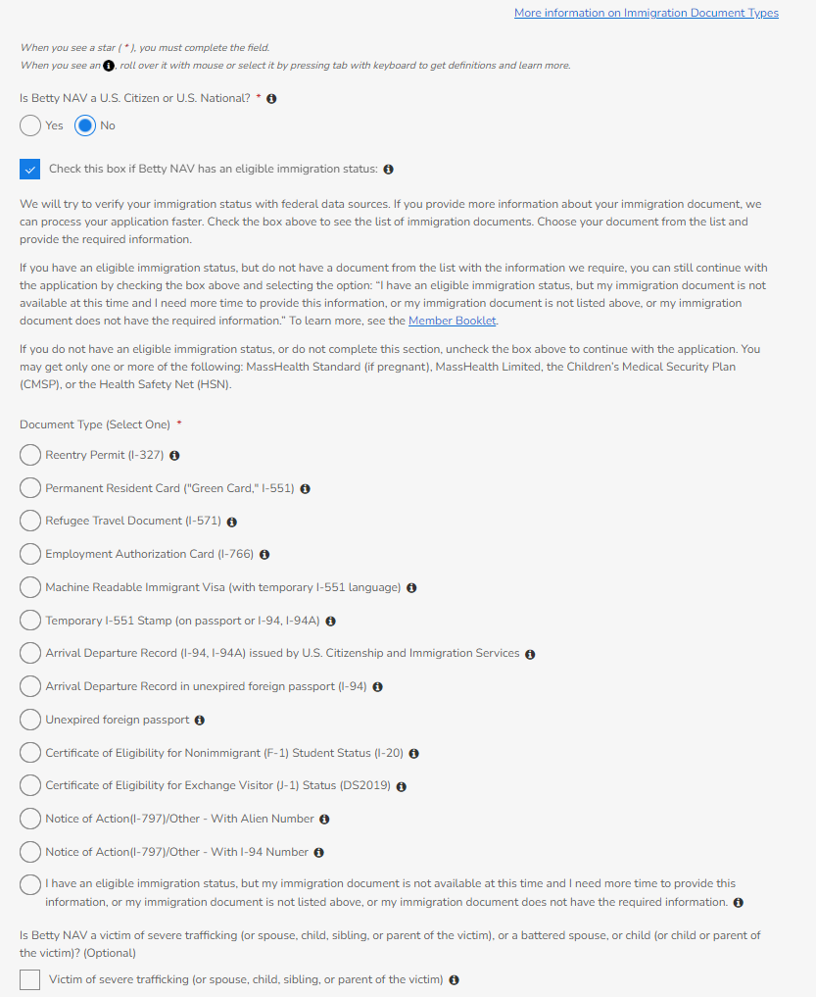
Citizenship/ Immigration Status: Example
Notes:
The system shall display the following question to the Individual or Agent Portal user on the “Citizenship/Immigration Status” screen in the SSAP flow:
Question:
“Is [Benefit Applicant] a victim of severe trafficking (or spouse, child, sibling, or parent of the victim), or a battered spouse, or child (or child or parent of the victim)? (Optional)
a. Victim of severe trafficking (or spouse, child, sibling, or parent of the victim)
b. Battered spouse or child (or child or parent of the victim)”
The user shall be able to select either one of these values, or both these values, or leave them both unchecked.
New Tooltip
The system shall display the following tooltips for “Victim of severe trafficking” and “Battered spouse or child” on “Citizenship/Immigration” status screen in SSAP flow:
Tooltip for “Victim of severe trafficking” option will be as follows:
“Includes a person (and certain relatives) that has been granted a nonimmigrant visa under section 101(a)(15)(T) of the Immigration and Nationality Act (8 U.S.C. 1101(a)(15)(T)) or who has a pending application that has a prima facie determination for this status. This nonimmigrant status provides immigration protection to victims of trafficking and allows victims to remain in the United States and help law enforcement authorities in the investigation and or prosecution of human trafficking cases.”
Tooltip for “Battered spouse or child” option will be as follows:
“Includes a battered spouse or child if they have an approved or prima facie case determination on a (1) self-petition for an immigrant visa filed under the Violence Against Women Act (VAWA), (2) immigrant visa filed for a spouse or child by a United States citizen or lawful permanent resident (LPR), or (3) application for cancellation of removal or suspension of deportation under VAWA. (4) Also, includes the parent or child of such battered spouse or child.”

Slide 18
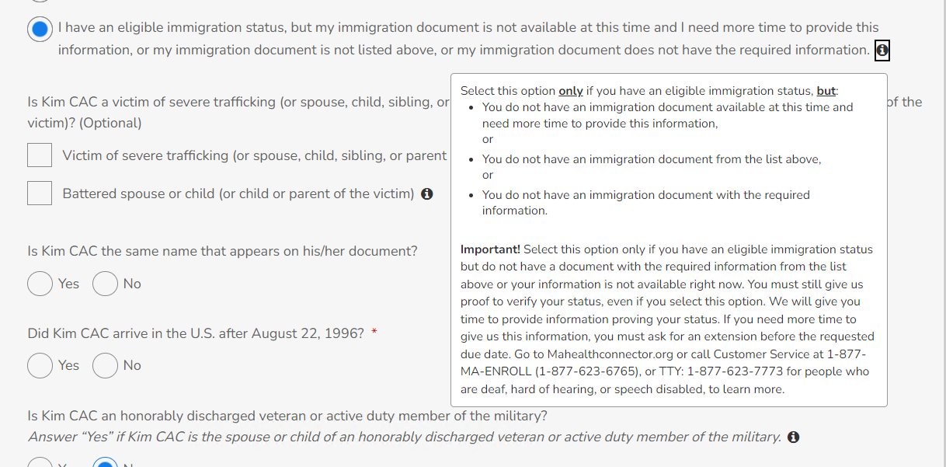
Immigration Status: Screenshots

Slide 19
When to Use the No Document Option
The “no document” type selection options will contain tool tips and users should select this only if they have a valid citizenship or immigration status, but do not have a required document from the predefined list provided in HIX
The following are examples of applicants who may be expected to use the new “no document” selection options:
Individuals who are newly naturalized and have not yet received their naturalization certificate
PRUCOL individuals who have applied for an immigration status but have not been granted a status yet and do not have a document available from the predefined list (e.g., PRUCOLs with I-797 applications that do not contain Alien or I-94 numbers)
Afghan Evacuees or Cuban/Haitian Entrants who have fled their countries and did not have an opportunity to get their immigration documents in order

Slide 20
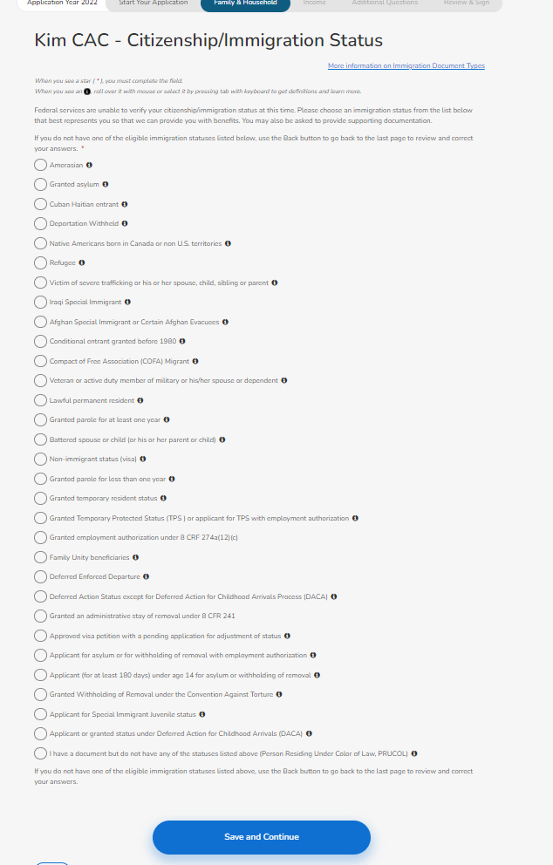
Citizenship/ Immigration Status

Slide 21
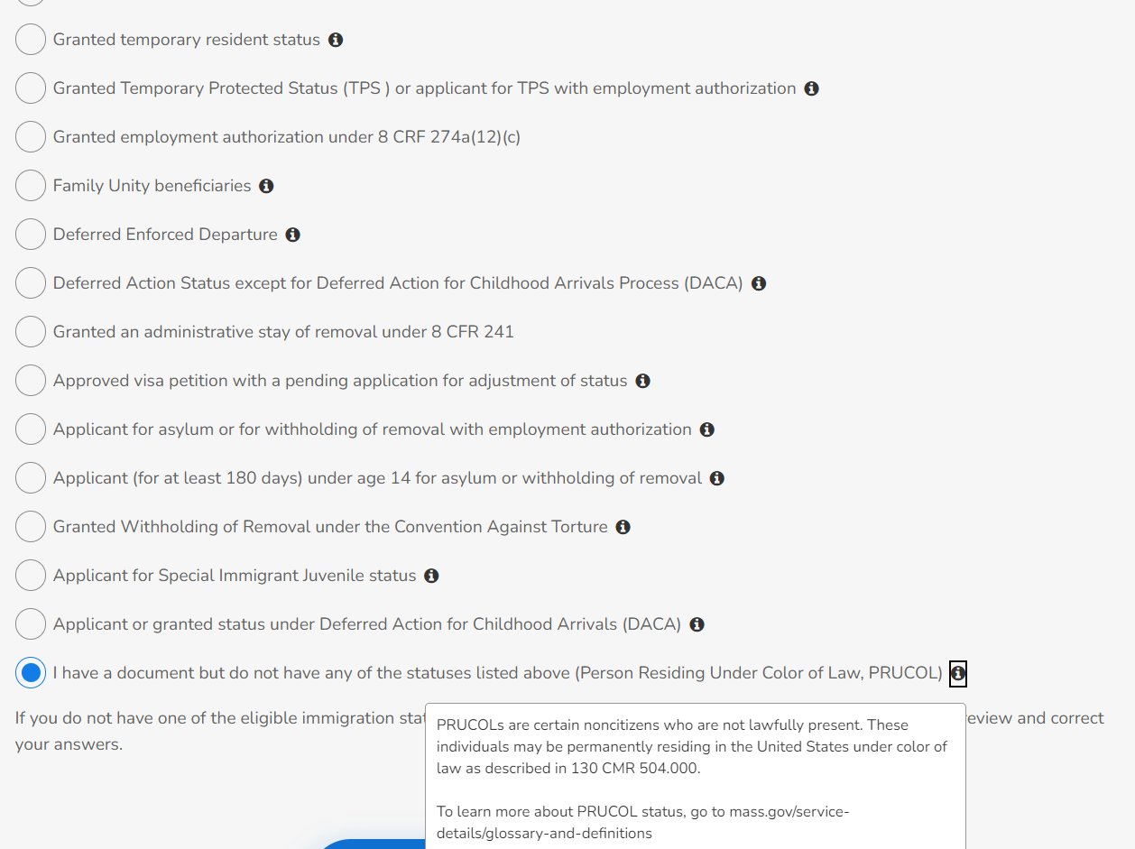

Slide 22
Reasonable Opportunity Period
Reminder: Reasonable opportunity period (90 days)
The individual has 90 days from receipt of the RFI notice for citizenship and immigration documents to provide all requested verifications.
Reasonable opportunity extension
Applicants/members having difficulty providing the requested documentation of immigration, can request a 90-day reasonable opportunity extension
Must be requested before the original RFI period expires

Slide 23
Reminder: Valid Nonimmigrant Visas
Per MassHealth regulations, applicants, and members with valid, unexpired “nonimmigrant visas” such as B1 (work visa) and B2 (visitor) visas are considered Immigrants Lawfully Present (ILP)
Other valid nonimmigrant visas such as J1 (work and study-based exchange visa) and F1 (student visa) would also place a member into ILP status
If an applicant or member with a nonimmigrant visa satisfies residency and other requirements, they may be eligible for MassHealth benefits or Health Connector coverage
In some situations, a person may enter the country on a valid nonimmigrant visa and apply for a different immigrant status during that time. If an applicant’s nonimmigrant visa expires, but the applicant can provide proof of their filed application for an upgraded status with the Department of Homeland Security (DHS), or for an extension of their visa (and they do not yet have employment authorization) they may qualify for PRUCOL or Person Residing Under Color of Law status

Slide 24
Additional Resources
Additional Resources: Recently published MassHealth Eligibility Operations Memos about eligibility for certain noncitizen groups:
EOM 22-03: Eligibility Rules for Cuban and Haitian Entrants
EOM 22-04: Verification of PRUCOL Status
EOM 21-15: MassHealth Benefits for Afghan Immigrant Evacuees

Slide 25
Reminder: Cuban and Haitian Entrants
Cuban and Haitian entrants are defined as certain nationals of Cuba and Haiti who have permission to reside in the U.S. based on humanitarian considerations or under special laws that apply to them
For MassHealth eligibility, these individuals are considered Qualified Non-Citizens
The Cuban/Haitian entrant categories are defined in 501(e) of Refugee Education Assistance Act (REAA)
Not every national of Cuba or Haiti is a Cuban/Haitian entrant
Immigration documents – Applicants coming from Cuba or Haiti could have other types of immigration statuses that could put them in a different healthcare eligibility category
If available, submit the documents with the application
Notes:
In some circumstances, the children of Haitian nationals are born in another country, prior to entering the United States. MassHealth has clarified that the children of these nationals would be considered Haitian nationals as well, and thus eligible for Haitian Entrant status if they satisfy the criteria for Haitian status described in this EOM. This clarification does not apply to the children of Cuban nationals born abroad at this time.

Slide 26
Application Completion Tips and Reminders
Answer all questions and print clearly
Put identifying information on documents such as D.O.B, name, and or SSN number
Put a telephone number that applicant/member can be reached
If you are an enrollment assister, list your direct telephone number
Ask applicants or members you are working with all the questions; don’t assume responses
Submit documents, such as immigration documents, with the application and provide the document ID# and the Alien number if it is available

Slide 27
Health Connector Reminders

Slide 28
Special Enrollment Periods (SEP)
If an individual qualifies for a SEP, they can enroll in or change health insurance plans outside the annual Open Enrollment period.
Changes that allow an individual to qualify for a SEP are called Qualifying Events, and may include:
Changes in household composition, income, immigration status, or address
Certain life changes, like getting married, having a baby, or losing job-based health insurance
All Qualifying Events should be reported as soon as possible
A SEP gives someone 60 days from the date of the qualifying event to select a new plan
Individuals may pay after the 60-day window, but they must submit a plan selection in the shopping process within 60 days—a plan in their shopping cart is not enough
Payment and enrollment deadlines still apply during a SEP

Slide 29
Qualifying Events
Gains a dependent or becomes a dependent as a result of:
Marriage
Birth, adoption or placement for adoption or foster care or court-ordered care of a child
Loses minimum essential coverage (MEC) for a reason other than failure to pay premiums or fraud
Loses pregnancy-related coverage or medically needy coverage under the Social Security Act
Is enrolled in Health Connector coverage and loses a dependent because of death, divorce or legal separation
Moves to Massachusetts or gains access to new plans as a result of a permanent move (including release from incarceration)
Is an American Indian or Alaska Native
Becomes a Lawfully Present individual
Is determined newly eligible for ConnectorCare or has a ConnectorCare plan type change
Is enrolled in Health Connector coverage and becomes newly eligible or ineligible for APTCs
Is a victim of domestic abuse or spousal abandonment
Start or end of a ConnectorCare premium waiver
Exceptional circumstances
Waiver from the Office of Patient Protection
Erroneously enrolled or not enrolled due to error, misrepresentation, or misconduct or inaction of the Health Connector or entity affiliated with the Health Connector providing enrollment activities
Carrier substantially violated a material provision of its contract with the enrollee
NOTE: A new applicant who applies during closed enrollment and is determined eligible for tax credits only and who doesn’t meet another qualifying event above, does NOT qualify for an SEP as a result.

Slide 30
ConnectorCare SEPs
Becoming newly eligible for ConnectorCare gives consumers 60 days to enroll from the date of the eligibility determination. This includes individuals who recently became eligible for ConnectorCare due to the FPL limit increase to 500%.
The online system will look at any existing eligibility to determine if consumer is newly eligible
ConnectorCare members cannot change plans unless they experience a new qualifying event, which includes a change of plan type or the start or end of a ConnectorCare premium waiver
Example: John applies on 4/1 and is determined ConnectorCare eligible. He has 60 days to shop. He picks a plan and pays his first premium by the due date and is enrolled in a ConnectorCare plan
In June, John reports an income change to his application that results in a ConnectorCare Plan Type change. John is eligible to change plans, as a ConnectorCare Plan Type change is a qualifying event

Slide 31
Helping those no longer eligible for MassHealth coverage
As a reminder when working with applicants and members, if someone loses their MassHealth coverage as part of the ongoing MassHealth renewal process, that is considered a Qualifying Life Event (QLE). This means they can enroll in a plan with the Health Connector outside of the regular Open Enrollment Period.
The Health Connector will continue to extend a special enrollment period until November 23, 2024 for those individuals who lost MassHealth during calendar year 2024, or on or after April 1, 2023 and have since been determined eligible for but remain unenrolled in a qualified health plan
For more information, review the Health Connector’s Administrative Information Bulletin 01-24 Guidance Regarding Special Enrollment Periods Due to the End of the Medicaid Maintenance of Effort (MOE) and the Federal COVID-19 Public Health Emergency (PHE) and National Emergency for Calendar Year 2024.
Note: These rules do not apply to enrollment in MassHealth, HSN, CMSP or a Health Connector dental plan or those enrolling in Health Connector for Business.

Slide 32
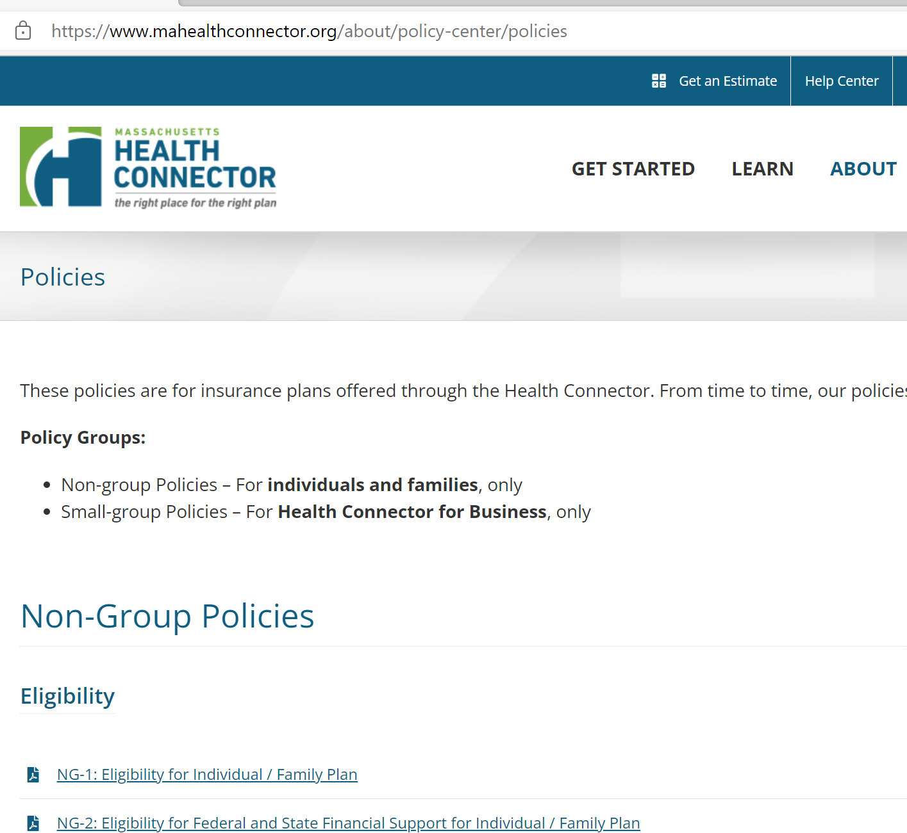
Health Connector Policies
To review the complete policy on qualifying events for individuals and families go to: Policy NG-5 Mid-Year Life Events or Qualifying Events (mahealthconnector.org)
To find all of the Health Connector policies, go to the Policy Center
Policies – Massachusetts Health Connector (mahealthconnector.org)

Slide 33
Zero Cost Medications
Starting with plan year 2023 and for plan year 2024, all ConnectorCare plans began including certain medications associated with chronic conditions without any cost sharing for:
Diabetes
Asthma
Coronary artery disease
Hypertension
ConnectorCare members can check to see if their medications are included https://www.mahealthconnector.org/learn/plan-information/connectorcare-plans/connectorcare-medication-guide

Slide 34
Medication Search tool
Select your Carrier and select your health condition and see which medications are covered. You can also search by the name of the medication to find out it’s included in the program.

Slide 35
ConnectorCare Card to Culture
The Health Connector and Mass Cultural Council have partnered to provide discounted admissions to art and cultural institutions for ConnectorCare members.
Because living a healthy life includes enjoying art and culture, ConnectorCare members have discounted admission to institutions throughout Massachusetts as part of a partnership between the Health Connector and the Mass Cultural Council
Enjoying the art and culture available to ConnectorCare members is easy. Here is a list of participating institutions. Members should bring their health insurance ID card (with “ConnectorCare” on it) to the institution to get the discounted admission
The Health Connector is excited to offer this program to ConnectorCare members and open up new doors to Massachusetts’ vibrant arts and culture community. Learn more about the Card to Culture program

Slide 36
Questions
Questions?

