Slide 1
SNAP 101:
Benefits & Eligibility 2024
Vicky Negus and Pat Baker,
January 2024

Slide 2
Massachusetts Law Reform Institute
MLRI - poverty law and support center for local Legal Services and community partners advocating on:
State & federal legislative campaigns,
Administrative advocacy/rule making with state & fed agencies,
Class action litigation,
Trainings and coalition building.
Focus on substantive poverty law including:
food and economic security,
employment and unemployment compensation,
housing, shelter and health care,
immigration, race equity and language access,
family law and domestic violence.

Slide 3
Today’s Training – Part 1
Introduction
What is SNAP?
SNAP household composition rules
Specific SNAP populations
College students
Immigrant households - including the NEW state-funded SNAP benefits
BREAK for 10 minute

Slide 4
Today’s training – Part 2
Overview of “SNAP math” and benefit amounts
Ways to apply, provide proofs and report changes
Client rights:
Language access/LEP
Disability/accommodations
Appeals and advocacy tips
Stolen or lost SNAP & replacement
Advocacy tips and resources

Slide 5
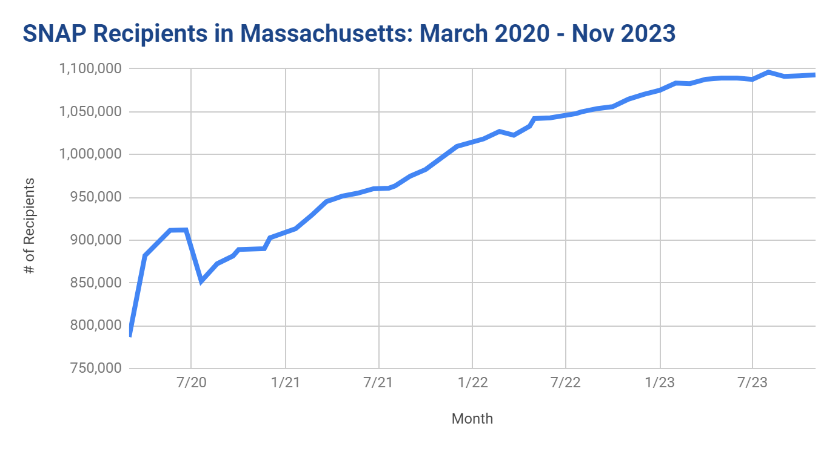

Slide 6
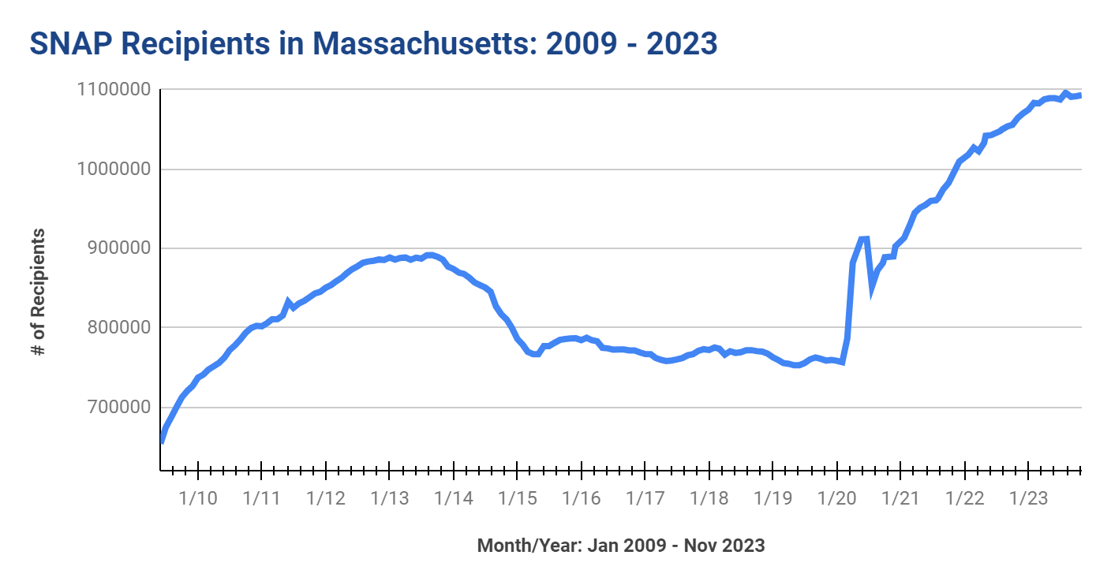

Slide 7
SNAP changes in past year, including May 2023 end to federal COVID public health emergency
SNAP benefit amounts and replacement of stolen benefits | October 1, 2023 COLA increase in SNAP monthly benefits, increase in standard deduction, shelter & homeless deductions 200% FPL gross income level increase expected Jan/Feb 2024 DTA has process for replacing SNAP stolen 2022-Sept. 2024 from skimming/phishing
Pandemic SNAP, Pandemic EBT, Summer EBT | SNAP “emergency allotments” (EAs) ended Feb 2023, state-funded EAs ended May 2023 Pandemic EBT (P-EBT) for children K-12 ended Summer 2023. P-EBT for kids under 6 on SNAP ended May 2023. Summer EBT will start summer 2024.
ABAWD Time Limit (certain childless adults) | 3 months of SNAP unless exempt/meeting work rules - NOT in effect now! Congress expanded the “ABAWD” rules in 2023 - when rules re-start in MA will impact ages 18-52, 54 starting 10/1/24.
College Students | COVID rules ended June 2023 but MA policies still provide SNAP to broad range of students - community college, MassGrant and other students.
SNAP application interview | Interview waived for many during COVID, starting April 2023 interview required for all applicants.
Restaurant Meals Program | Launched fall 2023, for 60+, disabled, and homeless (currently 6 vendors)
Online SNAP purchasing | Started during COVID, broad range of online ordering retailers.

Slide 8
What is SNAP?

Slide 9
Supplemental Nutrition Assistance Program
100% federally-funded entitlement program.
Paid thru Electronic Benefits Transfer (EBT).
Limited to food, vegetable/fruit plants & seeds (no hot foods).
Over 5,500 EBT retailers in state, including farmers markets, CSAs.
SNAP recipients qualify for HIP (Healthy Incentive Program).
Online purchasing available
Restaurant Meals Program now available in certain areas of state
for recipients age 60+, disabled and/or homeless

Slide 10
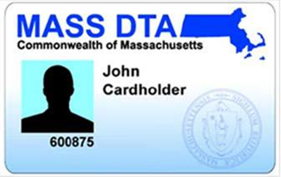
SNAP EBT cards
One EBT card is issued to the head of household
Most EBT cards do not have photos on them
Everyone in SNAP household can use EBT card
Retailers cannot look at card, PIN is security code
To get help with food shopping:
Household can let trusted person to use EBT card/PIN.
Household can appoint an “Authorized Rep” to get 2nd EBT card to help them food shop.

Slide 11
SNAP online purchasing
Use SNAP EBT to purchase food online including:
Amazon
Walmart & BJs
InstaCart (multiple stores)
Daily Table
Geissler’s
Shaws, Star Market, Stop & Shop, Price Rite
See Mass.gov/SNAPOnline

Slide 12
Restaurant Meal Program
Homeless, getting disability benefit or 60+ can use SNAP to buy food at eligible food trucks/restaurants.
Currently available RMP locations:
La Parada Dominican Kitchen Roxbury, MA 02119
Bella Isla Café, Chelsea, MA 02150
Sabrosa Venezuela, Worcester, MA 01603
Faneek's Coney Island. Fall River, MA 02724
Bridge Pizzeria Revere, MA 02151
New Wine Pizza, Worcester, MA 01603
More info: Mass.gov/massachusetts-snap-restaurant-meals-program-rmp

Slide 13
Who qualifies for SNAP?
Most low-income households - including:
Families with children and pregnant persons
Older adults and persons with disabilities
Unemployed/low-wage individuals
U.S. citizen and many immigrants qualify -
Ineligible adults can apply for eligible dependents.
NEW! State-funded SNAP for legal immigrants.
Must meet SNAP financial rules.
NO asset tests for most households.

Slide 14
Household Composition

Slide 15
What is a SNAP household?
Persons who live together must be in the same SNAP household and apply together if they:
“Purchase and prepare” most (2/3) of their food together - even if they are not related to each other*,
Are legally married spouses, living together,
Are children under age 22 living with their parents, OR
Are minors under age 18 living with responsible adults
*note special rules for persons with disabilities, see the Advocacy Guide

Slide 16
Household Example #1
Susan, age 20, works part time and lives with her parents. She barely eats at home.
Susan must apply for SNAP with her parents. She is not eligible for her own SNAP benefits, even if she rarely shares food with them.

Slide 17
Household Example #2
James, single parent age 21. He lives with his working Mom and 2 teenage siblings.
James and his child must be in the same SNAP household with his Mom and siblings - until he turns 22. He is not eligible right now for his own SNAP for himself and his baby. (James may be able to get TAFDC cash for himself and his baby, without his mother’s income).

Slide 18
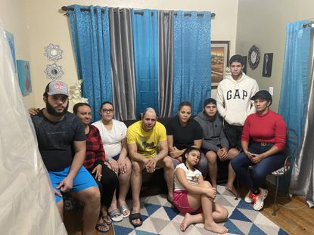
Household Example #3
Shawn and his family moved in with his sister Carla and her family in a small apartment after losing a job.
Carla works and gets SNAP benefits for herself and her two kids. She typically prepares food for her kids the day before she goes to work, and often food shops separately from Shawn.
Shawn can apply for his family for their own SNAP benefits as long as the two families are not pooling income and typically buying and preparing most of their food together.

Slide 19
Common Qs about SNAP “households”
Do I have to list on the SNAP application everyone who lives under the same roof? NO
Do I have to include the SSN or income of people who are not part of my SNAP household? NO
Do I have to include my adult children who live with me? NO if they are 22+ and make/buy most of their food apart from you.

Slide 20
Homeless, Group Homes
& Senior Congregate Meals
Some households qualify for SNAP - even if getting prepared meals:
Homeless or domestic violence shelters
Licensed group homes
run by the Dept of Mental Health (DMH), Dept of Developmental Services (DDS) or other licensed group homes for persons with disabilities
Senior congregate living programs
Meals on Wheels or Senior Day Care
Notes:
‹#›

Slide 21
Example: Homeless Individual
Gary is a 62 year old homeless veteran. He gets many meals at a local shelter.
Gary is eligible for his own SNAP benefits even though homeless. He does not need cooking facilities and can use the SNAP to supplement his diet.

Slide 22
QUESTIONS?

Slide 23
Low-income college students & SNAP

Slide 24
SNAP College Student Rule:
Special SNAP eligibility rules apply to college students who are:
Ages 18 to 50
Enrolled in college half-time or more
Attending a post-secondary education program that requires a GED, HiSET etc.
Students must meet “exemptions” to qualify. But MA SNAP rules cover most MA students!

Slide 25
SNAP College Student “Exemptions”:
To qualify, the 18-49 year old student must be:
Enrolled in community college or voc/tech program,
Awarded Work Study and anticipates working,
Receiving MASSGrant financial aid,
Caring for child under 12, or getting TAFDC cash benefits,
Has an incapacity or disability,
Enrolled in college through SNAP ET, OR
Working an average of 20 hours/week (includes self-employment).

Slide 26
Community College students
Who’s SNAP eligible in MA?*
Students enrolled in all 15 MA Community Colleges
Quincy College students
Franklin/Cummings Tech students
Regional Voc/Tech Students that offer post-secondary programs
Proofs required?
No DTA form needed. This may be self-declared (telephonic or in writing) unless questionable.
*Assumes students meet the financial and other SNAP rules

Slide 27
Work Study students
Who’s eligible?
Students awarded work study and anticipates working during the school period.
BUT - if student was offered a work study job, and declined - NOT SNAP eligible.
Proofs required? This may be self-declared (telephonic or in writing) unless questionable.

Slide 28
MassGrant financial aid students
Who’s eligible?
Students awarded MassGrant financial aid
Proofs required? This may be self-declared (telephonic or in writing) unless questionable.

Slide 29
Students with incapacity/disability
Who’s eligible?
Students with an impairment or disability that impacts their ability to work 20 hours a week and attend school.
Includes students:
Receiving a disability-based benefit like SSI, EAEDC, MassHealth as disabled
Enrolled in school through Mass Rehab Commission (MRC) or
An MD, psychologist or other licensed professional determines student cannot work 20 hours a week and also attend school.
Proofs required? This may be self-declared (telephonic or in writing) unless questionable.

Slide 30
Additional SNAP Student Rules
Students living with others may qualify for their own SNAP
if they “purchase and prepare” 50% or more meals separately or
if they have a meal plans - it covers less than ⅔ meals
Students under age 22 and living with parents must apply with parents, or be added to parent’s existing SNAP household.
Student financial aid does not count toward SNAP (or cash) benefits:
Federal education $ and Work Study does not count
State, local, private financial aid does not count

Slide 31
Student Example #1
Jane is age 23, a full time student at North Shore Community College majoring in Health Education.
Jane is SNAP eligible. She can declare her enrollment during the SNAP interview.

Slide 32
Student Example #2
Charles is a full-time student at UMass Boston. He receives a MassGrant award.
Charles is SNAP eligible and can self-declare his MassGrant during his SNAP interview.

Slide 33
Student Example #3
Raquel is getting her bachelors degree at Worcester State. She was awarded work study and is actively looking for a work study job.
Raquel is SNAP eligible because of her work study award. She can self-declare her work study during her application interview.

Slide 34
Talking points for reaching students
Most low income students are SNAP eligible.
SNAP is “financial aid you can eat” - up to $291/month for 1 person household, more if living with spouse or children.
SNAP can help reduce other financial pressures, like paying for books and travel costs.
It’s easy to apply: Online through DTAConnect.com from a smartphone or computer; call DTA or an outreach provider!
SNAP/student FAQs here: Hungerfreecampusma.org/resources/

Slide 35
Take Action to address food insecurity on College Campuses
Join the Hunger Free Campus Campaign: Hungerfreecampusma.org

Slide 36
Questions?

Slide 37
Eligibility for non-citizen immigrants

Slide 38
Immigrant eligibility - 5 key points
Immigrant parents can always apply for US citizen dependents - even if parent is not eligible!
Not need to provide SSN or immigration status if applying just for dependents, but immigrant must still verify their income.
Many legal immigrants are eligible for federal SNAP.
MA now has state-funded SNAP for some legal immigrants! (This may be temporary, depending on state funding)
DTA does not report any immigrants to USCIS or Homeland Security.

Slide 39
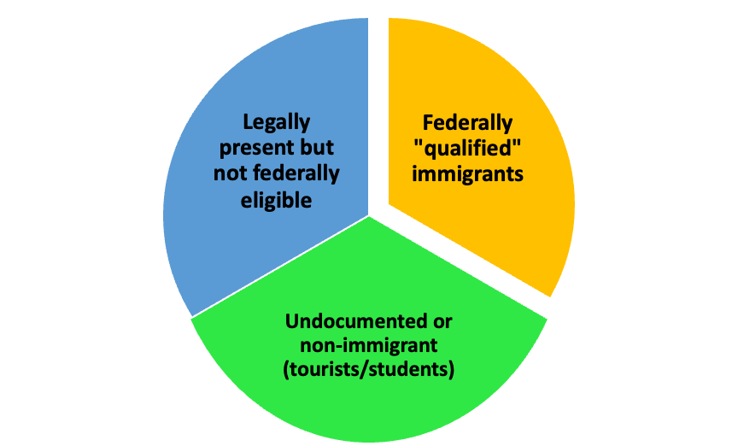
Three immigrant benefits groups
See MLRI and GBLS chart: Masslegalservices.org/content/incomefood-benefits-and-immigrant-eligibility-chart-eligible-statuses
See MLRI and GBLS chart:

Slide 40
Eligible for Federal SNAP: NO waiting period
Entered US as a Refugee
Granted Political Asylum
Granted Withholding of Deportation
Victims of Trafficking (in persons)
Haitians or Cubans with Pending Asylum, Humanitarian Parole, in removal proceedings
Iraqi and Afghan with Special Immigrant Visa status (SIV) and Humanitarian parolees
Afghan evacuees and Ukrainians with Humanitarian Parole
9

Slide 41
Cuban/Haitian Entrants:
“Cuban/Haitian entrant” is a public benefits status, not an immigration status.
Cubans or Haitians nationals with:
Pending political asylum
Granted humanitarian parole at any time and for any length
In “removal proceedings” - but no final enforceable order of deportation issued,
Granted LPR (green card) status granted under certain special federal laws that affect Cubans and Haitians
Benefits: Cuban/Haitian entrants qualify for federal benefits including SNAP, TAFDC cash or Refugee Cash assistance

Slide 42
Eligible for Federal SNAP: But possible waiting period
MAY need to wait 5 years:
Legal Permanent Residents (“green card” holders)
LPR via relative, lottery, employer petitions
Humanitarian Parole with 365+ days of parole status
Certain battered immigrants (VAWA petitioners)
Exceptions to 5-year wait:
Children - under age 18
Adults who receive disability-based benefit
e.g. EAEDC cash, MassHealth/disabled
LPRs who have 10 years of countable work history
Work of self, spouse, parents before LPR turned 18
The 5-year waiting period has ended
9

Slide 43
Legal Immigrants Eligible for State SNAP
Temporary Protected Status (TPS)
Pending political asylum
Pending adjustment of status
U-Visas (victims of violence)
Dreamers/DACA (deferred action)
Humanitarian Parolee of > 365 days
Parolees and battered immigrants subject to 5-year wait*
Other immigrants “under color of law”
* LPRs subject to 5-year waiting bar are not state-SNAP eligible. But may be exempt from wait if disability based benefit, work history, 5 years ended.

Slide 44
Not eligible fed or state SNAP
Non-immigrants:
students,
tourists,
diplomats and business persons
Undocumented immigrants - BUT they can apply for their eligible dependents.

Slide 45
SNAP Benefits for “Mixed Status” Households
Households with some members who are federally eligible for SNAP are called “mixed status” households.
Examples include:
TPS or pending asylum parent with US citizen children
Family with Parole or LPR status - children eligible without a wait, adult members must wait 5 years
Undocumented parent with citizen kids
DTA calculates federal SNAP in two ways:
A favorable mixed household calculation if the ineligible family member is legally present or subject to the 5 year wait.
An unfavorable calculation if the ineligible family member is undocumented and has countable income.
See Q 54 of SNAP Advocacy Guide.
Note - some mixed status households with legally present immigrants and with income may not get any state-funded SNAP if their federal SNAP is the correct amount.

Slide 46
REVIEW: Benefits for Newly Arriving Immigrants
Country | Status | DTA Cash (TAFDC/families and EAEDC/individuals) and SNAP | Refugee cash (individuals)
Haiti or Cuba | Parole (any duration) Pending Asylum Removal Proceedings | DTA Cash and SNAP | Yes (12 months from status)
Afghanistan | SIV or Parole | DTA Cash and SNAP | Yes (12 months)
Ukraine | Parole | DTA Cash and SNAP | Yes (12 months)
Nicaragua and Venezuela | Parole > 12 mos | SNAP only. Adults wait 5 years, but children < 18 and adults getting disability benefit may be eligible. EAEDC cash if 65+ or disabled | NO

Slide 47
Review:
Key Qs to ask clients:
Current immigration status?
Does it expire and when?
Prior status before now?
What country are they from?
How long in the US?

Slide 48
Immigrant Example #1
Harvec and Arja entered the US as refugees in November. They have an arrival/departure record (I-94) and their Employment Authorization Documents, but don’t have their “green cards” yet.
They are both SNAP eligible now because of their Refugee status. They can show DTA either the I-94 or their EAD work authorization. They do not need a “Green Card” and do not have to wait 5 years to qualify for federal benefits.

Slide 49
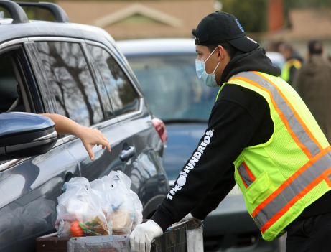
Immigrant Example #2
Juana and her 3 minor children fled Venezuela in September 2023 and were granted Humanitarian Parole for 2 years. She works at the local school’s cafeteria.
Juana can apply for SNAP for the family. Her children are eligible for federal SNAP benefits.
Juana can get state-funded SNAP for herself.
The amount of SNAP for herself and her kids depends on her income.

Slide 50
Immigrant Example #3
Sarah recently fled her abusive husband with their child. Sarah has filed a VAWA petition. She has a work permit.
Sarah may be eligible for TAFDC cash assistance for herself and child.
Sarah should be eligible for federal SNAP for her child and state-SNAP for herself.

Slide 51
Immigrant Example #4
Ping is undocumented with a US citizen baby. She entered the US with a student visa in 2018 but had to drop out of college. She is planning to file for political asylum but has not done so yet.
She is eligible for SNAP for her US citizen child (and WIC as well as TAFDC cash if she wishes)
She is not SNAP eligible if undocumented
She can get state-funded SNAP if she has a pending asylum application filed.

Slide 52
State-funded SNAP Benefits - how long?
Current funding available for state fiscal year 2024 is $6 million for 7 months.
DTA working on setting up state-funded program, hopefully available end of January.
Benefits available from 12/4/23 to 6/30/24 - or until state money runs out - whichever is first
NOTE: $6 million is not enough. Need to advocate for permanent, fully funded program!
Join the Coalition to fight for more funding:

Slide 53
Feeding Our Neighbors Coalition:
Restore Basic Benefits for Massachusetts Immigrant Residents!
An Act establishing basic needs assistance for Massachusetts immigrant residents.
House Bill 135 and Senate Bill 76 filed by Senator Sal DiDomenico, Representatives Antonio Cabral and Judith Garcia in Jan 2023.
FY25 Budget campaign - additional funding to continue these critical benefits.
More info: Pat Baker, MLRI pbaker@mlri.org Norieliez De Jesus, La Colaborativa, norielizd@la-colaborativa.org
Get involved! Feedingourneighborsma.org
This bill and FY25 Budget Campaign would restore basic food assistance (SNAP) to legally present immigrants (elderly, disabled, families with children) and cash benefits (TAFDC) to families with minor children.
Will impact low income immigrants with pending asylum, humanitarian parole, victims of violence, TPS, Dreamers and immigrants subject to 5-year bar.
MA provided state funded benefits 1997 to 2002 after 1996 Welfare Reform Law.
VICTORY! On Dec 4, 2023, MA joined five states (CA, IL, ME, MN and WA) that will soon provide state-funded food benefits to legally present immigrants.

Slide 54
QUESTIONS?
Come to Immigrant/Benefits 101 Training on March 27, 2024 to learn more!

Slide 55
STRETCH BREAK – 10 mins

Slide 56
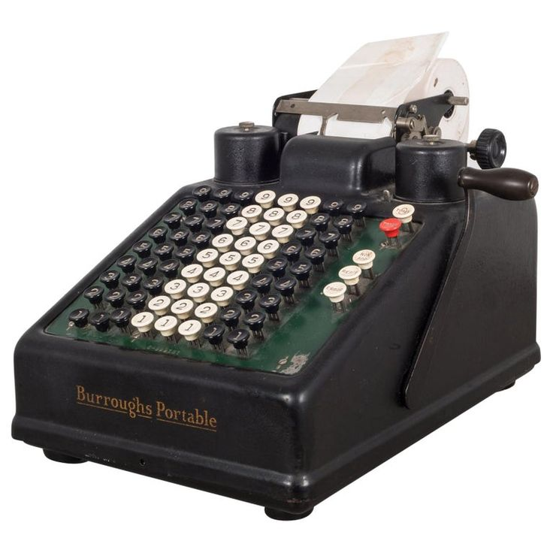
How SNAP Benefits are Calculated

Slide 57
SNAP Financial Rules - Overview
There is NO asset test for most SNAP households
Most households must have pre-tax (gross) income under 200% FPL.
Monthly SNAP amount is based on “net” income, after certain allowable deductions - shelter, dependent care, medical costs (for 60+/severely disabled).
Many income sources do not count!

Slide 58
The SNAP math – 3 steps!
Determine SNAP household size and gross income:
Does household pass gross income test?
Determine household net income:
Which deductions are allowed?
Estimate SNAP benefit amount for household

Slide 59
Examples of non-countable income
All federal, state, local and private financial aid including - Pell, educational loans, work study, MassGrant, internships etc
Non-educational loans
AmeriCorps, VISTA, certain other stipends
Tax credits - Child Tax Credit, EITC
Earnings of high school students under 18
Certain third party vendor payments
Cash contributions from someone not legally required to give money – when money for specific purpose
Income spent on legally-obligated child support (if verified)

Slide 60
Figuring out Monthly Income
Determine the average weekly gross income
Multiply weekly income by 4.333 (not 4!)
For self-employment income including gig workers:
Only count pre-tax net income – after all business-related expenses
In general, SNAP looks at “anticipated” income over certification period, not income from terminated sources
Notes:
‹#›

Slide 61
SNAP Gross income Limit - 200% FPL
Household Size | Maximum gross monthly income (as of Jan 2023)
1 | $2,430
2 | $3,297
3 | $4,143
4 | $5,000
5 | $5,857
6 | $6,713
7 | $7,570
8 | $8.427
Each additional member | Add approximately $867
Note:
Households with a senior 60+ or person with severe disabilities do not have a SNAP gross income test.
BUT if gross income is over 200% FPL they have asset test & need very high expenses to qualify for SNAP. This is not common.

Slide 62
Example: Working student
Rochelle is a student at Worcester State. She also works 15 hours/week with a cleaning company and makes about $200/week gross. Sally also gets financial aid and her uncle gives her $200/month to help her with her car payments.
Sally’s earnings from her job counts for SNAP. None of her federal financial aid counts and the help from her uncle does not count because it is for a specific need - her car.

Slide 63
Example: Gig worker earnings
Charlie drives for a restaurant take out chain. He’s an independent contractor, paid per delivery plus tips. Charlie is leasing a car and pays a $350/mo leasing fee, plus car insurance, gas and tolls. His finds his vehicle costs eat up roughly half of what he earns from the driving.
If Charlie applies for SNAP, he should report his pre-tax net income after all his business expenses but before his income taxes, FICA and FUTA.

Slide 64
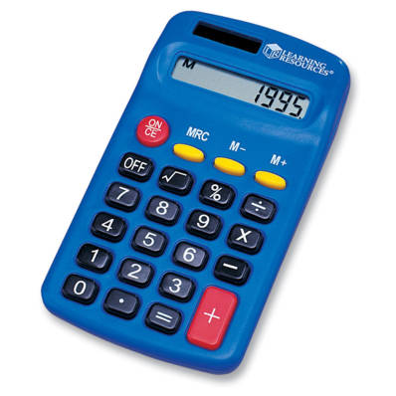
SNAP math - getting to net income
In general, SNAP is based on “net” income after 6 possible deductions :
A standard deduction based on household size
The 20% earned income deduction (off gross income),
Or pre-tax self employment - after business expenses
includes verified child support paid out of earnings
Health care costs of 60+ or disabled members only
Dependent care costs (child or disabled adults)
Legally-obligated child support paid out
Shelter costs
rent/homeownership + utilities (standard utility allowance)
OR homeless deduction

Slide 65
How monthly SNAP amount is calculated
Three key steps:
Identify maximum SNAP benefit for the household size
Subtract 30% of net countable income after deductions
The difference is the monthly SNAP
The minimum SNAP for 1 and 2 persons < 200% FPL = $23
EXAMPLE:
Jane has two kids. She has net countable income of $900/month after child care and shelter deductions:
Max SNAP for 3: $766
30% of net income: - $300
Monthly SNAP: = $466

Slide 66
SNAP Monthly Benefits
Household Size | Maximum SNAP (as of 10/1/23)
1 | $291
2 | $535
3 | $766
4 | $973
5 | $1,155
6 | $1,386
7 | $1,532
8 | $1,751
Regular SNAP issued the 1-14th of the month depending on last digit of the household’s SSN.
SNAP benefits are usually increased October 1st of each year.

Slide 67
Maximize SNAP with deductions
Four key deductions to maximize SNAP:
Child support paid to child outside of home
Child care and adult dependent care costs
Health care costs for persons age 60+ or disabled
AND
Shelter costs - rent or homeownership costs.

Slide 68
Getting info on the household’s SNAP
DTA approval and update notices describe amount of SNAP and information used to calculate the benefit amount
Notices are called EBT Notice or Benefit Decision Notice on DTAConnect. The BDN does not include a calculation - if you need one, email the DTA Ombuds.
DTA Connect has information on SNAP amount and notices.
Call the DTA Assistance Line for information on current balance
Call the EBT Customer Assistance line for current EBT balance

Slide 69
Child support paid out can boost SNAP
Legally-obligated child support paid out by a household member:
Does not count as income, BUT
When paid from earnings, is included in the 20% earnings deduction
Child support paid out must be verified - both the amount and the legal obligation (unless paid out of Social Security or Unemployment benefits).

Slide 70
Child support - example
Jules earns $700/wk - making $3,033/mo gross. Jules pays $1,000/mo court-ordered child support and $1,200/mo rent plus utilities.
If DTA counts $700/week earnings with no child support excluded, Jules over income for SNAP.
BUT if DTA correctly excludes the child support paid, Jules is eligible for $124/mo in SNAP (plus HIP).

Slide 71
Dependent Care Can Boost SNAP
The cost of child care or disabled-adult care are also a deduction including:
If needed for adult to work, attend school or look for work
Includes costs of YMCAs, summer day camps, after-school programs
Includes cost of transportation to/from (if driving, at federal mileage rate)
Dependent care costs can be self-declared!

Slide 72
Dependent Care Example
Jaime has 2 kids and earns $700/wk
They pay $1,500/mo in rent & have heat costs.
Jaime pays $500/month for babysitting when his Mom can’t take care of the kids. And, his mileage totals $200/month driving his kids to his Mom’s on his way to work.
Without claiming - $299/mo SNAP
With $700/mo childcare costs - $509 SNAP

Slide 73
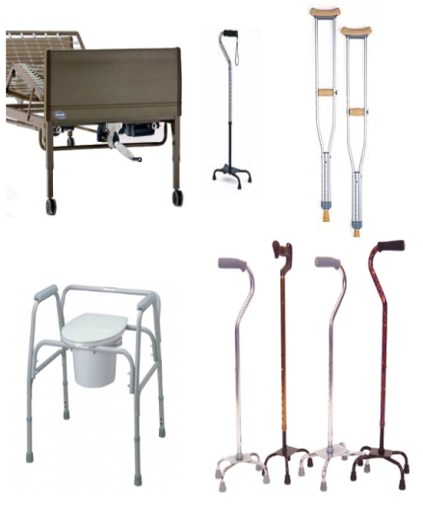
Health Care Expense Deduction

Slide 74
Healthcare costs can boost SNAP
For SNAP household members who are 60+ or severely disabled
Incur unreimbursed medical costs of $35/month or more
Can be self-declared in most cases
Notes:
‹#›

Slide 75
Common types of Health Care Costs
Medicare Part D, private insurance premiums and co-pays
Over-the-counter health care
pharmacy and “medicine chest” items
Hearing aids, batteries, eye glasses
Outstanding one-time bills
Dental and vision care
Adult dependent care
Durable medical equipment
Travel to MD, therapists, pharmacies
T-pass, bus, taxi/Uber, etc - or car mileage (fed mileage rate)
Health care costs can be self-declared unless household claiming more than $190/month

Slide 76
Sample proofs for healthcare costs - if needed
Written or verbal statement for mileage costs
Unpaid bills or paid receipts
Insurance bills with premiums amounts due
Pharmacy print out of co-pays (can remove drug names/dosages to protect private information)
Receipts that show cost of OTC drugs, vitamins (statement or Rx from MD not required!)
Public/subsidized housing “rent calculation worksheets.” See MLRI handbook: Masslegalservices.org/HousingSNAPguide

Slide 77
Shelter expense deduction
If household is homeless, the SNAP rules allow a standard homeless deduction of $180/month
If household has shelter costs, the SNAP rules allow the household to claim the following:
A shelter deduction of $672/mo (capped amount) or
Uncapped shelter costs if any SNAP household members are age 60+ or disabled
Notes:
‹#›

Slide 78
What counts as shelter costs?
Monthly rent due (even if not paid) ,or
Homeownership costs – mortgage, insurance, real estate taxes, condo fee
PLUS
A “Standard Utility Allowance” or SUA
$ 852 – heating, cooling or fuel assistance
$ 520 – electricity/cooking gas (if no AC costs)
$ 59 – phone/cell phone only

Slide 79
Shelter Deduction- Example
Massachusetts family of 3:
Income from work is $1,500/month
Rent is $1,000 + additional heat costs
No one is 60+ or disabled, no child care costs
Shelter costs = annual difference of $2,424 for food!
No shelter costs on case:
Monthly SNAP = $465
Shelter costs on case:
Monthly SNAP = $667

Slide 80
Calculators for SNAP math
MLRI’s Online SNAP Calculator: Masslegalservices.org/content/online-snap-calculator
MLRI Excel calculator and paper worksheet: Masslegalservices.org/SNAPCalculator
Notes:
‹#›

Slide 81
QUESTIONS?

Slide 82
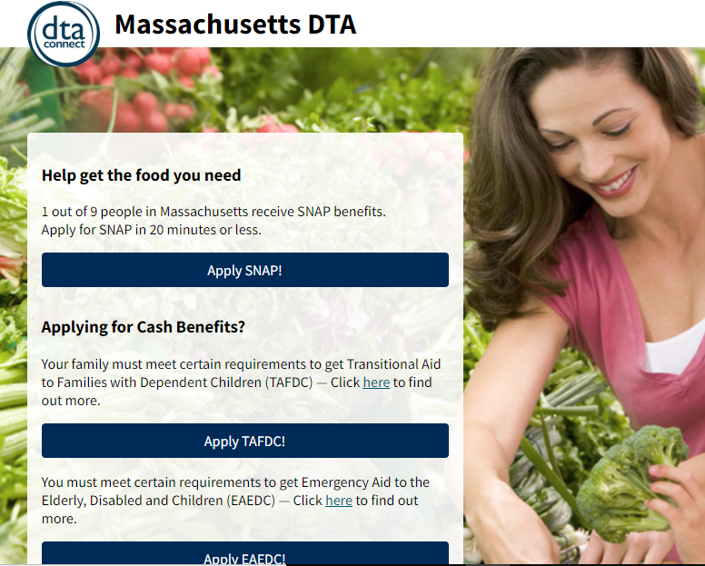
How to apply for SNAP + check case info

Slide 83
Applying for DTA Benefits
SNAP only
TAFDC or EAEDC cash benefits
DTAConnect.com (online or smartphone)
By mail/fax (paper apps Mass.gov/SNAP)
By phone - DTA Assistance Line: 877 382-2363 (press #7)
In person at DTA office
By phone through DTA Outreach Partner. List: Mass.gov/SNAP.
Via checkbox on MassHealth/Medicare Savings Plan paper applications
DTAConnect.com (online or smartphone). Also counts as SNAP application.
Call local DTA office and leave a message
In person at a DTA office
DTA Connect applications in English, Spanish, Portuguese, Vietnamese & Chinese
No need to make an account

Slide 84
Example: Applying for SNAP
Carol lost hours at work and is struggling to feed herself and two kids. She calls your food pantry for help but you realize she might also be eligible for SNAP.
If Carol has a smartphone (and is comfortable filling out an online application), she can go to DTAConnect.com and apply for SNAP immediately.
If she has enough minutes on her phone, or access to a free phone, she can call the DTA Assistance Line OR call a SNAP Outreach Partner and apply.
If she has no or very low income, tell her about TAFDC cash benefits.

Slide 85
Expedited SNAP
Eligible for expedited if household:
shelter costs > gross income and assets
gross income < $150, assets < $100 or
migrant household, assets < $100
Expedited DTA has to provide SNAP & EBT card within 7 days of application
Proof of identity is only verification required (DTA verifies SSN = verification of identity)
SNAP benefits issued for between 1-2 months
Notes:
‹#›

Slide 86
Verifications
Documents households provide, such as:
Pay stubs or pension information
Receipts or bills from health care providers
Proof of legal immigration status
Information DTA gets through state or federal databases, such as:
Social Security (RSDI or SSI)
MA Unemployment Benefits
Child support through MA Department of Revenue

Slide 87
Verifications (continued)
Collateral contact - Information DTA confirms directly with a third party-usually when household is having a hard time getting proof (such as proof of income).
Self-declarations – Statements from the household DTA should accept (unless “questionable”), such as:
U.S. citizenship
Shelter (rent or homeownership costs)
Type of utilities (heating/cooling, etc)
Child care/adult day care costs
Health care costs for people 60+/disabled unless claiming more than $190/month

Slide 88
“Questionable” information:
DTA may ask for more proof when information appears to be “questionable.”
Questionable means information must be INCONSISTENT with previous statements made by the client OR with other information DTA has.
Worker MUST write a case note explaining why something is questionable.

Slide 89
Verifications at SNAP application
Identity
DTA confirms when verifying SSN with the Social Security Administration
Other proofs acceptable if necessary
MA residence
DTA can confirm with RMV if client has MA ID or MA driver license
Other proofs acceptable if no MA RMV record
Income
“The Work Number” (if employer participates)
Social Security, SSI, DOR Child Support and Unemployment databases
Pay stubs, letter from employer, self employment proofs
Legal immigrant status - if applying for SNAP or showing status for favorable SNAP calculation (or in some cases, state SNAP!)

Slide 90
Example of Verifications
Jane is 67 & stopped working in Sept. Her only income is $1,050/mo Social Security. Jane pays for rent & heat. Social Security deducts $159/mo for Medicare. Jane says she is healthy and has no other medical costs.
DTA verifies:
Jane’s identity when verifying her SSN
MA residency w the RMV because Jane has a MA ID
Social Security & Medicare deduction from SSA
Jane self-declares on her application:
she isn’t working
her rent and utility costs
DTA does phone interview & approves SNAP.

Slide 91
Core application RIGHTS
Self-declare certain expenses (verbally or in writing)
DTA must consider any reasonable proof submitted
Get help from DTA – “worker assistance”
Have DTA accept the “best evidence available” for income
Get a decision within 30 days (if not expedited) – and if denied for proofs, can get re-opened within 30 days
Appeal a denial or termination

Slide 92
DTA worker assistance
DTA workers are required to help clients get verifications.
Help doesn’t mean just one thing!
Explain different types of proof documents
Discuss a “reasonable accommodation” due to disability
Do a “collateral contact”
Get information that can be verbally self declared
Check to see if proof is already on file
Look at data from other agencies
Accept the “best evidence available”

Slide 93
Best evidence available: Case Example
Janet is 78 and lives with her husband
Her income is RSDI and a monthly pension of $150
Her pension is deposited directly into her bank account, she doesn’t get monthly statements
She has been retired for 15 years and does not know how to reach the employer

Slide 94
Best evidence available: Case Example
What does Janet do?
Send DTA a letter with her pension amount & copy of bank account deposits.
Explain she does not have other proof because her employer does not send paper statements and she doesn’t know how to get in touch with them.
Give DTA permission to call the employer.
What should DTA do?
Accept the proof she can provide.
If DTA can find contact information, DTA can try to call the pension employer.
If not successful, DTA must accept the “best evidence available” and approve the application with a pension amount of $150/month.

Slide 95
Getting an EBT card
Answer application question if have a card or need a card
To get an EBT card:
DTAConnect.com, DTA Connect mobile app, DTA Assistance Line (follow prompts)
Go to local DTA office.
If regular mail or in person not helpful (eg. emergency for someone who can’t go in person), call DTA Ombuds. Possible to have card overnighted (takes 2-3 days) or in extreme circumstances sort out in person delivery option.
EBT card sent by mail usually takes ~3-7 days to arrive

Slide 96
DTA communications to households
DTA will text/email at certain times, including:
When the SNAP application is received
If an interview is scheduled or missed
If proofs are missing
When the application is approved or denied
When Emergency Allotment is issued
Quick tip: Easy to update phone #/email on DTA Connect.

Slide 97
DTA Case Info & Reaching a Worker
DTA Connect mobile app & DTAConnect.com:
Notices for last 12 months
Case status
Deposit history
Upload documents
Update contact info
Request EBT card
DTA Assistance Line - (877) 382 2363
Specific case info via phone system without talking to a worker
Reach a worker for SNAP or cash
Update contact info
Request EBT card
Connect directly with DV help or Client Assistance Coordinator
Report loss of food due to misfortune for replacement SNAP
*Can always press 7 at beginning to reach a worker

Slide 98
Submitting documents to DTA
Upload via DTA Connect app or DTAConnect.com online account (fastest option)
Note: If person gets benefits for kids & doesn’t have SSN, can use DTAConnect.com or call DTA to get info needed to use DTA Connect app
Fax to 617-887-8765
Go to local DTA office
Mail to:
DTA Processing Center
PO Box 4406
Taunton, MA 02780
Put DTA Agency ID or last 4 of SSN on the top of each page if faxing or mailing documents.

Slide 99
Senior Assistance Office (SAO)
DTA’s Senior Assistance Office - (833) 712-8027
Live workers answer phone, no IVR
Handles applications filed by older adults 60+
Any older adult 60+ can call SAO for SNAP help!
Staff help clients identify and maximize medical expense deduction

Slide 100
QUESTIONS?

Slide 101
Reporting changes
& reviewing eligibility

Slide 102
SNAP - periodic review of eligibility:
Paperwork is required:
Every 12 months for most SNAP cases
Some cases have to do an Interim Report after 6 months.
Every 36 months for cases with only seniors/persons with disabilities & no earnings (“EDSAP”)
To return paperwork:
Mail/fax/bring to local office
Do by phone
Online via DTAConnect.com
If DTA sends Interim Report or Recertification, it must be done!
SNAP ends if paperwork is not done.

Slide 103
Reporting changes:
EDSAP (60+ or disabled, no earnings)
if someone starts working, OR
someone leaves or joins the household
For other SNAP-only households, ONLY have to report when household income exceeds 200% FPL for the household size.
But, if someone 60+ or disabled in SNAP case, there is no reporting requirement in between paperwork periods.
Report these changes by the 10th of the month following the month of the change.
Different rules apply for households getting TAFDC or whose TAFDC recently ended & for some households getting just SSI. See SNAP Adv. Guide Part V!

Slide 104
Reporting Example:
Jayna is a mom of 2 who starts SNAP on April 1st after losing her job. She starts a new job in May.
The pay she gets in May puts her income over the SNAP gross income test of $4,143 (for 3 people)
Jayna needs to report new earnings to DTA by June 10. Her SNAP will end starting July.

Slide 105
QUESTIONS?

Slide 106
Protections for specific populations

Slide 107
Disability Access & Accommodations
DTA Client Assistance Coordinators (CACs)
CAC contact info is here
Common accommodations –
Help with forms, verifications, understanding notices
Reminder calls
Sign language interpreter
Large print notices
See DTA’s Disability Access Info & CAC brochure
If issues with access due to disability - contact CAC and/or legal services.

Slide 108
Domestic Violence Protections
Block DTA Connect & automated info from Assistance Line – can request verbally
Heightened Level of Security (HLS)
During COVID-19, HLS cases handled by DTA Ombuds Office.
Request by phone or using HLS form (English and Spanish).
Also blocks DTA Connect & automated info from Assistance Line
DV Specialist in each DTA office
If issues with DTA rules because of DV - contact DV specialist and/or legal services.

Slide 109
Language Access
Right to interpreter!
DTA notices only in English & Spanish
DTAConnect.com & Assistance Line in 6 languages
Some DTA brochures available in additional languages
DTA case specific texts/emails in English and Spanish
If issues with language access - contact DTA Ombuds Unit at 617-348-5354 and/or legal services.

Slide 110
Replacing Stolen or Lost SNAP

Slide 111
SNAP stolen through skimming/phishing
Skimming: Thief skims EBT card info, makes duplicate card to steal SNAP
Phishing: Thief poses as DTA to get EBT card/PIN/account info
DTA is replacing up to the full amount of SNAP (and cash) stolen
DTA needs a signature to do replacement with federal funds. Make a claim and get DTA signature by calling DTA, doing online form, or doing paper form (DTAConnect, in-person, fax, mail).
Report within 30 days of when household discovers the theft
For more info: Mass.gov/info-details/snap-replacement-benefits-faq

Slide 112
Replacement SNAP due to misfortune
Winter storms, summer hurricanes & tornadoes, fires & floods ….
If household loses power for 4 hours +, report to DTA loss of food bought with SNAP. DTA can replace up to one month of SNAP - including the Emergency Allotment!
Report has to be within 10 days of the loss.
Household then has 10 more days to get key info to DTA via a self declaration or a form.
Misfortune can also include loss of food due to equipment failure, shut off of utilities and other bad luck.
Learn more: Masslegalservices.org/SNAP-misfortune

Slide 113
Problem solving – advocacy tips
Contact Assistant Director or Director of local DTA office. DTA Local Office Contacts
Contact DTA Ombuds Unit: 617-348-5354 or email sara.craven@state.ma.us
Ombuds needs permission from client to talk to you. Specific form not required – can be photo of simple handwritten note. See sample.
Appeal: Help client file appeal within 90 days of date of notice.
Call DTA Division of Hearings at 617-348-5321 & leave message, or
Fax appeal form or written request for hearing to 617-348-5311
Contact Legal Services

Slide 114
QUESTIONS?

Slide 115
Additional benefits and resources

Slide 116
The Added Benefits of SNAP
SNAP Households can also receive:
Healthy Incentives Program (HIP) – EBT for purchases at Farmers Market, Farm Stands, CSAs
$40/mo 1-2 person households
$60/mo 3-5 person households
$80/mo 6+ person households
EBT “Card to Culture” – free or discounted museum and theatre passes with EBT card
Regulated utility discounts
Easier/faster applications for Fuel Assistance
MBTA Youth Pass discounts
Starting Summer 2024 - $120/K-12 child for Summer EBT!

Slide 117
Cash benefits and other resources
Families cannot live on SNAP alone!.... Help them apply for:
DTA Cash Assistance: TAFDC for families with kids/pregnant people, EAEDC for older adults/persons with disabilities with no or very low income. DTAConnect.com
Chapter 115 Veterans Benefits: Monthly cash benefit for needy MA Veterans, dependents & parents of veterans. Mass.gov/service-details/chapter-115-benefitssafety-net-program
Child care subsidy: If not on TAFDC, call 2-1-1 to get on waitlist. See child care flyers.
Federal Child Tax Credit & stimulus payments: FindYourFunds.org
Rent, mortgage, and utilities help: Call 2-1-1 or go to Mass.gov/covidhousinghelp
Money to help pay for the internet or a computer: ACPbenefit.org

Slide 118
SNAP Advocacy Resources
MLRI’s Advocacy Guides available for free on MassLegalServices.org
MLRI’s How to talk about SNAP: Messaging/information for households reluctant to apply
Join the SNAP Coalition!
Contact Vicky Negus vnegus@mlri.org or Pat Baker pbaker@mlri.org to join.

Slide 119
Emergency food resources
o Call Project Bread’s FoodSource Hotline: 1-800-645-8333
o Call Mass 2-1-1
o Direct info from the Food Bank in your area:
Greater Boston Food Bank: GBFB.org/need-food
Food Bank of Western MA: Foodbankwma.org/get-help/locate-a-local-feeding-program/
Worcester County Food Bank: Foodbank.org/find-food/
Merrimack Valley Food Bank: mvfb.org/member-agencies/

Slide 120
Legal Services
Free civil legal services for low-income people, including help with:
Benefits
Housing
Immigration
Disability, MassHealth
Employment
Family law
CORI/re-entry
Find Legal Aid programs across Massachusetts

Slide 121
QUESTIONS? And THANK YOU!

