Slide 1
White house conference on hunger, nutrition, and health
October 27, 2022

Slide 2
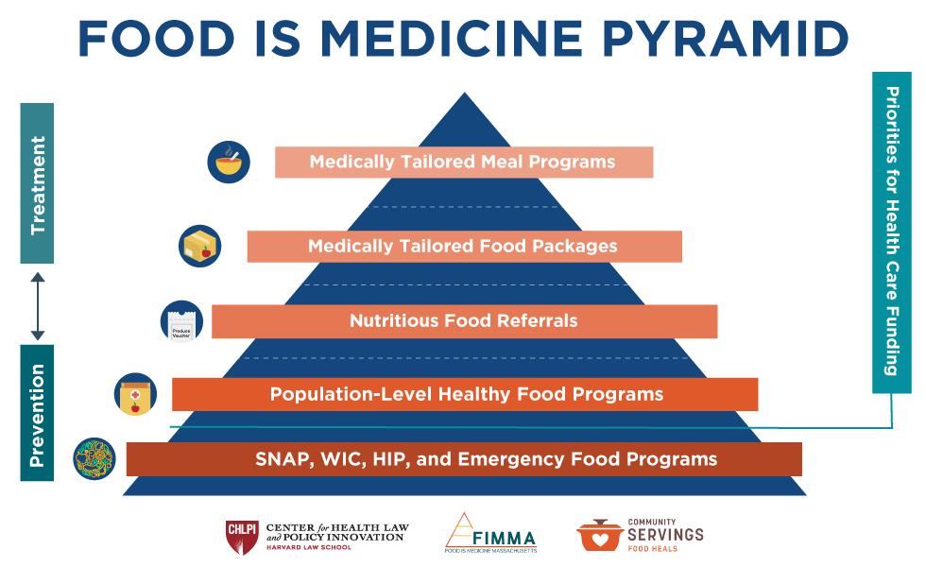

Slide 3
White House Conference: Overarching takeaways
Historic endorsement of the concept of Food is Medicine
Exciting commitments, but limited details on next steps
Commitment to follow-through on key existing proposals
Emphasis on state and industry role

Slide 4
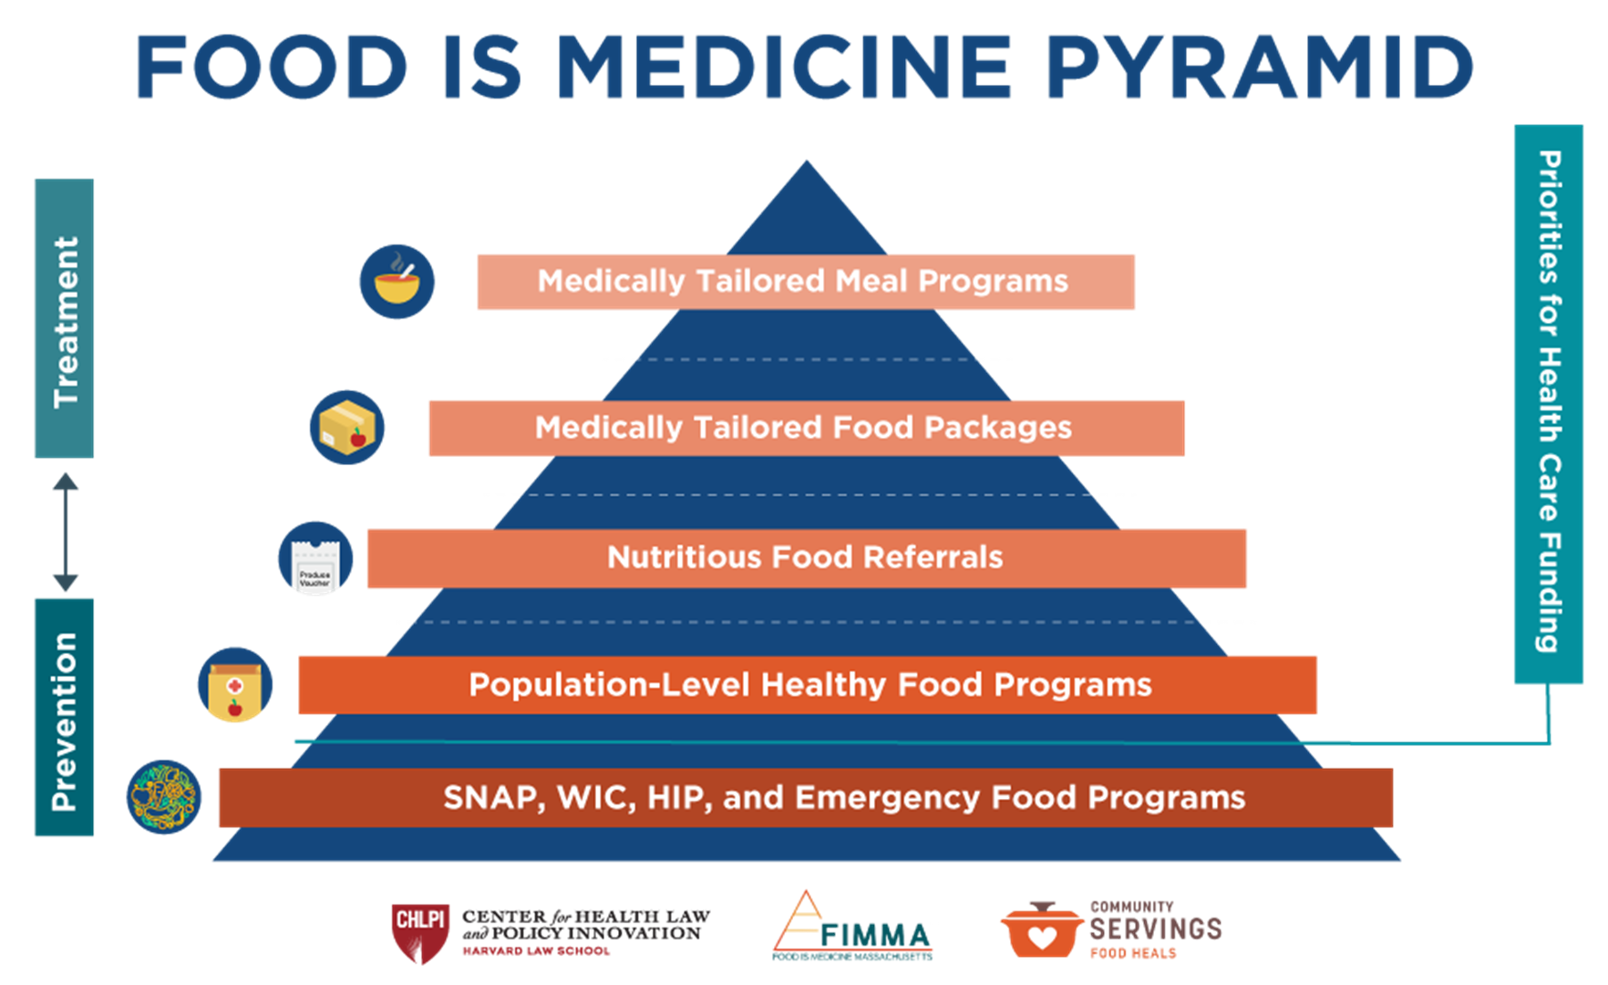
SNAP, WIC, and Emergency Food Programs
Supplemental Nutrition Assistance Program (SNAP)
Expansion of impact/reach of nutrition incentives
Broader program access
Re-examining prepared food restrictions
Promoting cross-enrollment
Special Supplemental Nutrition Program for Women, Infants and Children (WIC)
Continuation of expanded cash value benefit (CVB) for fruits/vegetables
Expansion of Online WIC

Slide 5
Community Level Healthy Food Programs
Nonprofit Hospitals
IRS clarification on Community Benefit Activities and Community Building Activities
Veterans Health Administration
Food pantry pilot
Nutritious Food Referrals
Produce Prescription Pilots
Veterans Health Administration, Indian Health Services
State-funded Produce Prescriptions
Encouragement for new programs and CBO partnership

Slide 6
Medically Tailored Groceries and Meals
Support for Legislation
Pilot MTM in Medicare
Across Food is Medicine
Encouraging uptake in Medicare Advantage
Strengthening access through Supplemental Benefits
Encouraging State-Based Pathways
CMS to provide additional guidance on 1115 Demonstration Waivers

Slide 7
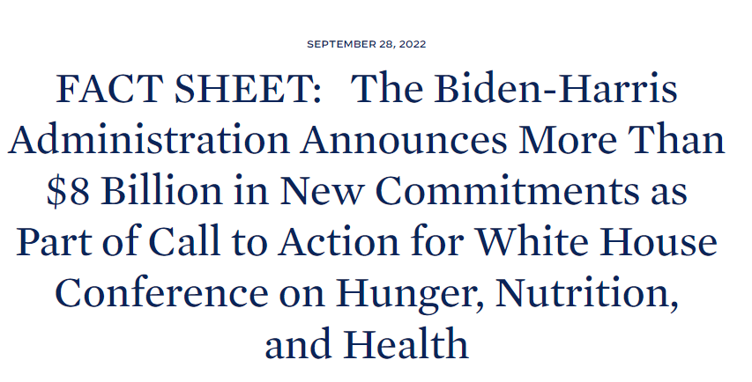
Whole-of-Society Response
Boston Medical Center
Building farms to supply its facility and prescription-based food pantry
Closing the SNAP Gap for patients
Improving access to health, affordable food in Roxbury
Community Servings
10 million MTMs
Mass General Brigham
Building teaching kitchens to deliver FIM programs
Capacity-building for CBOs
Expanded screening for food insecurity

Slide 8
MAssHealth Demonstration Waiver Extension

Slide 9
MassHealth 1115 Demonstration Waiver
2017: Waiver approved with Flexible Services
2020: Flexible Services launched
December 27, 2021: Extension Submitted to CMS
September 28, 2022: Extension Approved!
End of 2022: New version of Flexible Services Program to come
March 31, 2022: Earliest implementation of new Flexible Services Program
Mid-2023: Flexible Services Implementation Plan

Slide 10
Key Changes
FIMMA Advocacy Priorities
Continue Flexible Services Program (FSP)
Approve the Establishment of the Social Services Organization Integration Fund
Allow provision of FSP at the household level
Strategic expansions of FSP to better meet needs of children/families Require FSPs to serve some children Include childcare (while accessing nutrition supports) in FSP Extend health-needs based criteria to include postpartum up to 12 mos
Pursue Rigorous Evaluation of FSP
Status in Approved Waiver
Approved!
Approved! Up to $8m over first 4 years for: technology, developing business practices; workforce development; outreach and education
Approved! (with limitations) Meal support may be provided at household level when eligible beneficiary is child or pregnant person
Mixed – Area for Follow-up Questions ACO RFR indicated % FSP recipients under 21 should be proportional to % of ACO enrollees under 21 Coverage of childcare in FSP = No ? Postpartum up to 12 mos as health-needs based criteria = Unclear ?
Addressed CMS emphasized need for rigorous evaluation
Center for Health Law and Policy Innovation
10

